Slide 1
Help Your Patients Quit Tobacco with Quitline Iowa
A step-by-step provider guide
It’s easy. It’s effective. It’s Free.
Produced with funding from the Iowa Department of Public Health Division of Tobacco Use Prevention and Control

Slide 2
Help your Patients Live Healthier
Tobacco is the leading preventable cause of illness & death for Iowans
Quitline Iowa is a simple way to help your patients quit tobacco. Quitline Iowa provides the tools you need to help your patients on the path to quitting.
Use Quitline’s fax referral program to help your patients quit.
Free to all Iowans, 24 hrs a day, 7 days a week.
www.Quitlineiowa.org

Slide 3
Why QUITLINE IOWA?
QUITLINE IOWA is the primary resource in Iowa to help tobacco users quit
QUITLINE IOWA is confidential & private
QUITLINE IOWA offers FREE, specialized services such as:
1 on 1 counseling with a Quit Coach
Support and advice on cessation medications
Tools on how to overcome urges
Tailored quit plans
Cessation materials

Slide 4
The Facts
Studies have shown that enrolling in telephone tobacco cessation programs can more than double changes of quitting successfully.
Quitline Iowa is a comprehensive program that offers tools such as: education, support and written materials, customized protocols, up to 5 telephone sessions, trained coaches.
Frees up time and resources for providers
26% of callers to QUITLINE IOWA successfully quit!
Notes:
Note:
Quitline Iowa demonstrated a 7-month quit rate of 26% in 2016: Per UNI Evaluation of Quitline 2016. This can always be found:
https://idph.iowa.gov/tupac/cessation

Slide 5
What is the Brief Tobacco Intervention?
An approach to address tobacco use with your patients and to dramatically increase the likelihood that they will quit tobacco
It is effective in all types of health care organizations
Considered by the U.S. Dept. of Health & Human Services’ Best Practice Guideline to be the benchmark standard of care for tobacco cessation

Slide 6
Steps to Success:
2A’s and R Brief Tobacco Intervention:
1. ASK if the patient uses tobacco
2. ADVISE all tobacco users to quit
3. REFER those ready to quit to QUITLINE Iowa
Takes less than 3 minutes!

Slide 7
ASK
Ask
Advise
Refer
Ask every patient about tobacco use at every visit
Do you use tobacco?
A nurse, dental assistant, or other staff can complete the ASK during intake or while taking vital signs
Note:

Slide 8
ASK
Ask
Advise
Refer
Ask every patient about tobacco use at every visit
Ask if patient uses tobacco rather than asking if he/she is a smoker
Ask what kind of tobacco and how often
Document use status
Tips:

Slide 9
ADVISE
Ask
Advise
Refer
Advise all tobacco users to quit
Quitting tobacco is one of the best things you can do for your health. I strongly encourage you to quit.
The primary healthcare provider should be the one to advise quitting
Note:

Slide 10
ADVISE
Ask
Advise
Refer
Advise all tobacco users to quit
Give strong, respectful, & personalized message to get help quitting
Help make connection between tobacco use & the patient’s health
Explain how quitting will benefit his/her specific health concern
Advise those who have tried quitting and failed to try again!
Tips:
Notes:
This would be a good time to talk about educating pregnant women and women planning to become pregnant who use tobacco. If the Health Care Provider can advise and tie it back to the healthy of a baby, etc. that makes the advise stronger.

Slide 11
REFER
Ask
Advise
Refer
Refer those ready to quit to QUITLINE IOWA
Congratulations on your decision to quit tobacco. May I refer you to QUITLINE IOWA? They will provide you with support, help you create a quit plan, & help you overcome urges.
The primary healthcare provider or any assisting staff can complete the referral.
Note:

Slide 12
REFER
Ask
Advise
Refer
Refer those ready to quit to QUITLINE IOWA
Explain how the referral resource will help
Fax a referral directly to QUITLINE IOWA
They will place a proactive call to your patient
Helpful for those who may not reach out to make the call on their own
Tips:

Slide 13
Making the Referral
A Fax Referral should be made for patients ages 13-up willing to quit in the next 30 days
2 ways to refer patients to QUITLINE IOWA:
1) Use the Fax Referral Program
2) Give them the toll-free QUITLINE phone number
(1- 800-QUIT NOW) so they can call on their own

Slide 14
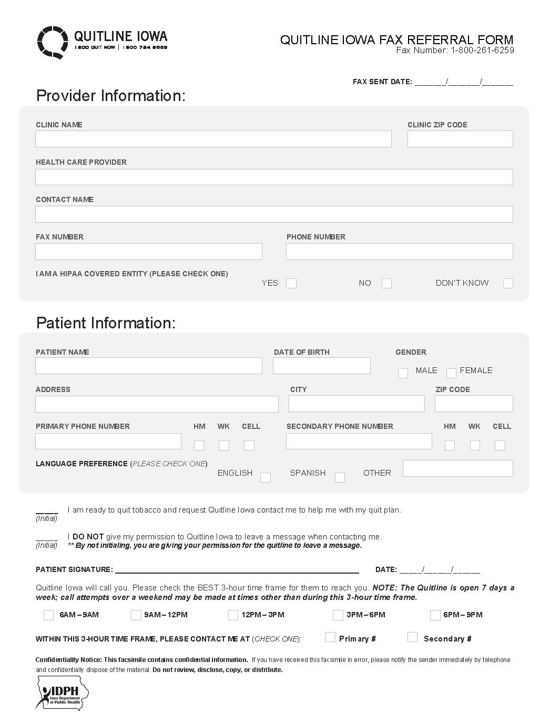
The QUITLINE IOWA Fax Referral
Fax Number
Provider Information
→ can be filled out once and make copies
Patient Information
Patient Initial & Signature
Notes:
This is the Quitline Iowa generic fax form. This is for any Iowan interested in quitting tobacco. All you need to do is fill out the Provider information, have the patient fill out their information, best time to contact etc. I highly recommend you suggest having the patient mark Quitline can leave a voicemail. Sometimes people have reservations when a number comes up on their caller ID and they don’t recognize it, so marking it’s ok to leave a VM would help patients feel better if they miss a call knowing who it is. Quitline Iowa will call your patient once the fax has been received within 2-3 days.

Slide 15
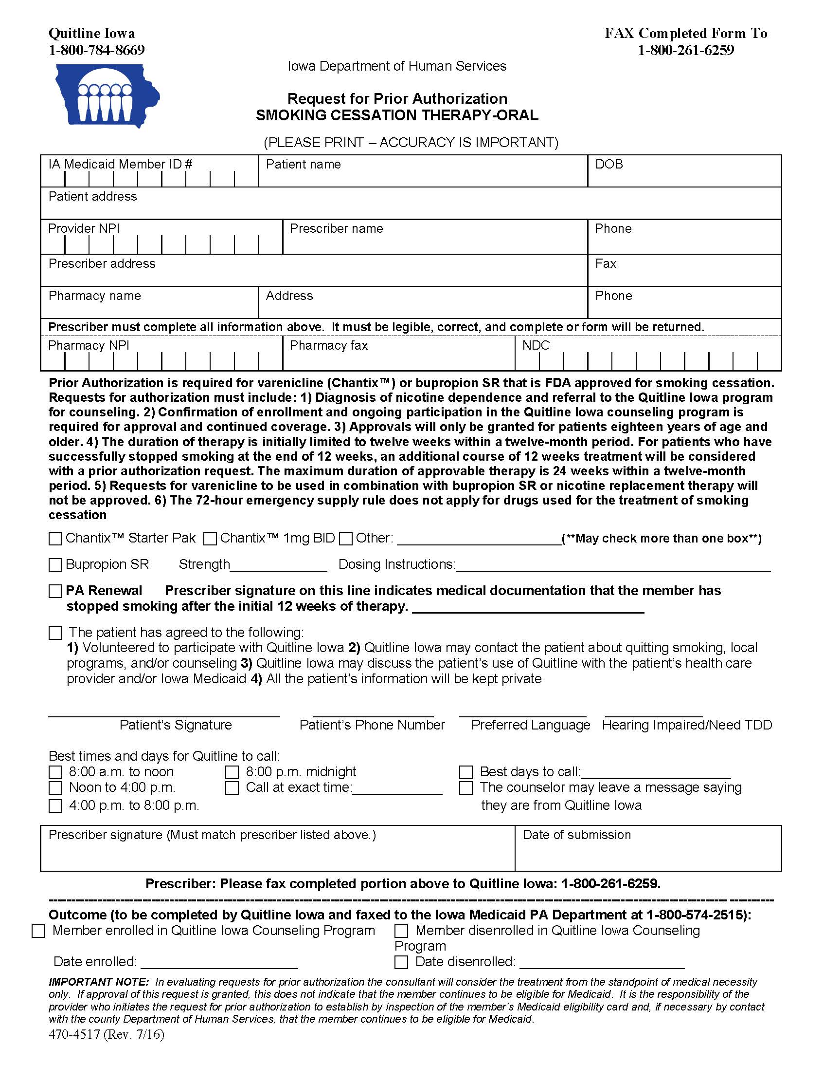
Medicaid Fee for Service: Oral Medication
For Medicaid Fee for Service (FFS) patients
For ages 18-up
Notes:
This form is for Medicaid Fee for Service individuals only, this is for a patient that has Medicaid and is on the FFS program. You would fill out this form only for a patient you want to prescribe oral medication to like Chantix or Bupropion. Please note, if your patient is part of an Managed Care Organization you will want to connect with your patients MCO to find out the process for tobacco cessation.
Special Note: Medicaid FFS individuals must use Quitline Iowa fax referral protocal to receive their medication benefits, they must stay enrolled in Quitline Iowa to continue to receive medication benefits.

Slide 16
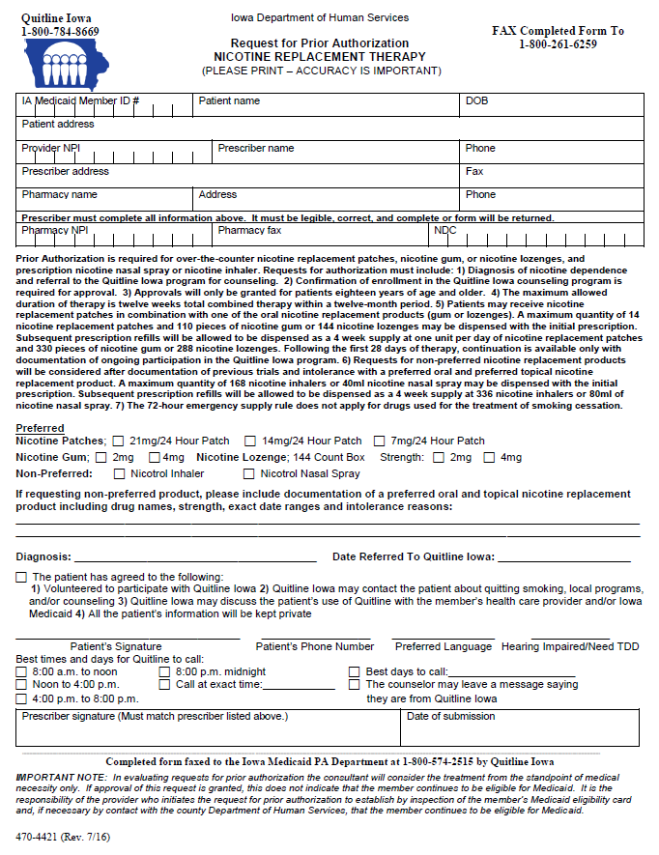
Medicaid Fee for Service: NRT
For Medicaid patients
For ages 18-up
Notes:
This is another Prior Authorization form for individuals that are on Medicaid Fee for Service, this would be filled out if you want to prescribe your patient to NRT, like the patch, gum or lozenge.
Note: There are 6 primary fax responses that a provider would receive after referring a participant to Quitline Iowa:
Unreachable
Declined to participate
Enrolled
NRT has been sent
Program complete
Invalid Referral
It would be a good suggestion to tell the provider to put the fax back report in the patients file so next time the patient comes in the provider can note what happened with Quitline and follow up if need be.

Slide 17
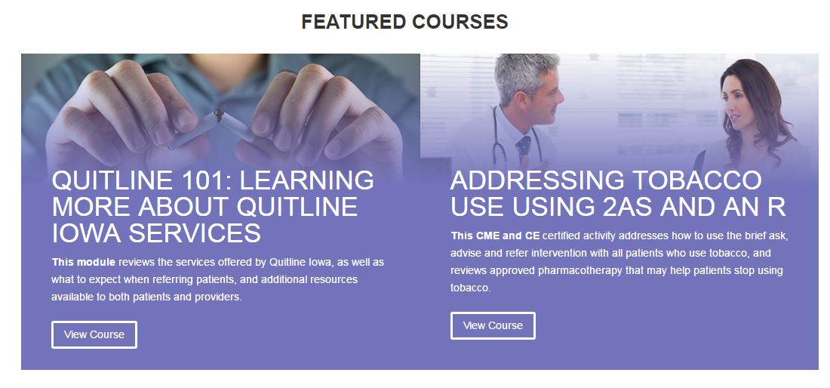
2A’s & R Online Training
Visit and Register:
www.quitlineiowaeducation.org
Complete the 2A’s & R
online training for continuing education credit
Notes:
This website will take you to two trainings. 1 is a Quitline 101 training, this would be a good training for an introduction into Quitline, the 2nd is an AAR training, this includes motivational interviewing and you may receive 1 CE. You will need to create an account and register one time, this is free.

Slide 18
Resources
Free Resources:
Quitline Iowa rackcards: English and Spanish
Quitline Iowa Quit Tip Cards
Other tobacco prevention/education pamphlets
IDPH TUPC Order form
http://idph.iowa.gov/tupac/control
Notes:
There is an order form on the website on the slide where you can order several items to aid you in AAR process and referring individuals to Quitline Iowa.

Slide 19
Contact and Questions
Notes:
Recommendation to personalize and add your contact information and leave time for Questions.

