Slide 1
Eligibility Verification Information System (ELVS)
Portal Training

Slide 2
Overview
ELVS is an online web portal used to verify member eligibility and benefit coverage.
Providers can access ELVS 24/7
Link to Iowa Medicaid Web Portal

Slide 3
ELVS: Online Solution for Provider Access Management
This information can be found on ELVS
Active or Inactive Member
Co-Pay information
Dental
Chiropractic
Hospital
Emergency Services
Pharmacy
Physician
Limited Services
Non-Covered Services
Vision
Mental Health
Urgent Care
Primary Care Services
Managed Care Organization (MCO)
Third Party Liability or Other Insurance

Slide 4
ELVS Registration
Access to the ELVS portal.
If you currently do not have access to the ELVS Web Portal, you can register your provider at https://connect.edissweb.com.
Each additional user that would like access to the provider’s information can complete the Additional Access Request Form.
Questions regarding EDISS (Electronic Data Interchange Support Services) registration please call 1-800-967-7902.

Slide 5
ELVS Registration (continued)
1. You must have the following pieces of information to Register:
NPI
TIN
Contract/demographic Information
Vendor Submitter ID (If clearinghouse or billing service will be utilized)
2. Account Security:
Upon initial registration, you will create your EDISS Connect username and password.
After your first login attempt into the system, you will need to establish account security questions.
This set of security questions will protect your account.

Slide 6
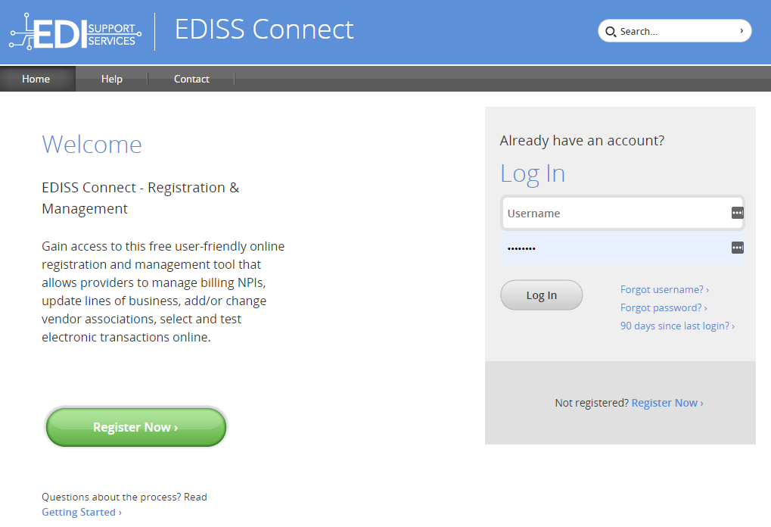
First Time User
https://connect.edissweb.com

Slide 7
Accessing and Navigating ELVS

Slide 8
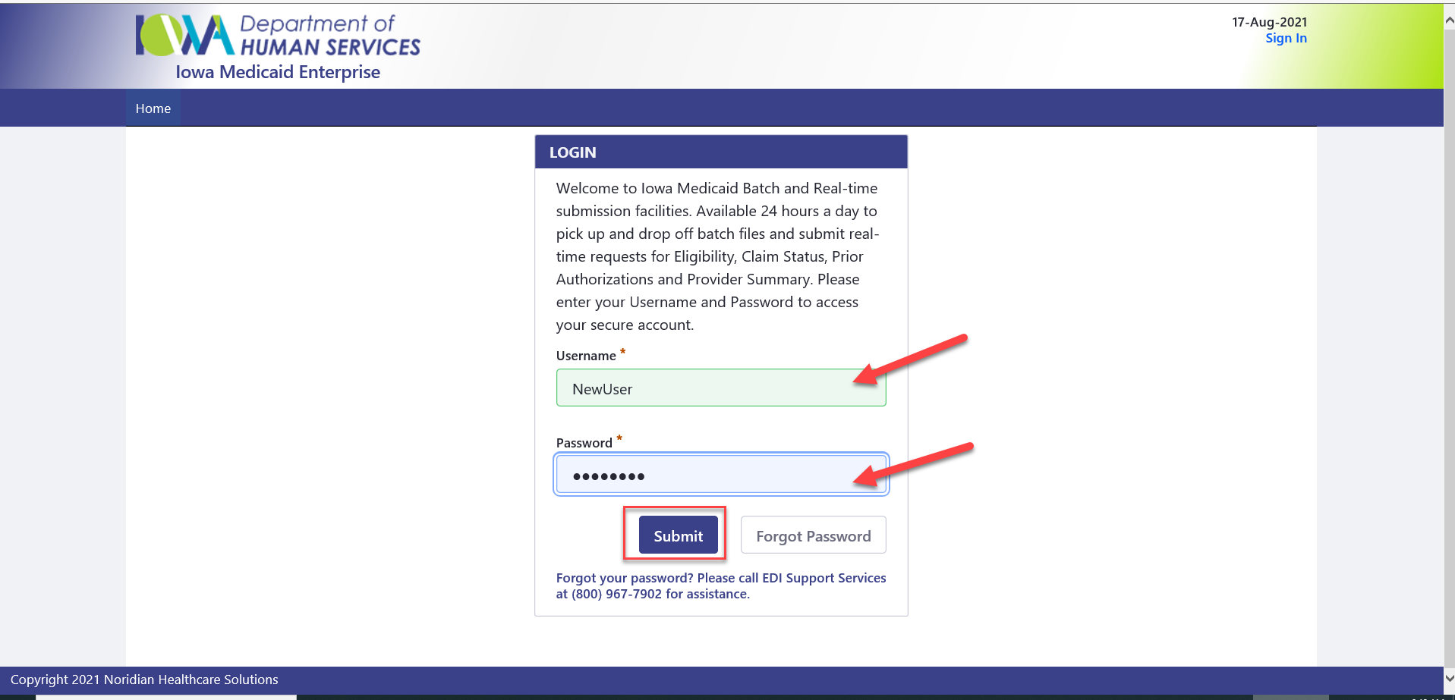
Log In Instructions

Slide 9
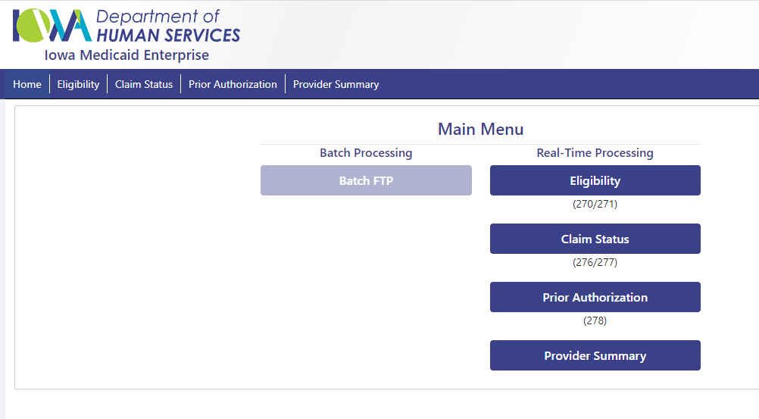
Log In Instructions (continued)

Slide 10
ELVS
This system also allows providers access to their last payment information including date of payment.
If you do not have the member state ID and feel that the member may be on Medicaid, providers may query data by entering the person's date of birth and Social Security number.

Slide 11
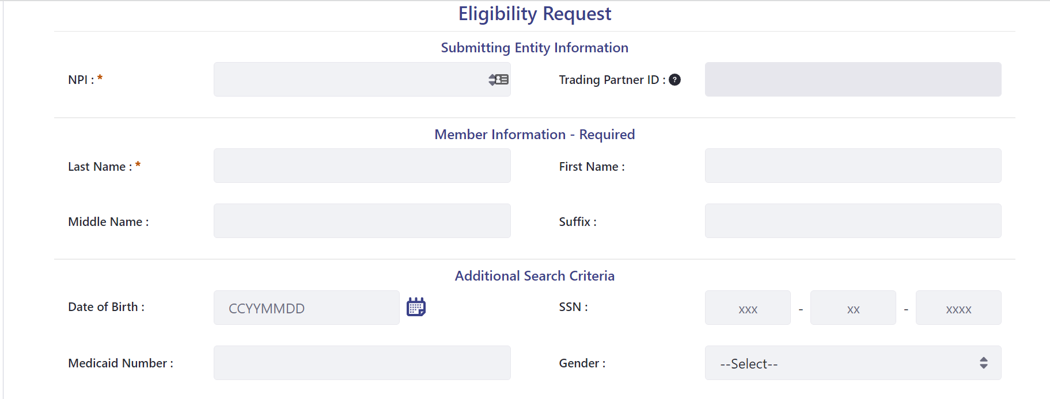
Complete the Eligibility Request
Year, Month, Day

Slide 12
Medical Coverage
Year, Month, Day

Slide 13
Medical Coverage: Inactive Member

Slide 14
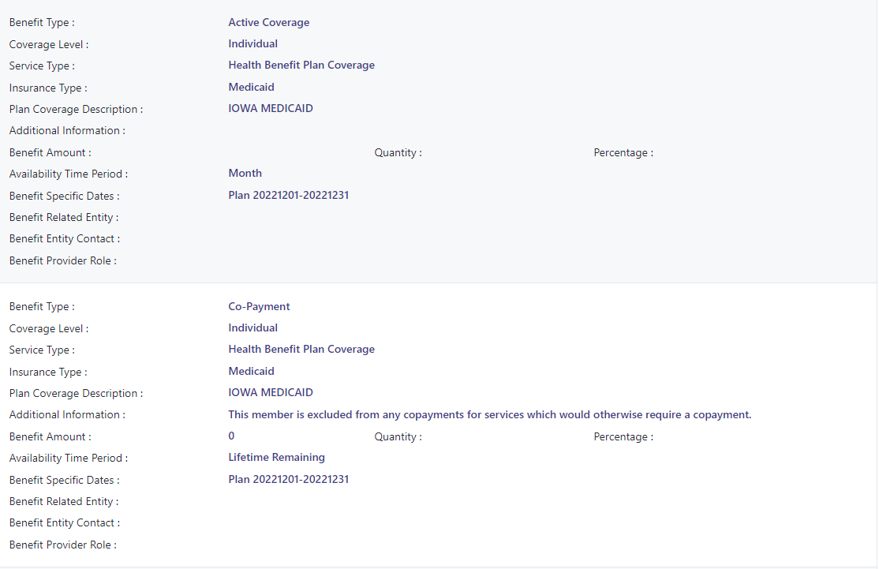
Medical Coverage: Active Member/Co-Payment Information

Slide 15
Dental Plans: Delta Dental or MCNA Dental

Slide 16
Chiropractic and Hospital Coverage

Slide 17
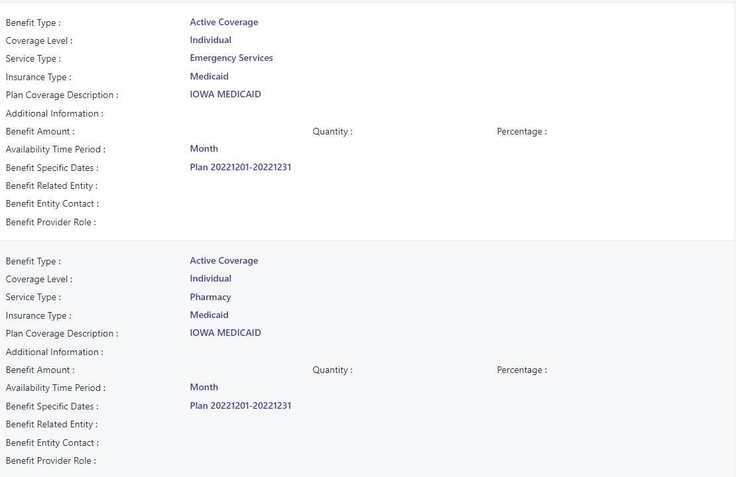
Emergency Services and Pharmacy

Slide 18
Physician and Vision Services

Slide 19
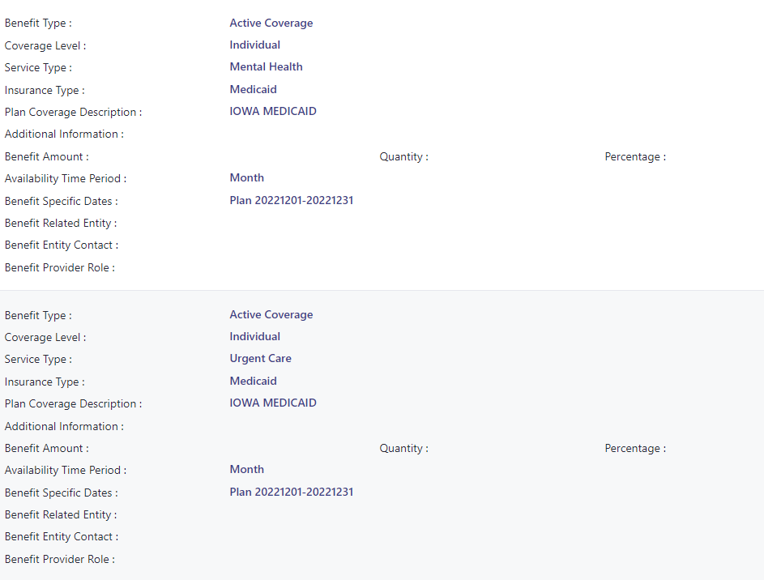
Mental Health and Urgent Care Services

Slide 20
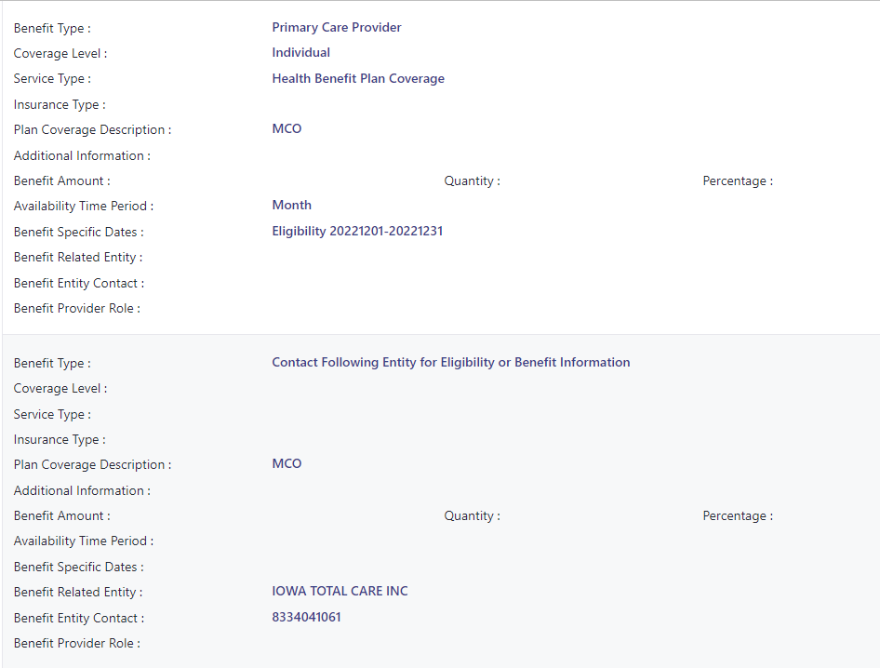
Primary Care Services and Managed Care Services

Slide 21
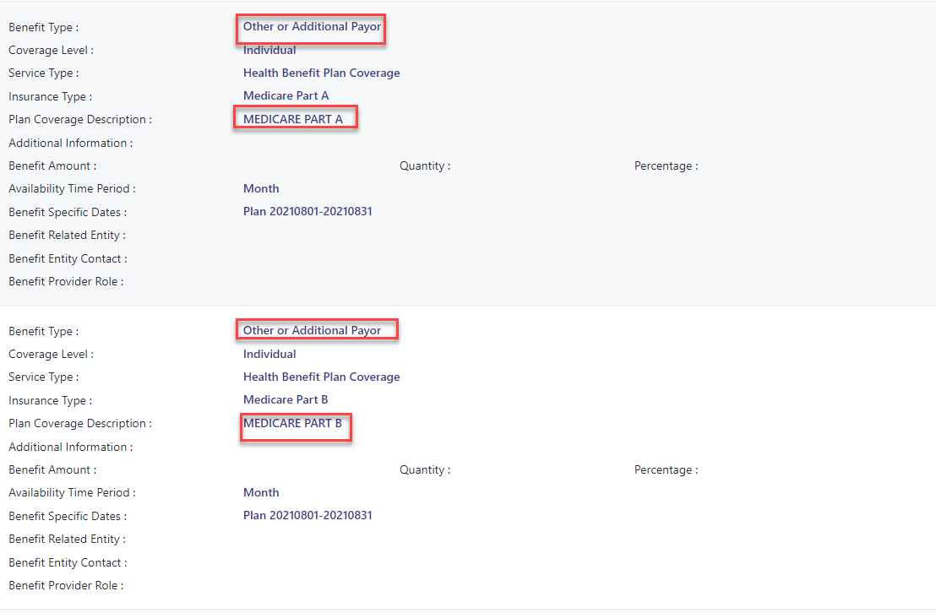
Other Payor Information - Medicare

Slide 22
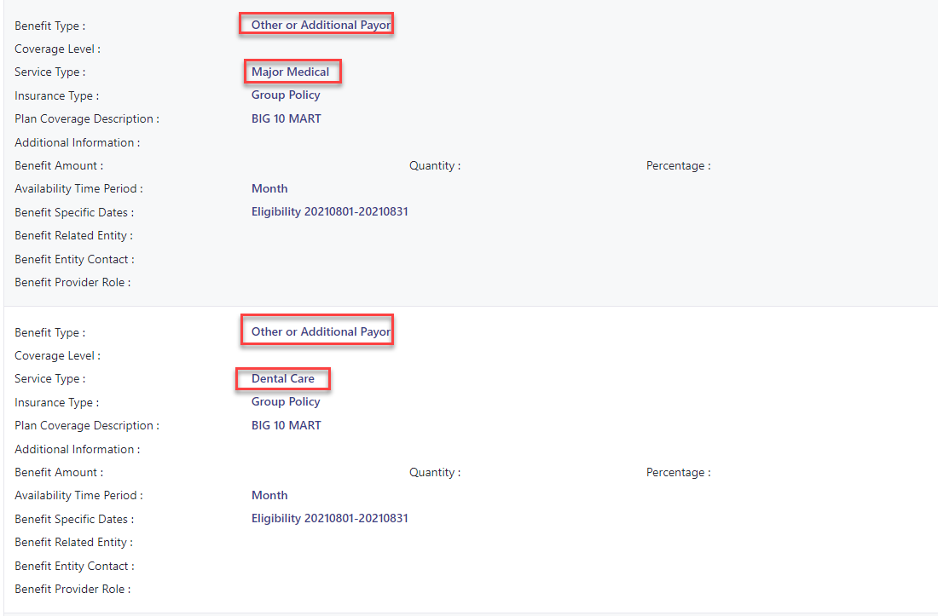
Other Payor Information

Slide 23
Limited Services

Slide 24
Non-Covered Services
Vision services for this member are limited. They are NOT eligible for frames and lens.

Slide 25
ELVS Phone Contact
For queries, call the ELVS phone line at:
515-323-9639 (locally in Des Moines)
1-800-338-7752 (toll-free)
Phone Inquires
Is the member eligibility for the current date or past dates of service?
Does the member have a primary insurance?
Does the member have any type of Managed Care program offered by the IME?
Is there any remaining spenddown on file?

Slide 26
Electronic Data Interchange (EDI) Assistance
EDI Support Services Help Desk
Phone: 800-967-7902
Hours of Operation
Monday - Friday 8:00 A.M. - 5:00 P.M. (CT) Link to See Training Closure Schedule
Mailing Address and Fax Number
Support Services, PO Box 6729, Fargo, ND 58108-6729
FAX: 701-277-7850

Slide 27
Electronic Data Interchange (EDI) Email Assistance
For non-critical questions or issues: support@edissweb.com
For concerns or praise to EDISS management: edimgmt@edissweb.com
Be sure to include the following when contacting us via email
Your name
Business name and location
NPI
Business phone number and extension
Complete description of your issue

Slide 28
Electronic Data Interchange (EDI) Helpful Hints
To ensure delivery to your inbox, please add these addresses to your address book or safe list.
Do not e-mail requests to EDISS for issues such as the status of a claim or remittance or questions about claim processing and denials. EDISS does not handle such inquiries.
Note: Gateway and Connect access questions cannot be done via email, please call the appropriate phone number for assistance.

Slide 29
Questions?

