Slide 1
Molina Healthcare of Iowa
Provider Town Hall – December 2023

Slide 2
Molina Iowa – Provider Network Updates
Newly contracted with Molina?
New Provider Orientation, held last Thursday of each month.
Sign up here: New Provider Education Registration
Still looking to Contract with Molina? Please contact:
IAProviderContracts@molinahealthcare.com
Reminder on LTSS Custodial Care Billing
Please be sure to bill with the below Rev Codes:
Home Health Agencies: Get set up for Electronic Visit Verification
To help ensure a smooth implementation, each agency needs to complete the CareBridge provider set up found here: CareBridge Provider Set Up & Access Request Form
Molina Iowa Provider Portal: Availity Essentials
New Availity Enhancements:
Authorization access for all provider types
Care coordination portal (assessments and case plan access) coming in 2024!
See upcoming Availity Training & Education here.
Provider Type/Service Category | Rev Code
LTC NF (Custodial) | 0100, 0101
SNF (Skilled) | 0110 - 0139
ICF/ID (Custodial) | 0100, 0101
ICF/PMI (Custodial) | 0100, 0101
StationMD Webinar
January 17th at 12:30

Slide 3
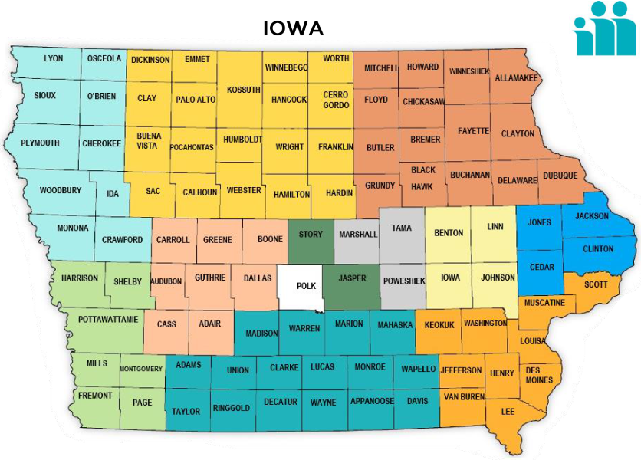
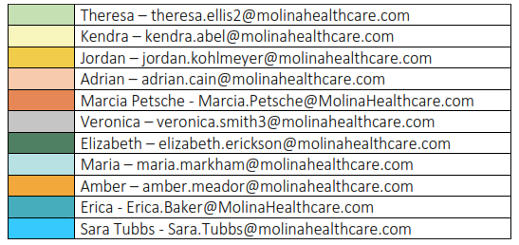
Molina Iowa – Provider Network Updates
The Molina Iowa Provider Relations team is growing!
We have added several PR team members
New territory map to be posted in first quarter 2024
Provider Communications
Jump on the list to receive secured communications (provider notices,
newsletters & more!)
Sign Up here!
New HCBS Work Group Coming 2024
Click Here to join!
2024
I.M.P.A.C.
(Iowa Molina Provider Advisory Council)
New Council coming in 2024: Click Here

