Slide 1
Molina Healthcare of Iowa
Member Town Hall – December 2023

Slide 2
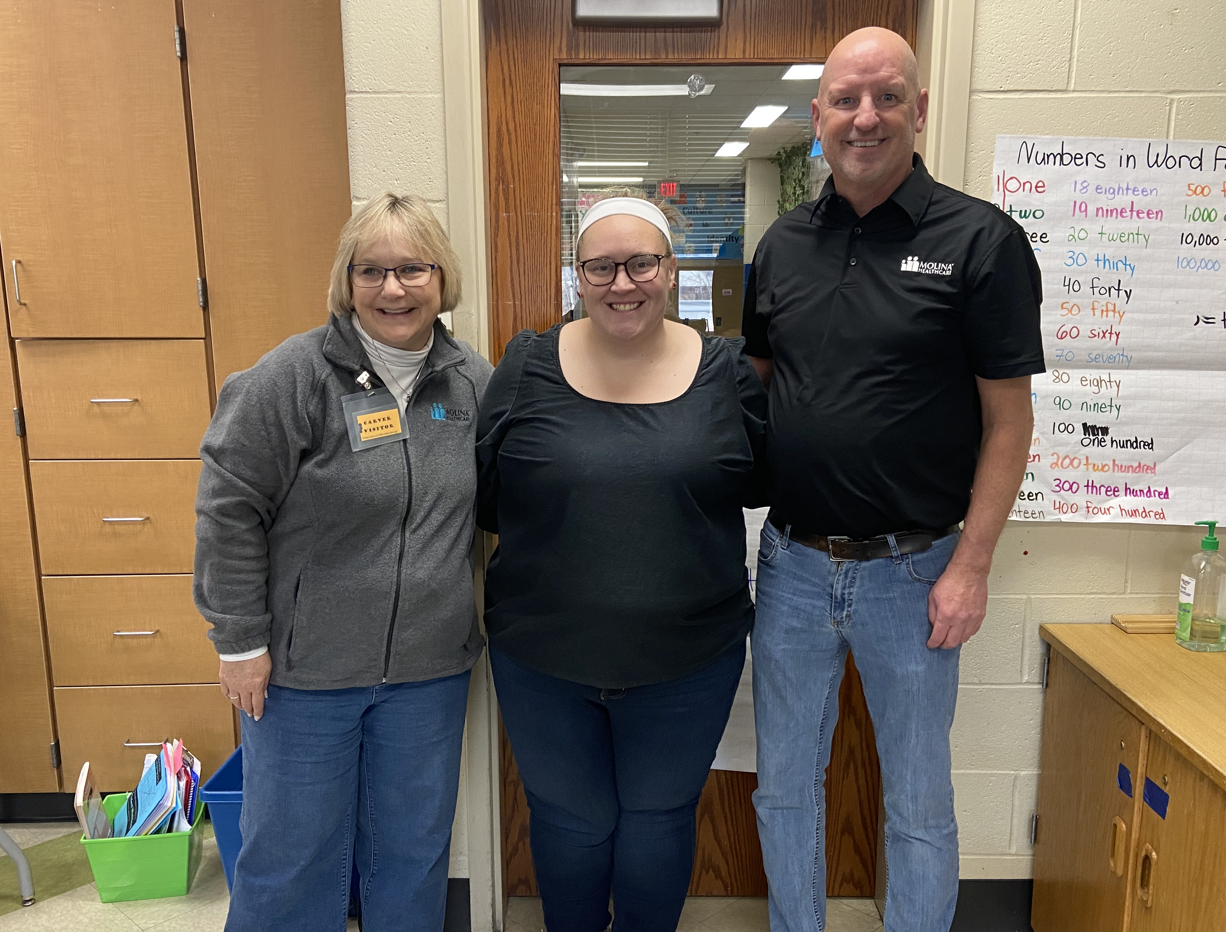
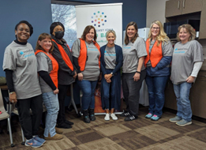
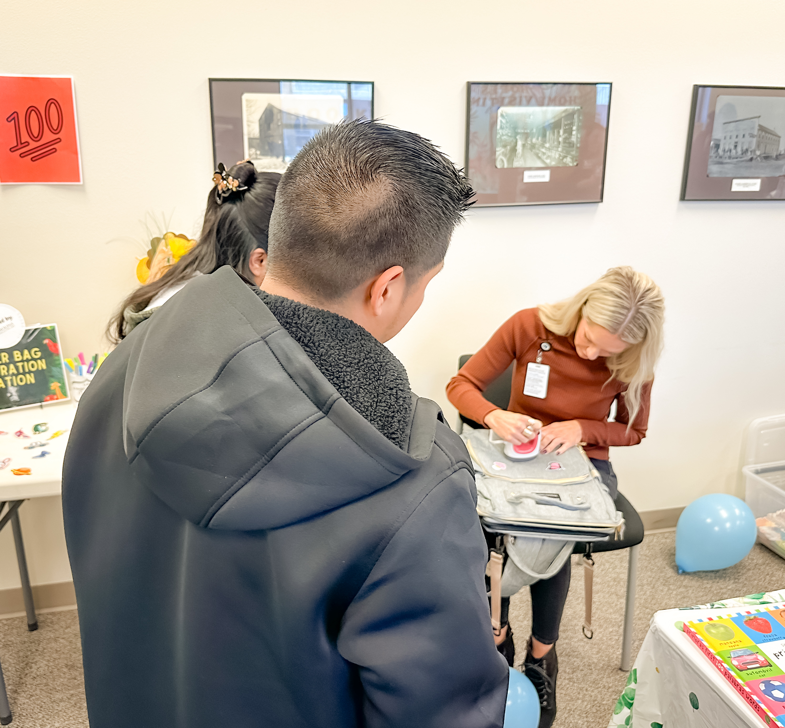
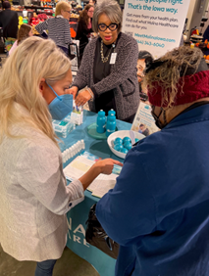
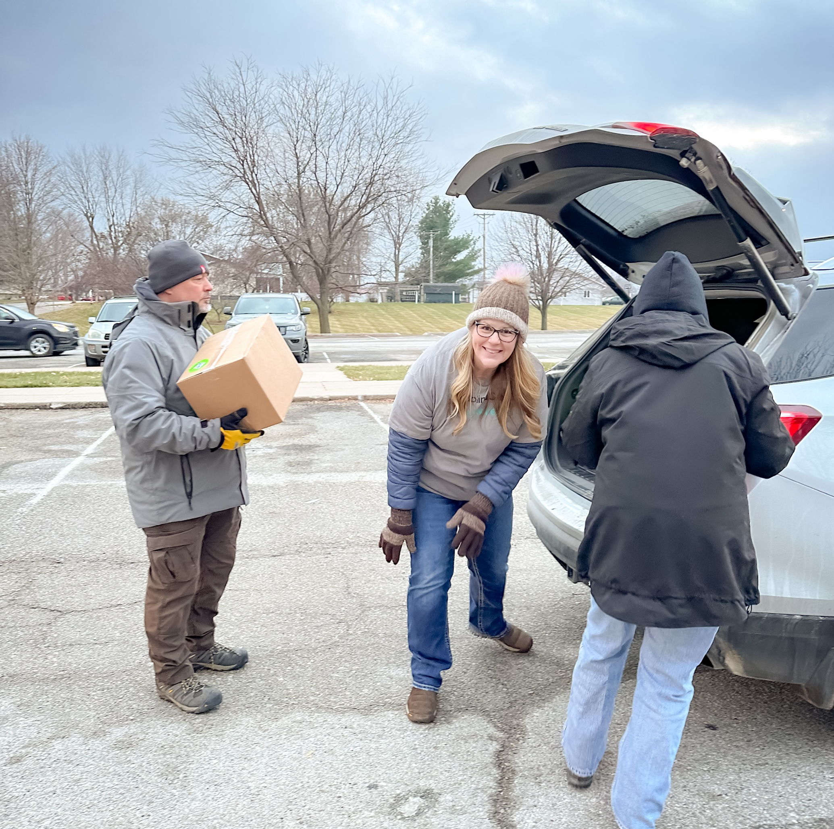
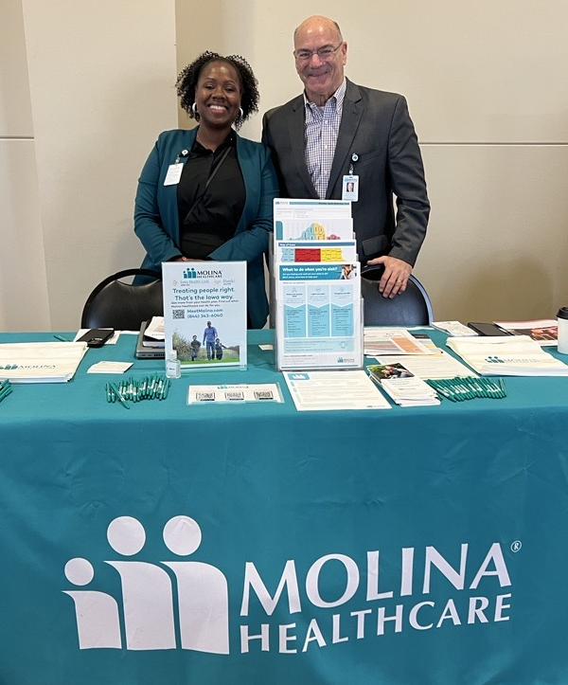
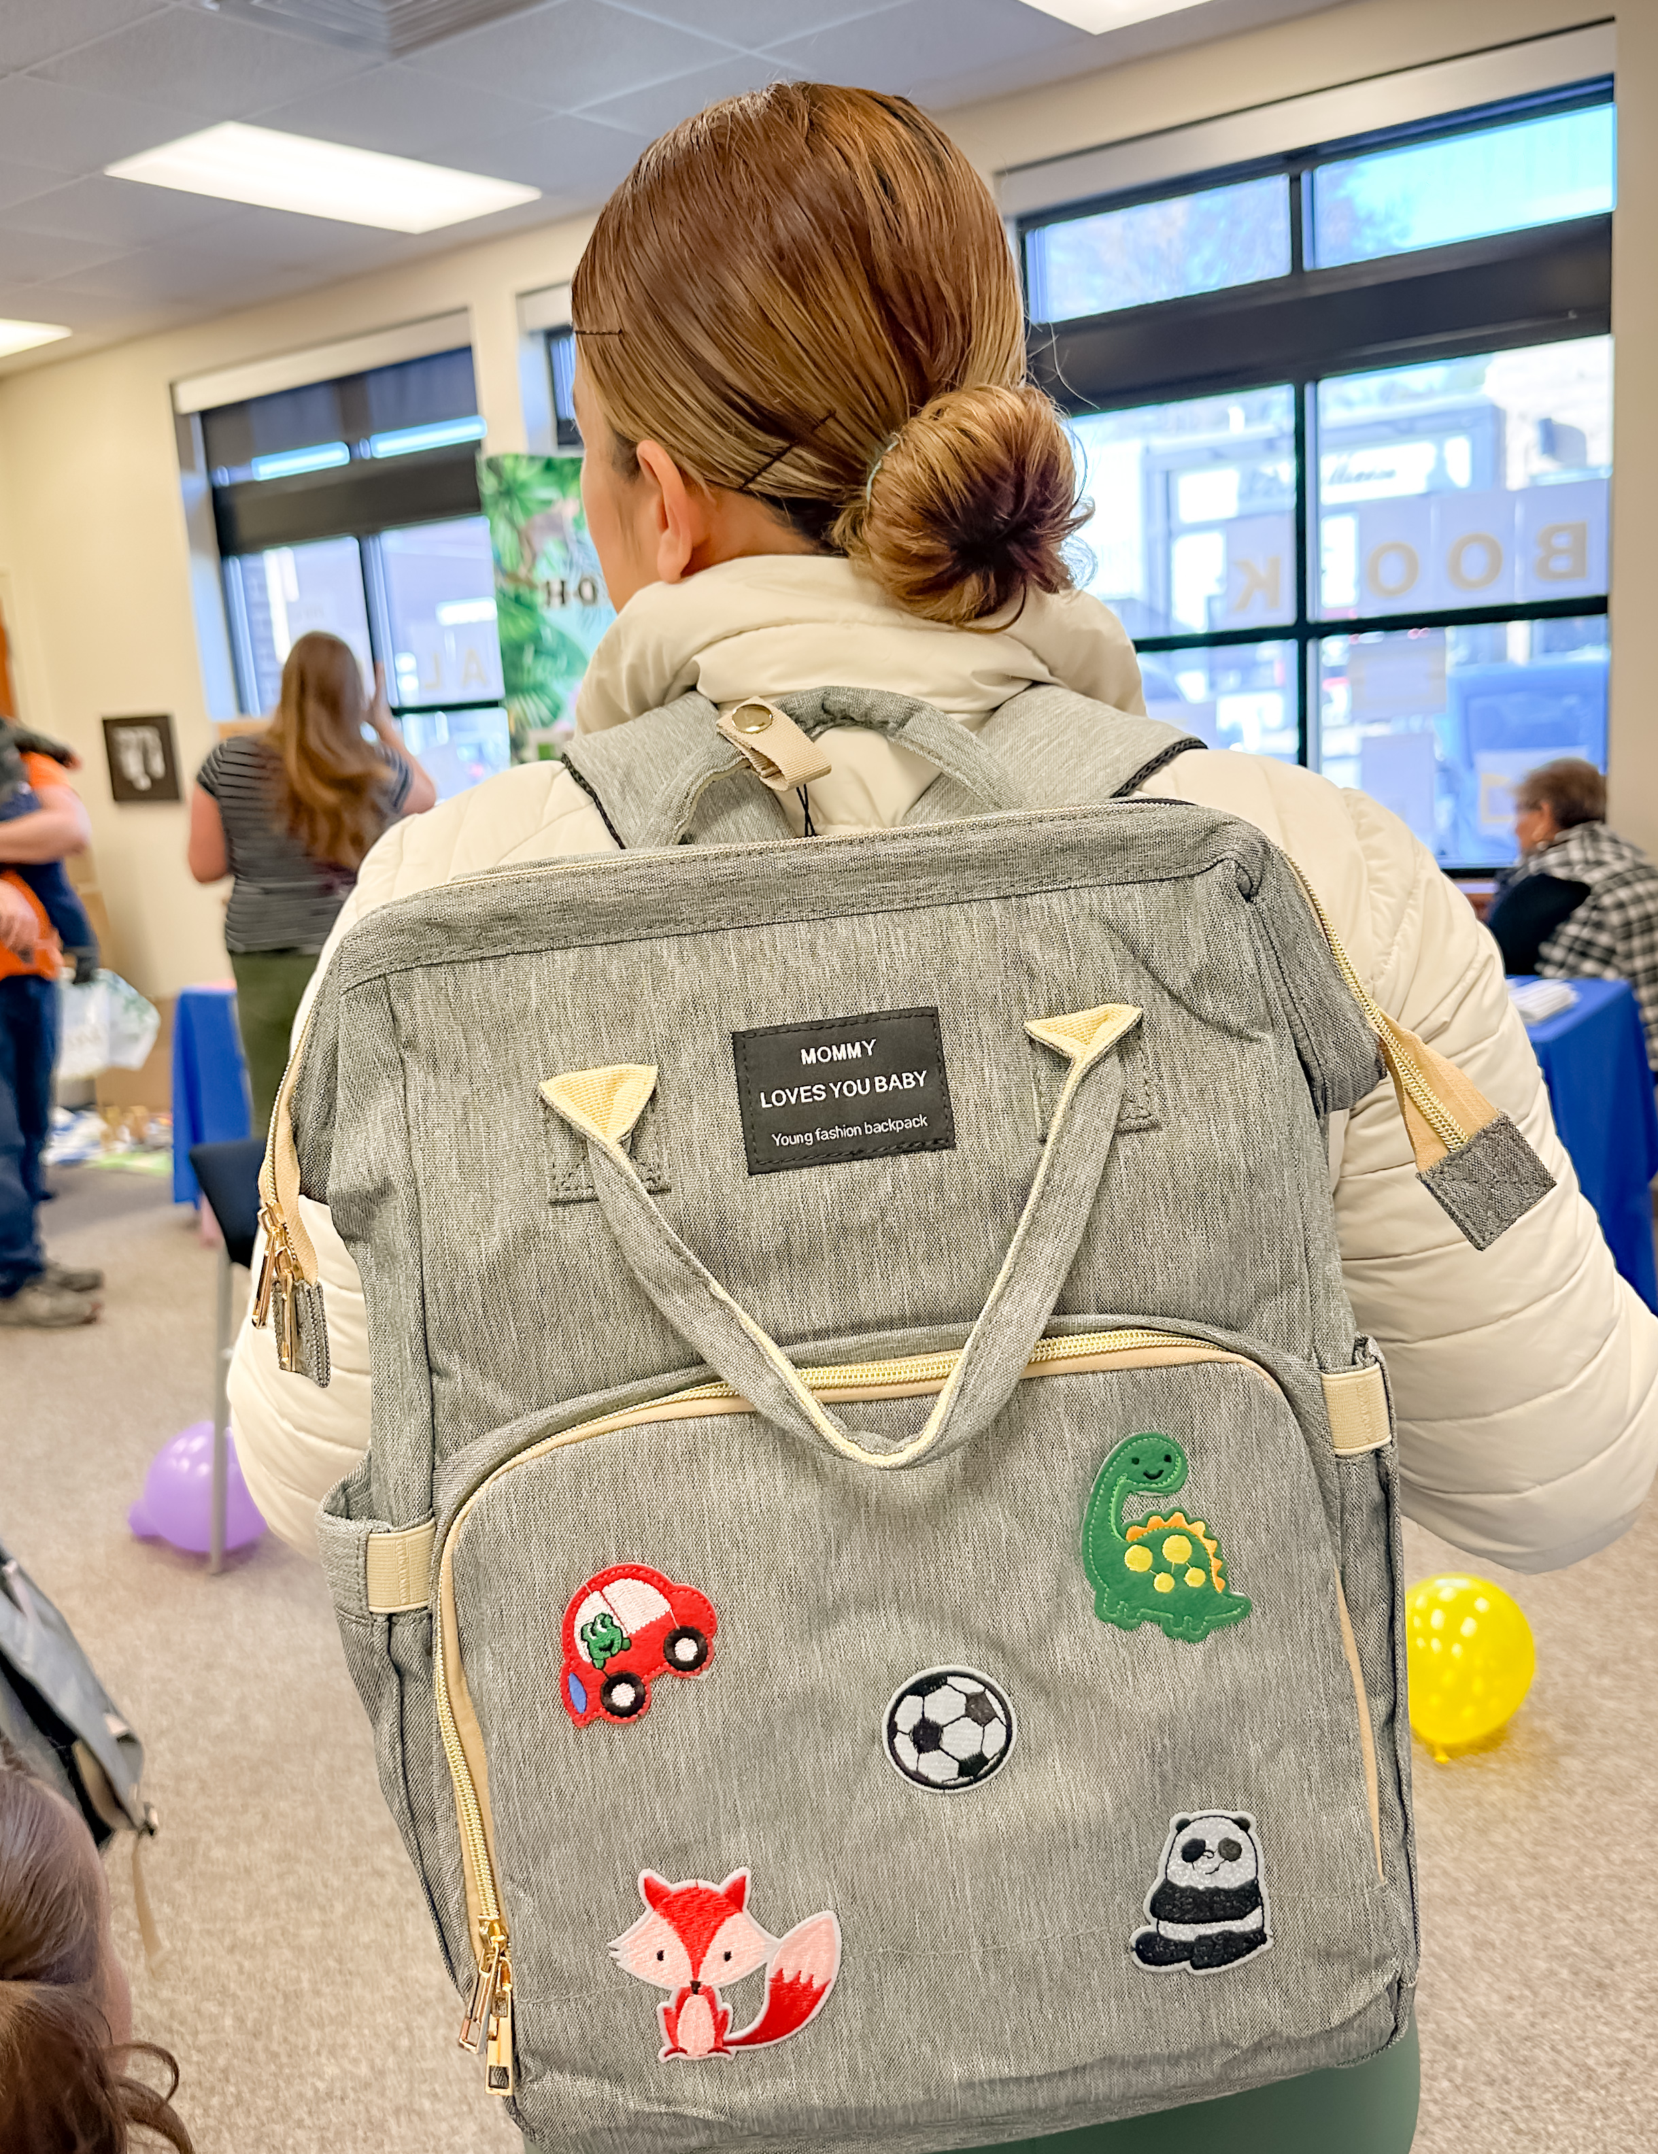
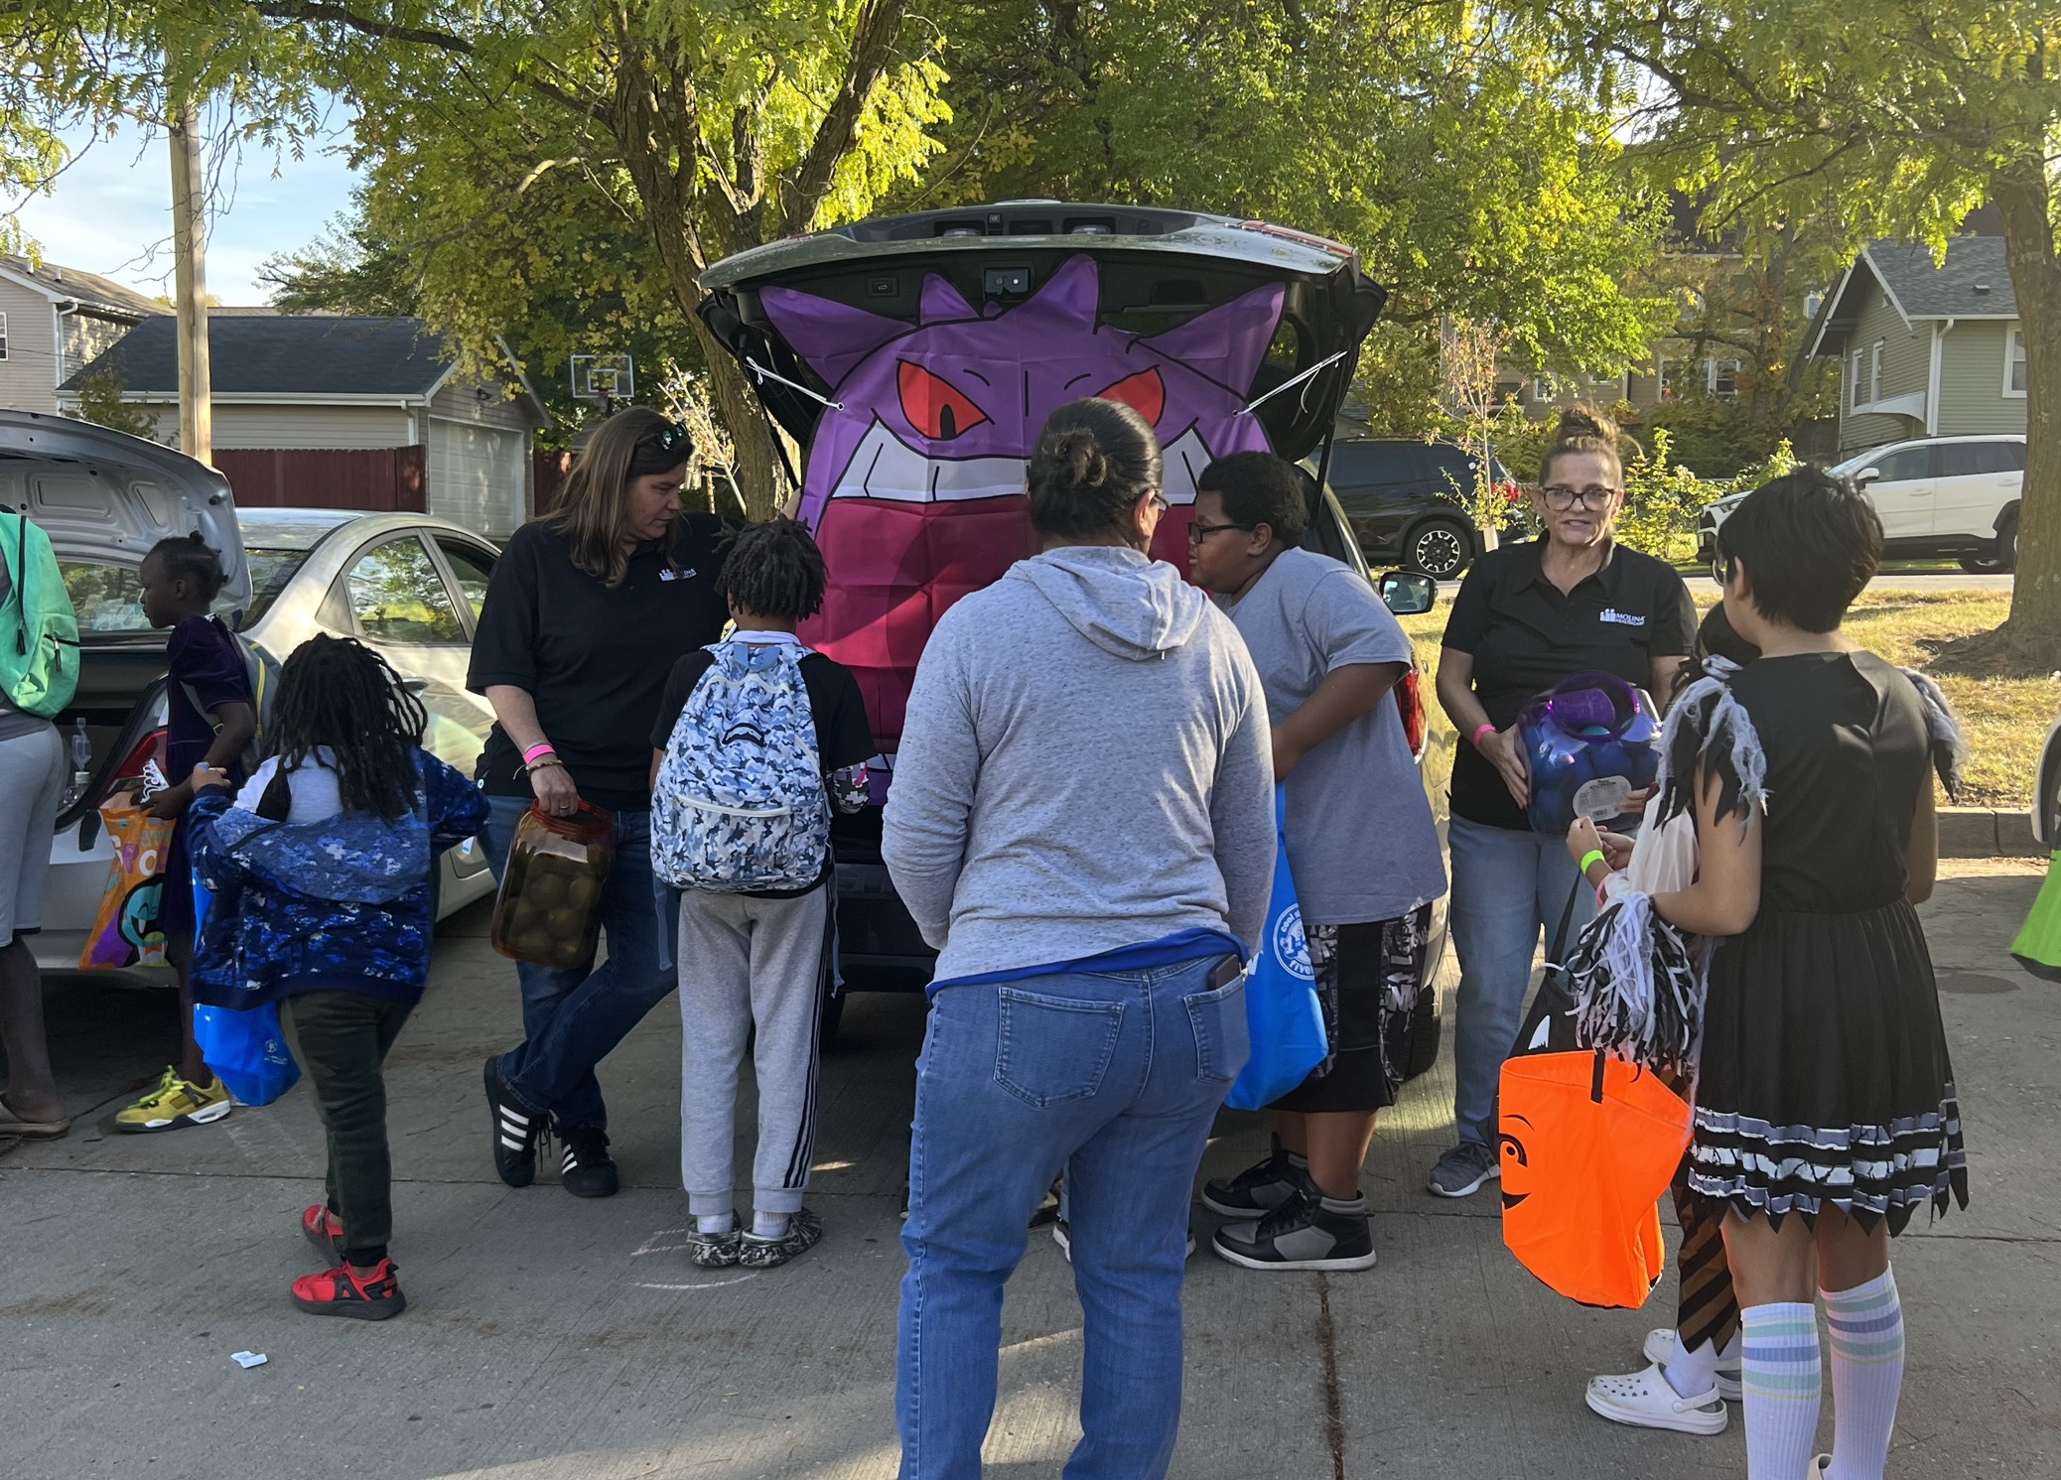
Molina Year in Review
Community Outreach
What Members Are Saying
Launched July 1st
“I am happy because I feel like I have a plan and a team that will help me improve my health.”
“Estoy contenta porque siento que tengo un plan y un equipo que me va a ayudar a mejorar mi salud.”
Smooth Implementation
Comprehensive Provider Network
What Providers Are Saying
Thank you for coming to my rescue, I was so stressed out how I was going to solve this, and you solved it before even coming into the call.”
- Siouxland Mental Health Center (CMHC)
Continuity of Care

Slide 3
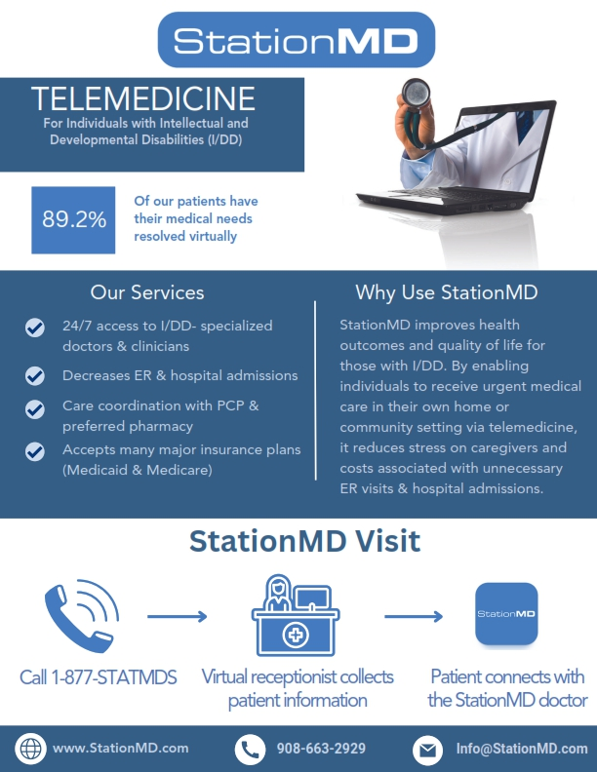
LTSS Updates
Now Live!
Telemedicine for individuals with intellectual and developmental disabilities (I/DD).*
ER doctors who have specialized training
No Cost
24/7 Care
*Case manager referral accepted.
$25
Gift Card
for attending
LTSS Stakeholder Advisory Board​
February 7th, 5-6pm​
Virtual Meeting​
Are you a Molina member or caregiver? ​
Are you interested in joining and participating in our advisory board? ​
If yes, please email: iowamemberservices@Molinahealthcare.com
Notes:
Member Town Hall: Molina would like to share that we have partnered with StationMD a telehealth provider who can help support our members with an ID/DD diagnosis along with their families, providers and loved ones. StationMD provides access to medical care 24 hours a day 7 days a week provided by ER doctors who have specialized training. Molina would encourage you to accept StationMD's support at no cost to you

Slide 4
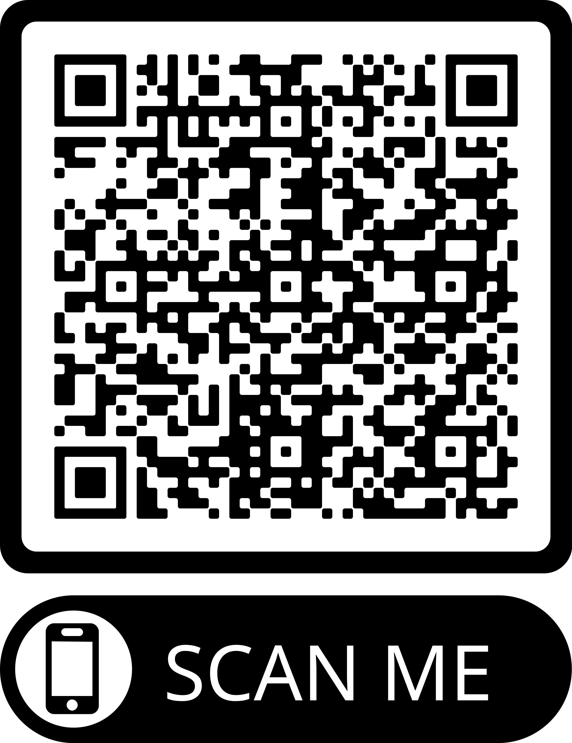
Get the most out of your healthcare!​
Scan to download the My Molina App.
Or visit MyMolina.com
Communicate with Your Care Team​
Claim Your Healthy Rewards
Get Important Health Reminders
Opt-in by texting JOIN to 94870

