Slide 1
Responsible Gaming
A Public Health Approach for Iowans
Iowa Department of Public Health
September 2019

Slide 2
Welcome & Introductions
Integrated Provider Network | Prevention Services
Overview of Gaming in Iowa
1-800-BETS OFF
Breakout Activity
Responsible Gaming
Gambling and Problem Gambling
Gaming Industry’s Role
Health Promotion
Prevention
Questions & Answers
Objectives

Slide 3
Welcome & Introductions
Please share the following:
Name
Role
Number of years you have worked in the gaming industry
Familiarity with Iowa’s problem gambling prevention services (using a scale from 1-10 with 1 being unfamiliar and 10 being very knowledgeable)

Slide 4
Integrated Provider Network Prevention Services

Slide 5
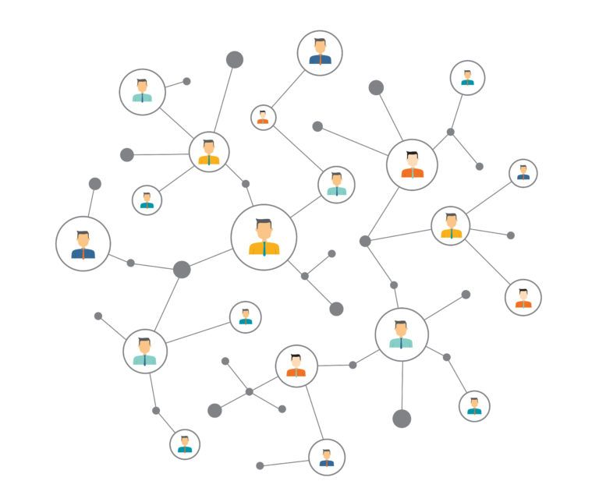
Integrated Provider Network (IPN) Grant
Beginning on January 1, 2019, Iowa Department of Public Health awarded nineteen (19) services areas in Iowa to provide substance use disorder and problem gambling prevention and treatment services.

Slide 6
IPN Grant identified three primary goals:
Establish and maintain a comprehensive and effective system of care for substance use and gambling problems through a statewide, integrated network of services and providers
Reduce substance use and gambling problems through public education, evidence-based prevention, and early intervention services
Increase remission and recovery from substance use disorders and problem gambling through timely, accessible, ongoing, and effective treatment services
Integrated Provider Network (IPN) Grant

Slide 7
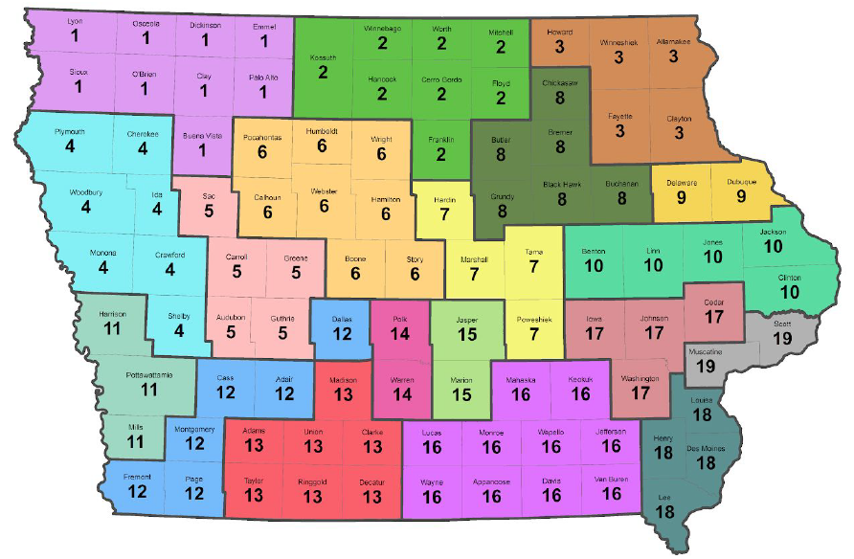
Integrated Provider Network Service Areas Map

Slide 8
Integrated Provider Network Contractors

Slide 9
SFY 2020 Goals/Activities:
Increase the amount of stakeholders involved in substance misuse and problem gambling prevention efforts
Promote the utilization of Your Life Iowa as the primary resource for substance misuse and problem gambling prevention information and services
Promote Problem Gambling Awareness Month to increase public awareness of problem gambling and the availability of services
Promote Responsible Gaming Education Week to increase awareness of problem gambling among gaming industry employees and customers to promote responsible gaming
Promote the Responsible Gifting Campaign
Problem Gambling Prevention Services

Slide 10
Overview of Gaming in Iowa

Slide 11
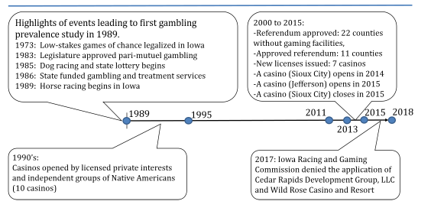
Gaming History in Iowa
https://www.iowagaming.org/about-us/iowa-gaming-history.aspx
Notes:
There have been previous studies with similar purposes conducted in the state. The first study was conducted in 1989 (Volberg & Steadman, 1989) after the state legalized riverboat casinos in 1974. A replication study was conducted in 1995 (Volberg, 1995) after an increase in the number of gambling licenses issued in the state was observed. Surveys of public attitudes and behaviors toward gambling were also conducted in 2011, 2013 and 2015.

Slide 12
Gaming History in Iowa
Iowa legislature signed the Pari-mutuel Wagering Act into law in 1983
Allowed for qualifying sponsoring organizations to apply for a license to conduct pari-mutuel wagering on horse and dog racing
Iowa Lottery - 1985
The first riverboat casino was opened on April 1, 1991
19th Casino opens (Wild Rose-Jefferson opens 2015)
https://www.iowagaming.org/about-us/iowa-gaming-history.aspx

Slide 13
Gaming in Iowa - Regulation
Iowa Racing and Gaming Commission (IRGC)
Created by the Pari-Mutuel Wagering Act in May of 1983.
Consists of five members appointed by the Governor, subject to confirmation by the Iowa Senate, and who shall serve a three-year term at the pleasure of the Governor.
Offers statewide Voluntary Self-Exclusion program (2018)
19 licensed casinos
Over $6B in tax revenue to the state since inception.

Slide 14
Gaming in Iowa - Regulation
Department of Inspection and Appeals (DIA)
Social and Charitable Gaming
Annually about 2,800 social and charitable gambling, amusement, concession and bingo licenses issued (DIA)
5,452 registered amusement devices (DIA)

Slide 15
Winnebago Tribe of Nebraska - WinnaVegas (April 30, 1992), Sloan, IA
Omaha Tribe of Nebraska - CasinOmaha (June 22, 1992), renamed Blackbird Bend Casino in April 2013, Onawa, IA
Sac and Fox Tribe of the Mississippi - Meskwaki Bingo and Casino (December 31, 1992), Tama, IA
Ponca Tribe of Nebraska - Prairie Flower Casino, Carter Lake, IA (October 31, 2018)
Tribal Gaming In Iowa

Slide 16
Gaming in Iowa – Iowa Lottery
Began in 1985
Sells tickets in three categories: instant-scratch, pull-tab, and lotto games
Offers a Voluntary Self-Exclusion Program
Products are sold in approximately 2,400 retail locations
Over $1.9B raised for state programs since inception.

Slide 17
Gaming in Iowa – Professional Associations
Iowa Gaming Association (IGA)
Began in 1999
Supports the state’s gaming industry
Advocates for the 19 licensed commercial casinos
Iowa Thoroughbred Breeders and Owners Association (ITBOA)
Non-profit organization responsible for promoting the breeding and racing of Thoroughbreds in Iowa.
Represents nearly 500 Iowa-bred owners and breeders

Slide 18
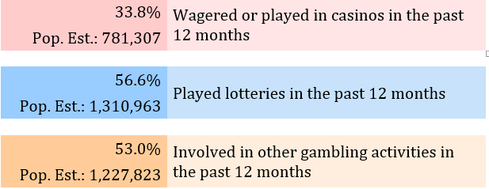
Gaming in Iowa - Adults

Slide 19
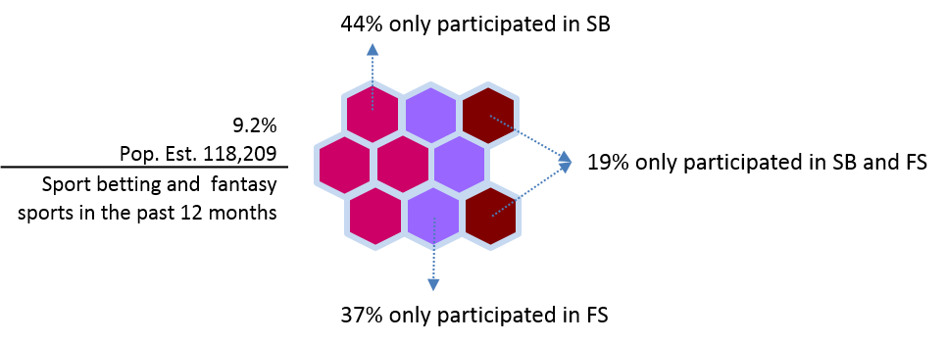
Gaming in Iowa - Adults

Slide 20
Gambling Attitudes & Behaviors (Adults)
Research is conducted by the Center for Social and Behavioral Research, University of Northern Iowa
Gambling Attitudes and Behaviors Studies have been conducted in 2011, 2013, 2015, and 2018
Other Surveys/Reports
Iowa Behavioral Risk Factor Surveillance System (Annual)
Iowa Gambling Treatment Outcomes (IGTO) Reports (Bi-Annual)
Iowa Youth Survey Problem Gambling Questions (Bi-Annual)
Iowa Gambling Treatment Program Annual Report
http://idph.iowa.gov/igtp/reports
Gaming in Iowa
Research

Slide 21
Gambling Attitudes and Behaviors:
A 2018 Study of Adult Iowans
A total of 1,761 interviews were completed from September 12, 2019 to January 16, 2019
The purpose was to collect data from adult Iowans to assess types and frequency of gambling activities, prevalence of problem gambling, and awareness of publicly-funded gambling treatment services
Used a dual-frame (land and cell) random digit dial telephone sampling process
Gaming in Iowa
Research

Slide 22
Gaming in Iowa
Research
Notes:
• The prevalence of gambling in the state increased from 2015 to 2018. The 2018 prevalence estimates indicate that:
o Nearly 9 in 10 adult Iowans have gambled in the past.
o About 7 in 10 adult Iowans gambled in the past 12 months.
o About half of adult Iowans gambled in the past 30 days.
• Similarily, the estimation of at-risk gamblers in 2018 is about 14% and this is slightly higher than in 2015. This represents about 315,000 adults in the state who may be experiencing some problem gambling symptoms.
• Gambling in the adult population has impacted persons in their social networks. About 1in 4 adult Iowans (27%) know persons whose gambling may be causing problems for them.
• In addition, about 1 in 5 adult Iowans (22%) said that they have been negatively affected by others’ gambling behaviors.

Slide 23
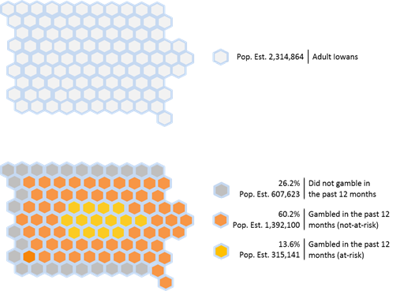
Gaming in Iowa
Research
Notes:
• The prevalence of gambling in the state increased from 2015 to 2018. The 2018 prevalence estimates indicate that:
o Nearly 9 in 10 adult Iowans have gambled in the past.
o About 7 in 10 adult Iowans gambled in the past 12 months.
o About half of adult Iowans gambled in the past 30 days.
• Similarily, the estimation of at-risk gamblers in 2018 is about 14% and this is slightly higher than in 2015. This represents about 315,000 adults in the state who may be experiencing some problem gambling symptoms.
• Gambling in the adult population has impacted persons in their social networks. About 1in 4 adult Iowans (27%) know persons whose gambling may be causing problems for them.
• In addition, about 1 in 5 adult Iowans (22%) said that they have been negatively affected by others’ gambling behaviors.

Slide 24
Less than half of adult Iowans (44%) said that the harm of gambling outweighs the benefits gambling has for society.
The percent of Iowans endorsing this negative perception has been steadily decreasing since 2013.
As would be expected, people who gambled were more likely to have more favorable views of gambling in society than those who did not gamble
Public funding to provide problem gambling treatment was important to 9 in 10 Iowans (28% very important, 35% important, 29% somewhat important).
A similar level of support was found for education of youth, adults and seniors regarding the risks of gambling
Gaming in Iowa
Research

Slide 26
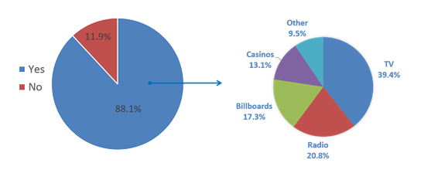
Almost 9 in 10 adult Iowans (88%) indicated they were aware of the gambling helpline 1-800-BETS OFF. However, the 1-800-BETS OFF website was lesser known.
About half of adult Iowans (54%) indicated they have seen or heard of the website www.1800BETSOFF.org.
This was an increase from 41% in 2015. About 1 in 10 (8%) adult Iowans have ever heard or seen Your Life Iowa (YLI).
The awareness of the YLI website www.yourlifeiowa.org was about 6%
1-800-BETS OFF

Slide 27
About 1 in 4 (24%) adult Iowans knew about the state’s gambling self-exclusion program.
Adult Iowans who gambled in the past 12 months were more likely to be aware of the statewide gambling self-exclusion programs than were those who did not gamble in the past 12 months
1-800-BETS OFF

Slide 28
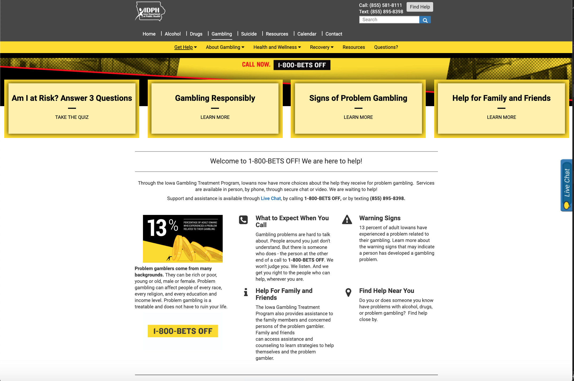
1800BETSOFF.ORG
Am I at Risk?
Gambling Responsibly
Signs of Problem Gambling
Help For Family & Friends
Chat, Text, Phone
Finder (facility locator)
24/7/365 – Free/Confidential

Slide 29
Breakout Activity

Slide 30
SWOT Analysis

Slide 31
SWOT Activity

Slide 32
Group up
10-12 minutes
List your perceived Strengths, Weaknesses, Opportunities and Threats that problem gambling poses at your casino’s property
Include & discuss all potential situations/variables associated with problem gambling in the casino
Each group will report out to the larger group
SWOT Activity

Slide 33
Responsible Gaming

Slide 34
Responsible gaming is social gambling. Social gamblers participate in gambling activities in a responsible manner without experiencing any negative impacts on any aspect of their life.
Responsible Gaming

Slide 35
Responsible Gaming Is . . .
A fun and entertaining form of recreation.
Sticking to limits with regard to time and money
Playing with expendable entertainment funds
The ability to temporarily or permanently exclude oneself if the gambler feels he or she is experiencing a concern about gambling behavior

Slide 36
Gambling with money is borrowed from credit cards, future paychecks, or family funds allocated for expenses
The cause of problems at home, on the job, legally or financially
Intended to take the place of personal relationships.
An obsession
A means to resolve a financial crisis, an escape from stressors, grief, or other feelings, or a replacement for other addictions
Responsible Gaming is NOT

Slide 37
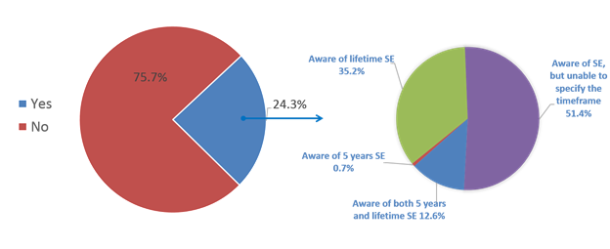
Iowa’s Voluntary Self-Exclusion Programs
Iowa has two statewide Voluntary Self-Exclusion programs.
Iowa Racing and Gaming Commission
Iowa Lottery
Both offer a five-year (as of July 1, 2017) and lifetime (irrevocable) option.

Slide 38
Gambling & Problem Gambling

Slide 39
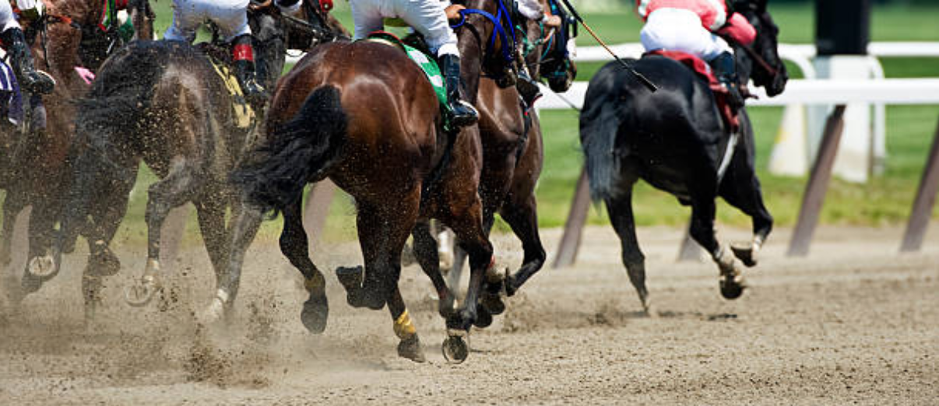

Slide 40
“
Gambling is a recreational activity for the vast majority of adults who participate, regardless of their age, income, education or socioeconomic status. Within the United States, most people have gambled at some point in their lives; many of whom have done so within the past year.
Gambling Attitudes and Behaviors: 2018 Study of Adult Iowans

Slide 41
Forms of Gambling
Casino-style card games (Texas Hold’em, Blackjack/21, etc.)
Card Games (Gin Rummy, Spades, Hearts, etc.)
Dice Games (Craps, etc.)
Electronic Games (Online Poker, Slots, Keno)
Betting on Sporting Events (Football, Baseball, etc.)
Pitching Quarters
Lottery Tickets or “Scratchers”
Raffle Tickets
Bingo
Games of Personal Skills (Basketball, Video Games, Bowling, etc.)
Mahjong, Native American stick games and other cultural games
https://calpg.org/common-types-of-gambling/

Slide 42
Gambling “Types”
Social
Frequent
Binge
Professional
Antisocial
Problem
Action
Escape
Disordered
https://calpg.org/identifying-types-of-gamblers/

Slide 43
Mental Health Disorders
Age
Sex
Influences of Family or Friends
Medication used to treat certain ailments
Certain personality characteristics
Problem Gambling Risk Factors
https://www.mayoclinic.org/diseases-conditions/compulsive-gambling/symptoms-causes/syc-20355178

Slide 44
What is Problem Gambling
A complex condition, an addiction, often with serious consequences, such as:
Financial (e.g., credit card debt, pay-day loans, inability to pay bills)
Spiritual/Psychological (e.g., depression, suicide)
Social (e.g., isolation, withdrawal)
Family (e.g., neglect, abuse, divorce)
Vocational (e.g., decline in work performance, loss of job, sick days, dropping out of school)
Physical health - (e.g., higher rates of cardio-vascular and gastro-intestinal issues)
Legal issues - (e.g., fraud, embezzlement, bankruptcy, bad checks)

Slide 45
What is Problem Gambling
Frequently connected to other addictions and mental health disorders:
People in recovery from drugs or alcohol often see gambling as an alternative and many of the same patterns of addiction emerge
A hidden disorder that has a higher rate of suicidal ideation/attempts than other addictive disorders:
Threats of suicide must be taken seriously
https://www.mayoclinic.org/diseases-conditions/compulsive-gambling/symptoms-causes/syc-20355178

Slide 46
Signs & Symptoms of Problem Gambling
Preoccupied with gambling - constantly planning how to get more money to support gambling
Needing to gamble with increasing amounts of money to get the same thrill
Trying to control, cut back or stop gambling, without success
Feeling restless or irritable when trying to cut down on gambling
Gambling to escape problems or relieve feelings of helplessness, guilt, anxiety or depression
https://www.mayoclinic.org/diseases-conditions/compulsive-gambling/symptoms-causes/syc-20355178

Slide 47
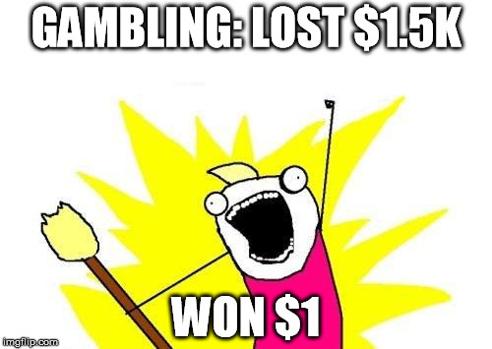
Signs & Symptoms of Problem Gambling
Trying to get back lost money by gambling more (chasing losses)
Lying to family and friends to hide gambling
Jeopardizing or losing relationships, jobs, school/work opportunities because of gambling
Resorting to theft or fraud to get money to support gambling
Asking others for money to support finances as the person’s money was lost to gambling
https://www.mayoclinic.org/diseases-conditions/compulsive-gambling/symptoms-causes/syc-20355178

Slide 48
Signs and Symptoms of Problem Gambling
Secretive behavior (e.g., hiding lottery tickets or betting slips, or having bills sent to work or another address)
Bragging about wins, not talking about losses
Frequent mood swings, which are elevated when winning and depressed when losing.
Floating money in bank accounts, borrowing from petty cash, or taking family funds allocated for other uses in order to gamble
Borrowing money, often lying about what the money will be used for, relying on others for living expenses, and struggling to pay for family needs
Continuing to gamble despite negative consequences (e.g., financial problems, relationship strife, and threats of divorce or losing their job)

Slide 49
A moral weakness
A lack of self-control
Just about gambling too much
Confined to a particular gender, age group, ethnic group, or social class
About "bad people"
Problem gambling occurs when gambling negatively impacts upon one or more aspects of a person’s life. The amount of time or money a person spends does not, in and of itself, indicate a problem, absent other behaviors
Problem Gambling is NOT

Slide 50
Problem Gambling/Impacts on Families
Family relationships can be severed and destroyed by someone experiencing serious gambling difficulties – up to and including the ultimate severance – suicide
Families can suffer from unmet basic needs as the result of problem gambling and often experience financial, physical and emotional difficulties
Families can be made homeless as a direct result of problem gambling
Indications are that domestic violence rates are higher among problem gamblers which may include child neglect and child abuse
American Psychiatric Association definition

Slide 51
Gaming Industry’s Role

Slide 53
The gaming industry is in a unique position to positively impact upon a segment of the patron population who may be in need of assistance for a gambling problem
The approach is not to prohibit gambling, but to put into place programs that can help to minimize the negative impact gambling can have on the percentage of gamblers who are unable to gamble with control
The Gaming Industry’s Role

Slide 54
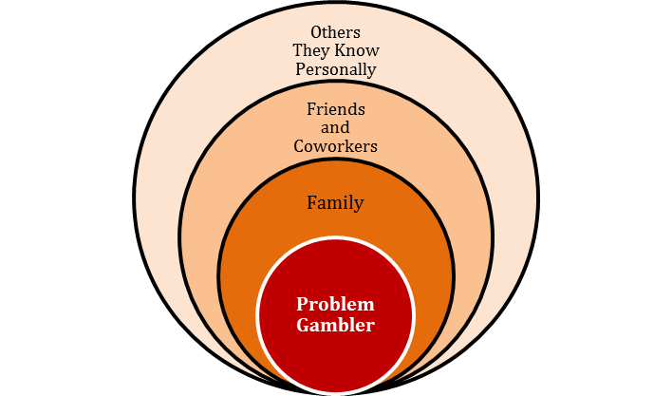
Problem Gambling Impacts
Behavior patterns that can compromise, disrupt or damage personal, family or vocational pursuits
Employee stress due to inability to assist a patron in distress
Positive patron experience
Employees can develop a gambling problem, even if they are restricted or prohibited from placing bets where they work
The Gaming Industry’s Role

Slide 55
Good Customer Service
Providing and promoting annual responsible gaming training
Responding to a patron who is in distress, regardless of the cause of the distress.
There may be many reasons for a patron’s distress, and If it is a gambling problem . . .
It is important to know the specific assistance, such as providing a problem gambling brochure, notifying management or security personnel and/or other steps as set forth in your company’s policies.
The Gaming Industry’s Role

Slide 56
A comprehensive responsible gaming program and training can limit liability and risk and includes:
Adopting a “see something, say something” approach that may identify a problem sooner
Responsible Gaming Policy review
Documentation of incidents
Procedures on how employees are to handle/report events on property such as: violence, embezzlement, child neglect or suicide
The Gaming Industry’s Role

Slide 57
Eyes and Ears focused and tuned for responsible gaming
First contact or “first responder” to patrons
Liaison to guide patrons to the help they need
Assess situations and present circumstances to management or security personnel in order to determine next steps:
Notifying management and/or security personnel
Providing information on help that is available to a patron
Listening in a respectful and non-judgmental manner
Understanding the risk of suicide and violence
What is My Role?

Slide 58
Don’t encourage patrons to play longer or for higher stakes
Don’t feed patrons’ superstitions or myths about gambling such as:
Machine is hot or cold
Practice makes perfect
You're lucky today
I’ll watch the machine while you take a break
Patrons can control the outcome of the game
What is my Role?

Slide 59
Be aware of . . .
Signs and symptoms of problem gambling
Problem gambling is often referred to as a “hidden illness”
Cannot see problem gambling in a patron’s eyes or smell it on their breath
There are no track marks
What is my Role?

Slide 60
When asked, provide accurate information such as:
Gambling is a game of chance
The odds of any given game are __ to __
Slot machine payout is random
In the long run, the odds of winning are against you
What is my Role?

Slide 61
Health Promotion

Slide 62
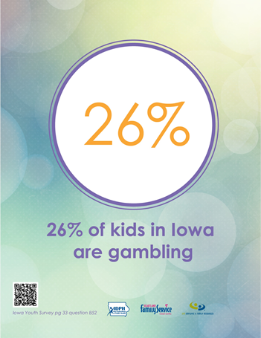
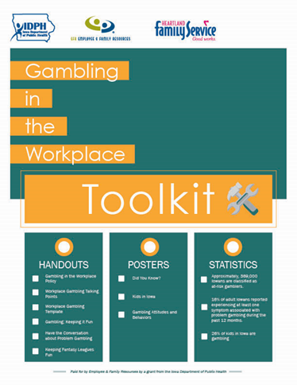
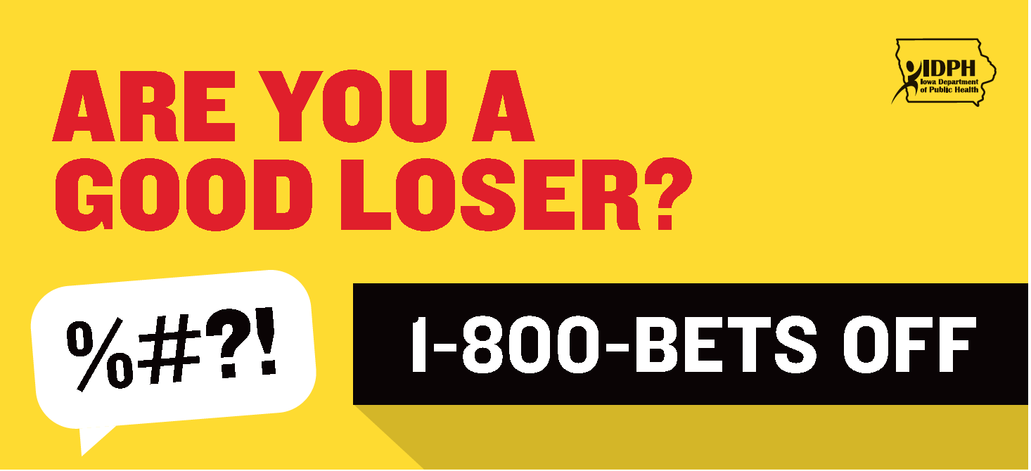
Health Promotion
The following resources work to support and enhance problem gambling prevention services
Iowa’s Gambling in the Work Plan Policy Toolkit
Iowa’s Self-Exclusion Toolkit
Responsible Gaming Toolkit
Are You A Good Loser Campaign
1-800-BETS OFF
Your Life Iowa

Slide 64
Next Steps

Slide 65
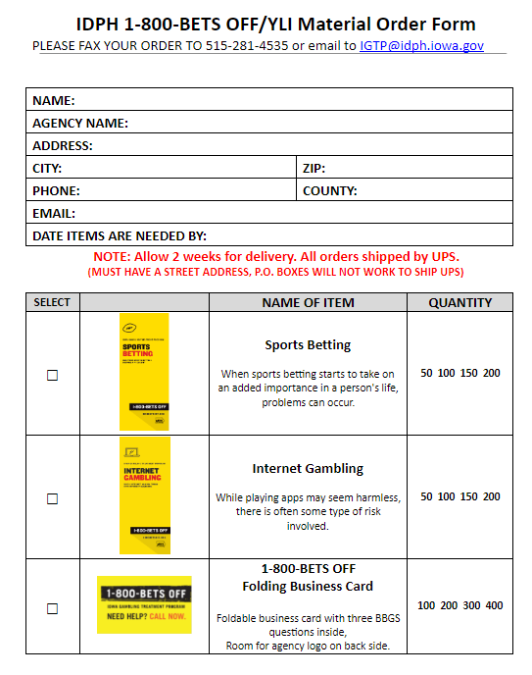
Gambling in the Workplace Policy Toolkit & Self-Exclusion Toolkit
Ongoing staff training (annual, bi-annual, staff orientation, etc.
Have the conversation
Collaborate with an IPN Provider on Nationwide Awareness Events
Appropriate Gifting (Nov/Dec)
Problem Gambling Awareness Month (March)
Responsible Gaming Week (Aug/Sept)
Promote and use of the following resources
Your Life Iowa
1-800-BETS OFF
Are You A Good Loser Campaign
ISU Clearinghouse Order Form
https://www.idph.iowa.gov/igtp/prevention
Next Steps

Slide 67
Enter your name, agency and contact information here
Contact

Slide 68
Thank You

Slide 69
Citations
https://www.iowagaming.org/about-us/iowa-gaming-history.aspx
https://www.britannica.com/topic/gambling
https://calpg.org/common-types-of-gambling/
https://calpg.org/identifying-types-of-gamblers/
https://www.mayoclinic.org/diseases-conditions/compulsive-gambling/symptoms-causes/syc-20355178
American Psychiatric Association
https://www.ncpgambling.org/wp-content/uploads/2014/08/DSM-5-Diagnostic-Criteria-Gambling-Disorder.pdf

