Slide 1
Instructions for using this template slide deck
This template is meant to be customized! Add, delete, and edit the content to fit your practice’s unique needs. Suggested speaker notes can be found in each slide’s notes section. Specific areas to be filled in are included in italics in the notes section.
Acknowledgements:
This template and associated materials were created by the Center for Food Security and Public Health, Iowa Department of Agriculture and Land Stewardship, and Iowa Department of Health and Human Services in partnership with expertise provided by Iowa State University College of Veterinary Medicine and Minnesota’s One Health Antibiotic Stewardship Collaborative.
Special thanks to the following organizations for their educational resources and commitment to AMS:
American Veterinary Medical Association
Iowa Healthcare Collaborative
Iowa Hospital Association
Iowa Pharmacy Association
University of Melbourne
Please remove this page when you are done customizing the template.

Slide 2
Antimicrobial Stewardship (AMS) Programs for Companion Animal Veterinary Practices in Iowa
Notes:
Today we’re going to discuss how to create and implement an antimicrobial stewardship program. We will talk about what AMS is, why it’s important, and what we can do together to prevent the spread of drug-resistant infections.
Consider changing the title to something more personal or light-hearted for your practice to welcome the team and make them comfortable.

Slide 3
What is AMS?
Image courtesy of Shutterstock
Notes:
Would anyone like to tell us what AMS means to them?
Wait and ask for volunteers to explain or guess what AMS means to them. Then explain the definition from CDC on the next slide.
Image courtesy of Shutterstock (https://www.shutterstock.com/image-photo/medicine-bottle-orange-pills-spilled-out-405639223).

Slide 4
What is AMS?
Antimicrobial stewardship is the effort to measure and improve how antimicrobials are prescribed by clinicians and used by patients.
Image courtesy of Shutterstock
Notes:
According to CDC, antimicrobial stewardship is the effort to measure and improve how antimicrobials are prescribed by clinicians and used by patients.
We can use this practice in all areas of health care – for both humans and animals. Here we have bolded four words to emphasize the importance of measuring, improving, prescribing, and using antimicrobials.
(https://www.cdc.gov/antibiotic-use/core-elements/index.html)

Slide 5
Why should we care about AMS?
Image courtesy of CFSPH
Notes:
Would anyone like to offer some possible reasons why we should care about AMS here in our practice?
Wait for volunteers to offer reasons why they care about AMS or why pet owners care about AMS. If no one offers a reason, use the graphic to explain some possible responses or provide your own personal reason for caring about AMS.

Slide 6
Antimicrobial resistance (AMR) is a problem
Video (7 min) courtesy of Iowa PBS
Notes:
Connect with your team by telling a story about why antimicrobial resistance (AMR) is a problem and why it is important to you. Is there a person or animal in your life who has been impacted? Is there a patient or family at your practice who has been diagnosed with a resistant infection?
If so, replace this video or add an additional slide with an image to help tell your story (respecting privacy whenever needed).
If not, show this 7-minute video and then ask each team member to share something that resonated with them or how it made them feel.
Or, consider using the story of the 2019-2021 outbreak of multidrug-resistant Campylobacter infections linked to contact with pet store puppies (https://www.cdc.gov/campylobacter/outbreaks/puppies-12-19/index.html) or sharing some of the stories available from the Minnesota Department of Health (https://www.health.state.mn.us/communities/onehealthabx/stories/index.html).
Video courtesy of Iowa PBS (https://www.iowapbs.org/shows/mtom/market-feature/clip/9356/minnesota-group-helps-draw-attention-pets-antibiotic-resistance), originally aired March 24, 2023.

Slide 7
AMR infections are emerging and spreading
“Each year in the United States, at least 2,000,000 people become infected with bacteria that are resistant to antibiotics and at least 23,000 people die each year as a direct result of these infections.”
Image courtesy of CFSPH
Notes:
Thanks everyone for the great responses!
Here are some reasons why we should care about AMS. For one reason, AMR infections are emerging and spreading.
According to CDC, “each year in the United States, at least two million people become infected with bacteria that are resistant to antibiotics and at least 23,000 people die each year as a direct result of these infections.”
To relate that to Iowa, two million people is roughly 62% of our state population and 23,000 people is roughly equal to the population of Muscatine in 2023.
Those are some sobering statistics.
(Statistics from https://www.census.gov/quickfacts/fact/table/IA/PST045222 and https://datausa.io/profile/geo/muscatine-ia)

Slide 8
AMR concerns from experts
Development of new antimicrobial medications to fight AMR is slow
AMR infections can affect the health of companion animals
Companion animals may increase the risk of AMR spread
In 2020, 45% of U.S. households own dogs and 26% own cats (AVMA)
Pets live closely with their human family members – they share our food, sleep in our beds, drink out of our toilets, and lick our wounds
Veterinary practices can spread AMR infections in their facilities
Notes:
Here are some other important reasons cited by experts studying AMS:
Development of new antimicrobial medications to fight AMR is slow
AMR infections can affect the health of companion animals
Companion animals may increase the risk of AMR spread
In 2020, 45% of U.S. households own dogs while 26% own cats (https://www.avma.org/news/new-report-takes-deep-dive-pet-ownership)
Pets live closely with their human family members – they share our food, sleep in our beds, drink out of our toilets, and lick our wounds
Veterinary practices can spread AMR infections in their facilities

Slide 9
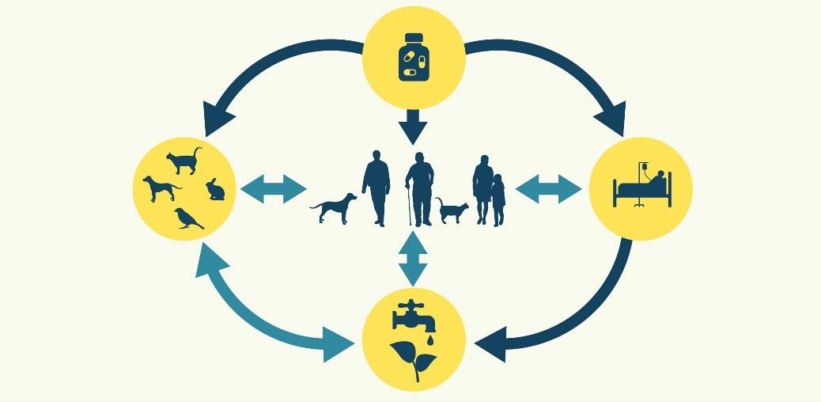
How does AMR spread?
Image courtesy of CFSPH
Notes:
Before we talk about how to prevent drug-resistant infections in ourselves and our patients, let’s first make sure we all understand how AMR spreads.
Bacteria and other disease agents protect themselves from antimicrobials by changing and evolving. This is a natural process that has been sped up due to a mixture of causes such as global travel and various advances in health care. The more we use antibiotics, the more likely bacteria will become resistant to them.
When antibiotics are given to animals, resistant bacteria can develop and spread to humans and other animals through poorly prepared food (as in the case of meat-producing animals), close proximity (as in the case of pets), and poor hygiene (as in the case of all animal encounters). When antibiotics are given to people, resistant bacteria can develop and spread to animals and other people through close proximity and poor hygiene, either in hospital or clinical settings or in the community. Resistant bacteria also spread to the environment from infected people and animals through contaminated water, soil, and air as well as wildlife.
This information will be useful to us as we consider ways to safeguard our current antimicrobial medications, treat a patient who gets diagnosed with a drug-resistant infection, and prevent its spread to anyone else – either here in our practice, at home with their family, or out in our community.

Slide 10
What can we do about it?
Image courtesy of CDC
Notes:
Would anyone like to share some ideas on what you think we can do as a team to fight the spread of AMR?
Wait for volunteers to offer ideas they have to prevent the spread of AMR.
Thank you for those great ideas! Recognizing that we are all connected is the first step. So thank you for joining me for this meeting here today.
Antimicrobial stewardship requires commitment by all health care sectors, including veterinary personnel working with large and small animals. To be most effective, it involves coordination and collaboration amongst stakeholders at all levels – including global, national, state, and local entities from all health care sectors, including medical and veterinary practitioners as well as pharmacists and pet owners.
We all have a role to play in preventing drug-resistant infections and using antimicrobials judiciously. Our family, patients, and community are counting on us.
Image courtesy of CDC (https://www.cdc.gov/drugresistance/resources/social-media.html)

Slide 11
Human AMS Programs, 2014-2022
Image courtesy of CDC
Notes:
According to the Association for Professionals in Infection Control and Prevention (https://apic.org/professional-practice/practice-resources/antimicrobial-stewardship/), an AMS Program promotes the appropriate use of antimicrobials (including antibiotics), improves patient outcomes, reduces microbial resistance, and decreases the spread of infections caused by multidrug-resistant organisms.
AMS has been most studied and utilized in human hospitals to date. Researchers have found that AMS Programs have significant value with clinical and economic impacts. For example, studies of patients in human hospitals with AMS programs have shown shortened hospital stays (https://pubmed.ncbi.nlm.nih.gov/30805182/) and improved patient outcomes through targeted antibiotic use (https://stacks.cdc.gov/view/cdc/35745).
This graph from CDC shows the change over time in hospital implementation of AMS programs in Iowa, with less than 20% of hospitals meeting all 7 core elements in 2014 to 95% of hospitals in 2022. We don’t need to go into detail about how those core elements are defined in human health care, but this is a great visual to show how change happens slowly and incrementally over time.
As veterinary providers, we too can develop AMS programs in our hospitals and clinics, by slowly incorporating more and more AMS practices into our daily routines.
Let’s now explore some actions we can all take together to create and implement an AMS Program here in our practice. Even one small step today will bring us closer to combatting antimicrobial resistance in our practice and our community.
Image courtesy of CDC (https://arpsp.cdc.gov/profile/geography/iowa?hai-select-changes-over-time-sir=haiMRSA&phenotype-select-ar-by-state=arPhenotype6#antibiotic-stewardship)

Slide 12
What should we do?
Commit to AMS
Advocate for prevention
Select and use antimicrobials judiciously
Build expertise
Evaluate AMS practices
Notes:
I’m here today to show you how easy it can be for us to start acting intentionally together towards a handful of small goals. I have already drafted an AMS program with some ideas of my own, but we all need to be on board for this to work. Writing our ideas down will help us all remember what we’ve decided together and stay accountable to the goals and activities we choose.
So let’s go through the main principles of an AMS program and then we’ll talk about each one specifically:
Publicly commit to the establishment and maintenance of this AMS Program
Advocate for strong preventive health care as well as infection control and biosecurity practices that prevent common diseases
Use antimicrobials sparingly and select them judiciously
Continuously evaluate and revise our antimicrobial use practices
Build AMS expertise within our practice, thereby enhancing knowledge across our community and state as well

Slide 13
How should we commit to AMS?
Activity | Previously completed | Target date for implementation | Postpone for later
Identify 1-2 AMS Champion(s) | X
Write an AMS Program |  | 12/31/2025
Document commitment to AMS by each staff person |  | 12/31/2025
Display a commitment poster for staff |  | 6/30/2026
Develop talking points on AMS topics with staff |  | 6/30/2026
Promote Antibiotic Awareness Week in November with staff/clients |  |  | X
Identify three most common conditions treated with antimicrobials in our practice to help focus AMS efforts |  |  | X
Notes:
Insert any additional activities of interest before the meeting or discuss and brainstorm new activities to add during the meeting. Modify this sample table by finding one or two activities to focus on together during the upcoming year.

Slide 14
How should we advocate for preventive health care, infection control and biosecurity?
Activity | Previously completed | Target date for implementation | Postpone for later
Use signage to remind staff about hand hygiene and PPE | X
Develop cleaning and disinfection protocols |  | 12/31/2025
Audit sterile technique in the surgical setting and surgical antimicrobial prophylaxis protocols |  |  | X
Share professional guidelines with staff on animal vaccines (e.g., AAHA and AAFP) and parasite control (e.g., CAPC) |  | 6/30/2026
Gather client educational materials on routine parasite control, nutritional counseling, and dental health care |  |  | X
Develop prevention protocols for three of the most common preventable conditions seen in our practice |  |  | X
Develop protocols for treating and containing resistant pathogens of concern (e.g., MRSA and CRE) |  |  | X
Notes:
Insert any additional activities of interest before the meeting or discuss and brainstorm new activities to add during the meeting. Modify this sample table by finding one or two activities to focus on together during the upcoming year.

Slide 15
How should we select and use antimicrobials judiciously?
Activity | Previously completed | Target date for implementation | Postpone for later
Bookmark and/or print consensus guidelines (e.g., ISCAID) for three commonly encountered conditions | X
Bookmark and/or print local, state, and federal guidelines for the disposal of antimicrobials |  | 12/31/2025
Compile a list of safe medication disposal locations nearby for staff and clients to easily utilize |  | 12/31/2025
Review culture and sensitivity practices and create a decision-tree for when it should and should not be used |  |  | X
Inventory antimicrobials according to priority of use and use signage/color-coding (traffic stoplight) as reminders |  |  | X
Require documentation of indications for antimicrobials in patient records and client communications |  |  | X
Develop a system to incorporate “antimicrobial time out” and “delayed prescribing” into treatment regimens |  |  | X
Customize prescription handouts for three most common conditions treated with antimicrobials in our practice |  |  | X
Notes:
Insert any additional activities of interest before the meeting or discuss and brainstorm new activities to add during the meeting. Modify this sample table by finding one or two activities to focus on together during the upcoming year.

Slide 16
How should we evaluate antimicrobial use practices?
Activity | Previously completed | Target date for implementation | Postpone for later
Compare our antimicrobial inventory and prescribing practices to published consensus guidelines for our three most common conditions identified |  | 6/30/2026
Compare our preventive health care, infection prevention/control, and biosecurity practices (e.g., vaccination and parasite control protocols) to published consensus guidelines and best practices, when available |  | 6/30/2026
Develop a feasible tracking system for consistently monitoring AMS activities over time (e.g., number of antimicrobial units sold/prescribed per year) |  |  | X
Track and share program metrics with staff on an annual basis |  |  | X
Notes:
Insert any additional activities of interest before the meeting or discuss and brainstorm new activities to add during the meeting. Modify this sample table by finding one or two activities to focus on together during the upcoming year.

Slide 17
How should we build expertise?
Activity | Previously completed | Target date for implementation | Postpone for later
Schedule a recurring (e.g., quarterly) AMS team meeting |  | 6/30/2026
Identify local experts available for questions/consults |  | 6/30/2026
Track attendance of AMS lectures/conferences as well as communication skills and ICP/biosecurity training |  |  | X
Notes:
Insert any additional activities of interest before the meeting or discuss and brainstorm new activities to add during the meeting. Modify this sample table by finding one or two activities to focus on together during the upcoming year.

Slide 18
Where do we go from here?
Commit to AMS
Advocate for prevention
Select and use antimicrobials judiciously
Build expertise
Evaluate AMS practices
Notes:
Summarize your goals and next steps with the activities your team has identified during the discussion.

Slide 19
How can we learn more about AMS?
Iowa Health and Human Services: Antimicrobial Resistance
MN One Health Antibiotic Stewardship Collaborative
National Institute of AMR Research and Education
Notes:
If you’d like to start learning more about AMS, please feel free to talk more with me or visit any of these helpful websites:
Iowa HHS: Antimicrobial Resistance (https://hhs.iowa.gov/center-acute-disease-epidemiology/hai-prevention/antimicrobial-resistance)
MOHASC (https://www.health.state.mn.us/communities/onehealthabx/index.html)
NIAMRRE (https://www.niamrre.org/)
Add any upcoming webinars, lectures, or other favorite resources to the list of recommendations here.

Slide 20
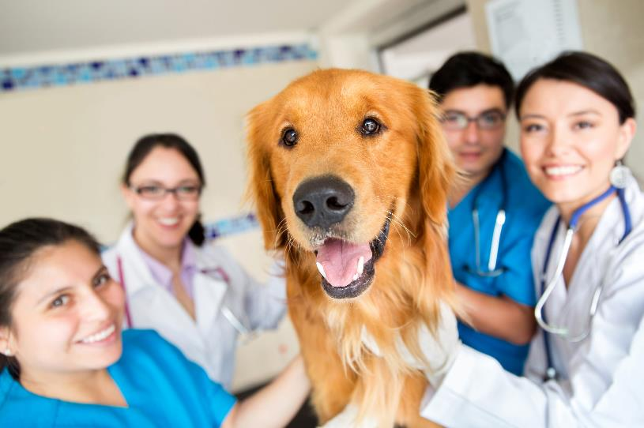
Thank you!
Image courtesy of Shutterstock
Notes:
Thank you all for today’s great discussion. I will update our AMS Program and send you all copies for your reference. We will then (insert any action items for next steps)…
Take a picture of you and your team at this first AMS meeting so you can replace this slide in future meetings and reminisce at how far you’ve all come together!
Image courtesy of Shutterstock (https://www.shutterstock.com/image-photo/cute-dog-vet-group-doctors-assistants-133776188).

