Slide 1
Candida auris (C. auris) Tabletop Exercise

Slide 2
Agenda
Welcome & Introductions
Tabletop Exercise Begins
Input 1: Ground Zero, The First Patient
Input 2: It’s Confirmed!
Input 3: Admissions and Transfers. Oh My!
Input 4: Facility Assessment
Input 5: Developing and Implementing a Screening & Communication Plan
Input 6: Screening Results & Follow Up Communication
Input 7: Long Term Action Plan
Hotwash

Slide 3
Input 1
Ground Zero, the First Patient
15 minutes

Slide 4
Input 1 – Refer to Appendix A – Mrs. Adam’s Medical History
NOTE: Hospital based players are employed by Memorial Hospital.
Refer to Appendix A – Mrs. Adam’s Medical History
The infection preventionist at Memorial Hospital has been notified that a blood culture on Mrs. Adams (A), drawn on July 6, 2023, is growing Candida haemulonii. This is of concern since a recent Iowa HHS Epi Update had an article that showed Candida auris could be misidentified as C. haemulonii. It is determined by the infection prevention team that an investigation should be started.
In general, it is known that C. auris is spread person-to-person and in healthcare settings, by contaminated hands and contact with contaminated environmental surfaces or equipment. C. auris in this hospital and catchment area is rare, but it can spread silently and rapidly in healthcare settings. The primary goal is to prevent the spread of this yeast.

Slide 5
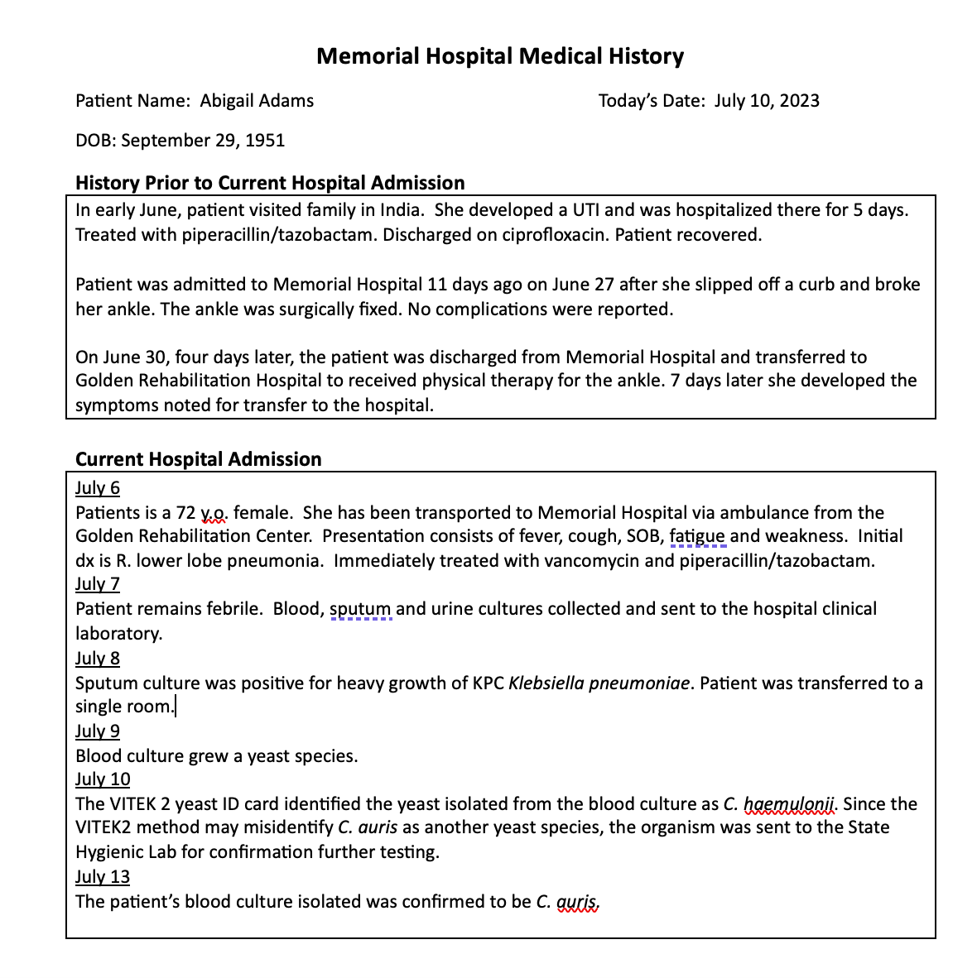
Appendix A: Mrs. Adam’s Medical History

Slide 6
Input 2
It’s Confirmed!
20 minutes

Slide 7
Input 2 – Refer to: Appendix B: Contact Summary & Appendix C: C. auris Patient Transfer Flow Diagram
Mrs. Adams’s sputum culture had heavy growth of KPC-Klebsiella pneumoniae. She is transferred to a single room that day.
3 days later, the infection preventionist is notified by the Iowa HHS Hospital Acquired Infection (HAI) Program that the yeast has been confirmed to be C. auris.
Given the confirmation of C. auris, Infection Control and Prevention staff are concerned that Memorial Hospital receives and discharges in- and outpatients to and from numerous facilities in their catchment area. Upon review of their policies and procedures, it they aren’t clear how internal and external information should be handled. They know that information must be provided in a timely manner, delivered accurately, presented at a level that is understandable to the audience and reach all appropriate people. But they are not sure who should be given information and what information they should receive. They also wonder whether or not hospital legal counsel should be included.

Slide 8
Appendix B: Contact Summary
 | Memorial Hospital | Golden Rehabilitation Hospital | Memorial Hospital
Mrs.Adams | Placed in double room | Placed in double room | Placed in double room
Mrs. Baldwin | Roommate to Mrs. Adams for 3 days. Discharged to Achieve LTCF Shared room with Miss Fisher
Ms. Conner |  | Roommate to Mrs. Adams for 7 days
Ms. Evans |  |  | Roommate to Mrs. Adams Transferred to Callaway LTCF Placed I double room
Mrs. Dawson | Admitted to Mrs. Adam’s former double room. Transferred to Bridges LTCF
Miss Fisher | Shared room with Mrs. Baldwin at Achieve LTCF
Mrs. Graham |  |  | Roommate to Ms. Evans

Slide 9
Appendix C: C. auris Patient Transfer Flow Diagram

Slide 10
Input 3
Admissions and Transfers! Oh My!
10 minutes

Slide 11
Input 3 – Refer to: Appendix B: Contact Summary & Appendix D: C. auris Flowchart BandW
Considering Mrs. Adams’s medical history and her transfers between the Golden Rehabilitation Center and Memorial Hospital, part of the internal investigation should determine the extent of possible contact with other patients, staff and visitors. Infection Prevention and Control staff begin contact tracing, which is made a bit more difficult given the numerous facilities with which Memorial Hospital shares patients.

Slide 12
Appendix B: Contact Summary
 | Memorial Hospital | Golden Rehabilitation Hospital | Memorial Hospital
Mrs.Adams | Placed in double room | Placed in double room | Placed in double room
Mrs. Baldwin | Roommate to Mrs. Adams for 3 days. Discharged to Achieve LTCF Shared room with Miss Fisher
Ms. Conner |  | Roommate to Mrs. Adams for 7 days
Ms. Evans |  |  | Roommate to Mrs. Adams Transferred to Callaway LTCF Placed I double room
Mrs. Dawson | Admitted to Mrs. Adam’s former double room. Transferred to Bridges LTCF
Miss Fisher | Shared room with Mrs. Baldwin at Achieve LTCF
Mrs. Graham |  |  | Roommate to Ms. Evans

Slide 13
Appendix D. C. auris Flowchart

Slide 14
CDC’s Guidance Document - Goals of initial containment response include:
Identify affected patients.
Ensure appropriate control measures are promptly implemented to limit further spread.
Determine if transmission within a healthcare facility and dissemination to other facilities are occurring (Tiers 1-2).
Characterize novel organisms or mechanisms to guide further response actions, patient management, and future responses.
Coordinate response with ongoing prevention activities (e.g., MDRO education, infection prevention and control improvement initiatives, routine colonization screening, and improved interfacility communication) in the region.
https://www.cdc.gov/hai/mdro-guides/containment-strategy.html

Slide 15
Input 4
Facility Assessment
25 minutes

Slide 16
Input 4 – Refer to Appendix E: Referral Transfer Network C. auris & Appendix F: ICAR
Staff from the Iowa HHS HAI Program arrange to visit Memorial Hospital to assess infection prevention practices by conducting an in-person Infection Control and Response (ICAR) assessment to assess the risk for transmission and to recommend specific steps for containment.

Slide 17
Appendix E: Patient Transfer Network C. auris

Slide 18
It is noted that:
1) Hand hygiene compliance varies by unit
2) Some staff exit a patient’s room wearing gloves, get supplies from the supply closet, and then re-enter the patient’s room
3) Gowns are not easily accessible
4) Some alcohol hand rub dispensers are empty or non-functional
5) Gait belts are used on > 1 patient and washed at the end of the day in a clothes washer and then dried in a drier.
6) Housekeeping uses quaternary ammonium-based product for cleaning and disinfecting surfaces

Slide 19
Input 4 continued..
Staff from the Iowa HHS HAI Program also visit Golden Gate Rehabilitation Hospital to assess infection prevention practices, assess the risk for transmission, and recommend specific steps for containment.
They note issues with hand hygiene and personal protective equipment use that are similar to those seen at Memorial Hospital. In addition, they identified issues with cleaning and disinfecting equipment in the PT gym:
Mrs. Adams and 4 other patients did PT in the gym.
PT equipment, including parallel bars, were wiped with wipes containing a quaternary ammonium disinfectant.
Staff did not allow adequate drying time.
At times, staff missed some pieces of equipment when disinfecting surfaces between patients.

Slide 20
Appendix F: ICAR – Page 1

Slide 21
Appendix F: ICAR – Page 2

Slide 22
ICAR – Full Document
https://www.public-health.uiowa.edu/wp-content/uploads/2023/10/Memorial-Hospital-C-Auris-ICAR.pdf

Slide 23
Appendix H: Incident Command System

Slide 24
Appendix I: STRATEGIC NATIONAL STOCKPILE PROCESS

Slide 25
Input 5
Developing and Implementing a Screening Plan & Communication Plan
30 minutes

Slide 26
Input 5 –
Refer to:
Appendix C: C. auris Patient Transfer Flow Diagram
Appendix D: C. auris Flowchart
Appendix E: C. auris Referral Transfer Network
Staff from the Iowa HHS HAI Program think there is a high likelihood that significant transmission has occurred. It is recommended that patients of Memorial Hospital and residents of the Golden Rehabilitation Center be screened for C. auris colonization.

Slide 27
Appendix C: C. auris Patient Transfer Flow Diagram

Slide 28
Appendix D: C. auris Flowchart

Slide 29
Appendix E: C. auris Referral Transfer Network

Slide 30
Input 5 continued..
Persons at highest risk of being colonized or infected with C. auris are:
Persons who have been hospitalized outside of the U.S. (at least an overnight stay in last 12 months), especially in countries with known C. auris cases. (Map: www.cdc.gov/fungal/candida-auris )
Persons cared for in post-acute care facilities, especially those with ventilator units
Persons colonized or infected with carbapenemase-producing bacteria (e.g., “CRE”)
Persons who have been hospitalized or been in a post-acute care facility (especially those with ventilator units) in hot spots in the US https://www.cdc.gov/fungal/candida-auris/tracking-c-auris.htm l AND https://www.cdc.gov/hai/mdro-guides/containment-strategy.html )

Slide 31
Input 5 continued..
CDC guidance indicates that facilities should consider screening patients who are at high risk for C. auris, including:
Close healthcare contacts of patients with newly identified C. auris infection or colonization
Patients who have had an overnight stay in a healthcare facility outside the U.S. in the past year, especially if in a country with documented C. auris cases
Strongly consider screening when patients have had such inpatient healthcare exposures outside the United States and have infection or colonization with carbapenemase-producing Gram-negative bacteria. C. auris co-colonization with these organisms has been observed regularly.

Slide 32
Input 6
Screening Results & Follow Up Communication
20 minutes

Slide 33
Input 6 – Refer to Appendix G: C. auris Flowchart
The screening results from Memorial Hospital indicate C. auris has spread within the facility. The joint information center decided that a communication plan should be implemented so that essential information can be disseminated within the hospital and to all other affected entities.

Slide 34
Appendix G: C. auris Flowchart

Slide 35
The following recommendations from Iowa HHS are communicated to:
Memorial Hospital
Continue contact precautions
Inform downstream facilities
Consider active screening on all admissions
Continue screening until you have two consecutive negative rounds
Golden Rehabilitation Hospital
Continue contact precautions
Screen new admissions that meet risk criteria
Continue screening until you have two consecutive negative rounds

Slide 36
The following recommendations from Iowa HHS are communicated to:
Cy Hawk Retirement Castle, Bridges LTCF & Callaway LTCF
Utilize enhanced barrier precautions for all residents who meet the criteria.
Continue contact precautions for residents who are infected, and the infection cannot be contained.
Screen new admissions that meet risk criteria.
Local Public Health Departments in the Region
Alert downstream facilities (IPs) about C. auris.
Screen patients transferred from Memorial Hospital, and any patient in Memorial Hospital or Golden Rehabilitation Hospital at the time of transmission.

Slide 37
Input 7
Long Term Action Plan
10 minutes

Slide 38
Input 7
Facilities that share patients with Memorial Hospital are notified with the suggestion that new admissions that meet risk criteria from this point forward have screening testing completed.
Iowa HHS HAI team revisits Memorial Hospital to evaluate whether infection prevention and control practices are improving.
The team decided to do additional point prevalence screenings 2 weeks apart to determine if there is further transmission.
This will be continued until two consecutive point prevalence screenings do not identify additional cases of C. auris colonization.

Slide 39
Hotwash
25 minutes

Slide 40
Thank you

