Slide 1
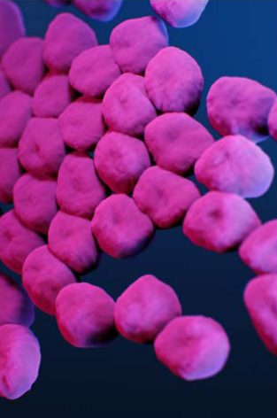
Carbapenem-resistant Acinetobacter baumannii (CRAB)
Tabletop Exercise

Slide 2
Agenda
Welcome & Introductions
Tabletop Exercise Begins
  Input 1: Ground Zero, The First Patient
  Input 2: Case History, Admissions and Transfers, Oh My!
  Input 3: Communications & Actions
  Input 4: Facility Assessment
  Input 5: Developing and Implementing a Screening Plan & Communications
  Input 6: Additional Screening Results & Follow Up Communication
  Input 7: Long Term Action Plan
Hotwash

Slide 3
Input 1
Ground Zero, the First Patient
10 minutes

Slide 4

Input 1 –
Refer to Appendix A & Aa: Iowa & Illinois Medical Admission and Transfers Flowchart
NOTE: Long-term care facility-based players are employed by the Cy-Hawk Retirement Castle.
On March 6, the Iowa HHS Healthcare Associated Infections (HAI) nurse clinician for the region contacted Cy-Hawk Retirement Castle to report that they were notified that a culture of a current resident, Mr. Adam’s decubitus ulcer wound grew carbapenem-resistant Acinetobacter baumannii (CRAB). The specimen was collected on February 25th when Mr. Adams’ was residing at the Cy-Hawk Retirement Castle. He is currently a patient at the Silver Gardens Hospital. This is the first time this organism has been isolated from a resident in the Castle.
The Iowa HHS HAI Program has started an investigation.
In general, CRAB is spread in healthcare settings primarily person-to-person. However, CRAB can also be spread via contaminated surfaces and equipment and during procedures that create aerosols or droplets. CRAB survives better in the environment than do many other bacteria.

Slide 5
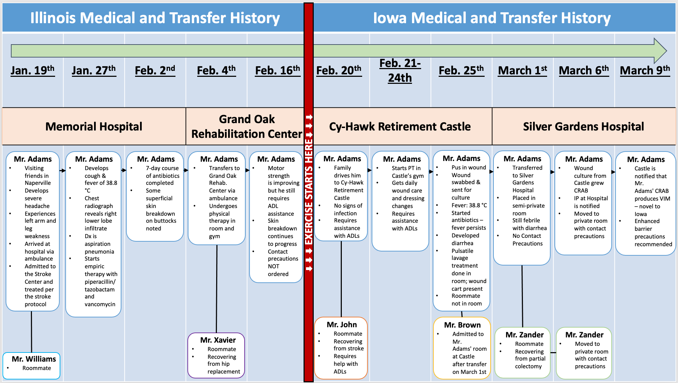
Appendix A: Illinois & Iowa Medical Transfer History Table

Slide 6
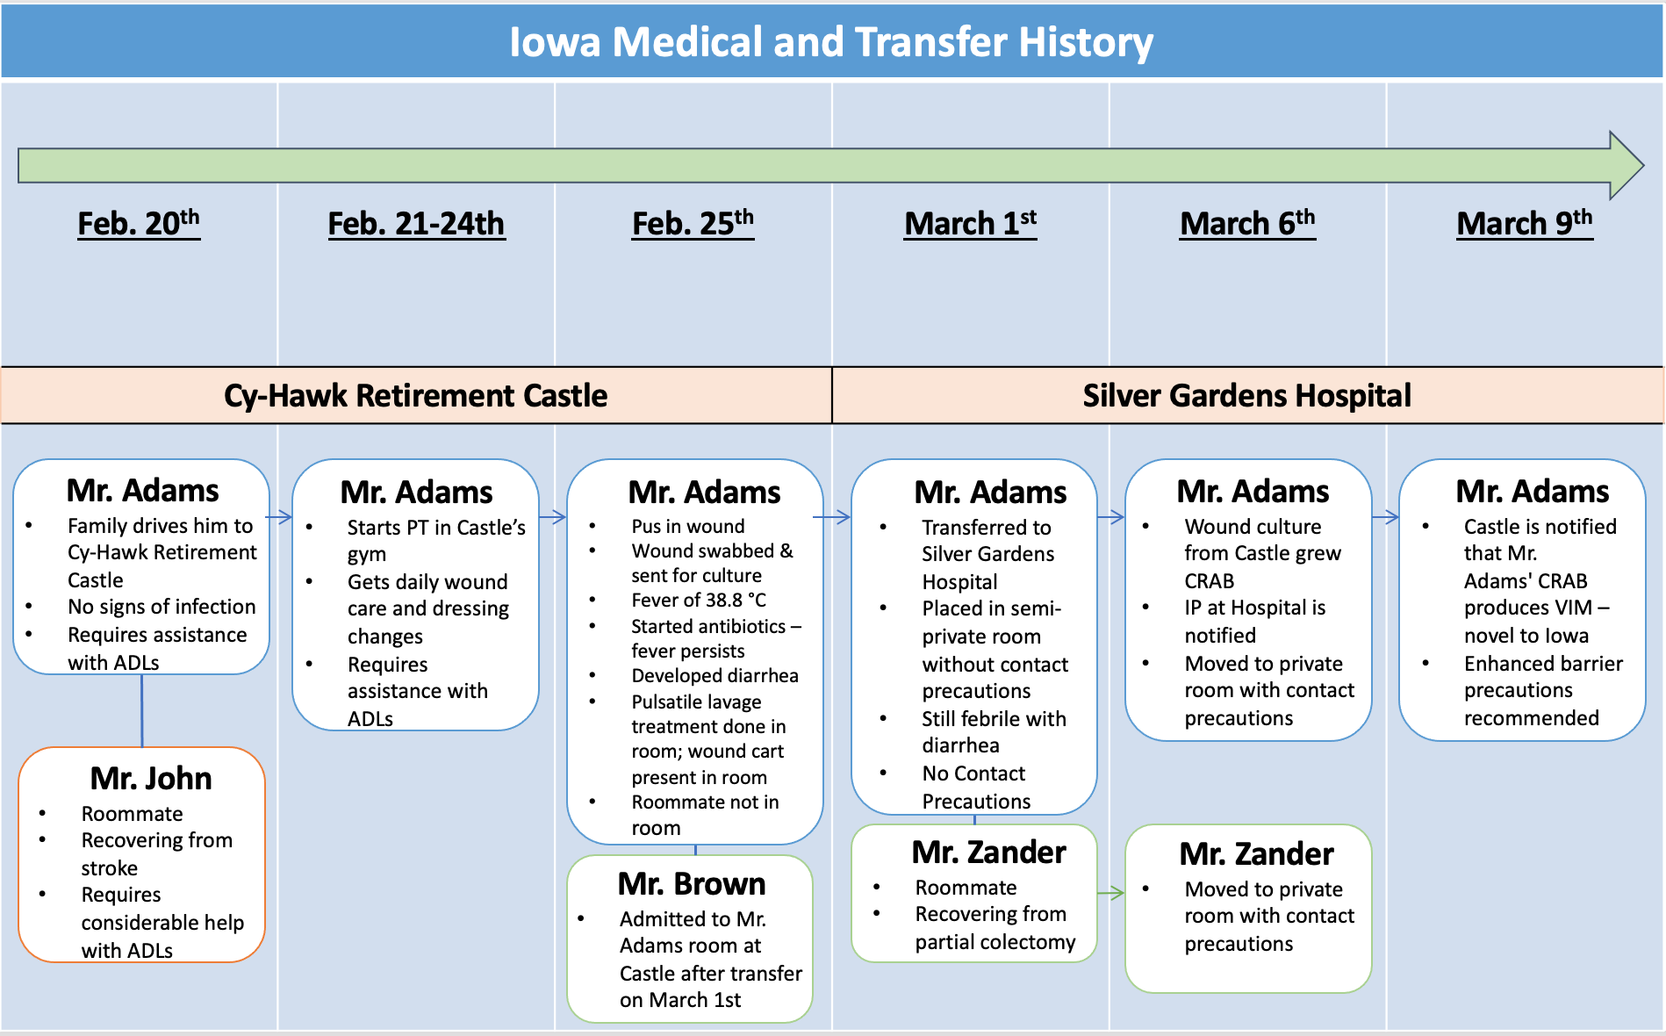
Appendix A: Iowa Admission and Transfer History

Slide 7
Input 2
Case History, Admissions and Transfers, Oh My!
20 minutes

Slide 8
Input 2 –
Refer to: Appendix A & Aa: Iowa & Illinois Medical Transfer History Table & Appendix B: Mr. Adams’s Medical History Prior to Arriving in Iowa
The CRAB isolate was forwarded to the State Hygienic Laboratory (SHL) in Coralville, IA, so that they could identify the mechanism behind the carbapenem resistance, which has implications for transmissibility. This testing is part of the statewide surveillance program for CRAB mechanisms.
On March 9, the Iowa HHS HAI Program notifies the Castle that the isolate produces Verona integron-encoded metallo-B-lactamase (VIM). VIM is a plasmid-mediated carbapenemase that makes bacteria highly resistant to antibiotics. This mechanism had not been identified in Iowa, although it has been identified in facilities in the Chicago area. As such, it is treated as a Novel, Tier 2 organism per the CDC initial containment response.

Slide 9
Input 2 continued..
The CDC goals of initial containment response for MDROs are: https://www.cdc.gov/hai/mdro-guides/containment-strategy.html
Identify affected patients.
Ensure appropriate control measures are promptly implemented to limit further spread.
Determine if transmission within a healthcare facility and dissemination to other facilities are occurring (Tiers 1-2).
Characterize novel organisms or mechanisms to guide further response actions, patient management, and future responses.
Coordinate response with ongoing prevention activities (e.g., MDRO education, infection prevention and control improvement initiatives, routine colonization screening, and improved interfacility communication) in the region
Silver Gardens Hospital moved Mr. Adams and Roommate Zander to private rooms and initiated contact precautions.

Slide 10
Appendix A: Illinois & Iowa Medical Transfer History Table

Slide 11
Appendix A: Iowa Medical Transfer History Table

Slide 12
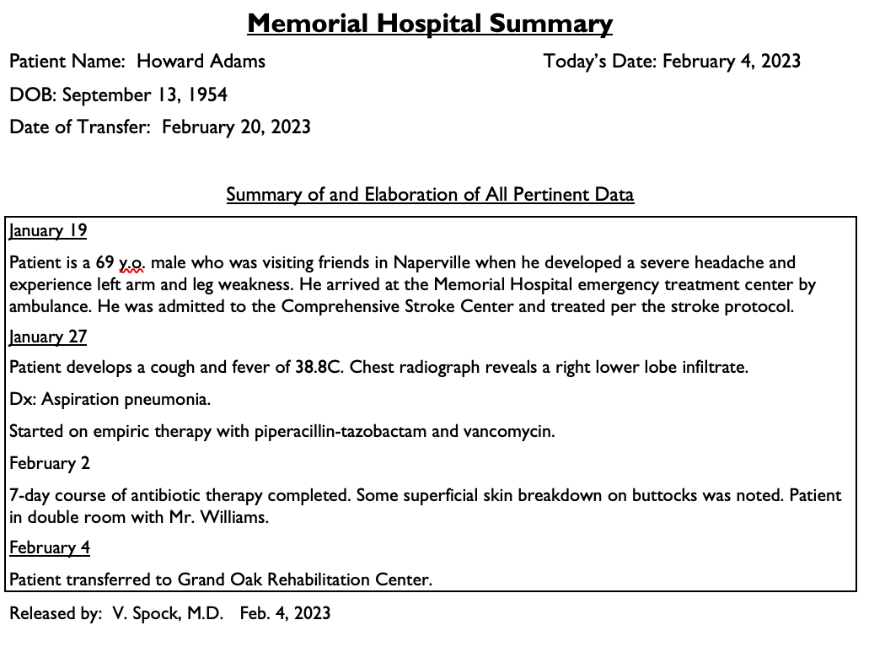
Appendix B: Mr. Adams’s Medical History Prior to Arriving in Iowa

Slide 13
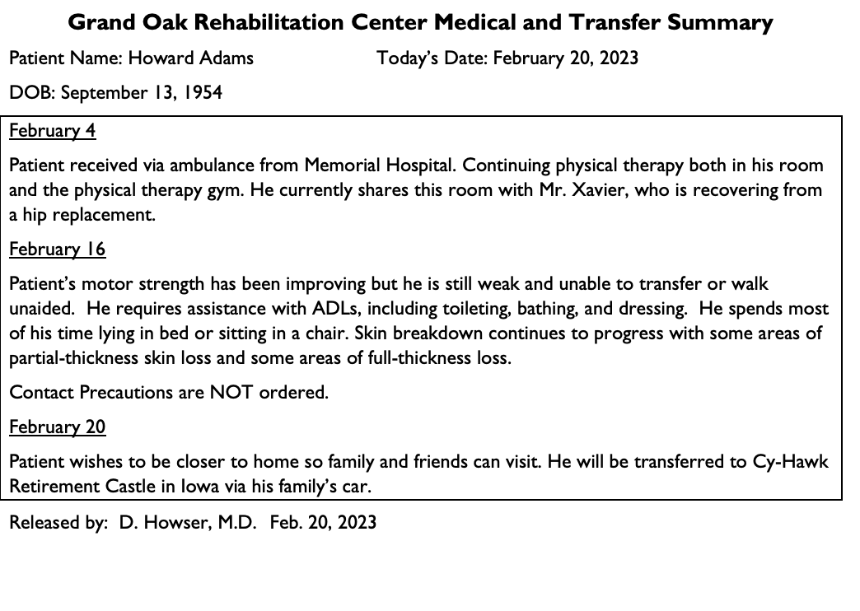
Appendix B: Mr. Adams’s Medical History Prior to Arriving in Iowa

Slide 14
Input 3
Communications and Actions
20 minutes

Slide 15
Input 3 –
Refer to: Appendix C: CRAB Flowchart & Appendix D: CRAB Referral Transfer Network
With the confirmation of CRAB, the Castle’s administration discusses who needs to be told what, when this communication should be done and whether or not their legal counsel should be consulted.
They know that Silver Garden’s Hospital’s infection preventionist is aware of the situation.
The Castle often transfers residents to Silver Gardens Hospital and Silver Gardens often discharges patients to the Castle.
The Castle’s infection preventionist realized the current policies do not specifically address how internal and external information should be handled. Information must be timely, delivered accurately, presented at a level the audience can understand and reach all people who need the information.

Slide 16
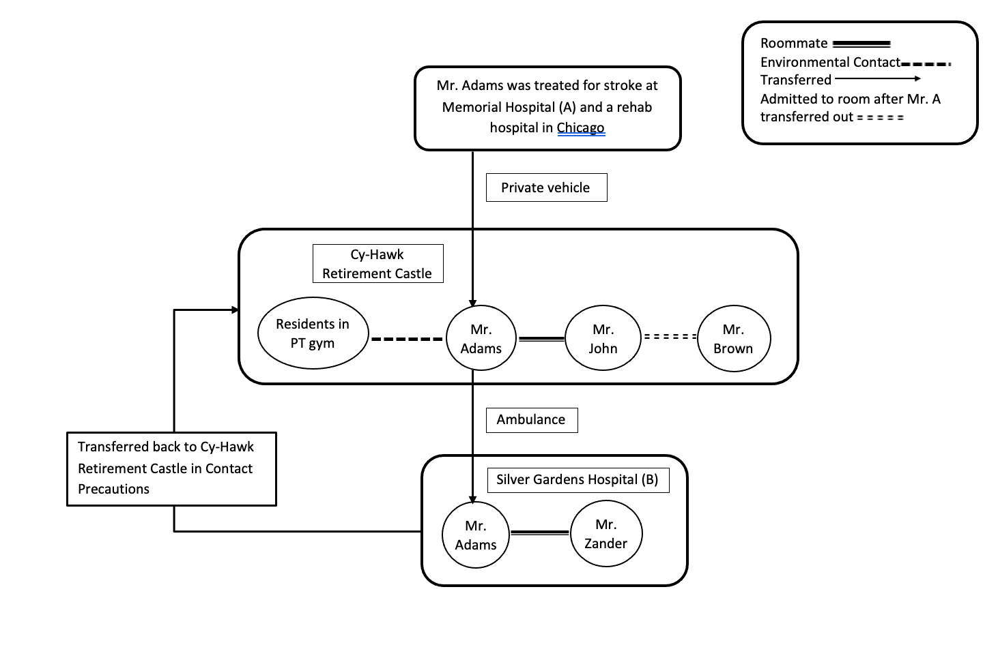
Appendix C - CRAB Flowchart

Slide 17
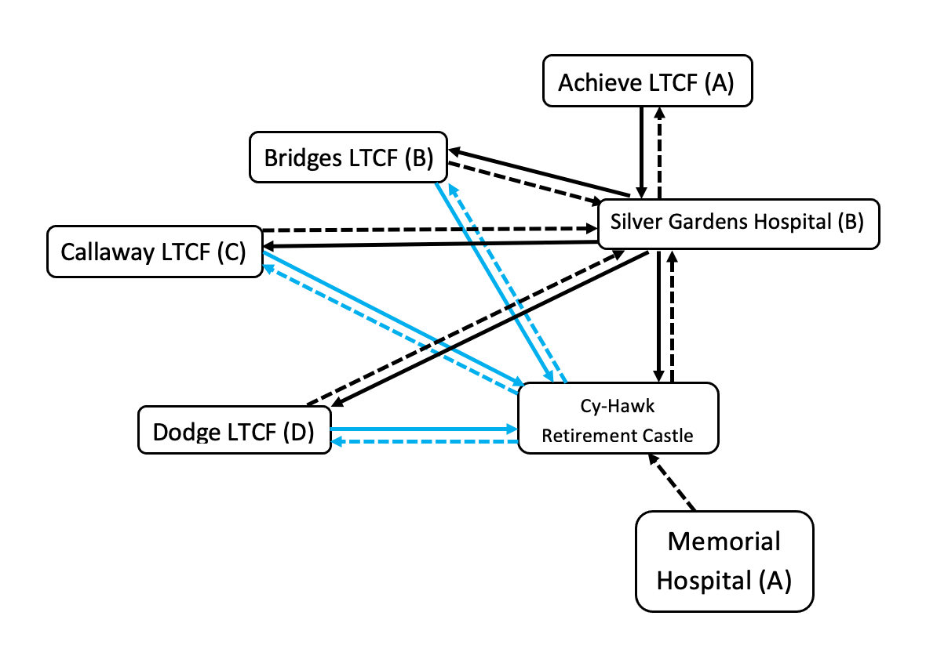
Appendix D – CRAB Referral Transfer Network

Slide 18
Communication with Staff
What information about CRAB and transmission prevention steps should be shared with staff members? (What is CRAB, why is it important, who is at risk, hand hygiene, PPE use, cleaning and disinfection, handling used linens…)
What just in time training (JIT) should staff receive? For example, what important infection prevention measures should be included in the JIT? Who should get this training?
Given the possible extent of the outbreak, will all facilities have enough PPE?
  If not, how do they get more?
  Is it likely that they will need to request activation of the SNS (Appendix G)?

Slide 19
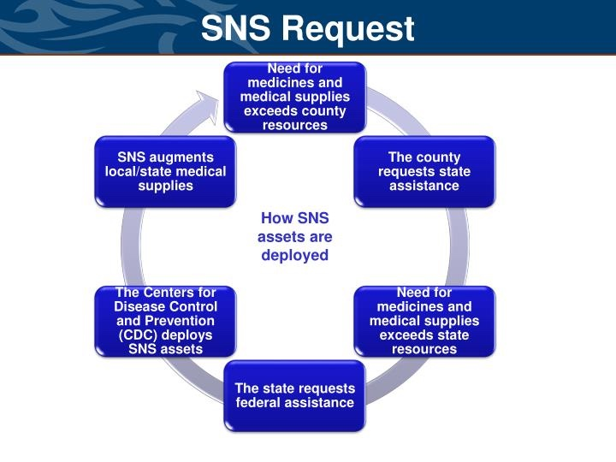
Appendix G: STRATEGIC NATIONAL STOCKPILE PROCESS

Slide 20
Communication with Residents and Family Members
What information about CRAB and the measures used to prevent CRAB transmission should be shared with residents and family members? (how it is spread, what is CRAB, why is it important, who is at risk, hand hygiene, PPE use, cleaning and disinfection, handling used linens,…)
What information should be shared about screening?
What should be shared about the precaution signs on residents’ doors in the Castle?

Slide 21
Communication with Other Facilities and Partners
Should the residents’ charts be flagged?
Which external facilities and partners should be notified? Who is responsible for this notification?
If the “shoe were on the other foot” and the Castle was receiving a resident known to have CRAB, what information should the transferring facility share?

Slide 22
Input 4
Facility Assessment
20 minutes

Slide 23
Input 4 –
Staff from the Iowa HHS HAI Program visit the Cy-Hawk Retirement Castle to assess infection prevention practices by conducting an in-person Infection Control and Response (ICAR) assessment (Appendix H) ICAR’s are completed to assess the risk for transmission and recommend specific steps for containment. The HAI Program staff remind the Castle staff that these in-person assessments are non-regulatory, thus non-punitive, but rather are focused on identifying gaps and enhancing resident care and staff safety.

Slide 24
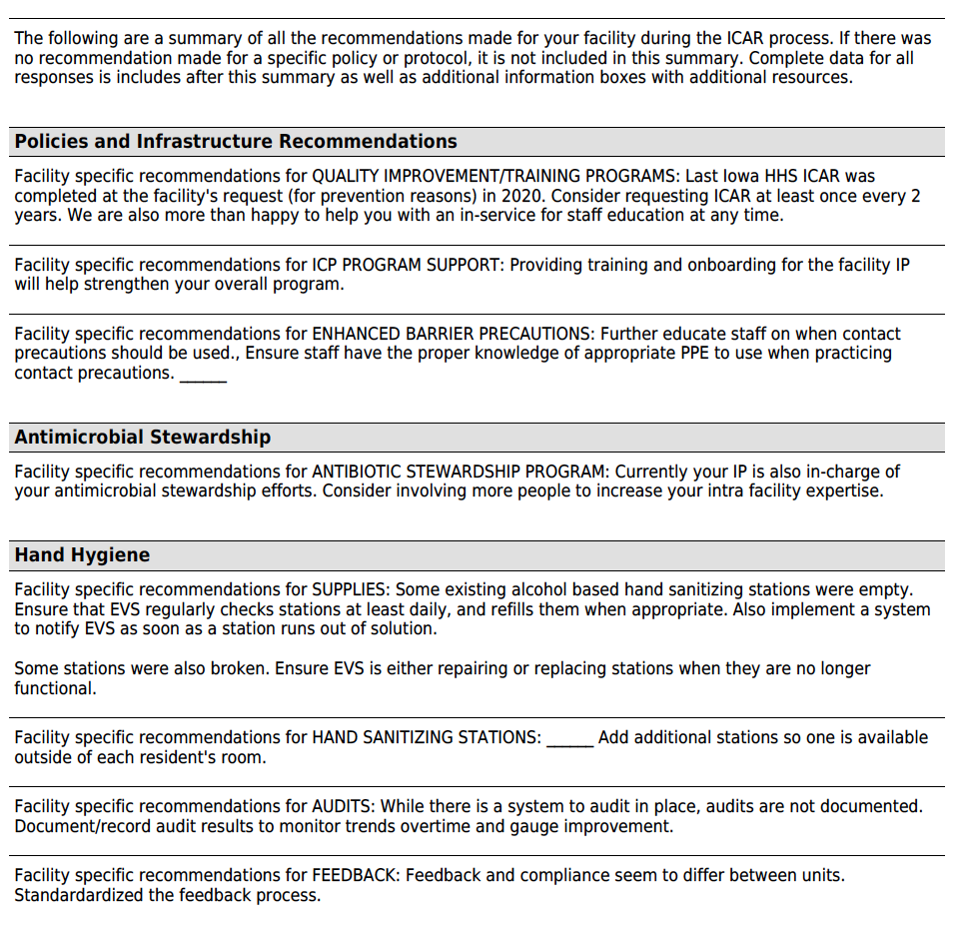
Appendix H: ICAR – Page 1

Slide 25
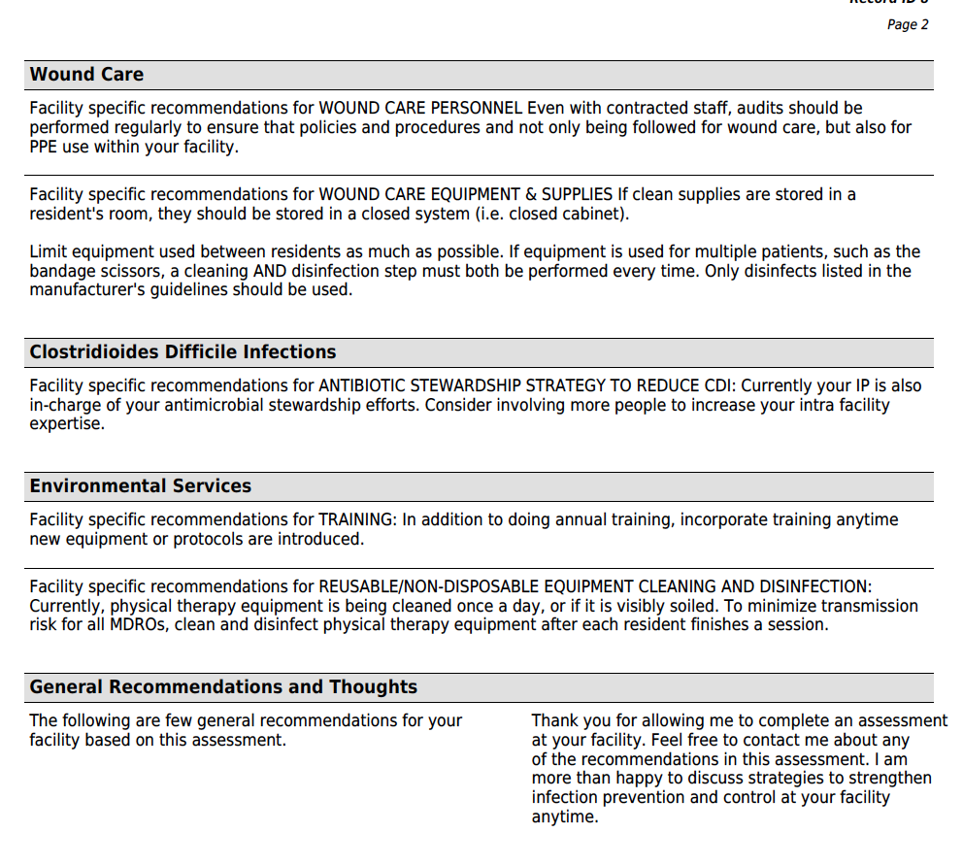
Appendix H: ICAR – Page 2

Slide 26
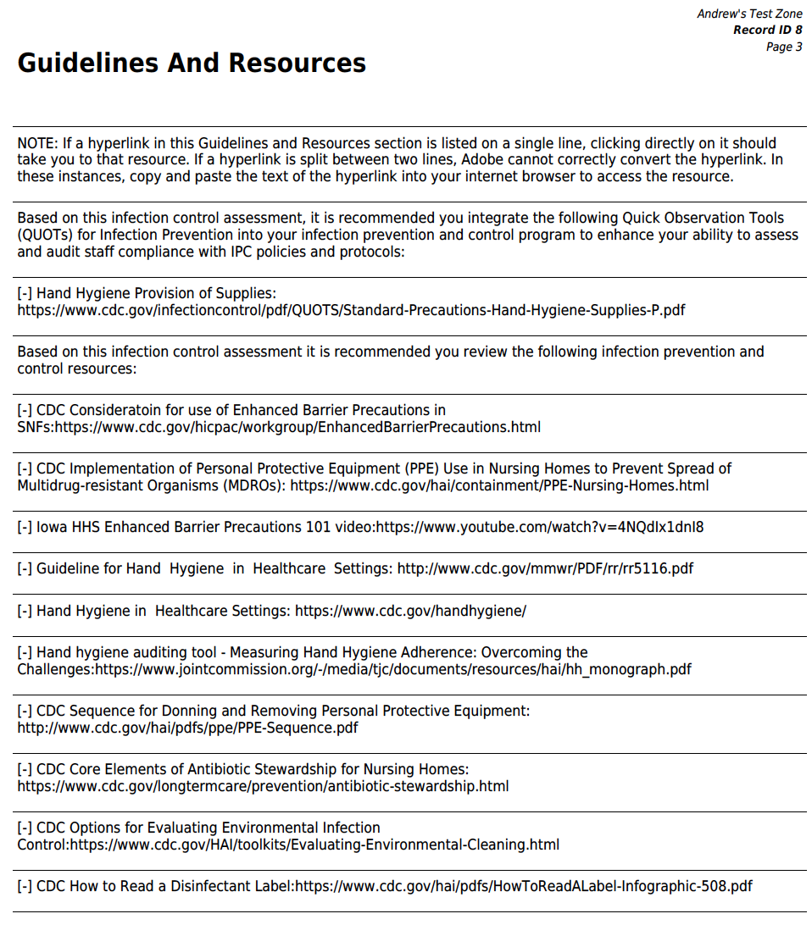
Appendix H: ICAR – Page 3

Slide 27
Appendix H: ICAR – Full Document
https://www.public-health.uiowa.edu/wp-content/uploads/2023/10/Cy-Hawk-CRAB-ICAR-Assessment93.pdf

Slide 28
The infection prevention and control gaps identified are:
Lack of training and onboarding for infection control coordinator
Hand hygiene compliance varies by unit
Some staff wore the same pair of gloves for multiple resident-care tasks and sometimes did not change them after performing dirty tasks.
Gowns are not easily accessible.
Alcohol hand rub dispensers are not available at/by each room, and some are empty or non-functional.
Gait belts and other physical therapy equipment were shared among residents without proper cleaning and disinfection.
Some environmental services staff members were not clear about policies and
procedures for cleaning and disinfecting surfaces.
Staff were observed exiting residents’ rooms while wearing gloves, getting supplies
from supply closets down the hall and then re-entering the residents’ rooms.
Single use items (i.e., gloves) were used more than once.
Reusable items (i.e., scissors) were not disinfected properly

Slide 29
They also observed wound care, including a pulsatile lavage wound treatment. Gaps identified include:
Understanding and appreciation for amount of aerosol generated during the procedure and how far the aerosol can travel.
Staff did not know how long the CRAB stays alive on surfaces.
Staff wore double gloves while caring for one resident, removed the top glove, and then used the bottom pair of gloves when caring for another resident.
Cleaning supplies were stored in an open cabinet close to the treatment table.
The cart in the room was cleaned and disinfected after each treatment BUT other surfaces in the room were not cleaned between treatments.
During the assessment, staff commented that they felt pressure to cut costs or avoid expenses and to increase efficiencies at the cost of using appropriate infection control measures.

Slide 30
Input 5
Developing and Implementing a Screening Plan and Communications
30 minutes

Slide 31
Input 5 –
Refer to Appendix C: CRAB Flowchart
Given their observations, staff from the Iowa HHS HAI Program feel that transmission could be occurring in the Cy-Hawk Retirement Castle. They recommend screening residents for CRAB colonization.

Slide 32
Appendix C: CRAB Flowchart

Slide 33
Input 6
Additional Screening Results & Follow Up Communication
20 minutes

Slide 34
Input 6 –
Refer to Appendix E: CRAB Flowchart
20 residents at Castle have been identified to be screened, including:
Residents who have received physical therapy in the gym or in their rooms (n=13)
Residents who have received pulsatile lavage wound treatments (n=5)
Mr. Brown, who was moved into the room vacated by Mr. Adams when he was transferred to Silver Gardens Hospital.
In addition, Roommate Zander at Silver Gardens Hospital and Roommate Mr. Williams at the hospital were also identified as persons to be screened.

Slide 35
Input 6 –
Refer to Appendix E: CRAB Flowchart
The screening results from the Castle show there is evidence of transmission. It has been jointly agreed by the Castle and Silver Gardens Hospital information coordinators that a communication plan is to be implemented to disseminate critical and essential information within the Castle, the hospital and to all other affected entities.
Of the 20 residents at risk of acquiring VIM-producing CRAB, 18 residents consent to be swabbed.
12 of these residents screened positive.
Of note, Mr. Brown (the resident who occupied Mr. Adams’s bed after Mr. Adams was discharged back to the hospital) colonized with the VIM-producing CRAB that has not been found in this area previously.

Slide 36
Input 6 continued..
Surveillance Culture Results
Silver Gardens Hospital:
Mr. Zander screened positive for VIM-producing CRAB
Memorial Hospital and Grand Oak Rehabilitation Hospital:
Mr. Adams’s Roommate Mr. Williams screened positive for VIM-producing CRAB. It is believed he is the source of VIM-producing CRAB for Mr. Adams.
Mr. Adams’s Roommate Mr. Xavier at Grand Oak Rehabilitation Hospital screened negative.

Slide 37
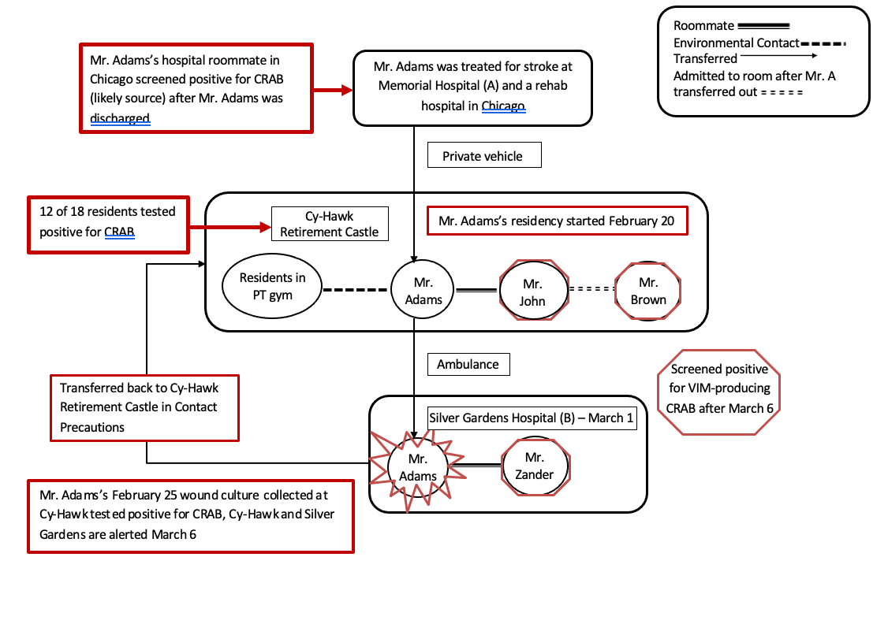
Appendix E: CRAB Flowchart

Slide 38
The following recommendations from Iowa HHS are communicated to:
Cy-Hawk Retirement Castle
Inform downstream facilities and upstream facilities.
Communicate timely and often.
Consider active screening on all admissions
Continue screening residents until there are two consecutive negative rounds.
Continue contact precautions until two consecutive screening rounds find little to no transmission at which time transition to enhanced barrier precautions for the Castle.
Clarify the role of nursing staff and environmental services staff for cleaning resident care equipment.
Reinforce education for nursing and environmental services staff on appropriate cleaning and disinfection of surfaces and equipment
Provide education for all staff (including dietary, etc.) about CRAB and appropriate infection prevention precautions (e.g. hand hygiene, PPE use, environmental cleaning, etc.)
Consider point prevalence screening on a quarterly basis.
Consider creating a communication guide about the response plan and policies.
Implement the use of enhanced barrier precautions facility wide for all nursing homes at all times.

Slide 39
The following recommendations from Iowa HHS are communicated to:
Silver Garden Hospital
Continue contact precautions.
Screen patients coming from the Castle and other high-risk facilities.
Clarify the role of nursing staff and environmental services staff for cleaning resident care equipment.
Reinforce education for nursing and environmental services staff on appropriate cleaning and disinfection of surfaces and equipment.
Educate all staff about preventing the spread of MDROs.
Memorial Hospital was notified of the incident and has implemented multiple measures to treat current infections and prevent future infections.

Slide 40
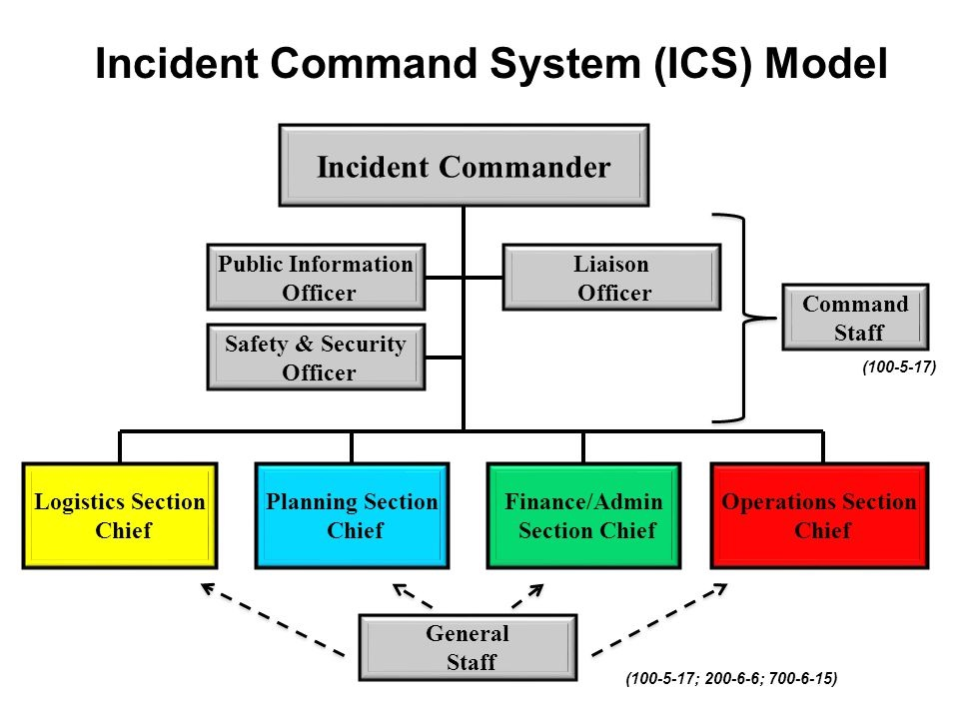
Appendix F: Incident Command System

Slide 41
Input 7
Long Term Action Plan
20 minutes

Slide 42
Input 7
Facilities that have shared residents/patients with the Castle have been notified of the outbreak.
The Iowa HHS HAI team has visited the Castle again to confirm infection prevention practices are improving.
The team recommends doing additional point prevalence surveys (2 weeks apart) to determine if there is further transmission.
Neither prevalence surveys identified additional VIM-producing CRAB.
Mr. Adams is discharged to the Cy-Hawk Retirement Castle with contact precautions until he can transition to enhanced barrier precautions.

Slide 43
Hotwash
25 minutes

Slide 44
Thank you

