Slide 1
MCHAT Training
A guide for best practices
use of the MCHAT-R/F tool
Site Coordinator Name, Credentials
1st Five Site Coordinator
Agency Name
Name of Practice / Date of Training
Notes:
Things to remember:
●whether completing virtually or in-person you may want to send the slides via email ahead of the presentation so that attendees have an idea of what
the content will include
●if delivering virtually you may want to mail or deliver hard copies of the slides with a space for notes to the practice to support tracking the information
●track attendance virtually via the chat box (name and email address) or in-person with an attendance sheet. Be sure to provide space for best method
for contact/follow-up i.e. email address or direct phone number
●share that there are built in opportunities for questions throughout the training so encourage tracking questions either in a parking lot (in-person with
sticky notes) or in the chat virtually
●make sure to introduce yourself and thank your audience for the time to share this important information with them

Slide 2
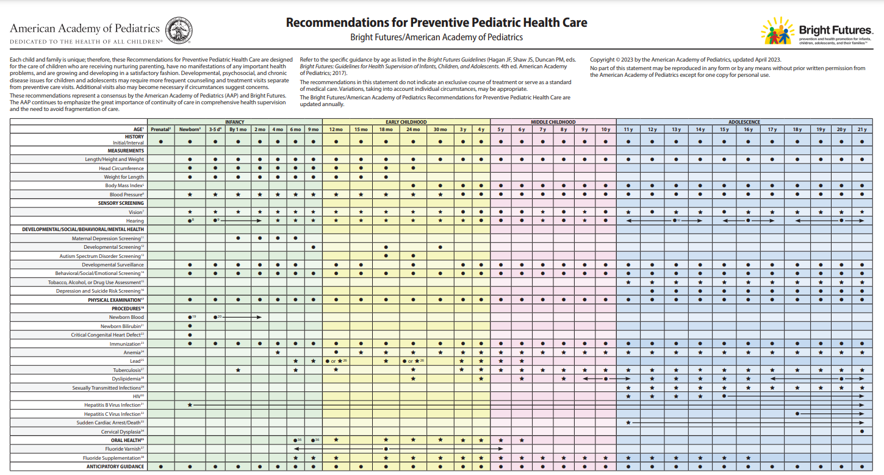
Best Practices for well-child care – endorsed by Bright Futures/AAP and EPSDT
Notes:
Minimum talking points:
explain recommendations for autism specific screening during 18 and and 24 month well-child exams
you may want to provide this as a handout within your mailed/delivered materials ahead of the training and/or provide the link for the attendees to the website: https://www.aap.org/periodicityschedule

Slide 3
Learning Objectives
Recognize why it’s important to do the M-CHAT-R/F as standard of care in your office
Describe the M-CHAT-R and how to quickly score
Identify next steps depending on scoring
Evaluate how to best address patients needing Follow-up questions
Demonstrate management through case examples
Consider challenges and review possibles ways to overcome
Notes:
Minimum talking points:
review learning objectives - these may be tailored/modified to meet the needs of your practice.

Slide 4
The WHY behind the recommendation
1:36 8-year-olds have Autism Spectrum Disorder*
Based on CDC data collected in 2020, released March 2023
A diagnosis of autism at age 2 years is typically reliable, valid and stable
Average age of diagnosis is currently at 4 years
In a 2015 study** asking if an ASD screen is needed, expert raters missed autism by observation alone
Found that children with autism showed more typical behavior (89%) than atypical behavior when observed
Atypical behaviors appeared 2% of the time in children with typical development or language-only delays
Recommendations from the study: formal screening tools and general developmental testing, along with observation, is best practice to ensure timely and accurate identification for kids at risk for autism
*New Data on Autism | CDC : https://www.cdc.gov/ncbddd/autism/new-data.html
**Gabrielsen TP, Farley M, et al “Identifying Autism in a Brief Observation”, Pediatrics 2015
Notes:
Minimum talking points:
explain the “why” behind the autism specific screening recommendation

Slide 5
Modified Checklist for Autism in Toddlers-Revised with Follow-up (M-CHAT-R/F)
A valid tool for screening for autism in children 16-30 months of age
85% sensitivity
99% specificity
2-step parent-reported screening tool designed to assess risk for Autism Spectrum Disorder
Compared with the original version (M-CHAT), the M-CHAT-R detects autism at higher rates
67 cases per 10,000 instead of 45 cases per 10,000
Decreased number of children needing follow-up testing
M-CHAT-R/F can be scored, and follow-up questions can be completed and scored by appropriately trained staff
Notes:
Minimum talking points:
review components of the MCHAT R/F screening tool

Slide 6
Step 1:
Complete and Score
the M-CHAT-R/F Screening Questions

Slide 7
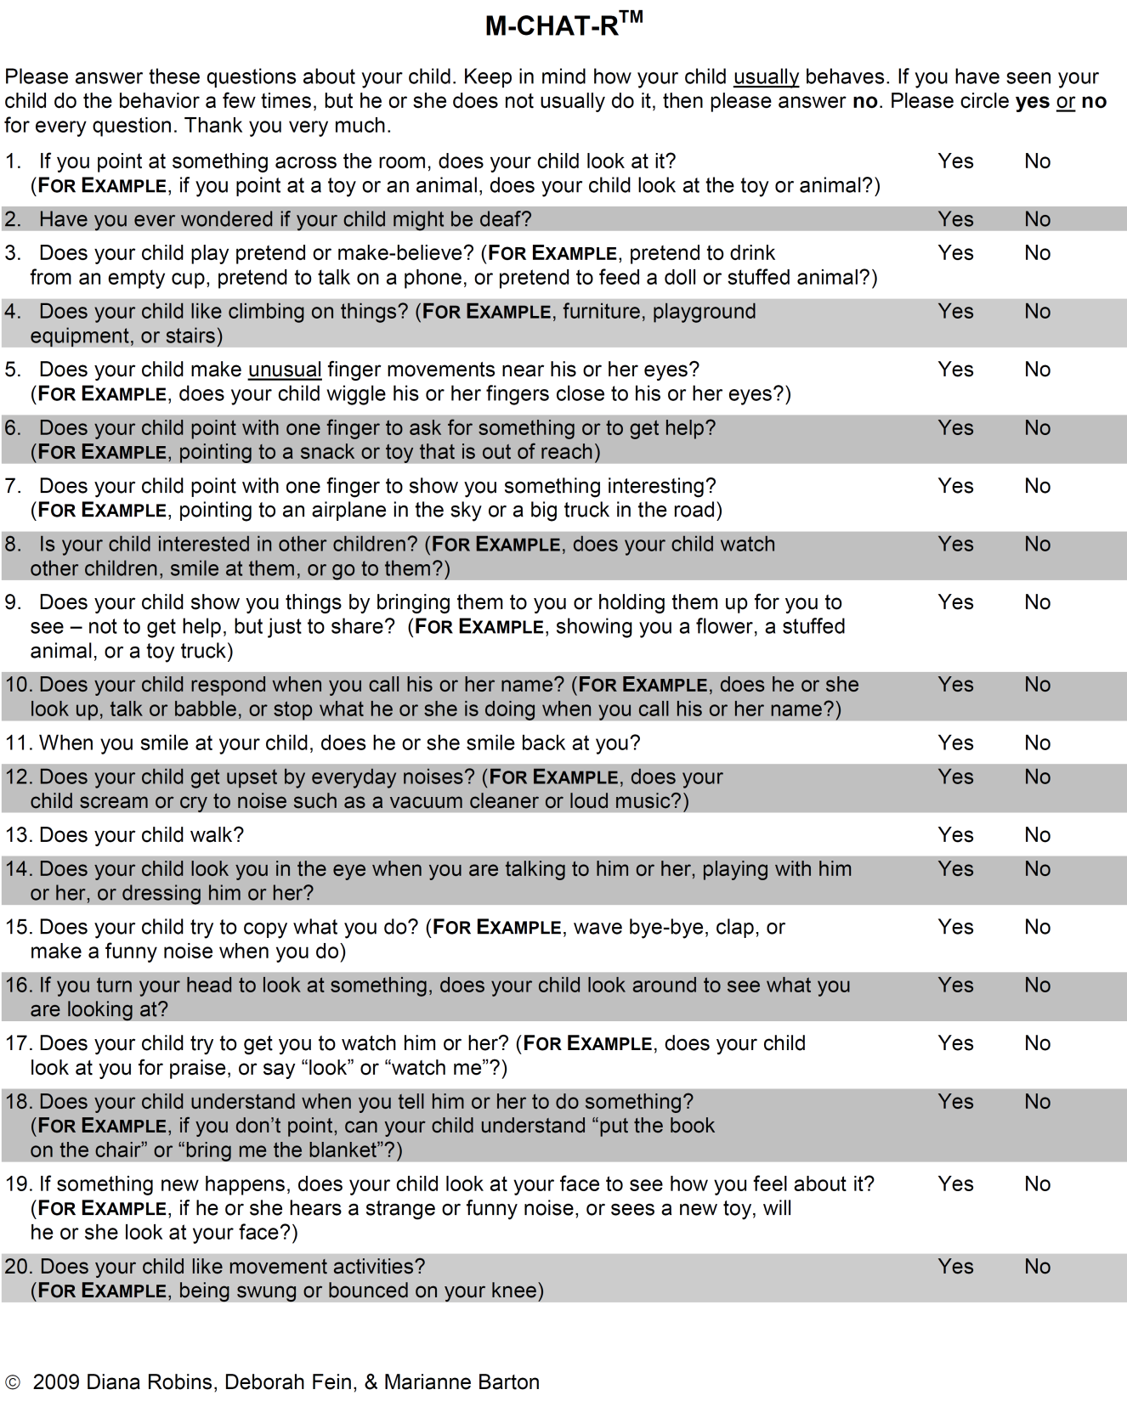
MCHAT-R Score = +1 point for every “incorrect” answer
=“no” is “correct” answer; otherwise “yes” is “correct” answer
M-CHAT™ - Autism Screening (mchatscreen.com)
Notes:
Now let's talk about the M-CHAT R/F screening tool that can be used to screen children for ASD. Again, this is recommended to be done at the 18 and 24 month well visit.
Minimum talking points:
The MCHAT is a screening tool that is used for low-risk toddlers. It is a 2-stage screener.
The MCHAT Is free to use and takes very little time to administer and can be completed by any appropriate trained staff.
This screening tool also comes in several different languages.
This screening tool is valid for children between the ages of 16 and 30 months.
There are 20 questions on the MCHAT and the parent has to respond with yes or no.
In a completely normal child, all the answers will be yes except for 2, 5, and 12—those should be no.
To score the MCHAT count up how many no’s there are for the questions excluding 2, 5, and 12. If 2, 5 or 12 are answered yes add that to the total score.
The score can range from 0-20.

Slide 8
M-CHAT-R scoring
Total Score 0-2 : Low Risk
If child is younger than 24 months, rescreen at 24 months
No further action unless surveillance indicates autism risk or hearing concern noted on screen (question 2)
Total Score 3-7: Medium Risk
Administer the Follow-up questions to get additional information
If Follow-up score is 2 or higher, the child has screened positive and needs referrals (see below)
Total Score 8-20: High Risk
Refer immediately for:
Diagnostic evaluation (medical referral)
Eligibility for Early Intervention (via 1st Five connection)
M-CHAT™ - Autism Screening (mchatscreen.com)
Notes:
Minimum talking points:
review the scoring categories for the MCHAT-R/F

Slide 9
M-CHAT-R/F Screening Statistics
With initial screening, odds of getting a specific score:
Follow-up questions are an important next step for Medium Risk group
Only 1/3 of the Medium Risk group will require further evaluation once
Follow-up Questions are completed
2/3 of the children in Medium risk group do not need further evaluation
once they get “Pass” score on their Follow-up questions
Low Risk 0-2: | 93%
Medium Risk 3-7: | 6%
High Risk 8-20: | 1%
M-CHAT™ - Autism Screening (mchatscreen.com)
Notes:
Minimum talking points:
explain the screening statistics for the MCHAT-R/F

Slide 10
M-CHAT-R/F Referral Statistics
A child has a 47.5% risk of being diagnosed with autism if they have:
a score of ≥ 3 on initial M-CHAT-R/F and
a score of ≥ 2 after M-CHAT-R follow-up questions (if needed to be done)
100% of high-risk group (score ≥ 8 on M-CHAT-R) had delays or concerns which justified immediate referral
Even though ~50% of children referred with a positive screen do not ultimately have autism, they all needed additional developmental support once evaluations were done so it's worthwhile to not delay those referrals
M-CHAT™ - Autism Screening (mchatscreen.com)
Notes:
Minimum talking points:
explain continued scoring statistics as they relate to referral

Slide 11
< Let’s Pause >
What questions do you have about the 1st step of the M-CHAT-R?
Can we clarify any details?
Notes:
Minimum talking points:
Request that questions be added to the chat for discussion after the training refresher.

Slide 12
Step 2:
Complete Follow-Up Questions if appropriate

Slide 13
M-CHAT-R Follow-up Algorithm
Medium Risk group (score of 3-7) requires use of Follow-up Questions
Select Follow-up Questions based only on questions failed in M-CHAT-R
For each failed question, identify the Follow-up question flow-chart
Follow each Follow-up Question using flowchart of questions until a “Pass” or “Fail” is reached for each question
If a parent responds with a “maybe”, ask if behavior is most often “yes” or “no”
Tally up the score by recording how many questions ended in a “Fail” answer
If 0 – 1 questions are “Fail” > screen is negative
Return to routine screening process, unless other concerns identified
If 2 or more questions are “Fail” > screen is positive
> Referrals are required
Referrals are the same as if the child failed M-CHAT-R outright:
needs referral to both medical diagnostic evaluation and1st Five for connection to Early Intervention services
M-CHAT™ - Autism Screening (mchatscreen.com)
Notes:
Minimum talking points:
explain scoring outcomes as they relate to the need for follow-up questions

Slide 14
When to do M-CHAT-R Follow-up questions
M-CHAT-R Follow-up questions can be done
Right away in the office when a child is identified in the medium risk category
As a follow-up phone call by medical assistants or nurses
As a follow-up office visit
Options depend on your practice work-flow
Follow-up questions should not wait for next routine visit but rather be done
in near future to minimize delay if referral is warranted
Provider should verify all positive screens and decide on plan of care
If choosing to do Follow-up questions as a phone call after the visit, we recommend getting 1st Five referral forms signed while family is present in the clinic so that it is ready to go if referral is needed
M-CHAT™ - Autism Screening (mchatscreen.com)
Notes:
Minimum talking points:
explain scoring outcomes as they relate to the need for follow-up questions

Slide 15
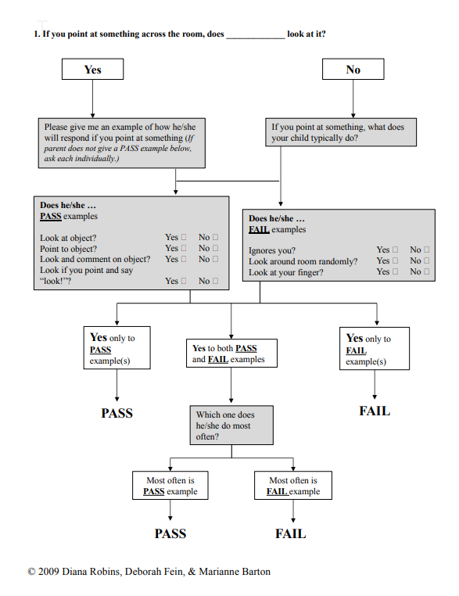
M-CHAT-R Follow-up Question example
M-CHAT™ - Autism Screening (mchatscreen.com)
Notes:
Minimum talking points:
review the process for completing follow-up questions

Slide 16
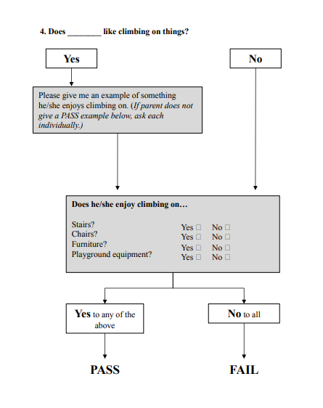
M-CHAT-R Follow-up Question example
M-CHAT™ - Autism Screening (mchatscreen.com)
Notes:
Minimum talking points:
review the process for completing follow-up questions

Slide 17
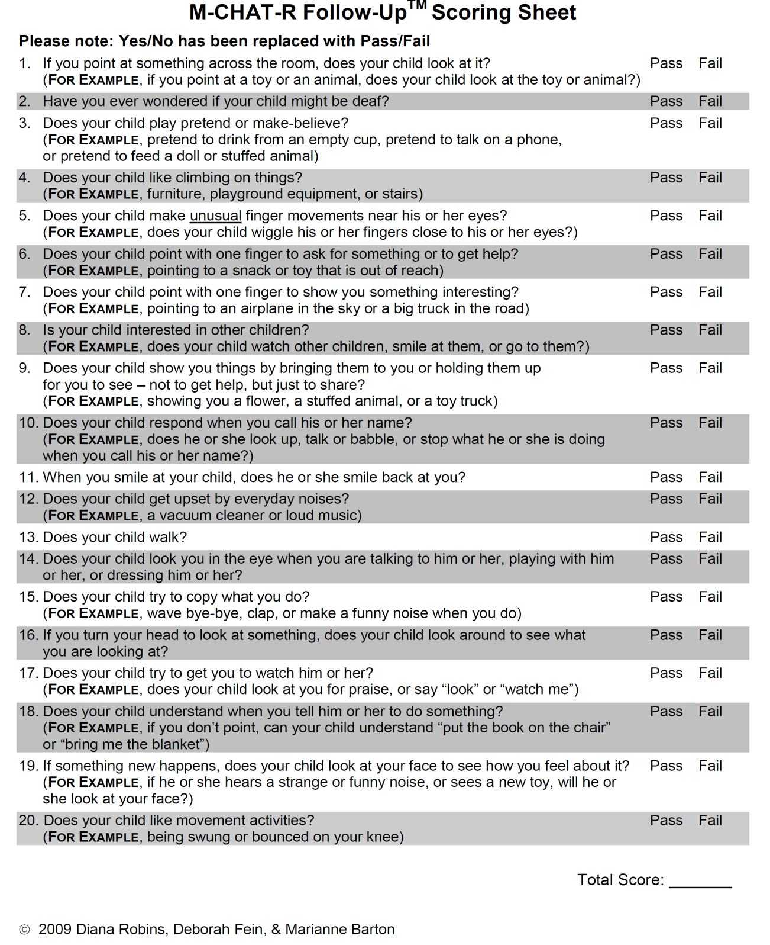
Score ≥ 2 Fails on Follow-up Questions🡪
refer to 1st Five and for diagnostic evaluation
M-CHAT™ - Autism Screening (mchatscreen.com)
Notes:
Minimum talking points:
review the follow-up scoring sheet
the same 20 questions are on the follow up.
the follow up questions just provide more specific examples for the parent to understand the question better.

Slide 18
ASD Case 1
Amy is being seen for her 18-month well child visit.
She is an only child, her medical history is unremarkable.
Parents voice no concerns about her development.
Her physical exam is normal.
M-CHAT-R: score is 1 based on question 12 being answered as “no” as she gets upset when they use the vacuum cleaner
Score 1 = Low Risk Autism
Recommended follow-up?
Re-screen for autism using
M-CHAT-R/F at 24-month exam
Notes:
Minimum talking points:
review case examples that demonstrate how to successfully implement the MCHAT R/F with different scores

Slide 19
ASD Case 2
Charles is being seen for his 18-month well child visit.
He attends day care and both school staff and parents voice developmental concerns.
He is a loner, infrequently interacting with the other children. He has only one or two toys which he plays with all the time.
Parents note he does not usually respond to his name, does not like to cuddle and stopped using words about two months ago.
His past medical history is unremarkable. His physical exam is normal. He does not like the exam but appears to ignore you.
M-CHAT-R: score is 8 based on number of incorrect answers
Score 8 = Positive Screen, High Risk for Autism
Recommended follow up? – refer for:
1. comprehensive developmental assessment
2. hearing evaluation (based on concern noted in Q2)
3. 1st Five for connections to Early ACCESS
Notes:
Minimum talking points:
review case examples that demonstrate how to successfully implement the MCHAT R/F with different scores

Slide 20
ASD Case 3
Billy is being seen for his 24-month-old well child visit.
Parents voice concerns about the child’s development since his last 18-month well child visit.
He was born one month premature and developed neonatal jaundice which required phototherapy.
Family history is notable for an older sibling who has developed normally.
Physical exam is normal. Bill responds negatively to being examined.
M-CHAT-R: score is 4 based on “incorrect” answers for questions 2, 4, 8, 20
Score 4 = Moderate Risk for Autism (3-7 incorrect answers)
Recommended follow up? Administer M-CHAT-R Follow-up Questions for those incorrect answers (#2, 4, 8, 20)
Notes:
Minimum talking points:
review case examples that demonstrate how to successfully implement the MCHAT R/F with different scores

Slide 21
ASD Case 3 Continued
M-CHAT-R Follow-up:
Question 2 – PASS Question 4 – PASS Question 8 – PASS Question 20 – FAIL
Score 1 – negative screen
Recommended Follow-up?
Schedule 30-month visit with autism surveillance + general development screening
*A missed item may need clinical evaluation even if the child screens negative on the M-CHAT-R/F
Example: hearing concerns (question #2)
Notes:
Minimum talking points:
review case examples that demonstrate how to successfully implement the MCHAT R/F with different scores

Slide 22
< Pause for Questions >
What questions do you have about the 1st step of the M-CHAT-R?
Can we clarify any details?
Notes:
Minimum talking points:
Pause for questions

Slide 23
ASD screening limitations
If made, the diagnosis of autism is quite reliable in children as young as 18 months
However, routine screening with M-CHAT-R/F does not catch every child
Children with mild symptoms and average intelligence often are missed until older ages
Often symptoms can go unnoticed until school age when differences in social skills, social language and personal rigidities affect school function
As there is no validated, recommended screening tool >30 months, ongoing surveillance in the PCP office is important
https://pediatrics.aappublications.org/content/120/5/1183
Notes:
Minimum talking points:
discuss limitations of the MCHAT R/F screening and the connection to ongoing surveillance as an important strategy for early identification

Slide 24
Frequently Asked Questions (FAQ)
What if you forget all this?
What are the best Office Workflow Strategies?
Can I bill for this?
What is the best Timing for Follow-up Questions?
M-CHAT™ - Autism Screening (mchatscreen.com)
Notes:
Minimum talking points:
1st Five support includes navigating typical challenges a practice might encounter during implementation of the MCHAT R/F. We’ve thought ahead to some frequently asked questions. These are next.

Slide 25
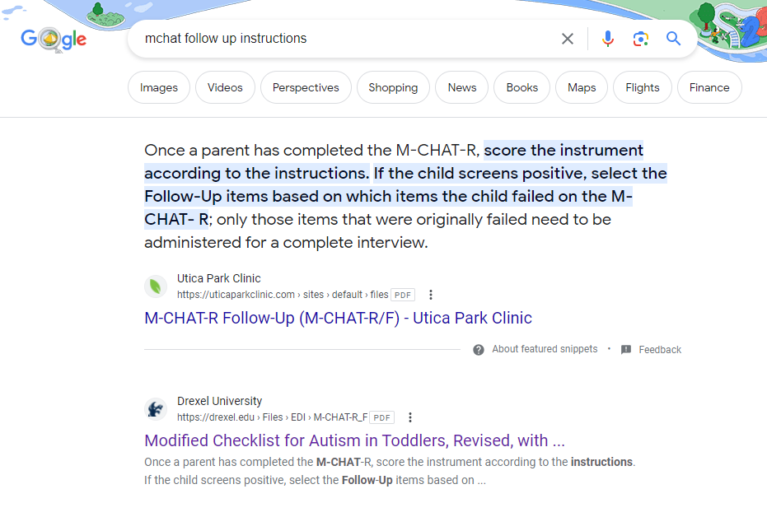
What if you forget all this?
M-CHAT is free online – Google it!
May be a good way to find the follow-up instructions for clinics who may not need to use the follow-up questions frequently
Notes:
Minimum talking points:
provide support to the practice with strategies for how to recall specifics from this training

Slide 26
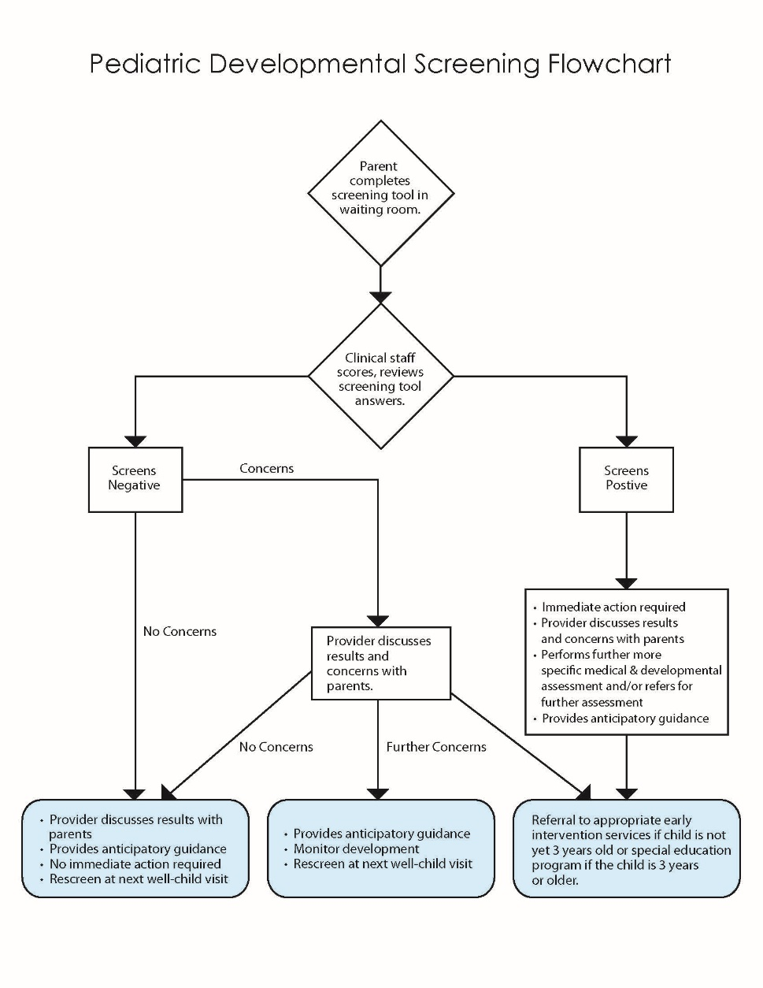
Office Workflow
Slightly variable depending on if you practice uses paper or electronic tools
Can implement this screening tool similar to other screenings you are likely already doing in your office
example: general developmental screen, Medicare annual wellness screenings, etc
Typically, changing the workflow is the most challenging piece of implementing a new tool in the office
1st Five Peer consultants available to assist with any challenges that arise
https://www.cdc.gov/ncbddd/autism/hcp-screening.html
Notes:
Minimum talking points:
present an option for a typical workflow to complete the MCHAT R/F

Slide 27
But my patient’s first language is not English!
M-CHAT-R/F comes in multiple languages
Available for free online:
https://www.mchatscreen.com/mchat-rf/translations/
Albanian
Arabic
Arabic-Syrian
Arabic-Tunisian
Azerbaijani
Bangla
Brazilian Portuguese
Bulgarian
Chilean
Chinese (Cantonese/Traditional)
Chinese (Mandarin)
Chinese (Taiwan)
Creole
Czech Republic
Dutch
Finnish
French
French Canadian
Georgian
German
Greek
Hebrew
Hindi
Hmong
Icelandic
Indonesian
Italian
Japanese
Kazakh
Korean
Latvian
Lithuanian
Macedonian
Malay
Marathi
Mongolian
Nepali
Omani
Persian
Polish
Portuguese
Punjabi
Romanian
Russian
Serbian
Slovene
Swahili
Spanish (Argentina)
Spanish (Panama)
Spanish (Spain)
Spanish (Western Hemisphere)
Swedish
Tagalog
Tamil
Telugu
Thai
Turkish
Ukranian
Urdu
Uzbek
Vietnamese
Notes:
Minimal talking points:
Review that MCHAT has free translations online via their website
Consider bringing a copy of the printed MCHAT-R/F packet in English and printed questionnaires in languages commonly used in the office when you present.

Slide 28
Billing for Autism Screening
Code for billing is 96110
Same code for M-CHAT-R/F and general development screens (ie: ASQ)
Use “25” modifier added to preventive service or E&M code to flag its presence
example: Z00.129/25, 96110
Attach “59” modifier if using more than one developmental screen
example: doing both M-CHAT + ASQ-3 at 18-month WCC: Z00.129/59, 96110, 96110.
If billing electronically, if you do not see an obvious button to click, please check with your billers for best practices, including if you need to manually enter “25” modifier or if will automatically drop if you click a developmental screening.
Check with payers directly regarding reimbursement rates, as rates vary by insurance type
Notes:
Minimum talking points:
provide information on billing for the MCHAT R/F
1st Five Site Coordinators are not expected to be experts on billing or coding. Always encourage practices to work directly with their payers about reimbursement if there are specific questions.

Slide 29
Timing for Follow-up Questions
Review M-CHAT-R Follow-up questions can be done in whatever way works best for a practice workflow
Right away in the office when a child is identified in the medium risk category
As a follow-up phone call by medical assistants or nurses
As a follow-up office visit
All options have workflow challenges – delay in clinic flow, challenges getting ahold of the family another day, parents having to take time out of work again to return for a visit
Need to find the right balance for your practice and it might be different depending on the situation
Consider having pre-printed Follow-up Questions quickly accessible to be able to do questions in real-time most easily
Notes:
Minimum talking points:
a challenge practices may encounter is navigating unique scenarios for completion of the follow-up questions - review strategies for how to support the practice with completing the follow-up questions to overcome this typical barrier.

Slide 30
< Pause for questions >
What questions do you have regarding FAQs?
Can we clarify any details?
Notes:
Minimum talking points:
address questions that may be in the parking lot (if completing the training virtually)

Slide 31
< Pause for Questions >
What questions do you have regarding FAQ's?
Can we clarify any details?
Notes:
Minimum talking points:
Take a moment for questions

Slide 32
1st Five is here for any
questions and/or follow-up!!
Site Coordinator Name, Credentials
phone number
email address
Notes:
Minimum talking points:
encourage connection for support and when questions arise.
plan for follow-up with the practice at an agreed upon time (post implementation to confirm screening launch and address any initial concerns that might interrupt screening process)

Slide 33
Thank you!
Reach out to your 1st Five Site Coordinator if you have any questions or need support

