Slide 1
Iowa Dental Wellness Plan and Hawki Dental Pre-Paid Ambulatory Health Plan (PAHP)
RFP# MEDIOMC27001
Bidders’ Conference
February 18, 2025

Slide 2
Agenda
Presentation Overview
Iowa Dental Programs
RFP Process
Questions?

Slide 3
Presentation Overview
Medicaid Dental Overview
Dental Program Overview of the Question & Answer Process
Types of Dental Coverage with Medicaid
Federal Authorities
Dental Plan Vision
Dental Goals
Key Goal
Iowa DWP and Hawki Program Procurement
Key Updates
How the Dental Program Achieves Quality Outcomes
What Services are Included in the Dental Program?
Excluded Services
Pay for Performance (PFP)
Iowa HHS Oversight
Key Groups

Slide 4
Medicaid Dental Overview
On July 1, 2017, Iowa HHS combined dental benefits for all adult Enrolled Members into one (1) Dental Wellness Plan (DWP), delivered via prepaid ambulatory plans (PAHPs).
Iowa HHS also provided children dental coverage through various packages.
Medicaid children under the age of nineteen (19) received comprehensive dental coverage on a fee-for-service basis and Hawki children received dental coverage through a PAHP.
Hawki also included a dental-only program for children with third-party liability (TPL) coverage.
Effective July 1, 2021, all Medicaid children under the age of nineteen (19) transitioned from the previous dental fee-for-service delivery system and began receiving dental benefits through the currently contracted PAHPs.
Iowa HHS worked to enroll children in PAHPs to better coordinate dental care for children and help promote oral health in an accessible and cost-effective manner.
Iowa HHS currently contracts with two (2) PAHPs to deliver dental benefits.

Slide 5
IA Health Link Program Overview of the Question & Answer Process
Questions answered verbally today are not binding or considered part of the RFP.
Individuals should state their name and organization before submitting or asking a question.

Slide 6
Iowa Dental Programs

Slide 7
Types of Dental Coverage with Medicaid
Most Medicaid members and Hawki members are included in Medicaid Dental Coverage.
The Dental Wellness Plan (DWP) provides Medicaid dental coverage for
The Healthy and Well Kids in Iowa (Hawki) program provides dental health care coverage for uninsured children of eligible families.
DWP-Kids (DWP-K)
Non-Hawki members 18 years and younger
DWP-Adults (DWP-A)
Non-Hawki members 19 years and older
Hawki - Medical & Dental
Children under age19 with no other health insurance and income at or below 302% of the federal poverty level (FPL).
Hawki - Dental Only
Children under age 19 that meet the requirements for the Hawki program, but the child is covered by insurance through another health plan without dental insurance.
Income is at or below 302% FPL.

Slide 8
Federal Authorities
1115 Waiver for Dental Health and Wellness Plan
CHIP Expansion for Hawki
Iowa State Plan

Slide 9
Dental Plan Vision
Created a single system of care that will:
Build stability for Iowa Medicaid members and providers by coordinating and integrating care.
Improve quality outcomes and efficiencies across the healthcare delivery system.
Decrease costs through the reduction of unnecessary, inappropriate and duplicative services.

Slide 10
Dental Goals
Improve network adequacy and availability of services
Increase recall and prevention services
Improve oral health equity among Medicaid members
Improve coordination and continuity of care between managed care plans
Enhance medical and dental integration

Slide 11
Key Goal
Iowa HHS seeks to emphasize member choice, access, safety, independence, and responsibility while providing high quality dental healthcare services appropriate to member’s health. The program is intended to integrate care and improve quality outcomes and efficiencies across the dental healthcare delivery system, in turn decreasing costs through the reduction of unnecessary, inappropriate, and duplicative services.
For more information visit: https://hhs.iowa.gov/programs/welcome-iowa-medicaid

Slide 12
Iowa DWP and Hawki Program Procurement
Iowa HHS expects to contract with two (2) or more bidders with a demonstrated capacity to coordinate care and provide quality outcomes for Medicaid and CHIP populations.
The final number of awarded contracts under this RFP is not definitive at this time and will be determined at the sole discretion of Iowa HHS at the time of award.
Bidders should comprise of qualified PAHPs, capable of delivering high-quality dental health care services to the people of Iowa.
Iowa HHS expects to implement a contract that will have an initial three (3) year contract term with the ability to extend the contract for two (2) additional two (2) year terms.
Iowa HHS will have the sole discretion to extend the contract.

Slide 13
Key Updates
Contract Structure
Updated structure to align with current Iowa Health Link contracts
Service Delivery
DWP and Hawki services will be provided by all awarded contractors
Carved Out Services
Orthodontia is no longer intended to be carved out of capitation rates
Quality and Contract Compliance
- Updated Pay for Performance Measures and new Liquidated Damages - Overall alignment with Iowa’s Dental Quality Strategy Plan

Slide 14
How The Dental Program Achieves Quality Outcomes (Pt.1)
Holding contractors accountable for costs and outcomes creates incentives for:
Increased care coordination and reduced duplication
Combining accountability for costs and outcomes enables:
Bending the cost curve through appropriate utilization management
Contractor payments tied to outcomes
Performance outcomes can be increased each contract year
Investment in preventive services which lead to long-term savings
Prevention of unnecessary hospitalizations

Slide 15
How The Dental Program Achieves Quality Outcomes (Pt.2)
This design includes all Medicaid-covered dental benefits
Provides state oversight and coordination of dental services
Provides incentives for coordinating care and avoiding duplication
Expect contractors to develop strategies to integrate care across the system.
Supports integration and efficiency
Prevents having scattered services and misaligned financial incentives

Slide 16
How the Dental Program Achieves Quality Outcomes (Pt. 3)
Member Benefits
Contractors will use the HHS-approved Oral Health Equity Self-Assessment Tool to assess Enrolled Members' oral status and needs, incorporating social determinants of health and tailoring member’s services based on those needs.
Care Coordination program to monitor and coordinate the care for Enrolled Members identified as having special dental health care needs, including the need for specialty providers.

Slide 17
What Services are Included in the Dental Program?
All medically necessary covered benefits in Exhibit E of the RFP
DWP- A full list of covered dental services are available at https://secureapp.dhs.state.ia.us/MedicaidFeeSched/X04.xml
Hawki - Services include diagnostic and treatment services, preventive services, minor restorative services, major restorative services, endodontic services, periodontal services, prosthodontic services, oral surgery, orthodontics and adjunctive general services
Early and Periodic Screening, Diagnostic and Treatment (EPSDT)- EPSDT provides a comprehensive array of prevention, diagnostic, and treatment services for low-income infants, children and adolescents under age 21

Slide 18
Excluded Services
Excluded services include services that are:
Fail to meet existing standards of professional practice, are currently professionally unacceptable, or are investigational or experimental in nature;
Are rendered during a period when the member was ineligible for Medicaid
Require prior approval but for which approval was not obtained or was denied
Are the responsibility of third parties, such as Medicare or private Health Insurance
Are fraudulently claimed
Represent abuse or overuse
Are for cosmetic purposes and are provided only because of the member’s personal preference
Have already been rejected or disallowed by Medicare, when the rejection was based upon findings for any of the reasons set forth above
Are provided to a person while the person is an inmate of a non-medical public institution. A non-medical public institution includes, but is not limited to, jails, prisons, and juvenile detention centers. If a non-covered service is provided, providers must inform the member before providing the service that the member will be responsible for the bill
Medically unnecessary or unreasonable

Slide 19
Pay for Performance (PFP)
The State has established a set of PFP measures for contractors that may be selected under this RFP for the DWP and Hawki dental program.
Final SFY 2026 capitation rates that will be established prior to the start of the Contract will be calculated in consideration of the Pay for Performance measures.
During each measurement year, the State will withhold a portion of the approved capitation payments. The amount withheld in this current rate period is two percent (2%) of the Capitation Payments made.
Contractors may be eligible to receive some or all the withheld funds based on the Contractor’s performance in the areas outlined in the Contract.

Slide 20
Iowa HHS Oversight
The Iowa DWP and Hawki contracts have remedy options in place to address compliance issues as they arise.
Health Policy Oversight Committee
Medical Assistance Advisory Committee (MAAC)
Council on Health and Human Services
Ombudsman Offices
HHS has developed new liquidated damages that outline what remedies will be applied in various compliance situations. The State’s intended goal is clear expectations and transparency.
Iowa Medicaid works in tandem with other HHS divisions for performance review

Slide 21
Who is included in this Program?
Included
Excluded
Majority of Medicaid members
Hawki members
Iowa Health and Wellness Plan
Long Term Care Facility
HCBS Waivers
Beneficiaries who have a retroactive Medicaid eligibility period
PACE (member option)
Health Insurance Premium Payment Program (HIPP)
Eligible for Medicare Savings Program only
Non-qualified immigrants eligible for short-term emergency services only
American Indian/Alaskan Natives voluntary
Medically Needy
Persons incarcerated, ineligible for full Medicaid benefits
Persons presumed eligible for services
Persons residing in Iowa Veteran’s Home
Beneficiaries eligible only for the State Family Planning Waiver

Slide 22
Key Groups
Town Halls
Member and Provider Town Halls have been established to align Iowa Medicaid with National Best Practices and create program improvement.
Dental Stakeholder Workgroup
A diverse group of stakeholders convened in Fall of 2022 to determine inefficiencies when referring members for oral health needs between medical and dental providers. Feedback from this process was considered in the RFP development.

Slide 23
RFP Process

Slide 24
RFP Topics
RFP Formal Question and Answer Process
Letter of Intent to Bid Template
Accessing RFP Documents
Key Dates
Technical Proposal Response Guide

Slide 25
RFP Overview of Question & Answer Process (Pt. 1)
Questions answered verbally today are not binding.
Submit letter of intent to bid and any questions that will affect your proposal in writing.
It is not mandatory for bidders to submit an Intent to Bid form. However, Iowa HHS will only respond to first and second round questions about the RFP that have been submitted by prospective Bidders who have expressed their affirmative intent to bid.
Submitting a letter of intent to bid is not a requirement to submit a proposal.
Submitting a letter of intent to bid is not a commitment to submitting a proposal.
Iowa HHS will post written responses to questions from prospective bidders on the State’s procurement website.
Responses to questions are not considered part of the RFP. If Iowa HHS decides to change the RFP, it will issue an amendment. All amendments will be posted to: https://bidopportunities.iowa.gov/Home/BidInfo?bidId=767284b0-3bef-4da3-bd4c-1966699eb519.
Follow-up questions to initial responses are permissible if all questions are received by the final due date and time for Bidder Questions as provided in the procurement timetable.

Slide 26
RFP Overview of Question & Answer Process
Submit questions using Attachment H - Question and Answer Template (Round 1) and Attachment I - Question and Answer Template (Round 2)
First round due on February 19th at 3 p.m. Central
Second round due March 26th at 3 p.m. Central
Follow-up questions to initial responses are allowed if all questions are received by the final second round due date and time indicated above.

Slide 27
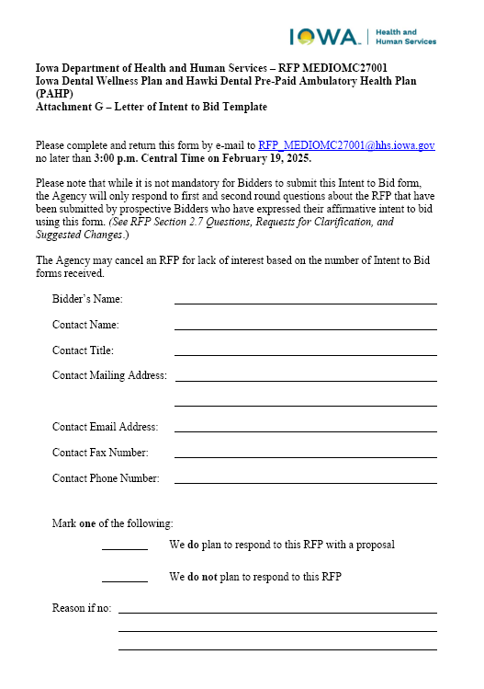
Template for Letter of Intent to Bid
The template for the letter of intent to bid (Attachment G) is due on February 19, 2025, at 3 p.m. Central.
Though it is not mandatory that Iowa HHS receives an intent to bid, HHS will only respond to first and second round questions about the RFP by potential bidders who have confirmed their intent to bid.

Slide 28
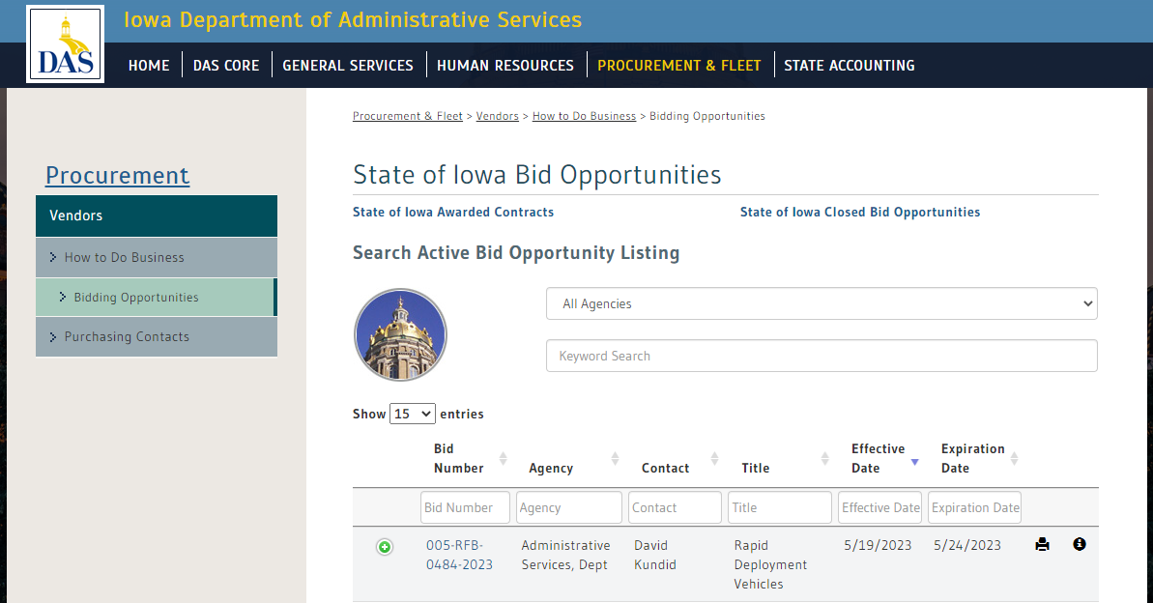
How to Access RFP Documents (Pt. 1)
Visit http://bidopportunities.iowa.gov
Search for “Iowa Dental Wellness Plan and Hawki Dental Pre-Paid Ambulatory Health Plan (PAHP)” or “MEDIOMC27001” in the keyword search bar.

Slide 29
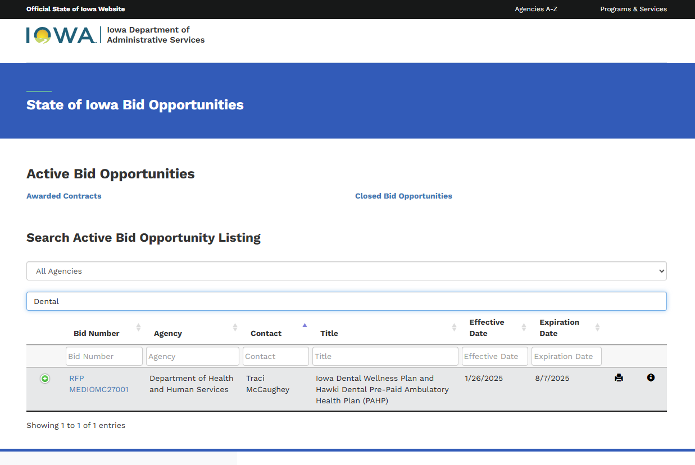
How to Access RFP Documents (Pt. 2)
Step 2: Click on the Bid Number

Slide 30
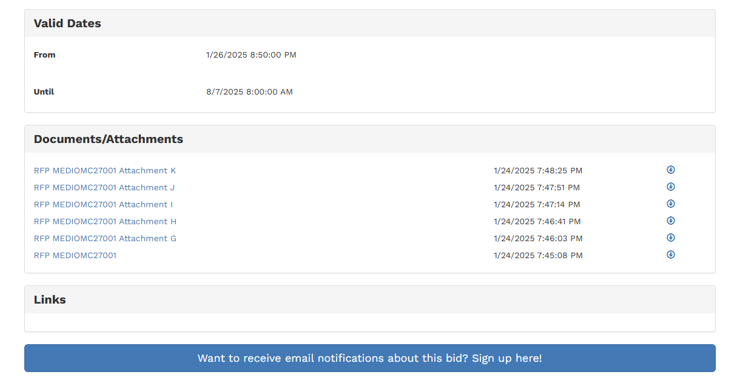
Accessing RFP Documents (Pt. 3)
Step 3:
Scroll down to access RFP documents and updates
Sign up for email notifications.
Continue checking the website for updates.

Slide 31
Accessing RFP Documents (Pt. 4)
Alternatively, bidders can access the RFP documents using the following direct link:
https://bidopportunities.iowa.gov/Home/BidInfo?bidId=d78c8332-f479-4387-a42d-a9612c41a9e8

Slide 32
Key Dates
See the procurement timetable in the RFP for more details. Times provided are in Central Time.
Event | Date
Agency Issues RFP Notice to Targeted Small Business Website | January 24, 2025
Agency Issues RFP to Bid opportunities Website | January 27, 2025
Bidders’ Conference and Capitation Rate Estimate Presentation | February 18, 2025 2:00-3:30 PM
Bidder Letter of Intent to Bid Due By | February 19, 2025, by 3:00 PM
Bidder Written Questions (Round 1) Due By | February 19. 2025, by 3:00 PM
Agency Responses to Questions (Round 1) Issued By | March 5, 2025
Agency Posts Scoring Guide and Technical Proposal Components | April 23, 2025
Bidder Written Questions (Round 2) Due By | March 26, 2025, by 3:00 PM
Agency Responses to Questions (Round 2) Issued By | April 9, 2025
Bidder Proposals and any Amendments to Proposals Due By | May 7, 2025, by 3:00 PM
Bidder Presentations of Bid Proposals (held at the discretion of the Agency) | July 29, 2025
Agency Announces Apparent Successful Bidder/Notice of Intent to Award | August 15, 2025
Transition Activities Begin | September 15, 2025
Anticipated Start Date for the Provision of Services | July 1, 2026

Slide 33
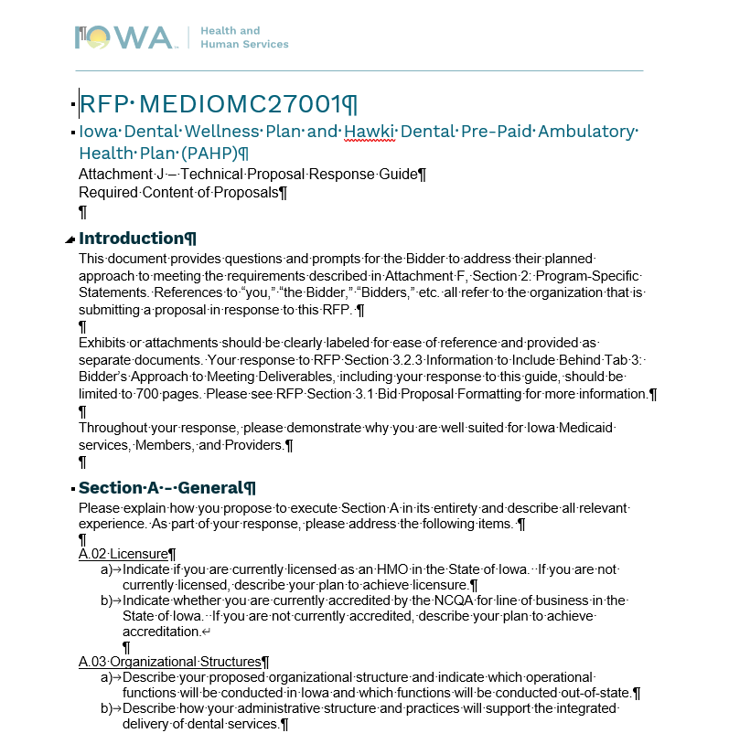
Technical Proposal Response Guide
Follow Section 3 of the RFP for format and content specifications for bid proposals.
Respond in accordance with Attachment J: Technical Proposal Response Guide.
See instructions in RFP Section 3.2 and at the beginning of Attachment J.

Slide 34
Questions?

