Slide 1
Behavioral Health and Aging and Disability Services Town Hall
Marissa Eyanson, Director of Behavioral Health, Iowa HHS
Zach Rhein, Director of Aging and Disability Services, Iowa HHS
Aaron Todd, CEO of the Iowa Primary Care Association

Slide 2
Meeting Logistics: Zoom Navigation
Please ensure your mic is muted when you are not speaking during the meeting. This can be found in the far-left corner of your screen.
There is a Q&A button for you to type your questions.
To ask a question, hit the “raise hand” button.
Chat button can be found here.
Click the “CC’ button” for closed captioning.

Slide 3
Behavioral Health Service System Statewide Plan
Marissa Eyanson, Director of Behavioral Health
Iowa HHS

Slide 4
Iowa’s Behavioral Health Service System will:
Iowa’s Behavioral Health Service System will:
Offer information, coordination, and clear access points throughout each Behavioral Health district.
Ensure that individuals and families have access to person-centered services and supports, no matter where they live.
Reduce confusion, duplication of effort, and correct misplaced spending by linking and organizing effort under Federal, State, and local governance and authority.
Eliminate administrative red tape to empower behavioral health safety net providers to focus on meeting the needs of Iowans who rely on them for care.
Guide investment through assessment and planning processes linked to measurable outcomes and results.

Slide 5
Building a Behavioral Healthcare Continuum
Prevention​ and Education​
Early​ Intervention​
Treatment​
Recovery​
Crisis​

Slide 6
Installation of Behavioral Health Administrative Service Organization (BH-ASO) District and Statewide
Ensure access to comprehensive prevention, early intervention, treatment, recovery, and crisis services for mental health and addictive disorders.
Connect and collaborate with local leaders and systems like schools, law enforcement, and public health to meet behavioral health needs.
Provide information, referrals, and support to help Iowans navigate the behavioral health system.

Slide 7
Target Outcomes: Cross-cutting Improvement
Build an integrated, comprehensive, statewide system of high-quality behavioral health services.
Improve access to high-quality continuum of behavioral health services.
Strengthen Iowa’s behavioral health workforce.
Increase behavioral health wellness and reduce the stigma associated to asking for care and support.
Improve health outcomes and decrease the number of Iowans who die due to substance-involvement, overdose, or suicide.

Slide 8
Focus Areas
 | Operations Operations strategies optimize efficiencies, resilience, and effectiveness through integration of technology, policies and processes, with a focus on collaboration and coordination.
 | Impact Impact strategies connect service delivery and access to maximize resources to help individuals, families, children, and communities thrive.
 | Culture Culture strategies advance and leverage leadership, engaged and motivated teams, effective communication, innovation, and positive culture building.
Notes:
Focus areas are descriptive topics that categorize related strategies under each of the system’s functions.
The focus areas align with the Iowa HHS strategic plan priorities to advance excellence (operations), help Iowa thrive (impact) and elevate organizational health (culture).

Slide 9
Strategies, Tactics, and Measuring Results
 | Strategies Discreet strategies in each of the focus areas to move the system forward. Tactics Action steps to progress toward each of the strategies; responsible system partners have also been identified for each tactic. results Establishing baseline metrics helps to define our focus and see our success. Metrics should always be linked to our "why". We are focused on demonstrating results that protect and improve the health and resiliency of individuals, families, and communities in Iowa. Baseline metrics include suicide, binge drinking, smoking, and overdose.
Notes:
Strategies and Tactics
Strategies are high-level statements of what will be done within each focus area.
Tactics detail how each strategy will be achieved.
Results will be measured at the system level by monitoring meaningful indicators rather than counting widgets and thing-a-majigs.

Slide 10
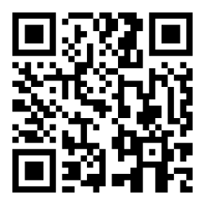
Behavioral Health State Plan Feedback Form
Behavioral Health Service System Statewide Plan Feedback Form
https://forms.office.com/g/bJV3cqqRCa

Slide 11
Behavioral Health Service System System Navigation, Service Coordination, and Case Management
Marissa Eyanson, Director of Behavioral Health
Iowa HHS

Slide 12
System Navigation
What is System Navigation?
Help individuals and families understand the behavioral health service system and provide information, education, referral and support.
Brief intervention, accessible, and available to anyone.
Work is often performed by peer support specialists, community health workers, or intake coordinators.
Ensure warm hand-offs and coordination with other systems such as CCBHCs, Medicaid MCOs, and Disability Access Points.
System Navigation also assists in coordinating key transitions in the behavioral health service system, including:
Crisis Services navigation includes finding and securing the best service options, coordinating level of care transitions such as from emergency rooms to crisis, residential, or inpatient care settings and ensuring follow up and after care.
Jail-based Behavioral Health Services navigation includes ensuring access to jail-based services and connecting individuals leaving jail to community-based behavioral health supports and follow-up such as: CCBHCs, CMHCs, addictive disorder treatment, and recovery services and supports.
Plans to establish System Navigation, including identification of access points and processes, will be included in each district plan and budget for Iowa HHS' review and approval.
Notes:
What is System Navigation?
Defined in proposed rule at: Iowa Administrative Code 441-300
System Navigators help individuals and families understand the behavioral health service system, including mental health and addictive disorder services and supports. They provide information, education, and referral to available options.
Intervention is typically brief, offering real-time, easily accessible assistance to connect individuals and families to resources and providers in their communities.
System Navigation is available to anyone and does not have an eligibility threshold or asset test.
Work is often performed by peer support specialists, community health workers, or intake coordinators.
When individuals display service needs requiring ongoing engagement and support, System Navigators will ensure warm hand-offs and coordinate with CCBHCs, Medicaid MCOs, and Disability Access Points for ongoing Service Coordination or Case Management support.
Specialized System Navigation assists in coordinating key transitions in the behavioral health service system, including:
Crisis Services
Services include crisis assessment and evaluation, mobile crisis, residential crisis services, and access centers.
System Navigation includes finding and securing the best service options and coordinating level of care transitions such as from emergency rooms to crisis, residential, or inpatient care settings and ensuring follow up and after care.
Jail-based Behavioral Health Services
Services include screening, assessment, diagnosis and treatment for individuals in jails.
System Navigators ensure access to jail-based service options and connect individuals leaving incarceration settings to community-based behavioral health supports such as CCBHCs, CMHCs, addictive disorder treatment, and Recovery Services and Supports.
April 30 – System Navigation access points and processes will be proposed in each district's plan and budget for Iowa HHS review and approval.

Slide 13
Service Coordination
Collaboration and coordination across multiple providers such as therapists, psychiatrists, substance use counselors, PCPs, etc.
Avoid duplication, reduce confusion, and close care gaps.
Coordinators engage in regular, ongoing, cross-disciplinary communication.
The behavioral health service system does not include Service Coordination requirements.
Notes:
Subject to district-level planning and budgeting, behavioral health safety net providers may include non-duplicative service coordination as part of a plan for utilization of access funding.

Slide 14
Case Management
Case Management
Serious, long-term needs including individuals with chronic, serious mental illnesses, serious emotional disturbance, serious substance use disorders or complex co-occurring conditions.
Develop, monitor and adjust care plans to ensure effect care planning and coordination across multiple services and needs.
Performed by social workers, behavioral health clinicians, or case management practitioners within their area of expertise.
System Navigators connect individuals and families to resources, including the Service Coordination and Case Management services, available through local providers, Medicaid MCOs, and Disability Access Points.
Notes:
People served often display serious, long-term needs such as individuals with chronic, serious mental illnesses, serious emotional disturbance, serious substance use disorders or complex co-occurring conditions.
Case Managers develop, monitor and adjust care plans including supports through therapy, medication management, housing assistance, or employment supports.
Case Managers are often social workers, behavioral health clinicians, or case management practitioners within their area of expertise.
Case Management is a core service that will be offered by Certified Community Behavioral Health Clinics (CCBHC) on July 1, 2025.
Individuals needing Case Management or Service Coordination support will be connected by System Navigators based on need to: CCBHCs or other behavioral health safety net service providers, assigned Medicaid MCOs, or Disability Access Points in their district.

Slide 15
Disability Access Points
Zach Rhein, Director of Aging and Disability Services
Iowa HHS

Slide 16
Disability Access Points Definition
“Disability access point” (DAP) means a local organization designated by the department to serve as the primary access points for people with disabilities and their caregivers. DAPs serve as ADRC member organizations as defined in rule 441—224.1.
Disability Access Points will be responsible for providing person-centered assistance, ensuring that individuals receive accurate guidance necessary to make informed decisions about their services and support.
This includes offering information and referral services, options counseling, and personalized support to help individuals understand and access available services.

Slide 17
DAP Awardees
District | Award
District 1 | Pottawattamie County
District 2 | Central Iowa Community Services
District 3 | Central Iowa Community Services
District 4 | Pottawattamie County
District 5 | Polk County Behavioral Health
District 6 | Central Iowa Community Services
District 7 | MHDS of East Central Iowa
For more information about the Intent to Award, please contact Ryan Roovaart at ryan.roovaart@hhs.iowa.gov.

Slide 18
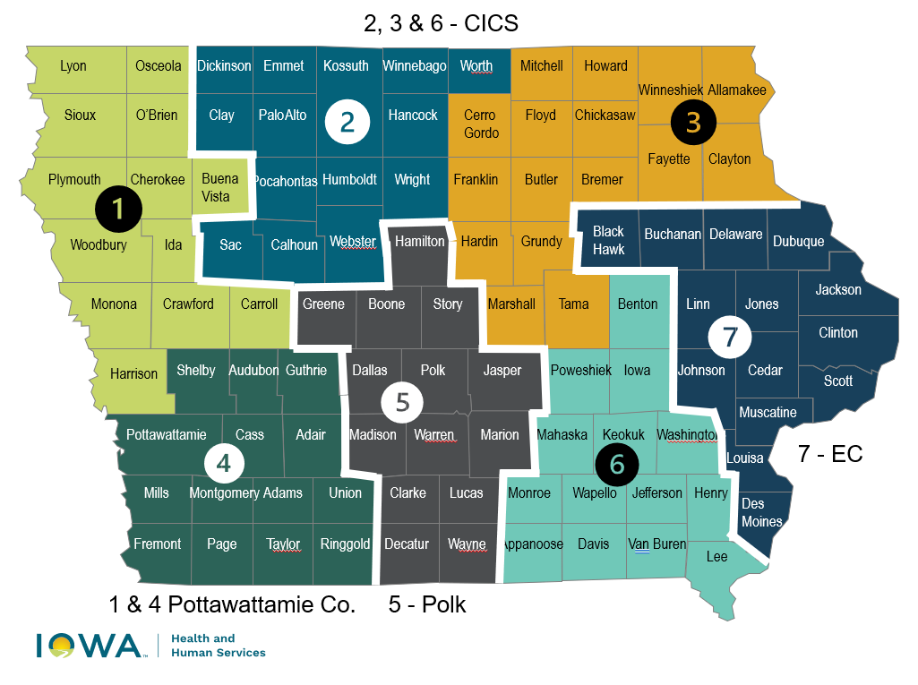
DAP Map

Slide 19
Behavioral Health Provider Contract Updates
Marissa Eyanson, Director of Behavioral Health
Iowa HHS

Slide 20
Right of First Refusal
Opportunity for established safety net providers and partners to first review, negotiation, and decision to accept or refuse BH-ASO contracts and terms and continue to perform activities under the new contract structure effective July 1, 2025.
Applicable to current contractor coverage or service areas.
Right of first refusal is not the adoption of current contracts. To establish consistency and ensure system stability, terms, requirements, and reimbursement may look different for July 1, 2025, contracts.
Available to Iowa HHS and MHDS Regional contracted providers based on matching established work to July 1, 2025, behavioral health service system requirements.
Notes:
Other Notes: Covered services and rates for inpatient, outpatient, and residential behavioral health treatment services will not be contracted. Iowa HHS will establish a statewide fee schedule for behavioral health safety net services. Providers will submit claims to Iowa HHS for payment for covered services rendered to eligible individuals.

Slide 21
Linking Assessment, Planning, Budgeting,
and Contracting
In March, Iowa HHS will be able to deliver assessment data, budget target estimates, contract packages, and orientation training linking behavioral health service system funding to requirements.
District Advisory Councils will convene in April to advise the BH-ASO regarding district planning, which includes budgets, for July 1, 2025. District Plans, including budgets, are due to Iowa HHS by April 30, 2025 for HHS' review and approval.
Iowa HHS has collected assessment data, contracts, and expenditures and matched to July 1, 2025, behavioral health service system and disability service system requirements.
BH-ASO provider contracting will be concentrated in May and June 2025 after final Iowa HHS review and approval of district plans and budgets for July 1, 2025.
Disability Access Points (DAPs) will also launch disability services transition planning activities in April.
Notes:
April 2025 - District Advisory Councils convene to review and provide feedback for BH-ASO district planning and budgeting targets and recommendations.
4/30 – district plans and budgets due to Iowa HHS for review and approval.
May and June 2025 – BH-ASO will execute contracts with providers and partners at the district level based on approved plans and budgets for SFY26.
7/1/2025 – BH-ASO full contract execution to meet minimum service requirements may include short term "bridge" contract structures as well as year long contracts based on system needs.
Future year planning, budgeting, and contracting cycles will begin and finalize sooner as systems will be established.

Slide 22
Rules Update
Theresa Armstrong, Deputy Director Behavioral Health
Operations and Compliance
Iowa HHS

Slide 23
Behavioral Health Service System Rules
Implement Iowa Code 225A (HF 2673)
Iowa Administrative Code 441 Chapters 300-310
Definitions
Behavioral Health Service System Eligibility and Services
Behavioral Health Administrative Service Organizations
District Behavioral Health Advisory Councils
Data Collection
Includes Mental Health Advocates as authorized by Iowa Code 229
Regulatory Analysis published
Iowa Administrative Bulletin Component Document
Public hearing held February 25, 2025.
Notice of Intended Action published March 19.

Slide 24
Updates from the Iowa Primary Care Association
Aaron Todd, CEO

Slide 25
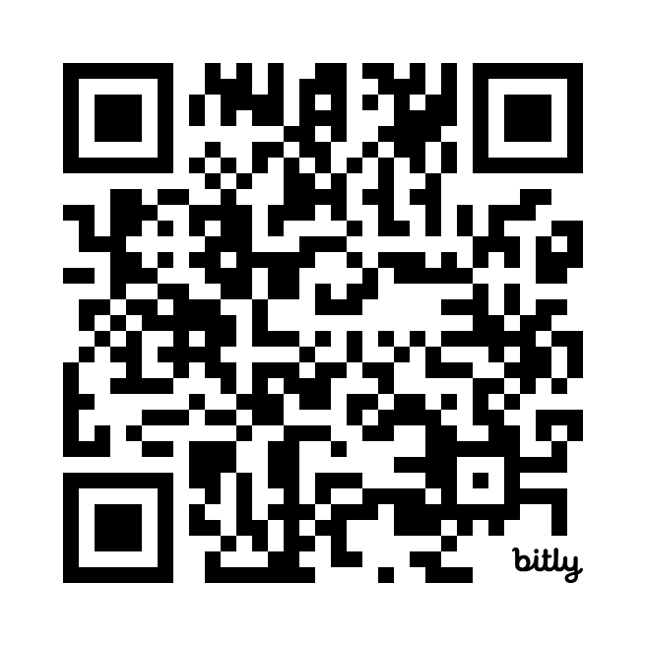
Staff Announcements
Staff Announcements
Chief Behavioral Health Officer
Jeni Hanselman
info@iowapca.org
Recruitment: Positions posted now and more to come:
Director of Network Development
Network Contracting Consultant
Director of District Operations
Program Manager
Accounting Specialist
Communications Consultant
Learn more and apply at: www.iowapca.org or scan the QR code.

Slide 26
District Advisory Councils
Received over 300 applications from across the state
District 1: 26
District 2: 33
District 3: 34
District 4: 24
District 5: 72
District 6: 42
District 7: 126
Currently: Reviewing applications, including resumes and personal statements
March 2025: Notification of District Advisory Council members
10 members each Council
Weeks of April 7 & 14 2025: Convene District Advisory Council meetings for feedback on planning and budgeting
Notes:
District Advisory Council – what's coming next?
Selection process overview
Target date to announce advisory council membership
Convening district advisory councils in April for feedback on planning and budgeting

Slide 27
March Meetings with MHDS Region CEOs
March Meetings with MHDS Region CEOs ​
Iowa PCA is scheduling meetings with Regions to take place in March
Proposed Agenda topics:
Feedback to inform district-level planning including unique and critical components of how services are delivered today
Continuity of care planning process
Identification of current local workgroups and coalitions - i.e, provider network, justice-involved, crisis, etc.
System Navigation including suggestions for Navigator co-location
Discuss contract information Iowa HHS shared with the Iowa PCA

Slide 28
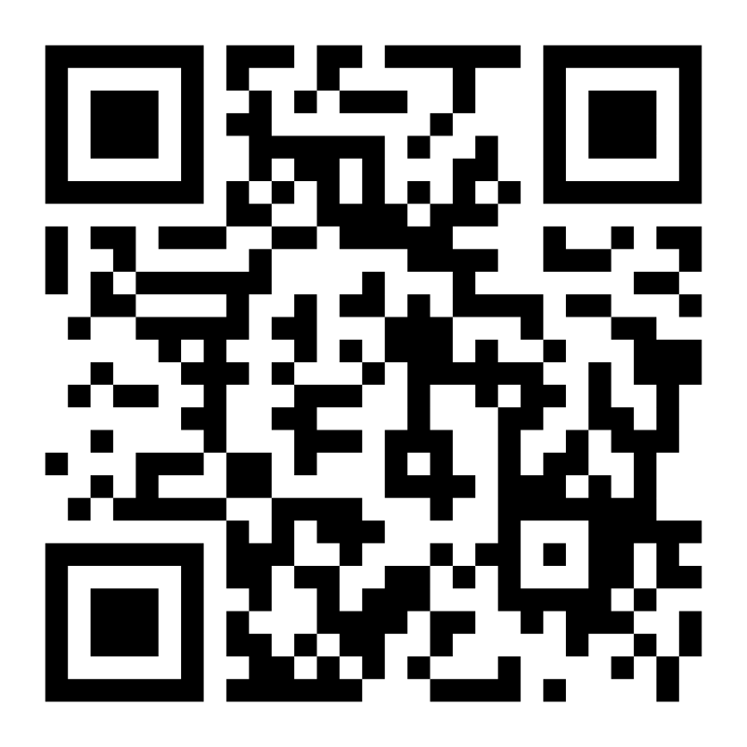
Questions and Answers
Behavioral Health Feedback Form
https://forms.office.com/g/1SG266pkNM
Notes:
Please use either the Q and A function or raise your hand. We'll use the time we have available to answer questions and answers and we'll also use this time to inform next FAQ and Town Hall meetings. Thank you!

