Slide 1
GI Multidisciplinary Feeding Clinic
Referrals, Supporting, and More
Emily Morton RD, LD, CNSC
Linda Cooper-Brown, PhD
Professor and Division Director, Pediatric Psychology

Slide 2
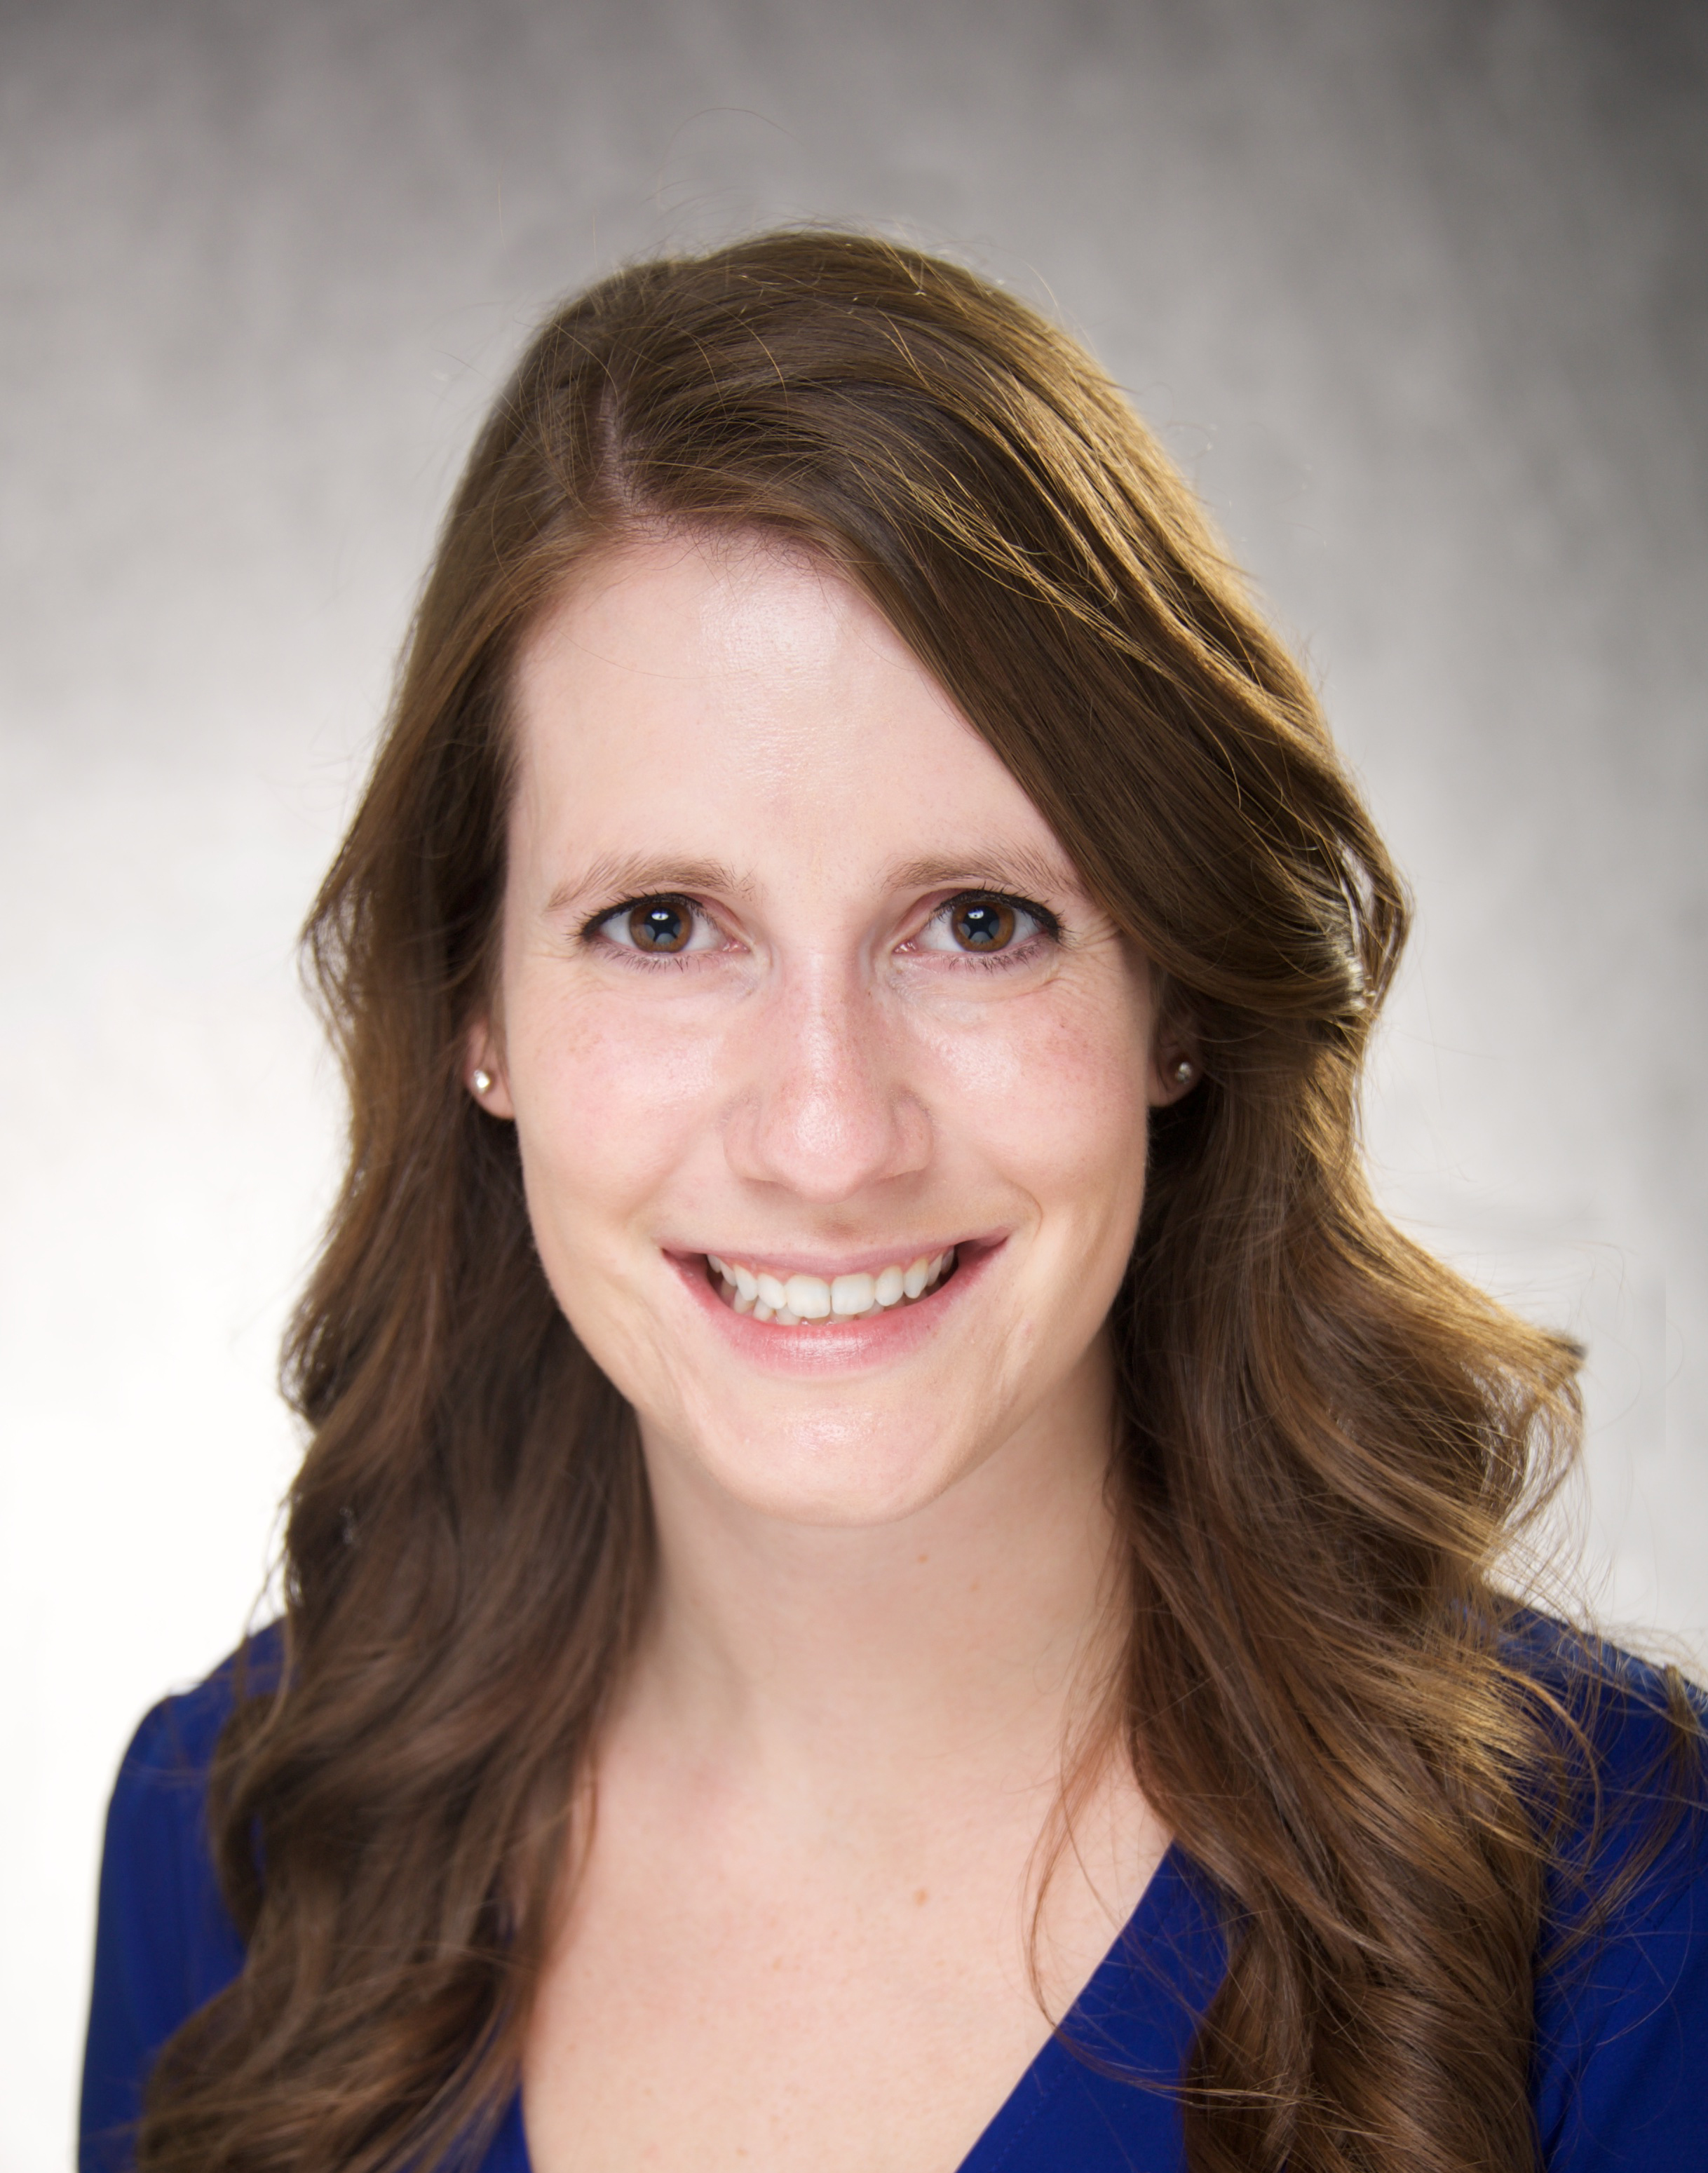
Emily Morton RD, LD, CNSC
Emily has been a clinical dietitian for over 12 years. She works with all patients within the pediatric gastrointestinal department including but not limited to Feeding therapy, Celiac Disease, Short Bowel Syndrome, Home TPN, IBD, EoE, and Tube feeding management. She is a member of ASPEN and is a preceptor for the Masters of Clinical Nutrition program at Iowa Health Care.
Contact: emily-morton@uiowa.edu

Slide 3
Linda Cooper-Brown, PhD
Linda has been working in Pediatric Psychology for 32 years, specializing in feeding and behavior disorders.
Contact: linda-cooper@uiowa.edu

Slide 4
GI Multidisciplinary Feeding Clinic
Patients we see:
  Behavioral (e.g., autism)
  Trouble with different textures
  Difficulty chewing
  Feeding difficulty due to developmental delays
  Severe reflux
  Poor weight gain/FTT
  Family mealtime problems
  Picky eater
  Poor appetite
  Constipation
  History of anatomical problems s/p repair

Slide 5
Team members
  Dina Al-Zubeidi, MD – GI Physician
  Emily Morton, RD LD, CNSC – Dietitian
  Scott Dailey, PhD, CCC-SLP or colleague – Speech-Language Pathologist (focus on oral-motor and feeding skills)
  Linda Cooper-Brown, PhD – Pediatric Psychologist (focus on behavioral issues and therapy)
Structure of clinic
  New and return patients seen by all team members at the same time
  Most often an observation of a meal/snack conducted
  Recommendations provided to address primary concerns
  Consideration of feeding therapy with our service

Slide 6
Dietitian Referral within Feeding Clinic
Concerns about growth- may come from PCP, parent, or another discipline
Feeding tube- wanting to wean from a feeding tube
Only taking formula
Picky/selective eater

Slide 7
Dietitian’s Role
Assessing food variety
  May be reassuring parents their child is not as picky as they think
Helping create goals to add food variety if lacking
Assessing micronutrient gaps and how to meet these
  Refuses any dairy foods- recommendations for calcium supplementation + creating goals for other foods that contain calcium
  Ex: Vitamin/mineral recommendations, chewable vs. liquid vitamins, etc.
  Making sure formula is appropriate – not all nutrition supplements/toddler formulas are nutritionally complete, depends if complimenting oral diet or sole source nutrition

Slide 8
Dietitian Role Cont.
Weaning from feeding tube
  Dependent on growth and feeding skills
  May happen quickly vs. take longer depending on child
  May include alter timing of tube feeds given (food first then g-tube feed), different formula (more calorie dense), ability to drink formula, hydration needs (thickened vs. thin liquids)
  Does not have to wait till clinic visits to wean- keep an open line of communication/access to families to work on this in between visits
Weaning dependence on formula to take other beverages
  Slowly diluting formula or introducing cow’s milk mixed with formula

Slide 9
How Can WIC Dietitians Support
Children often need formula over 1 year of age- prompting plan for when a child turns one, early if possible. Encouraging family to reach out for orders to continue formula past 1 year of age if on a feeding tube/struggling to take food by mouth
Encouraging to continue to expose children to a variety of foods, even if they refused it once or twice
  Kids like flavor, discuss with family cooking options for foods they may refuse
  Encourage meals together
Communicating to parents that a portion of formula from WIC could be available

Slide 10
Psychologist’s Role
Partner with Dr. Dailey or colleague to determine skills and initial recommendations to improve oral intake
Often need to start with empty spoon or just tastes and not worry about volume of intake to reduce aversion
Once we can get inside the mouth, we can work on chewing and volume of intake
We use positive reinforcement (e.g., praise, highly preferred activities) to motivate and reward
We can consult with local providers on strategies

Slide 11
How can WIC Dietitians Support
Oral session before tube feeding
Assurance – OK to use tube, will take time for oral intake
Elimination of tube feeding will not automatically improve oral intake – will need to systematically reduce when appropriate (oral intake improves)
Giving large pieces of food will not “make” the child learn to chew
Keep meals positive but OK if child not happy all the time – we emphasize short, graduated exposures to new items and textures

Slide 12
Feeding Therapy
Jayme Mews, BCBA, MSW conducts the feeding therapy
Must be seen by Feeding Clinic or Linda and Scott to screen
Typical therapy
  Conducted by Jayme with parent/caregiver present in room, turn over to parent/caregiver with coaching
  Single appointments (2-3 hours duration) in person, may be able to conduct MyChart visits between these in-person appts.
  Multiple sequential days (3-4 per week for up to 3 weeks), parent(s) given homework

Slide 13
Therapy focuses on ways to reduce negative behaviors, increase acceptance of tastes/volume (food, liquid) and feeding skills using behavioral principles
Inclusion of other team members as needed
  Scott or colleague evaluates and recommends strategies for chewing, need for further evaluation of swallowing
  Emily monitors weight, intake and makes recommendations for foods, calorie needs, tube feeding schedule and weaning
  Involvement of WIC for ongoing community supports would be great!

Slide 14
Questions?

