Slide 1
Iowa Hope and Opportunity in Many Environments (HOME)
Steering committee
meeting
April 29, 2025

Slide 2
Quick Reminders
We record these meetings to help us write high-level meeting summaries.
Topics and documents we share are for internal purposes and should not be shared outside of the steering committee.

Slide 3
Agenda
HOME 2025 Priorities
CBCM Reporting Ratios
MCO and Provider Update
HOME Redesign Strategic Member Communications Planning: Assessment

Slide 4
2025 Priorities for HOME
Notes:
Speaker: Kera Oestreich

Slide 5
HOME Check-In Meetings
HHS has been working closely with Iowa state leadership to chart the best path forward for HOME implementation.
HOME remains a priority for HHS as was communicated by Director Garcia to the state legislature and Medicaid townhall in January and February 2025.
Today, we are excited to share more about the next steps for HOME in 2025!
HOME

Slide 6
Paving the Path to Integrated Behavioral Health, Disability and Aging Services in Iowa
Currently, Iowans face roadblocks in getting behavioral health care, disability services, and support with aging.
From 2022 to 2024, Iowa HHS worked with Iowans to learn how to create a coordinated system with better access to services.
Starting in 2025, Iowans will see improvements to the programs and services that provide support for people to live independently and in their community.
The guiding principles of HOME remain at the center of our work.
2025
2026
2027
In the current system
Iowans often cannot access services until they have very intense needs
Iowans do not have information to understand what services are available to them
Iowans with similar needs may qualify for different levels of support
In 2025
Iowans will have easier access to information through Aging and Disability Resource Centers
Iowans with behavioral health needs will have access to Certified Community Behavioral Health Clinics (CCBHCs)
Other services may be available to help people who live in institutions move back to the community
In 2026
Iowa proposes to:
Streamline the number of Medicaid waivers it offers and base their supports on need rather than diagnosis
Improve the waiver waitlist system
Strengthen community-based services, including crisis services, for children with Serious Emotional Disturbance (SED)
In 2027 and beyond
Iowa proposes that:
Children with SED will access new services, including intensive case management
Two new services will launch under new Medicaid waivers: Peer Mentoring and Community Transition Supports
Notes:
Five-year timeline graphic for the Iowa Hope and Opportunities in Many Environments (Home) and Responsive and Excellent Care for Healthy Youth Initiative (REACH) projects, titled “Paving the Path to Integrated Behavioral Health, Disability and Aging Services in Iowa”.
Three main summaries of the timeline are:
Currently, Iowans face roadblocks in getting behavioral health care, disability services, and support with aging.
From 2022 to 2024, Iowa HHS worked with Iowans to learn how to create a coordinated system with better access to services.
Starting in 2025, Iowans will see improvements to the programs and services that provide support for people to live independently and in their community.
A road graphic shows a car driving down a road with many hazards, such as potholes, before 2025. A popup description of the Path to Integrated Services reads:
In the Current System
Iowans often cannot access services until they have escalated needs.
Iowans do not have information to understand what services are available to them.
Iowans with similar needs may qualify for different levels of support.
After 2025, the road graphic has construction barriers, (i.e. road signs and excavators). A popup description of the 2025 Path to Integrated Services reads:
In 2025
Iowans will have easier access to information through Aging and Disability Resource Centers.
Iowans with behavioral health needs will have access to Certified Community Behavioral Health Clinics (CCBHCs).
Other services may be available to help people who live in institutions move back to the community.
After 2026, the road graphic shows construction wrapping up and families introduced onto the sidewalk with traffic moving forward unobstructed. A popup description of the 2026 Path to Integrated Services reads:
In 2026
Iowa proposes to:
Streamline the number of Medicaid waivers it offers and base their supports on need rather than diagnosis.
Improve the waiver waitlist system.
Strengthen community-based services, including crisis services, for children with Serious Emotional Disturbance (SED).
The road graphic ends in 2027 with individuals moving forward on inclusive transportation devices, (i.e. wheelchairs and bikes). A popup description of the 2027 Path to Integrated Services reads:
In 2027 and beyond
Iowa proposes that:
Children with SED will access new services, including intensive case management.
Two new services will launch under Medicaid waivers: Peer Mentoring and Community Transition Supports.

Slide 7
2025 CBS Priorities and Guiding Principles*
1. Implement Uniform Assessment
Guiding principles for implementing priorities:
2. Improve waitlist process and policies
3. Explore opportunities for aligning fee schedule across seven waivers to make transition to HOME waivers easier
A.
Consider phased implementation rather than implementing an entire policy on one date
B.
Align with current operational effort, when possible
4. Improve consumer-directed programs (ICDAC/CCO)
5. Align services across seven waivers to make transition to HOME waivers easier
C.
Prioritize work that provides value to Medicaid participants and providers
6. Continue to assess and enhance provider capacity and network adequacy
7. Advance a quality management system that supports compliance with access requirements and lawsuits
*Confirmed by Director Garcia on 1/17/25
Note: Teams will also continue working on preparatory tasks that contribute to REACH and HOME implementation

Slide 8
2025 CBS Priorities High-Level Timeline
*Schedule specifics including key milestones are tracked by individual HHS teams completing the work

Slide 9
HOME
Priority | Activity
Implement Uniform Assessment (priority 1) | Use interRAI-Early Years for 0-3
 | Implement Uniform Screener*
Improve waitlist process and policies (priority 2) | Implement new risk of institutionalization questions to existing Waiver Priority Needs Assessment
Explore opportunities for aligning the fee schedule across seven waivers to make transition to HOME waivers easier (priority 3) | Research rate alignment options; confirm feasibility of options
Align service definitions (priority 5) | Align service definitions across waivers; update to merged services
* Waiver amendments that effectuate January 2026 would go for public comment in July 2025 and to CMS in August 2025. MCO Contract updates to align with waiver amendments would be completed in fall 2025.

Slide 10
HOME (cont.)
Priority | Activity
Assess and enhance provider capacity and network adequacy (priority 6) | Identify opportunities to enhance provider capacity; support ongoing state provider capacity efforts
Advance a quality management system that supports compliance with access requirements and lawsuits (priority 7) | Monitor Case Management Ratios
Preparation for HOME go-live | Prepare Individualized Budgets and provider tier reimbursement methodology
 | Make HOME IT Systems changes
 | Update HOME waiver applications and take them for public comment
 | Complete HOME communication planning; support public engagement around HOME

Slide 11
Case Management: Community-Based Care Management (CBCM) Ratios

Slide 12
CBCM Ratio Update
HHS standardized CBCM ratios and updated frequency of CBCM contact in July 2024.
MCOs were required to meet ratio requirements by January 2025.
CBCM Contact Frequency:
Unchanged: Monthly contact by phone or in person
In person contacts once a quarter except for ID waiver.
ID waiver requires in-person contacts at least every other month
CBCM Ratio Adjustment:
Average ratio no more than 1:45
No individual over 1:50

Slide 13
CBCM Ratio Progress
MCOs efforts have resulted in lower case manager-to-member ratios!

Slide 14
Updated CBCM Trainings Toolkit and Trualta
Starting July 1, 2024, IA HHS required case managers serving LTSS populations to complete the case manager ‘Toolkit’.
The ‘certification toolkit’ includes 27 trainings (approximately 29.5 hours of trainings).
The ‘refresher toolkit’ for case managers hired before July 1, 2024 includes7 trainings (approximately 7.5 hours of training).

Slide 15
Certification Toolkit Topics
Medicaid Eligibility:
The Basics
A Life in the Community: Review of the Olmstead Decision
Home and Community-Based Services Philosophy & HCBS Settings Rule
HCBS 101
Case Management Roles and Responsibilities
Adopting a Trauma-informed lens for LTSS providers
Developing and Maintaining Relationships with Members and Care Teams
Person-Centered Planning
Mandatory Reporter Training Series (2 Trainings)
Service Documentation and Service Monitoring
Incident Reporting
Accessing Community-Based Supports and Resources
Transitions in Care
Transitions in Care: Hospitals to Community-Based Care
Facility Diversion
Providing Services to Children and Youth
Transitions from Child to Adult Services
Mental and Behavioral Health Crisis Response
Suicide Risk Screening and Safety Planning
Iowa DHS TBI Training
Person-Centered Planning for Medicaid-funded HCBS Employment Services
Consumer Choice Options for Case Managers

Slide 16
Refresher Toolkit Topics
Adopting a Trauma-informed lens for LTSS providers
Developing and Maintaining Relationships with Members and Care Teams
Person-Centered Planning
Service Documentation and Service Monitoring
Incident Reporting
Facility Diversion
Mental and Behavioral Health Crisis Response

Slide 17
MCO and Provider Engagement
Notes:
Speaker: Wendy Trafton

Slide 18
HOME Services and Providers Workgroup Logistics
Meeting Frequency: Monthly for 1.5 hours.
Participants:
HHS, MCOs, and Providers
Workgroup Kick-Off Meeting:
April 10, 2025
HHS Workgroup Members:
Christy Casey, LTSS Policy Manager (Workgroup Lead)
Sabrina Johnson, Provider Enrollment Officer
LeAnn Moskowitz, LTSS Policy Manager
Latisha McGuire, LTSS Policy Manager

Slide 19
HOME Services and Providers Workgroup
Goals of the workgroup are to:
Define the qualifications providers should have to deliver HOME services to all eligible populations.
Provide guidelines to MCOs about provider enrollment in HOME waivers.
Provide input on the provider communications and engagement plan for HOME implementation (e.g., informational letters, provider manuals, HCBS provider application).
Identify strategies to enhance HCBS workforce and provider capacity.
Discuss and identify areas of collaboration between HHS, MCOs, and participating providers to prepare for the successful implementation of HOME.
Outputs from this workgroup include:
Recommendations for provider qualifications.
List of information needs, dissemination needs, and timing considerations to inform the Provider Communications and Support Plan.
Recommendations to support HCBS providers and improve service delivery for populations of concern.
List of considerations for provider transition and enrollment under the HOME waivers.

Slide 20
HOME Redesign Strategic Member Communications Planning: Assessment

Slide 21
Background
Member communications needs around:
2025 assessment changes:
Transition to Telligen conducting assessments
Transition from SIS to interRAI for ID waiver members
HOME upcoming transition to uniform assessment
Why a uniform assessment is beneficial
Educate about new assessment tool & process
Give members information they need to navigate the new process
Understand what’s changing & what’s staying the same
Provide information on how the transition stage between assessments will work
How assessment results will inform service planning & budgets
Notes:
-

Slide 22
Guiding questions to consider:
What information is needed before, during, and after policy changes to address key member informational needs and common concerns?
What is the best way to make sure members get the facts about what is changing and what isn’t, why the changes are happening, and what the change will mean for them?
What communications pathways are best for reaching members about this topic?

Slide 23
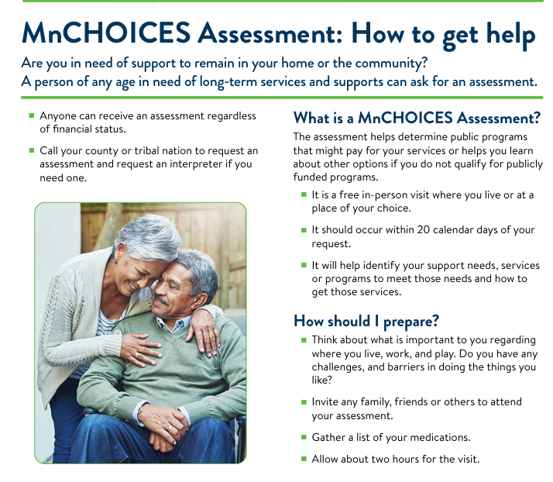
Minnesota
MnCHOICES is a computer application used by counties, tribal nations and managed care organizations to support their assessment and support planning work for Minnesotans who need long-term services and supports (LTSS), regardless of age, type of disability or service needs.
Certified assessors, care coordinators and case managers work with people of any age with a disability or anyone in need of long-term services and supports. They use MnCHOICES to discuss your preferences and the supports you need to live a good life. Your responses determine eligibility for a number of public programs, including home and community-based services waivers and Community First Services and Supports. Its rules-based system ensures that everyone is treated equitably.
To improve the state's long-term services and supports assessment and support planning process, DHS worked with FEI Systems to develop the MnCHOICES computer application. The application:
Eliminates the need for multiple assessments to receive needed supports and services.
Helps you choose how you want to live, learn, work and play through the assessment and support-planning process.
Ensures consistency and equal access to services and supports statewide.
Notes:
https://mn.gov/dhs/partners-and-providers/news-initiatives-reports-workgroups/long-term-services-and-supports/mnchoices/

Slide 24
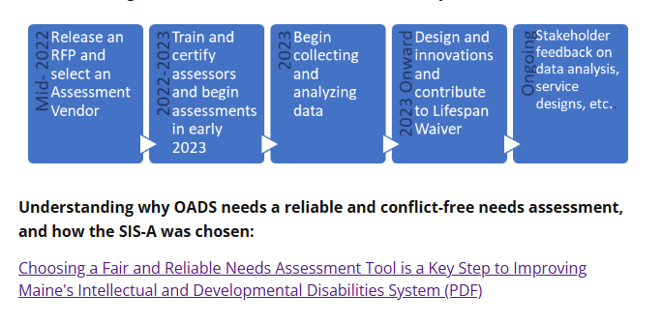
Maine
SIS-A Implementation Project
The Department of Health and Human Services recognizes the need for a new standardized needs assessment tool for individuals with Intellectual and Developmental Disabilities (IDD) or Autism. In partnership with service recipients, families, providers, and other stakeholders, the Department has selected the SIS-A 2nd Edition for use in Maine. The SIS-A is intended to be used for all participants in the planned Lifespan Waiver and in 2023 and 2024 is being used to inform the Lifespan design, and to support Person Centered Planning. This project began in May 2021 and is expected to continue through March 2025.
This project is part of reform work that is already underway at the Department’s Office of Aging and Disability Services (OADS). The implementation of this assessment tool is expected to provide fair and equitable determinations of need as well as other beneficial changes and efficiencies within the IDD service system.
Notes:
https://www.maine.gov/dhhs/oads/about-us/initiatives/needs-assessment-implementation-project

Slide 25
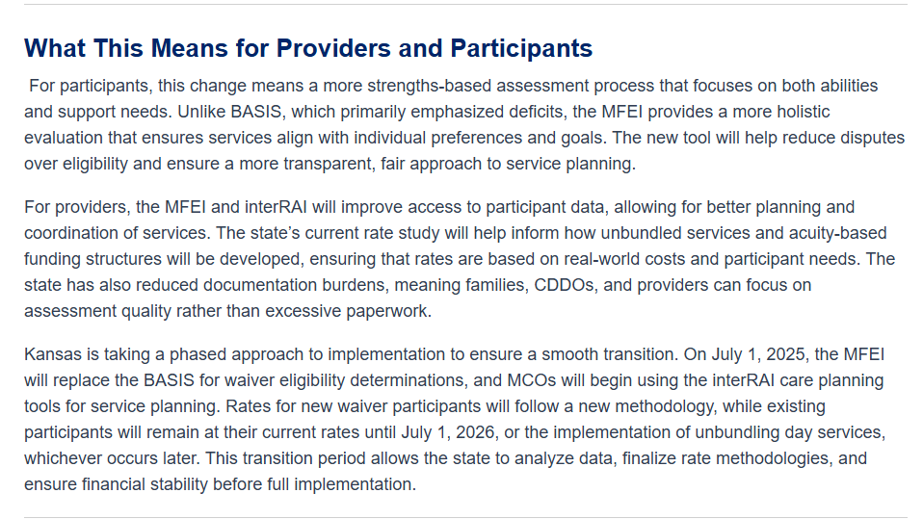
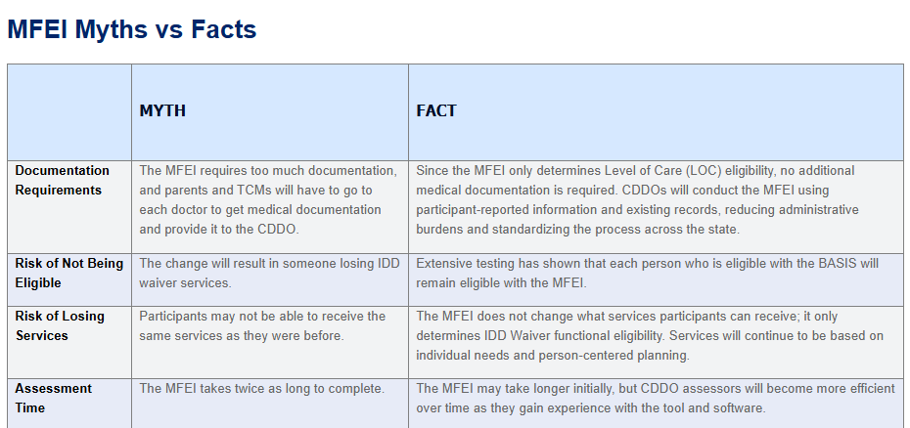
Kansas
Kansas is implementing the Medicaid Functional Eligibility Instrument (MFEI) as part of a broader effort to modernize how supports for individuals with intellectual and developmental disabilities (IDD) are assessed and provided. The IDD Modernization Committee strongly recommended transitioning away from the BASIS assessment, which has long been criticized for being deficit-based and failing to provide a complete picture of an individual’s strengths and support needs.
The shift to the MFEI, built on the interRAI framework, ensures that functional eligibility determinations are more accurate, standardized, and person-centered. In addition, Kansas is currently conducting a rate study to inform future rates and funding models. While new rate methodologies have not been finalized, the MFEI and interRAI tools will provide critical data to ensure that funding aligns with actual service needs rather than outdated assessment models.
Notes:
https://www.kdads.ks.gov/services-programs/long-term-services-supports/home-and-community-based-services-hcbs/i-dd-waiver-program-modernization/medicaid-functional-eligibility-instrument-mfei-and-interrai-care-planning

Slide 26
Assessment-focused member communications
What assessment communications would you want to see Iowa HHS develop for members?
Topics and language
Format and methods for sharing
What worked well in peer state communications materials? What didn’t?
Notes:
Kimberly facilitates: What would a great waiver redesign communications campaign look like? What information, in what format, do members need? (probe for: 1) elements of HOME Comms to date that work well, 2) examples from peer states that Iowa should borrow, 3) communications strategies to address misconceptions of HOME, and 4) communications strategies to support transparency in spite of pending decisions
Claire facilitates: What information, in what format, do providers need? What should HHS steer clear of in waiver redesign communications? What messages or communications approaches might reduce trust? What should HHS do instead to communicate effectively with members and providers? (Focus on finding strategies to address any challenges, facilitation should make sure this doesn’t turn into a vent session)

Slide 27
Questions?

