Slide 1
Iowa Hope and Opportunity in Many Environments (HOME)
Steering committee
meeting
March 25, 2025

Slide 2
Quick Reminders
We record these meetings to help us write high-level meeting summaries.
Topics and documents we share and discuss are for internal purposes and should not be shared outside of the steering committee.

Slide 3
Agenda
HOME Redesign Strategic Communications Planning
REACH
Next Steps

Slide 4
HOME Redesign Strategic Communications Planning

Slide 5
Background
Overview of HOME member & provider strategic communications plans
Approach to developing communications plans
Need for steering committee input
Notes:
-Mathematica and HHS are working on strategic communications plans for members and providers to make sure both groups have clear, complete, and accurate information about redesign decisions and activities
-discuss peer state research, engaging HOME/HHS SMEs & reviewing past project input from Iowans to identify communications needs
-note steering committee has provided great input on communicating with members to date (brief summary), and note this conversation is focused on the communications needed leading up to and during redesign go-live. Heads up about this being the beginning of steering committee input, we will be asking for more specific feedback on how to communicate specific policy needs in coming months.

Slide 6
Peer State Medicaid Redesign Communications Campaign Review
OhioRISE
Indiana Pathways for Aging
Notes:
Explain why these were campaigns we reviewed, and what we looked for

Slide 8
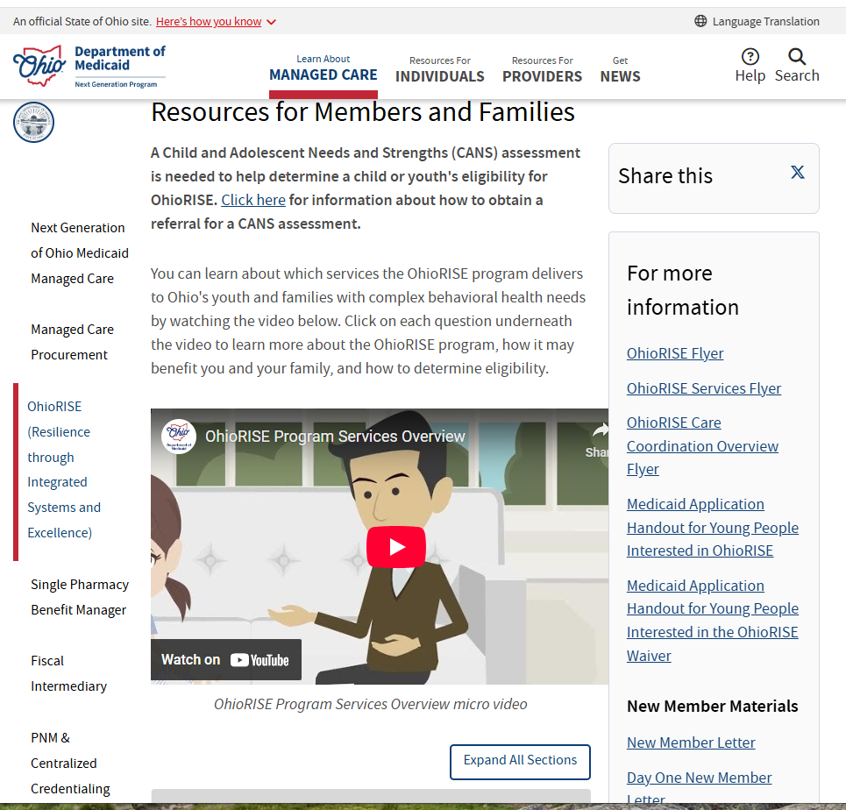
OhioRISE
Member Communications
Flyers
Videos & webinars
Member-focused FAQs
Newsletters & “launch reports”
Member notices, letters, application handouts, quick guides, and handbook

Slide 9
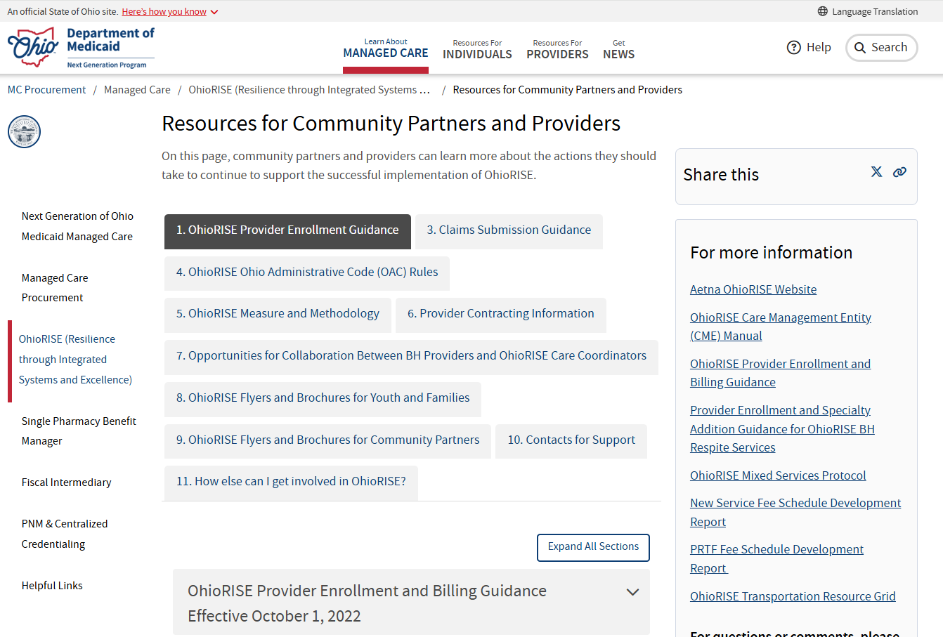
OhioRISE Provider & Community
Partner Communications
Enrollment & claims submission guidance
Administrative Code rules
Brochures for families and community partners
Provider-focused FAQs
Community & Provider trainings

Slide 10
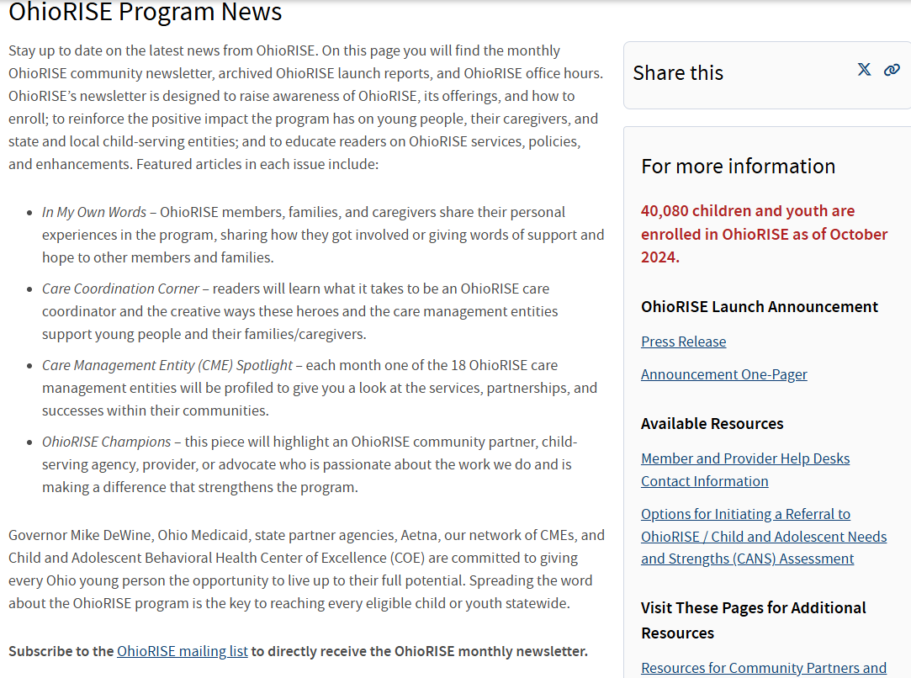
OhioRISE Program News
Newsletters and launch reports
Office hours
Press release
Member & provider help desk contact

Slide 11
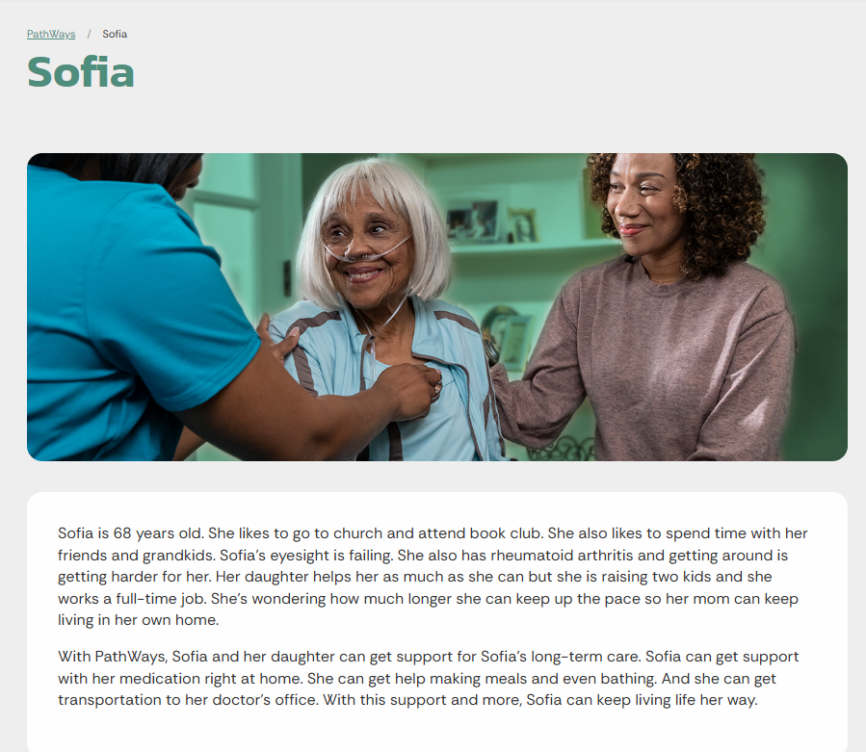
Indiana Pathways for Aging
Homepage
Commercial & description
Informational webinars
Audience subpage links
Call center
Rollout timeline
Personas

Slide 12
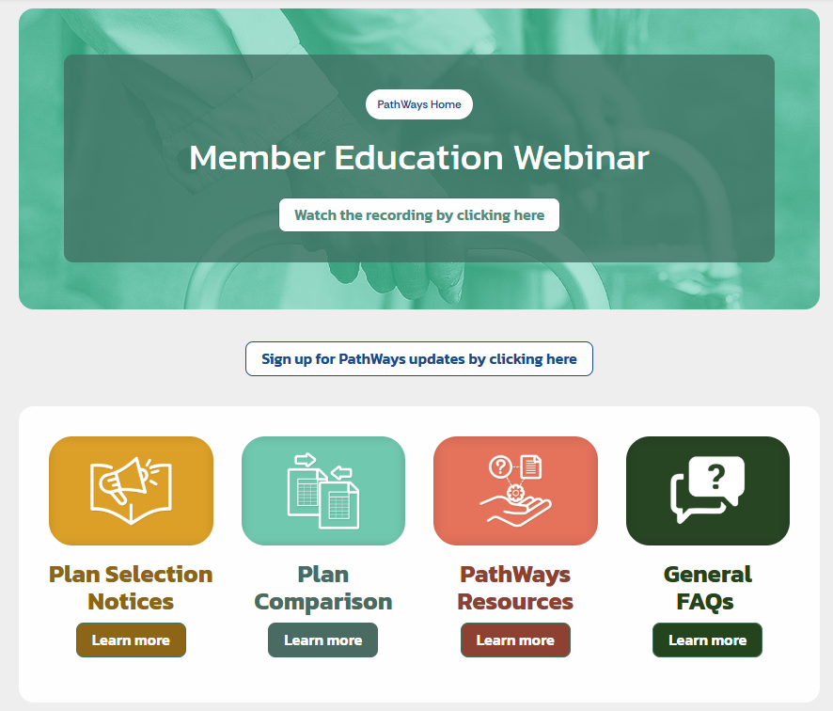
PathWays Member Page
Education webinar
Contacts
Commercial
Glossary
Member notices
Plan comparison tables
General FAQs

Slide 13
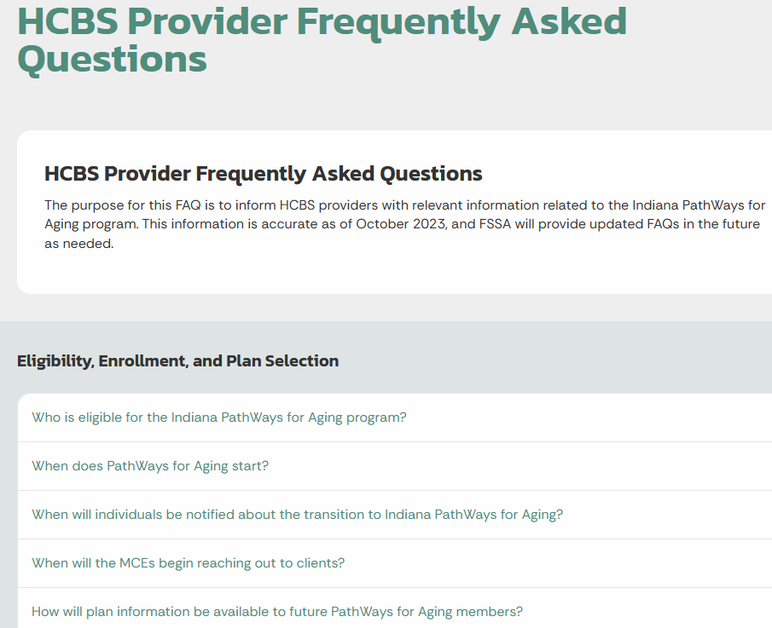
PathWays provider materials
Provider video
Provider FAQs
Provider manuals
Provider helplines
Provider communications update, claims training, authorization, and member enrollment webinars
Notes:
https://www.in.gov/pathways/provider-frequently-asked-questions/

Slide 14
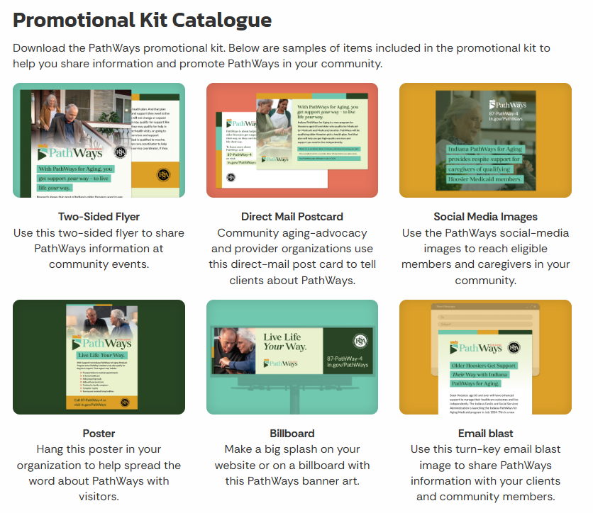
PathWays Promotional Kit
Flyers
Postcards
Posters
Emails
Social media
Billboard

Slide 15
PathWays Key Policy Decision Log
Presents topic, policy decision, final recommended decision, and decision date for 22 key decisions from Spring 2021-Spring 2022. Decisions categorized as:
Decisions complete or nearly complete
Decisions under consideration
Future decisions for consideration with stakeholders
Notes:
https://www.in.gov/pathways/files/LTSS-Decision-Log-Draft-December.pdf

Slide 16
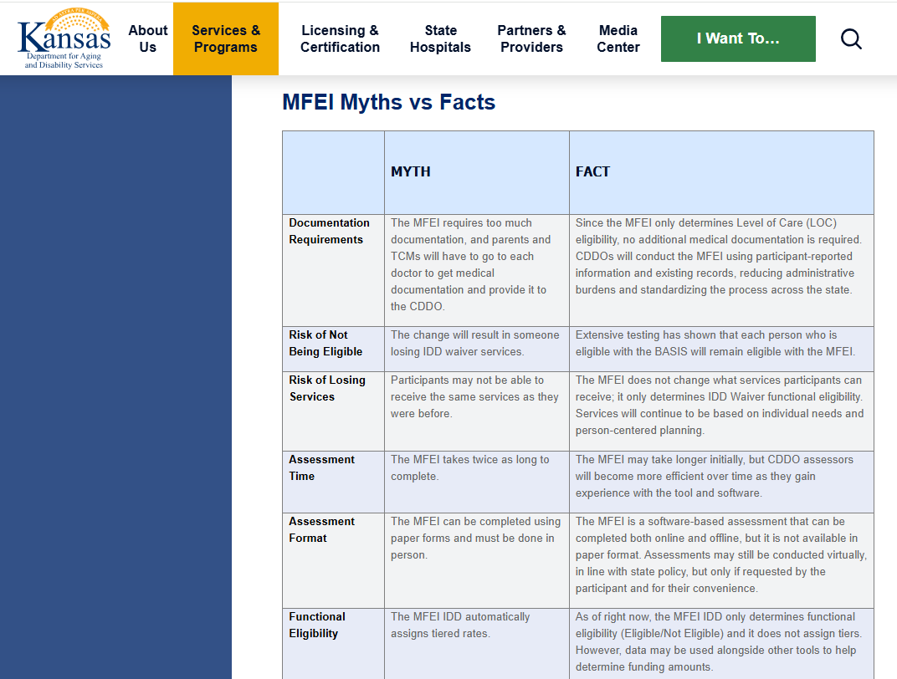
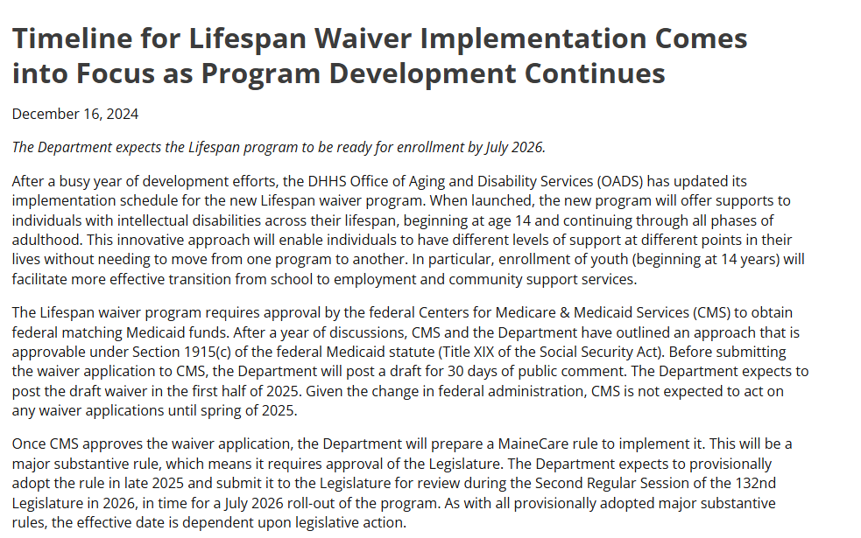
Additional Peer State Best Practices (Kansas & Maine)
Approaches to addressing misconceptions, explaining timeline shifts, and communicating reasoning behind policy changes.
Myths vs Facts tables
Blog post explaining redesign rollout timeline
Language on why each change is being made, and what the change will mean for providers and participants
Office hours and informational tours
Notes:
https://www.maine.gov/dhhs/blog/timeline-lifespan-waiver-implementation-comes-focus-program-development-continues-2024-12-16
https://www.kdads.ks.gov/services-programs/long-term-services-supports/home-and-community-based-services-hcbs/waiver-programs/intellectual-developmentally-disabled-i-dd/i-dd-waiver-program-modernization

Slide 17
Waiver Redesign Strategic Communications Planning Brainstorming
What would a great waiver redesign communications campaign look like?
What information, in what format, do members need?
What information, in what format, do providers need?
What should HHS steer clear of in waiver redesign communications?
What messages or communications approaches might reduce trust?
What should HHS do instead to communicate effectively with members and providers?
Notes:
*Kimberly definitely welcome feedback/additions here. I was thinking we could somewhat informally flag some of the comms suggestions we’ve heard from task leads for feedback during brainstorming too?
Note we are looking for ideas, but also want insights on biggest bang for buck: communications don’t need to be super fancy, or too abundant, to be effective. We want to be efficient and strategic here.
Q1: probe for elements of HOME Comms to date that work well, things from peer state examples to borrow, things that have been missing in other Medicaid policy changes that should be better this time around.
Q2: focus on finding strategies to address any challenges, facilitation should make sure this doesn’t turn into a vent session

Slide 18
Iowa REACH Initiative
Responsive and Excellent Care for Healthy Youth Initiative

Slide 19
Iowa REACH Overview
Iowa REACH is a new Iowa Medicaid initiative focused on developing, improving, and strengthening home and community-based behavioral health services for children and adolescents with serious emotional disturbance in Iowa.
Notes:
Iowa REACH is a new Iowa Medicaid initiative to help kids and youth with mental health challenges thrive at home and in their communities. Iowa REACH is focused on helping kids and youth who have a serious emotional disturbance, a severe mental health challenge that makes it harder for them to engage with friends, succeed at school, or live a healthy life in their community.
The initiative is focused on improving services that help kids and youth live at home instead of in institutions. Receiving these services helps kids develop into healthy and independent adults.
Examples of helpful services include things like:
Day programs that focus on social skills, communication, and understanding emotions
Coaching for a child’s family members to learn coping strategies
Help managing medications or personal hygiene
Case management
Transportation to appointments
Respite services that give a break to both the child and caregiver

Slide 20
Background of Iowa REACH
In 2023, plaintiffs representing Medicaid-eligible children with serious emotional disturbance brought a class action lawsuit against the State of Iowa.
The lawsuit focused on access to mental and behavioral health services.
In January 2025, a federal court preliminarily approved a Settlement Agreement with an Implementation Plan for Iowa REACH.
Notes:
In [2023], plaintiffs representing Medicaid-eligible children with serious mental and behavioral health needs brought a class action lawsuit against the State of Iowa. They argued that the Iowa HHS administers an inadequate mental health service system that does not provide children and youth with behavioral health services required by the Medicaid Act. (C.A. v. Garcia, case number 4:23-cv-00009-SHL-HCA, United States District Court for the Southern District of Iowa).
This January, a federal court preliminarily approved the Settlement Agreement in the class action lawsuit brought against Iowa HHS to ensure that children with mental health disabilities receive the legally required and medically necessary mental health care services. The final approval hearing is set for early May.
The settlement agreement requires Iowa HHS to develop and roll out a set of key services statewide including care coordination, in-home mental health services, and mobile crisis services.
It includes an Implementation Plan or high-level plan for how HHS will improve and strengthen intensive HCBS for children and adolescents with SED in Iowa.
The full plan and information on the legal actions is available on Iowa’s website.
https://hhs.iowa.gov/initiatives#children-mental-health-lawsuit

Slide 21
Governance Structure
Implementation Team
Communications subcommittee
Assessment Tool subcommittee
Care Coordination subcommittee
Service Development and Provider Capacity subcommittee
Quality Improvement and Accountability subcommittee
Consumer Steering Committee
Notes:
In January, Iowa launched an Implementation Team responsible for coordinating and overseeing the REACH Implementation Plan. The Implementation Team also has subcommittees on:
Communications
Identification of an assessment tool
Intensive care coordination
Service development and provider capacity
Quality improvement and accountability
REACH also has a Consumer Steering Committee that has members who have lived experience in one of the following areas: being a young person in Iowa, navigating the behavioral health system in Iowa, a parent or guardian that has or is supporting a child or youth with behavioral health needs in Iowa.
The Implementation Team, Consumer Steering Committee and the Subcommittees are authorized to make formal recommendations to Iowa as it designs and improves services for youth with SED.

Slide 22
REACH Update
The Iowa HHS website has been updated to include a new section focused on Iowa REACH.
https://hhs.iowa.gov/initiatives#children-mental-health-lawsuit
Iowa REACH | Health & Human Services

Slide 23
Questions?

