Slide 1
Provider Education
Medicaid Presumptive Eligibility (PE) Policy and Medicaid Presumptive Eligibility Portal (MPEP) Training

Slide 2
Presumptive Eligibility Training Agenda
Presumptive Eligibility (PE)
ACA
MAGI Rules
PP/QE
Roles/Responsibilities
Programs
Medicaid PE Portal
View Applications
Complete Applications
Appeals
Support
Presumptive Eligibility Resources
Policy
Technical
Withdrawals
PE Summary and Self-Quiz
Flow
ACA
Applications
Polices
MPEP

Slide 3
Presumptive Eligibility Policies
ACA, MAGI Rules, PP/QE, Roles/Responsibilities, Programs

Slide 4
Affordable Care Act (ACA)
The Patient Protection and Affordable Care Act was signed into law in 2010.
This law is a comprehensive health care reform. The ACA has impacted health care availability and eligibility determination, including presumptive eligibility.

Slide 5
Affordable Care Act (ACA)

Slide 6
Presumptive Eligibility and Programs
PE refers to a government program that offers immediate health services access by providing temporary health insurance through Medicaid or Children’s Health Insurance Program (CHIP).
Presumptive Provider
Organization that approves PE determinations
Authorized by state agency
Only employees of PP have authority to make PE determinations
May not delegate PE authority to another entity, subcontractor, or agent
Qualified Entity
Individual authorized to determine Presumptive Eligibility
Under the supervision and authority of a Presumptive Provider

Slide 7
PE determination is based on MAGI Rules
Modified Adjusted Gross Income (MAGI) Rules:
Tax rules determine the income to be counted for eligibility
Household (HH) size is based on the tax-filing unit
Taxpayer’s family size includes all claimed dependents
MAGI defines HH size to use when no taxes are filed
Different people in same HH may have different MAGI HH
Child support is excluded from taxable income

Slide 8
Inform the applicant of the following application information:
All information entered on the application must be known by the applicant to be true
An application signature is required and, if information has been falsified, the individual is subject to penalties of perjury
After PE determination, applications are automatically forwarded to HHS via MPEP for ongoing Medicaid determination, per client request. Submission of paper documentation to HHS is not needed.
All applicants may opt out of applications being processed for ongoing Medicaid benefits
For ongoing Medicaid benefits, additional information and verifications may be required (does not impact PE)
Medicaid determination ends PE benefits
Inform applicant of Iowa Medicaid Estate Recovery Program
Provide applicant with a copy of Rights and Responsibilities Comm. 233

Slide 9
QE Responsibilities: Process & Inform
The QE is responsible for processing the application with all client-reported information. The QE is also responsible for informing the applicant of the next steps with HHS processing the ongoing Medicaid application.
Application is valid and must be date stamped on the date submitted to QE with applicant’s name, address, and signature under penalty of perjury at the bottom of page 16 of Application for Health Coverage and Help Paying Costs.
All necessary information must be obtained from applicant before application can be entered and completed in MPEP.
All valid applications must be submitted for processing in MPEP. Contact MPEP Support desk if unable to enter application in MPEP.

Slide 10
QE Responsibilities: Process & Inform
QE who fails to ensure that complete and accurate information is obtained from the applicant and entered into MPEP may lose the certification to act as QE and process PE applications.

Slide 11
Process the Application
Enter ALL client-reported information into MPEP
A postponed entry into MPEP will result in delayed eligibility
Eligibility cannot begin prior to entry into MPEP
Print and Maintain Documentation
Print the Notice of Action (NOA) and Right and Responsibilities (R&R) Comm. 233.
Provide the applicant with the printed NOA and R&R as soon as possible but no later than two (2) working days after the date of determination.
Print a PDF of the PE application and NOA for the QE file.
QE must provide the client with a printed copy of the application, NOA and R&R.
Date stamp the application upon receipt
Maintain PE records for five (5) years

Slide 12
QE Responsibilities: Documentation
After processing the application and providing the applicant with the PE and Medicaid information, the QE is responsible for printing and providing the NOA, application and Right and Responsibilities to the client. The QE file must have a copy of the NOA and application. The QE/Presumptive Provider (PP) is responsible for maintaining the PE records for five (5) years.

Slide 13
QE Responsibilities: When approval results in BCCT presumptive eligibility
The QE must complete all actions listed in the previous slide, and in a separate document provide HHS the items listed below:
Person’s Name and Date of Birth
Verification the person has been screened under the breast and cervical cancer early detection program (BCCEDP)
Need for treatment for breast or cervical cancer
Anticipated initial length of treatment
Does not have other creditable coverage
Name of approved BCCEDP provider:
Example: Holly Jones, RN,BSN, Care For Yourself, Iowa Breast and Cervical Cancer Program Coordinator
Note: This is only required when a PE BCCT applicant is also applying for ongoing Medicaid.

Slide 14
QE Responsibilities: When approval results in BCCT presumptive eligibility and applicant is also applying for ongoing Medicaid.
The information listed on the previous slide should be sent to HHS using the Upload Documents feature within MPEP. Refer to slides 113-117 later in the presentation for information on uploading documents in MPEP. Information can be submitted using Medicaid Treatment Option Eligibility Verification form:
Other forms are acceptable as long as all the required information is listed.

Slide 15
When approval results in BCCT presumptive eligibility and applicant is also applying for ongoing Medicaid AND the Upload Documents feature in MPEP results in an error.
If unable to upload the documents using the Upload Documents feature in MPEP due to an error, then the BCCEDP provider may email the required information to:
IMEMPEPSupport@dhs.state.ia.us

Slide 16
Application Process
Step 1
Paper Application and addendum or Applicant to give the information
Step 2
Information Entered into MPEP
Step 3
PE Determined and Print Signature page from MPEP (if no paper application)
Step 4
Application is automatically forwarded to Iowa HHS via MPEP. Submission of paper documentation to HHS is not needed.

Slide 17
Application Process Summary
The PE Application process begins with the QE entering all client reported information into MPEP which makes the PE determination. If verbal information is obtained without paper application, you must print the signature page from MPEP. The application is then automatically forwarded to HHS via MPEP for ongoing Medicaid determination, if client requested. Submission of paper documentation to HHS is not needed

Slide 18
PE Rules
PE has very specific rules regarding eligibility determination. These rules determine the acceptance and denial of benefits and the eligibility for Presumptive Types.
Must be an Iowa Resident
Must be US citizen or qualified alien
Exceptions: Pregnant Women and Breast and Cervical Cancer Treatment (BCCT) Applicants
PE based on the applicant statements regarding circumstances and income; self-attestation
PE is not retroactive
Applicant may not have received PE in past 12 months
Exceptions: Pregnant Women and BCCT Applicants

Slide 19
PE Self Attestation
PE is based on the applicant’s self-attested circumstances
The QE must also document clarification of any information provided by the applicant as part of the file the QE maintains to support the PE decision
If the self-attested applicant information entered in MPEP remains questionable after clarifying the situation with the household, the QE should let HHS know by emailing the MPEP Support desk (IMEMPEPSupport@dhs.state.ia.us or calling the HHS Contact Center 855-889-7985

Slide 20
PE Self Attestation (Continued)
A QE who becomes aware of discrepancies or questionable information reported by an applicant must clarify the situation with the household
The QE is responsible for obtaining correct information about ALL people in the applicant’s household (including tax household) and MUST also ensure that all current income of anyone in the household is reported accurately.

Slide 21
PE Self Attestation (Continued)
If the QE has information in their other office paperwork (e.g. SSN, income, other household members) that is not reported on the PE/Medicaid application, this is a discrepancy the QE is required to clarify.
QE who fails to ensure that complete and accurate information is obtained from the applicant and entered into MPEP may lose the certification to act as QE and process PE applications.

Slide 22
PE Rules
PE information must be entered into MPEP exactly as documented on the application no later than three working days after receipt of the application
Enter information in MPEP as attested by applicant
All PE group applicants (PW, BCCT, Children & Hospital groups) can opt out of ongoing Medicaid determination inside of MPEP at this time
Applicants have the right to file an appeal of the Eligibility Decision, however Appeal Hearings are not granted for PE Medicaid Applications 441 Iowa Admin. Code 7.5(2)(a)(6)
PE rules include the type of information the applicant needs to provide, as well as how and when the applicant information is to be entered into the system.

Slide 23
PE Rules (Continued)
PE is granted on a daily basis, rather than monthly basis
Coverage through end of month after application month
Note:
PE may end earlier, if the ongoing Medicaid eligibility determination is made
PE may continue longer, if the ongoing Medicaid application is in a pending status
PE Rules determine the type of benefits for which the applicant is eligible and the length of time for which those benefits are available

Slide 24
Hospital Groups Name Change (Adults and Children)
MPEP still shows Hospital group
Adults & Children is the actual group
Any QE approved for Hospital can use Adults & Children PE category

Slide 25
PE Program Types: There are six (6) types of PE Programs: Pregnant Women, BCCT, Children, Iowa Health and Wellness Plan, Parents/Caretakers and Expanded Medicaid for Independent Young Adults (E-MIYA)/Former Foster Care.
PE Program Types
BCCT
Children
Hospital (Adults& Children)
Pregnant Women
Iowa Health and Wellness Plan
Parents/ Caretakers
Former Foster Care (E-MIYA)
Children (under Hospital Group tab)

Slide 26
Pregnant Women (PE only once per pregnancy) - Citizenship/Qualified Alien status is not an eligibility factor - Income limit: 215% Federal Poverty Level for MAGI HH size - Ambulatory prenatal care: Medicaid-covered services except inpatient hospital or institutional care and charges associated with delivery of baby (including miscarriage or pregnancy termination)
PE Program Types
BCCT
Children
Hospital (Adults& Children)
Pregnant Women
Iowa Health and Wellness Plan
Parents/ Caretakers
Former Foster Care (E-MIYA)
Children (under Hospital Group tab)

Slide 27
Breast and Cervical Cancer Treatment - Qualified Alien status is not an eligibility factor - Under age 65 - Screened and diagnosed: Breast/Cervical pre-cancer/cancer results in - need for treatment - No creditable insurance coverage Note: Only BCCEDP providers can determine BCCT PE
PE Program Types
BCCT
Children
Hospital (Adults& Children)
Pregnant Women
Iowa Health and Wellness Plan
Parents/ Caretakers
Former Foster Care (E-MIYA)
Children (under Hospital Group tab)

Slide 28
Breast and Cervical Cancer: Need for Treatment
Definitive treatment for breast or cervical cancer is needed, including treatment of a precancerous condition or early-stage cancer, and including diagnostic services necessary to determine the extent and proper course of treatment; AND more than routine diagnostic services or monitoring services for a precancerous breast and cervical condition are needed.

Slide 29
Breast and Cervical Cancer: Creditable Coverage
Any plan that covers hospital or physician care (or both) for treatment of the person’s breast or cervical cancer is creditable coverage for BCCT. Note: Medicare Part A or Part B are considered creditable coverage for BCCT.

Slide 30
Breast and Cervical Cancer: Creditable Coverage
A person does not have creditable coverage for BCCT if:
Coverage is limited, such as dental, vision, or long-term care, or coverage only for a specified disease or illness [other than breast or cervical cancer]
Their policy does not cover treatment of breast or cervical cancer.
They are in a period of exclusion for treatment of breast or cervical cancer (such as a pre-existing condition).
They have exhausted their lifetime limit on all benefits under their plan.

Slide 31
Children - Under age 19 - Family income limit is 302% of Federal Poverty Level (FPL) for children ages through 18 years of age
PE Program Types
BCCT
Children
Hospital (Adults& Children)
Pregnant Women
Iowa Health and Wellness Plan
Parents/ Caretakers
Former Foster Care (E-MIYA)
Children (under Hospital Group tab)

Slide 32
Adults & Children Group - May process five (5) types of PE programs - Hospital/Adults & Children QE: Only ones allowed to do PE determinations for Iowa Health and Wellness Plan, Parents/Caretakers, and E-MIYA - May process determinations for patients and non-patients -- Only BCCEDP hospitals may do all six (6) types of PE
PE Program Types
BCCT
Children
Hospital (Adults& Children)
Pregnant Women
Iowa Health and Wellness Plan
Parents/ Caretakers
Former Foster Care (E-MIYA)
Children (under Hospital Group tab)

Slide 33
Iowa Health and Wellness Plan - Ages 19 through 64 - Not pregnant - Not eligible for Medicare or Medicaid - Dependents in home have, or are applying for, insurance - Income limit is 133% Federal Poverty Level (FPL)
PE Program Types
BCCT
Children
Hospital (Adults& Children)
Pregnant Women
Iowa Health and Wellness Plan
Parents/ Caretakers
Former Foster Care (E-MIYA)
Children (under Hospital Group tab)

Slide 34
Parents and Caretakers (Includes Spouses) - Parent/caretaker of dependent child under age 18 (or 18 and still in high school) - Caretaker is adult who takes on parental role/responsibilities - Monthly Income limit is $1033 for HH of four - Income limit varies by HH size
PE Program Types
BCCT
Children
Hospital (Adults& Children)
Pregnant Women
Iowa Health and Wellness Plan
Parents/ Caretakers
Former Foster Care (E-MIYA)
Children (under Hospital Group tab)

Slide 35
E-MIYA/ Former Foster Care - Age 18 though 25 - No income test for E-MIYA - At the age of 18 or older was concurrently enrolled in Foster Care and Medicaid in any state
PE Program Types
BCCT
Children
Hospital (Adults& Children)
Pregnant Women
Iowa Health and Wellness Plan
Parents/ Caretakers
Former Foster Care (E-MIYA)
Children (under Hospital Group tab)

Slide 36
MPEP
View Applications, Complete Applications, Appeals, Support

Slide 37
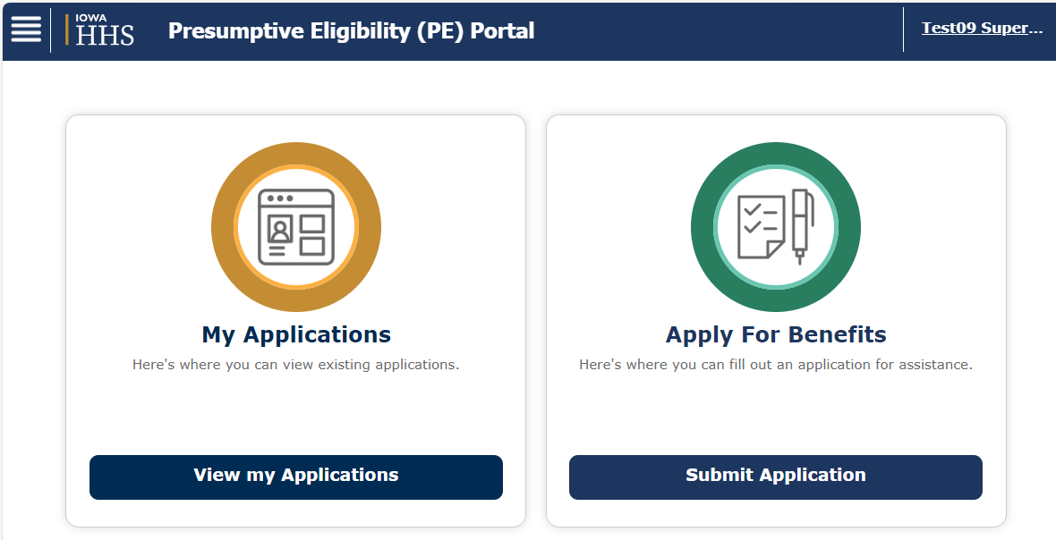
MPEP
MPEP is Iowa’s online Presumptive Eligibility Determination portal used by Presumptive Providers to enter PE Applicant information, run Eligibility Determination, and create Notice of Actions. MPEP sends PE applications to ELIAS, the HHS Eligibility system, for determination of ongoing benefits, if client requested.

Slide 38
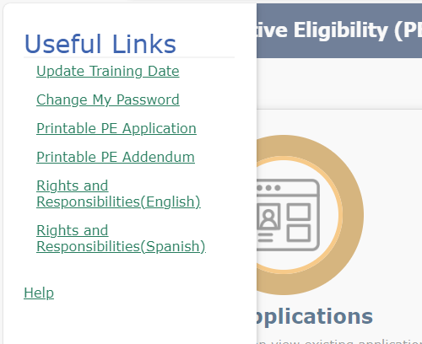
Useful Links
To view Useful Links, click the lines in the upper left corner.

Slide 39
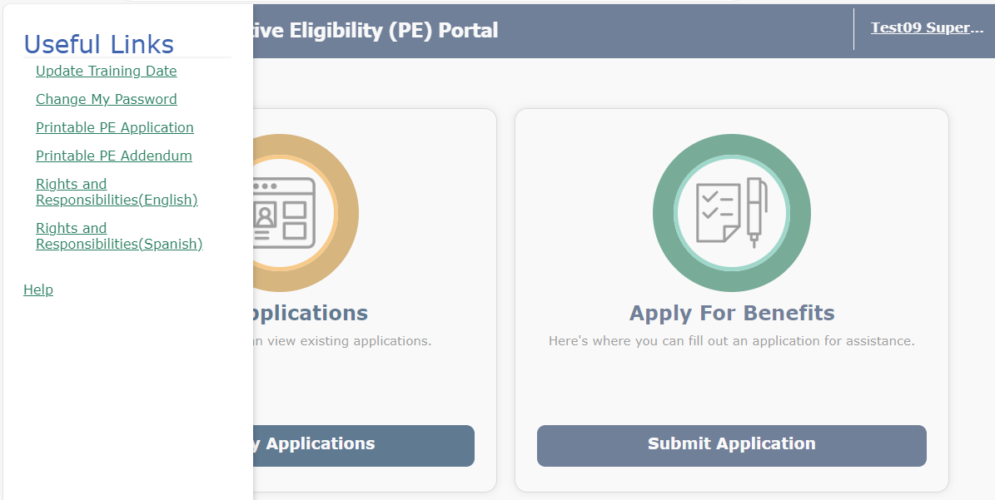
Client Signature (Required)
There are two options for obtaining the client signature.
Paper application and addendum are printed from MPEP site, then completed and signed by the client.
The QE enters client information directly into MPEP and prints the signature page for the client to sign.

Slide 40
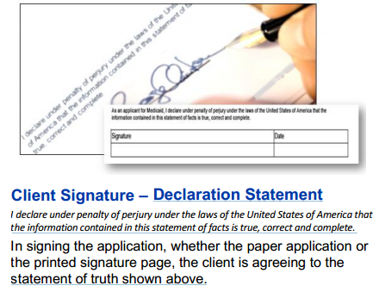
Applicant (Client) Signature is a Requirement
Client Signature – Declaration Statement
I declare under penalty of perjury under the laws of the United States of America hat the information contained in this statement of facts is true, correct and complete.
In signing the application, whether the paper application or the printed signature page, the client is agreeing to the statement of truth shown above.

Slide 41
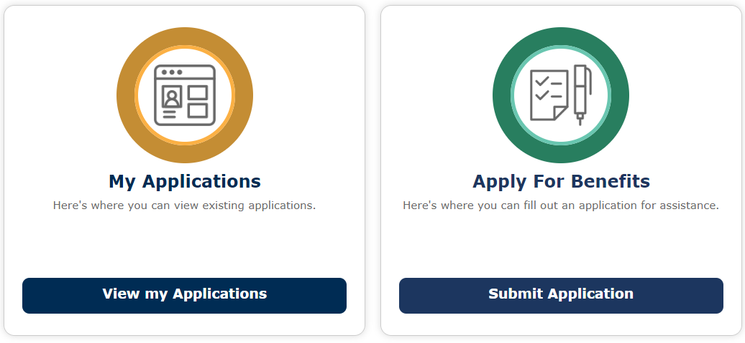
Portal Homepage
MPEP Homepage shows the two portlets available to users.
My Applications: (Existing applications)
Search, view, access, and update PE applications
Apply for Benefits: (New applications)
Start, complete, and submit PE applications

Slide 42
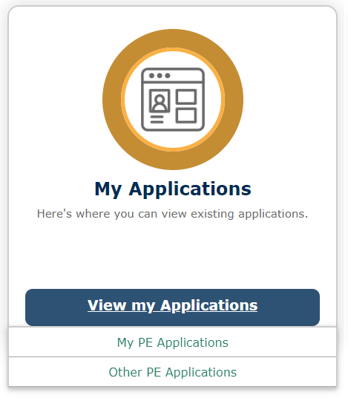
View My Applications
By hovering over View My Applications, additional menu items appear. Qualified Entities can view, access, and update applications based on their security roles. QE can search for and view all of their own PE applications. QE has 30 days to complete unfinished applications in MPEP. QE Supervisors can view the applications of the workers assigned within their provider organization.
At least one QE supervisor is recommended. Supervisor access grants access to all PE types, HOWEVER, it is only appropriate to enter applications for your approved PE types(s).

Slide 43
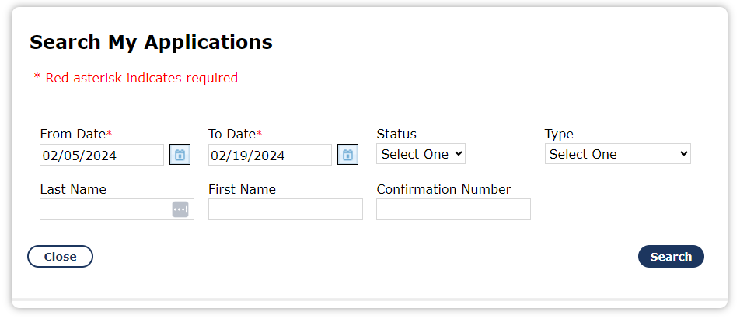
Search by Application Date or by Name
Date Search: Users can search for an application by using specific date ranges. Date range for completed applications cannot span more than 30 days.
Name Search: Users can search for an application using the applicant’s last name and first name or last name and first initial.

Slide 44
Search by Confirmation Number
Confirmation Number Search: Users can search by the confirmation number. This number is generated after the application has been submitted and is displayed on the confirmation page. Incomplete or expired applications do not have confirmation numbers.

Slide 45
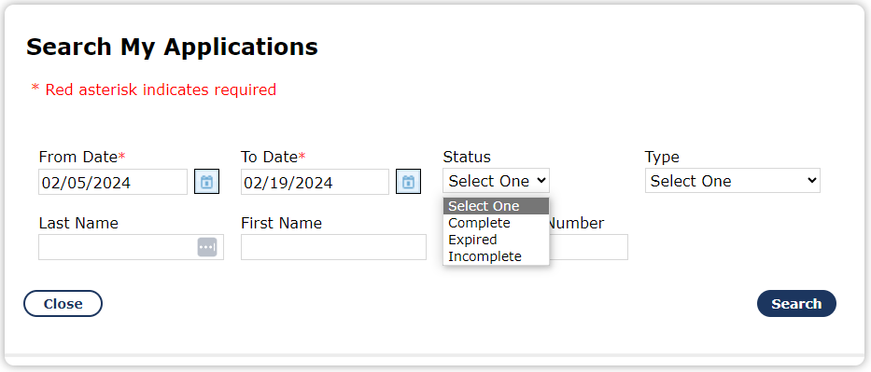
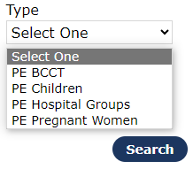
Search by Application Status or Type
Searches can be done using Application Status or Type.
Status:
Complete - Eligibility has been determined
Expired - Started, but not completed after 5 days
Incomplete - In progress
Type: BCCT, Children, Adults & Children (Hospital Groups), Pregnant Women

Slide 46
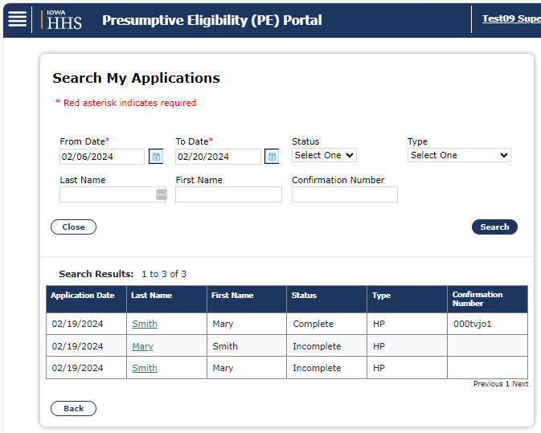
Search My Applications
When the search results appear, the user is able to view the status of the application. Incomplete applications can be opened by clicking on the last name hyperlink. A completed (submitted) application is not able to be opened or viewed.

Slide 47
Apply for Benefits
The Apply for Benefits portlet is where users begin the applications, complete in-progress applications, and submit PE applications for the program(s) for which they are authorized, based on their security roles.

Slide 48
Application Process
PE applicant information can be collected one of two ways:
Paper: Applicant completes Application for Health Coverage and Help Paying Costs and PE Addendum
Online: QE asks applicant the PE questions and enters then answers directly in MPEP

Slide 49
Data Collection for PE Determination
This portlet is the location of the online application. It is important that all client-provided information is entered into the application. The PE Determination and subsequent ongoing Medicaid eligibility will be the most accurate when all available information is entered.

Slide 50
Data Collection for Ongoing Medicaid Benefits
Some application data is not required for PE Determination, but will be used by HHS to process ongoing Medicaid applications, if applicable
Completing as many fields as possible reduces the number of information requests HHS must make of the applicant(s) and speeds up members’ benefit processing

Slide 51
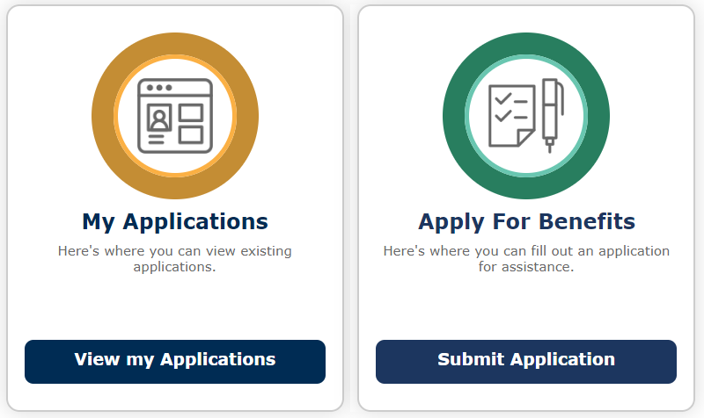
Tip: Eligibility Determination Calculations
ACA has changed PE eligibility determinations including household composition, size determination, and income and deduction inclusions. All PE calculations are completed by MPEP using the ACA rules and the client information. QE does not need to complete manual determinations.

Slide 52
Program Selection | Primary Applicant Information | Others in Household Information | Job and School Information | Income and Tax Information | Income and Tax Information | Application Submission
 | Name DOB Contact data App Date PE Info Language SSN Gender Medicaid Medicare Disability U.S. Born Residency Language Summary | Name DOB Contact data App Date PE Info Language SSN Gender Medicaid Medicare Disability U.S. Born Residency Language Summary | School Information Training School Name Part-Full Time Employment Information Hours of Work Weekly Gross Income Self-Employed Hours of Work Summary | Dividends Unemploy-ment Alimony Interest Dividends Retirement Accounts SSA Pensions 401K / IRA Tax Dependents Summary | Parental Control Work Health Insurance In-home Support Services Other Health Insurance Medicaid Medicare Cobra Summary

Slide 53
Data Completion
The application collects information in the following order: Primary Applicant, Other Household Members, Job and School, Income and Tax, Relationships, and Insurance Information. At any point during the application, the user can click one of the tabs to go to a different category area.

Slide 54
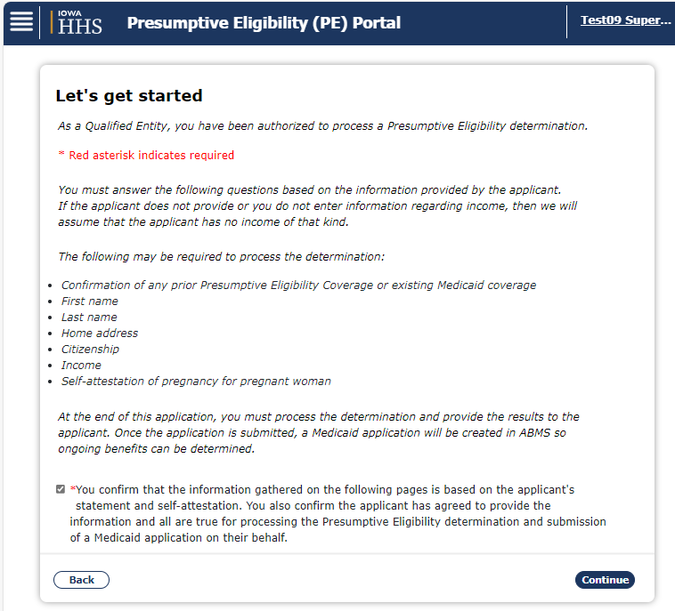
Let’s Get Started
This page addresses some of the QE responsibilities in processing a PE Determination. There is a required field the QE must click to confirm that the data being entered is based on client information provided for the processing of a Medicaid application.

Slide 55
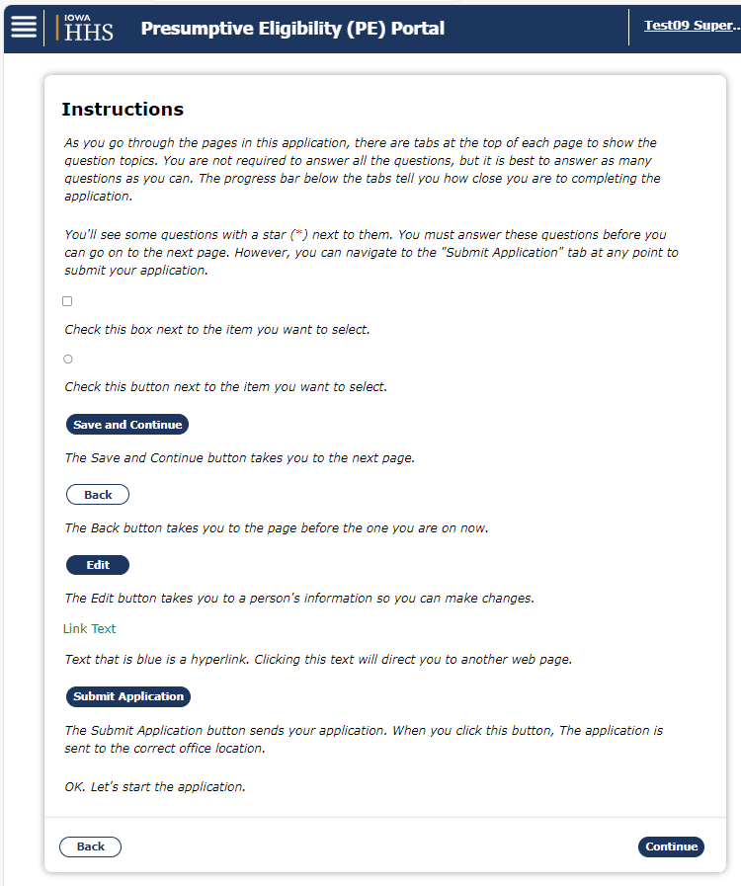
Tip: Application Instructions
The Instructions page gives an overview of basic system operations, including buttons and functions within the application. To go to a previous page, use the MPEP system back button and not the browser back button. It is important to note that a * indicates a field is required.

Slide 56
Required in MPEP system:
Name
Address
Application Date
Gender
Date of Birth
Applying for PE?
Type of PE?
Had PE in last 12 months?
Receiving Medicaid?
Resident of State?
Required to run eligibility: (does not show as required fields)
Born in US?
If no, eligible immigration status?
Additional fields required, if applicable, e.g. number of babies if pregnant, income/working, relationship, parental control
What are the required fields for PE in MPEP?
Note: QE is required to obtain and enter ALL information about the applicant’s current situation even if a field is not required by the system.

Slide 57
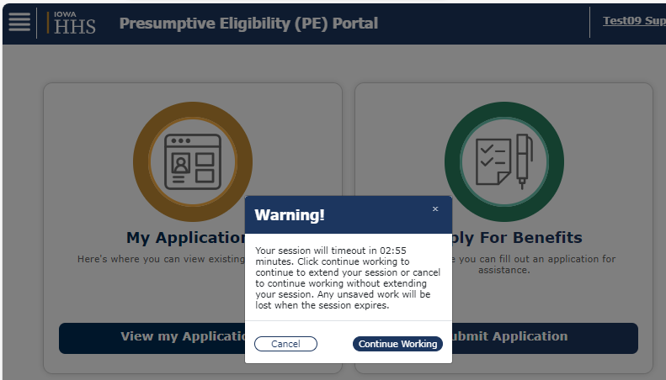
Tip: Session Timeout
For security purposes, MPEP sessions timeout after 5 idle minutes. A warning message appears 2 minutes before timing out. The user can continue with the session by clicking the Continue Working button.

Slide 58
Application Example: Household ABC
Name | Relshp | Info | Possible PE Programs | Benefits/Limits
Ani | Parent/ Spouse | Pregnant Parent | Pregnant Woman (PW) Adults & Children (Hospital Group) Parent/Caretaker Iowa Health and Wellness | PW Higher income limit Do not have to apply for full Medicaid Limited to ambulatory prenatal care Adults & Children (Hospital Group) Lower income limit Do not have to apply for full Medicaid Full Medicaid benefits
Bob | Parent/ Spouse | Parent | Adults & Children (Hospital Group) Parent/ Caretaker Iowa Health and Wellness | Same
Chaz | Son | 18 in HS E-MIYA | Children Adults & Children (Hospital Group) EMIYA | Children – Higher income limit E-MIYA – No income limit
Program Determination
An applicant may be eligible for multiple PE programs. It is the responsibility of the QE to know the options, requirements, and benefits of each PE Program Type in order to select the optimal program for the applicant(s).

Slide 59
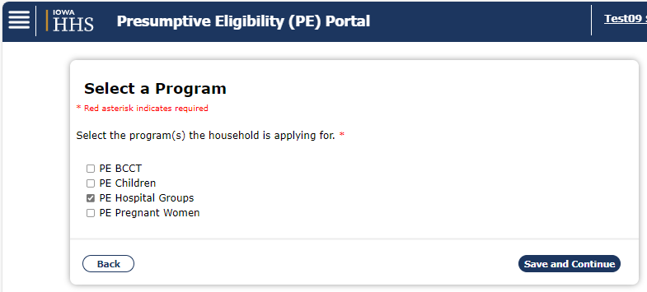
Select Program(s)
PE program(s) selection is the first part of the application. The QE must select at least one program for an application. Note: It is advisable to select all QE authorized programs shown on this page. Later in the application each applicant will be assigned, by the QE, to a specific program.
Adults & Children (Hospital) Group will be shown as Hospital Group

Slide 60
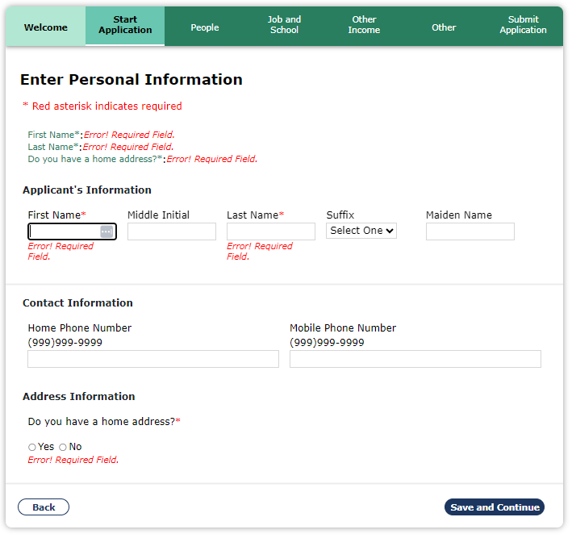
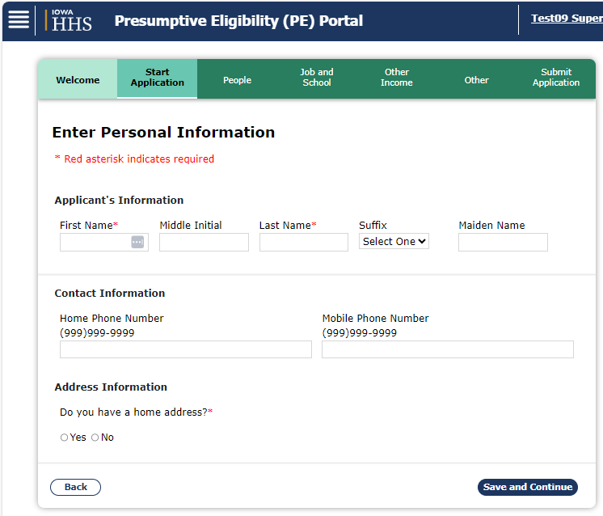
Enter Personal Information
The first data collection page includes basic information. Additional fields may display, depending on the address information. Note: If required information is missing or entered in an incorrect format an Error! message(s) will display after clicking the Save and Continue button.

Slide 61
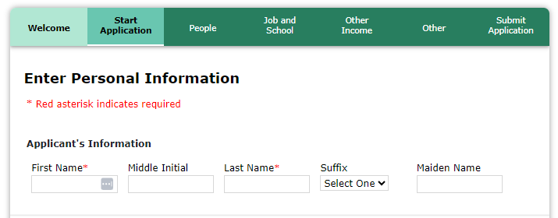
Primary Applicant
If a child has a parent or caretaker adult living with them, enter the adult as the Primary Applicant, regardless of whether the adult is applying for PE.
Entering a child as the Primary Applicant when other adults are in the household may cause incorrect ongoing Medicaid eligibility results.

Slide 62
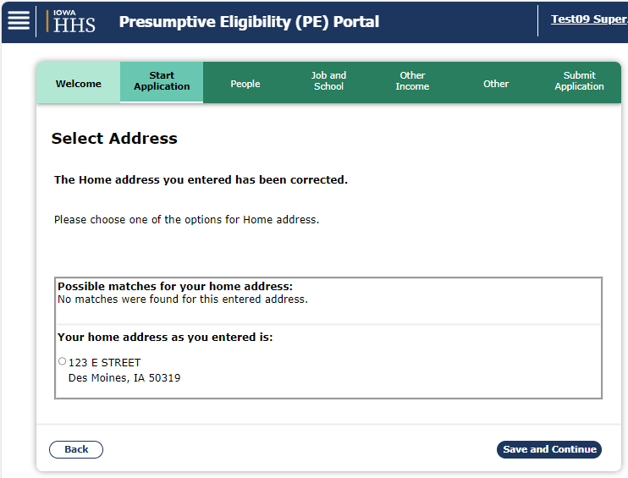
Select Address (A valid mailing address is required)
On this page, user entered address and system generated addresses are displayed. Select appropriate address and click ‘Save and Continue’ button.
Notes:
If both home/physical and mailing addresses are entered, the user must select one home/physical address and one mailing address. *Select the address that contains the county.
If the applicant indicates they are homeless, a valid mailing address must be obtained. Your hospital location cannot be used as a valid address.

Slide 63
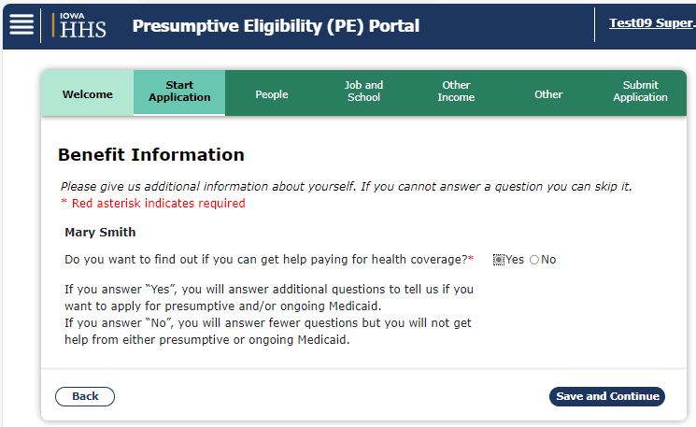
Benefit Information
If ‘No’ is selected to ‘Do you want to find out if you can get help paying for health coverage?’ question, the system will only ask relevant questions. If ‘Yes’ is selected, more information will be requested in subsequent pages.

Slide 64
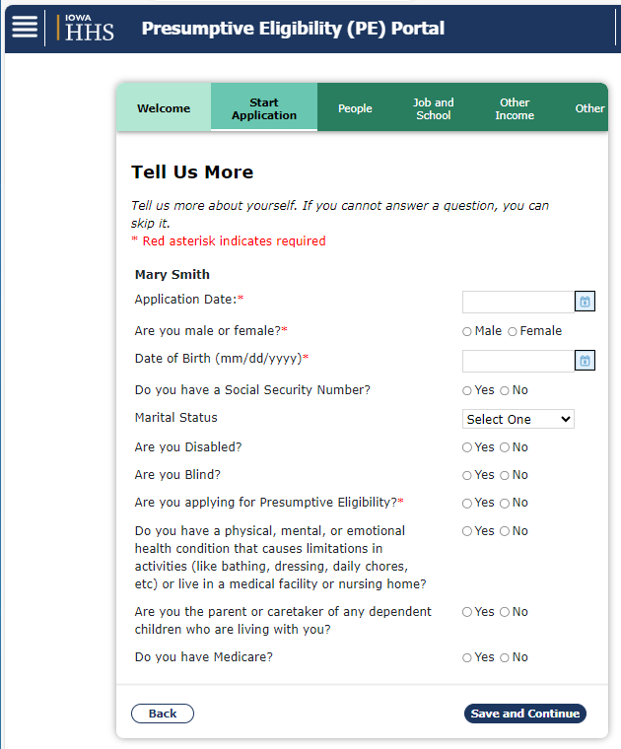
Upon answering ‘Yes’ to ‘Do you want to find out if you can get help paying for health coverage?’ question, the following necessary fields are displayed: *Application Date, *Gender, *DOB, *Applying for PE?, *PE Type, *Received PE in past 12 months? and *Current Medicaid Coverage?
Note: QE must enter the current date in the ‘Application Date Field’ with an exception allowed only when MPEP system downtime prevents a QE from submitting on the same day a valid application is received by the client. MPEP will not allow an application date that is more than 3 days in the past. An incorrect date can cause a denial, non-payment or other issues.

Slide 65
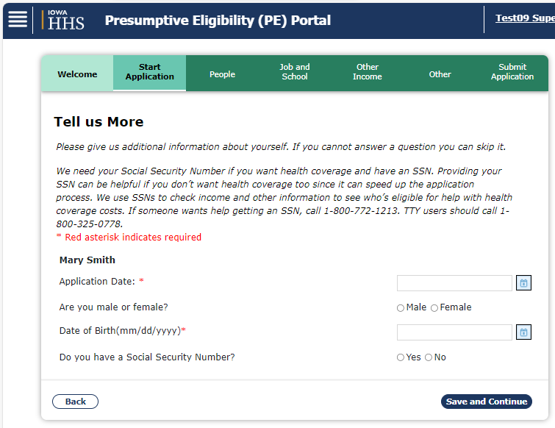
Upon answering ‘No’ on ‘Benefits Information’ page the following necessary fields are displayed on ‘Tell us More’ page: *Application Date, *DOB
Note: ‘Background Information’ page is not displayed for non-applicants
In this scenario, upon clicking ‘Save and Continue’ button on Tell us More page, user will be directed to People chevron.

Slide 66
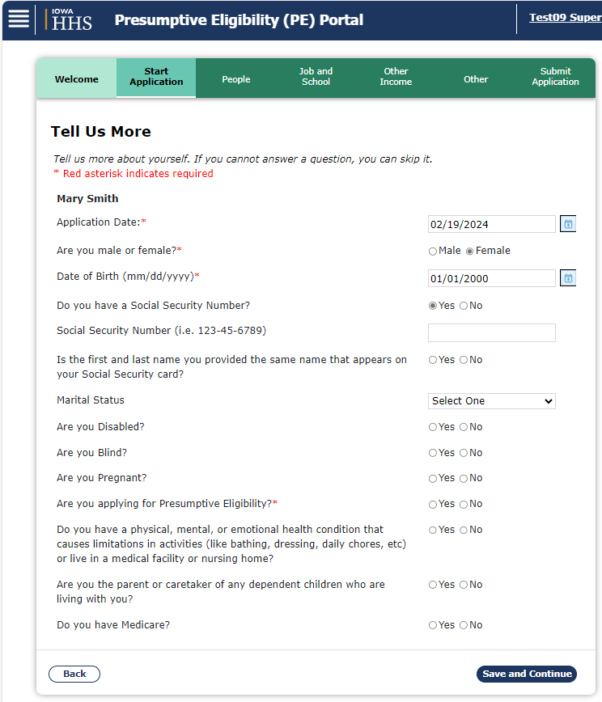
Tip: Social Security Number / PE Program Type
IMPORTANT: Although Social Security Number (SSN) is an optional field, the QE is required to obtain and enter an SSN whenever possible without delaying the PE application date as it will lessen the chance of a new CIN being created for a person who already has one.
Select the PE Program Type from the drop-down box, populated with selections from the application’s first page.

Slide 67
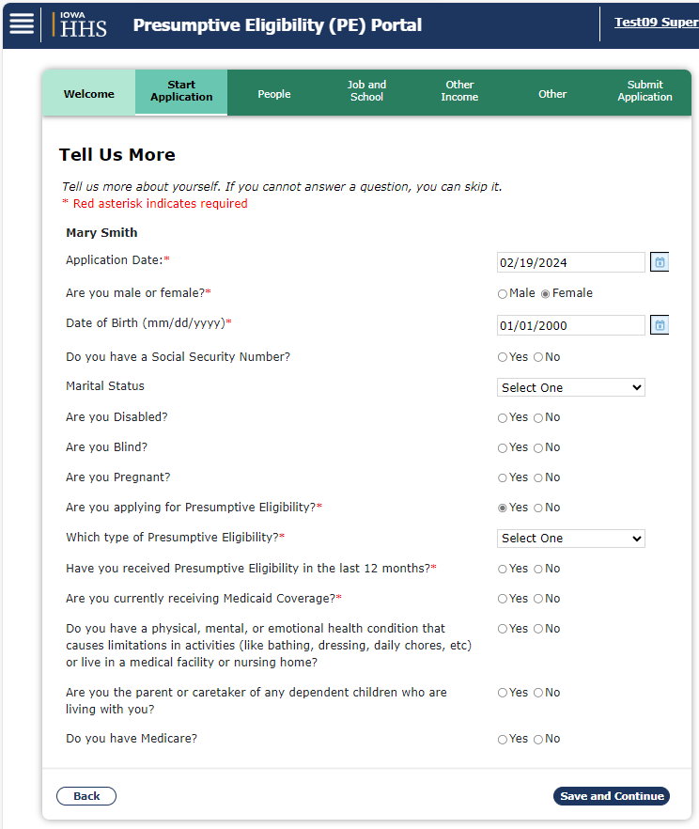
Tip: Received PE in the last 12 months?
Application month is the start of the 12 month period.
PW only answer Yes, if PE was during current pregnancy.
Pregnant Women allowed PE only once per pregnancy.
BCCT who received PE and has new cancer diagnosis may receive PE again, even within the same 12 months

Slide 68
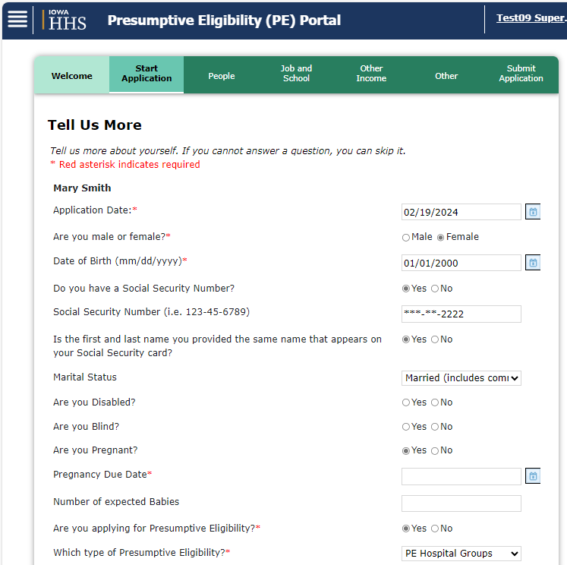
Tip: Are you pregnant?
If an applicant answers that she is pregnant, two additional fields display. Due Date shows as required. Number of expected Babies is needed for accurate PE Determination results.
Note: Number of expected babies is required for correct PE results for Pregnant Women.

Slide 69
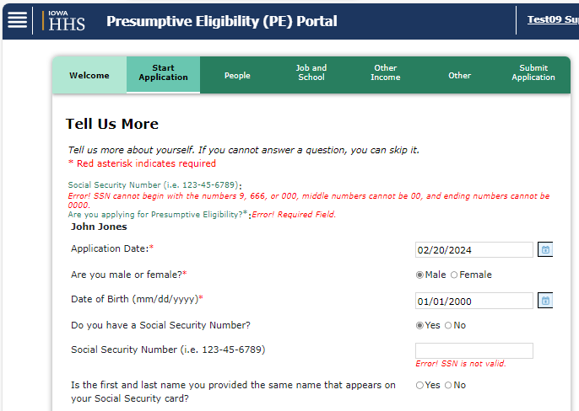
Do NOT enter an SSN that starts with a ‘9’. An error message is displayed if ‘9’ is used in SSN field
Do NOT make up an SSN or use all 1’s etc.

Slide 70
Client Index Number (CIN)
After clicking Save and Continue on this page, the QE is directed to the CIN information page where the QE will create a new CIN or locate an existing CIN for an applicant who is already in the system.
Note: The CIN is the same as State Identification number.
IMPORTANT: Creating a new CIN for an applicant who already has one may result in unnecessary requests for information to the client from HHS with denial/cancellation if no response, denial of claims, or the need to continually reapply for Medicaid.
Helpful hints to avoid creating a duplicate CIN:
Ask the applicant if they have received Medicaid in Iowa before. This may be an indicator that they have an existing CIN and information may need to be modified on the application if not found when searching for a CIN.
Make sure that the applicant’s name, date of birth, and SSN (if they have one) are entered correctly. Note: If you are expecting a CIN to appear in the search and it does not, it may be that the applicant is giving you a nickname (Mike instead of Michael). Clarify with the applicant if they go by a different name than what is on their Social Security card, immigration documents, etc.

Slide 71
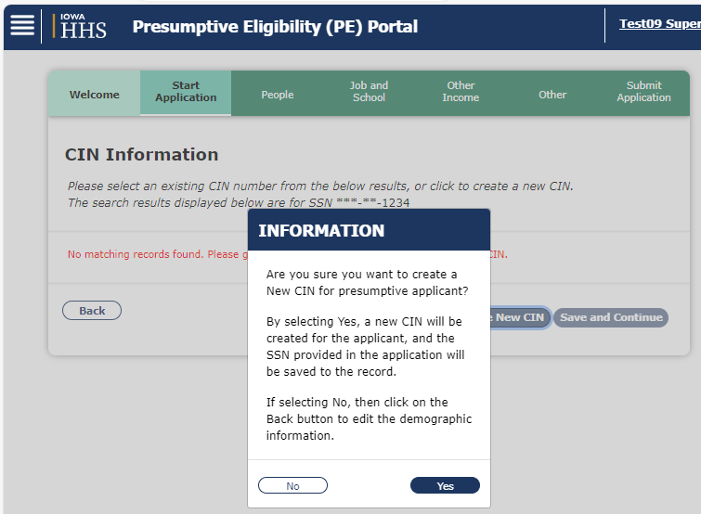
CIN Information: New Client Index Number

Slide 72
CIN Information (Continued)
View name(s) that display. If no names display, no matching records are found, and a new CIN must be created.
Click Create New CIN button. A message verifying CIN request displays. Note: The CIN does not display until creating NOA.
Tip: Both First and Last name must match and Social Security Number (if used) to obtain a matching CIN.
Refer to FAQ for more on CIN matching

Slide 73
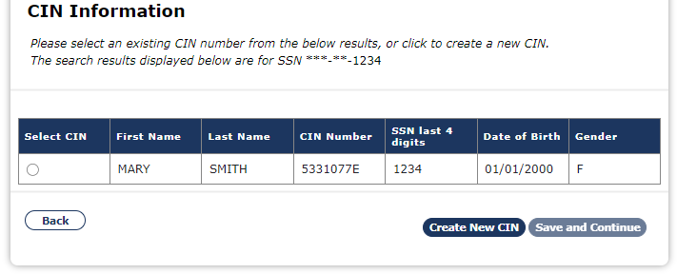
CIN Information: Existing Client Index Number
On this page, view name(s) under Select CIN. View the list of names. If there is a match with first and last names, DOB, gender, and SSN, if available, then click the button next to the matching name. Click Save and Continue button to continue processing. To avoid creating a duplicate CIN for the same person, carefully review this screen. If a duplicate CIN is created, it may cause an issue getting claims paid.

Slide 74
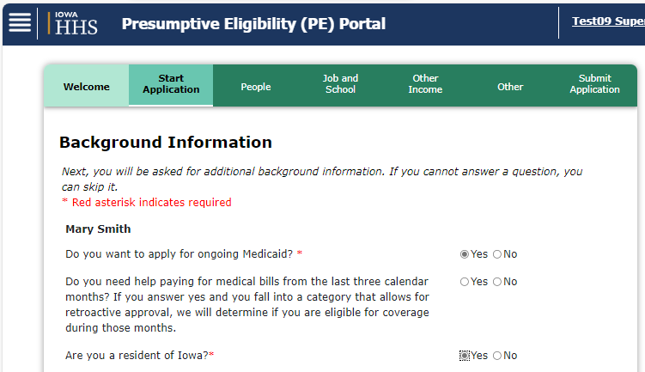
Tip: Want to apply for ongoing Medicaid?
This question is mandatory for all applicants.
Important: If an approved PE Application is processed for ongoing Medicaid benefits and does not meet the eligibility requirements, the PE ends immediately.

Slide 75
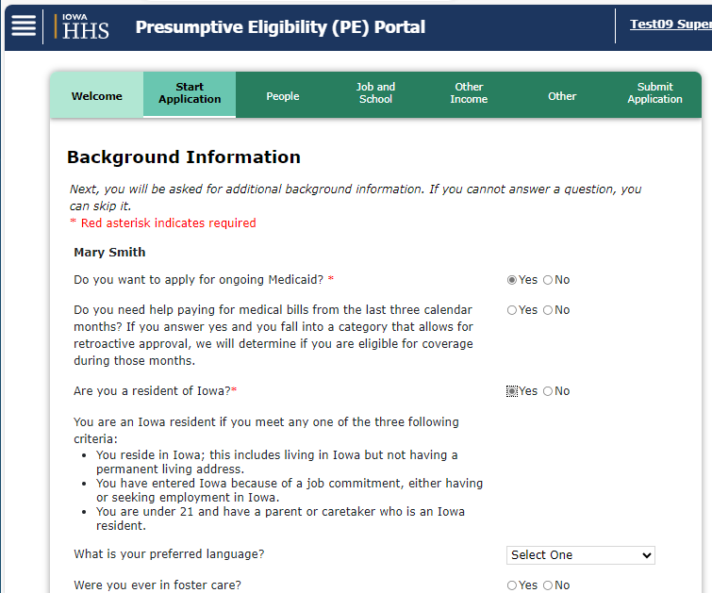
Background Information
Static text is displayed under ‘Are you a resident of Iowa’ question. This description helps answer the question correctly.
This page uses dynamic questions that may open up more fields. One example is Were you born in the U.S.? which may open additional fields, making it a question that is required for accurate PE Determination results.

Slide 76
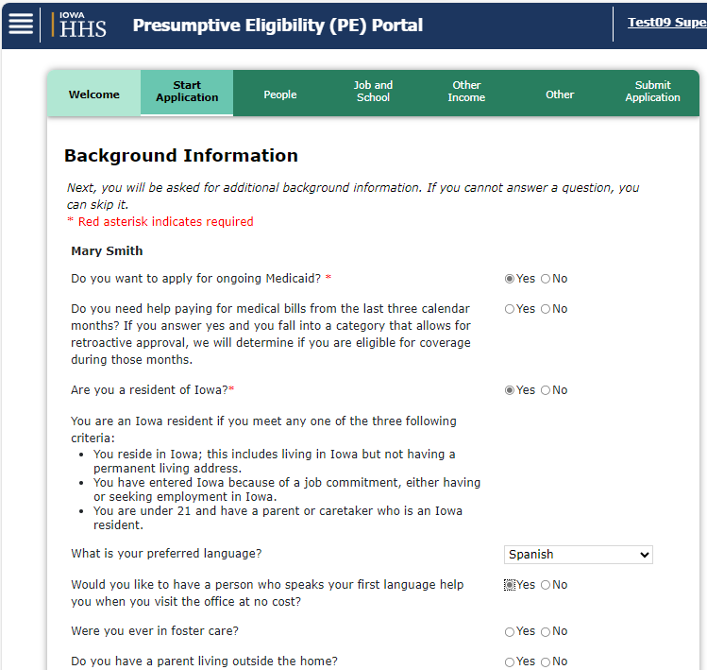
Background Information
When Spanish is selected as the response to the question ‘What is your preferred language?’ for the Primary Applicant, the NOA that is generated in MPEP after determining PE results will be a Spanish/English version.
The NOA will first include the Spanish version of the NOA, then a page that says ‘THIS PAGE IS INTENTIONALLY LEFT BLANK’, followed by the English version of the NOA.

Slide 77
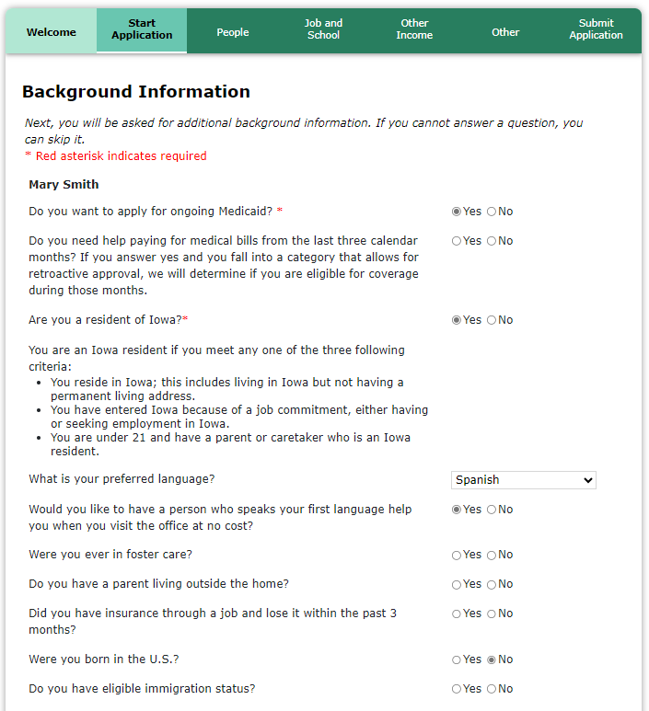
Background Information
Tip: Were you born in the U.S.?
To receive correct PE determination, it is required to answer this question. Additional fields display with an answer of ‘No’. One additional question is Do you have eligible immigration status? The Federal Government has a website on Immigration Status and Eligibility. (see next slide)
Notes:
Note: The following clarifying language is only displayed for clients applying for PE BCCT/PE Pregnant woman upon answering ‘No’ to ‘Were you born in U.S?’ and ‘Do you have eligible immigration status?’ questions:
‘Answering the question below is optional. A pregnant woman or BCCT applicant will get accurate PE results if this question is not answered, but this information will be needed if this individual is applying for ongoing Medicaid’

Slide 78
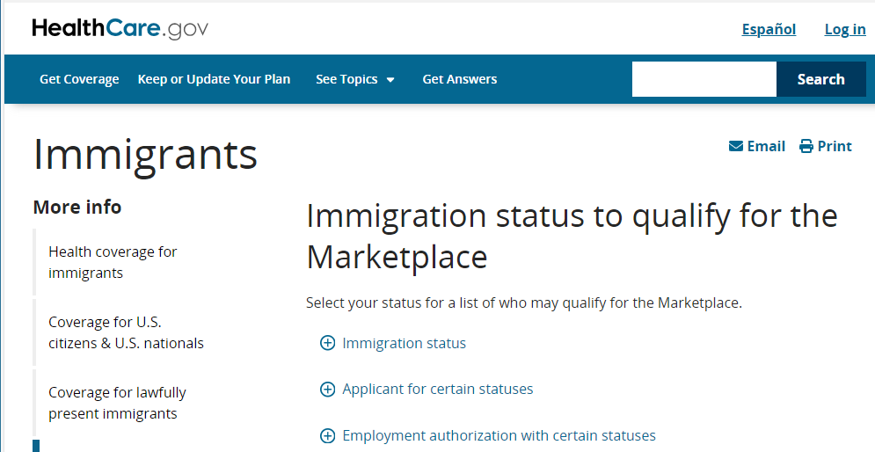
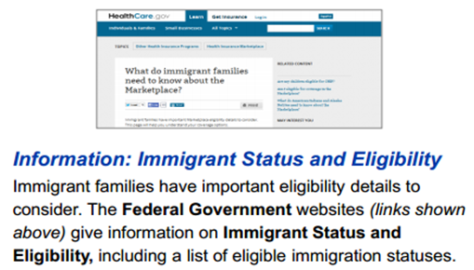
Immigration Status
For Adults, see the list under the heading ‘Immigrants and Medicaid & CHIP’ at https://www.healthcare.gov/immigrants/lawfully-present-immigrants/
For Children, see the list under the heading ‘Immigrants with the following statuses qualify to use the Marketplace’ at https://www.healthcare.gov/immigrants/immigration-status/
For Children, see the list under the heading ‘Immigrants with the following statuses qualify to use the Marketplace’ at https://www.healthcare.gov/immigrants/immigration-status/
Notes:
Note: The 2021 Consolidated Appropriations Act (CAA) was signed into law on December 27, 2020. Section 208 of the CAA adds Medicaid coverage for citizens of Palau, the Marshall Islands, and the Federated States of Micronesia living in the United States through treaties known as the Compacts of Free Association (COFA).

Slide 79
Were you born in the U.S. & do you have eligible immigration status?
Pregnant Woman Category and BCCT Category will get accurate PE results if these questions are not answered, although this information will be needed if these individuals are applying for ongoing Medicaid.

Slide 80
Immigration Status
The PE applicant must attest to being a citizen or having an eligible immigration status. The QE needs to help the applicant understand how to answer the immigration question, but the QE does not need to verify or make the determination of the immigration status.

Slide 81
Do you have eligible immigration status?
YES Child under 21 lawfully present in U.S. Asylee Refugee Cuban/Haitian Entrant Conditional entrant granted pre-1980 Trafficking victim and spouse, child, sibling, or parent or person with pending app for trafficking victim visa Granted withholding of deportation Tribe: Member of a federally recognized Indian tribe or American Indian born in Canada Citizens of Palau, the Marshall Islands, and the Federated States of Micronesia Afghan Evacuees: This includes Afghan Humanitarian Parolees who arrive in the U.S. between July 31, 2021 and September 30, 2022 (see slide 82 for more info on Afghan evacuees) Ukrainian Humanitarian Parolees (UHP) and non-Ukrainian individuals who last habitually resided in Ukraine and received humanitarian parole arriving in the U.S. between February 24, 2022 and September 30, 2023, are treated as refugees. They are eligible to receive full Medicaid/CHIP, without a five-year bar, if they meet all other eligibility requirements. (See slide 83 for more info) | NO at all ages Undocumented Alien in U.S. without papers or status documentation NO only if 21 or older *Lawful Permanent Resident, Note: LPR/ Green Card Holder Do not have eligible immigration status until qualified alien status for 5 years *Battered non-citizen, spouse, child, or parent Note: Do not have eligible immigration status until qualified alien status for 5 years *Paroled into U.S. for at least one year Note: Do not have eligible immigration status until having qualified alien status for 5 years Nonqualified Alien lawfully admitted to U.S. in any other alien status. Afghan Humanitarian Parolees who did not arrive in the U.S. between July 31, 2021 and September 30, 2022. *LPRs, Battered, and Parolees age 21 or older should answer Yes to the question once they’ve held that qualified alien status for 5 years.
Immigration Chart
This chart includes eligible immigration status information.
More details for Adults can be found under the heading ‘Immigrants and Medicaid & CHIP’ at https://www.healthcare.gov/immigrants/lawfully-present-immigrants/ More details for Children can be found under the heading ‘Immigrants with the following statuses qualify to use the Marketplace’ at https://www.healthcare.gov/immigrants/immigration-status/
Notes:
This chart includes eligible immigration status information. More details for Adults can be found under the heading ‘Immigrants and Medicaid & CHIP’ at
www.healthcare.gov/immigrants/lawfully-present-immigrants/.
More details for Children can be found under the heading ‘Immigrants with the following statuses qualify to use the Marketplace’ at:
www.healthcare.gov/immigrants/immigration-status/

Slide 82
Afghan Evacuees
Afghan evacuees are Afghan individuals who have assisted the U.S. government and have relocated to the U.S. Most Afghan evacuees will receive one of the 3 lawful immigration statuses listed in the chart below. The chart also includes possible immigration documents that the person may have for each of the immigration statuses which may help in determining if someone is an Afghan evacuee.
Note: A person is not required to provide immigration documents for presumptive eligibility. However, if the person does have documents available and they’re also applying for ongoing Medicaid, then uploading them in MPEP may speed up processing and help HHS make a correct eligibility determination.

Slide 83
Additional Ukraine Supplemental Appropriations Act, 2022
The Additional Ukraine Supplemental Appropriations Act, 2022 (AUSAA) authorizes assistance to specific Ukrainian populations and other non-Ukrainian individuals in response to their displacement from Ukraine and entry into the United States. This legislation grants eligibility for Ukrainian Humanitarian Parolees (UHP) and non-Ukrainian individuals who last habitually resided in Ukraine and received humanitarian parole who arrived in the U.S. between February 24, 2022 and September 30, 2023. Acceptable documentation for these groups is listed in the chart below.
Immigration Status or Category of Applicant | Acceptable Documentation
Ukrainian citizen or national who received humanitarian parole, known as a Ukrainian Humanitarian Parolee (UHP) | Form I-94 noting humanitarian parole (per INA section 212(d)(5) or 8 U.S.C. § 1182(d)(5)) Or Foreign passport with DHS/CBP admission stamp noting “DT” Or Foreign passport with DHS/CBP admission stamp noting Uniting for Ukraine or “U4U” Or Foreign passport with DHS/CBP admission stamp noting Ukrainian Humanitarian Parolee or “UHP” Or Form I-765 Employment Authorization Document (EAD) receipt notice with code C11 Or Form I-766 Employment Authorization Document (EAD) with the code C11
A non-Ukrainian individual who last habitually resided in Ukraine and received humanitarian parole | Any one of the forms or stamps listed above for UHPs And Documentation of last habitual residence in Ukraine Acceptable documentation indicating last habitual residency in Ukraine includes an original Ukrainian government-issued document, such as a current driver’s license or identification card. For documentation outside of these examples, contact the SPIRS helpdesk for assistance.
Note: A person is not required to provide immigration documents for presumptive eligibility. However, if the person does have documents available and they’re also applying for ongoing Medicaid, then uploading them in MPEP may speed up processing and help HHS make a correct eligibility determination.

Slide 84
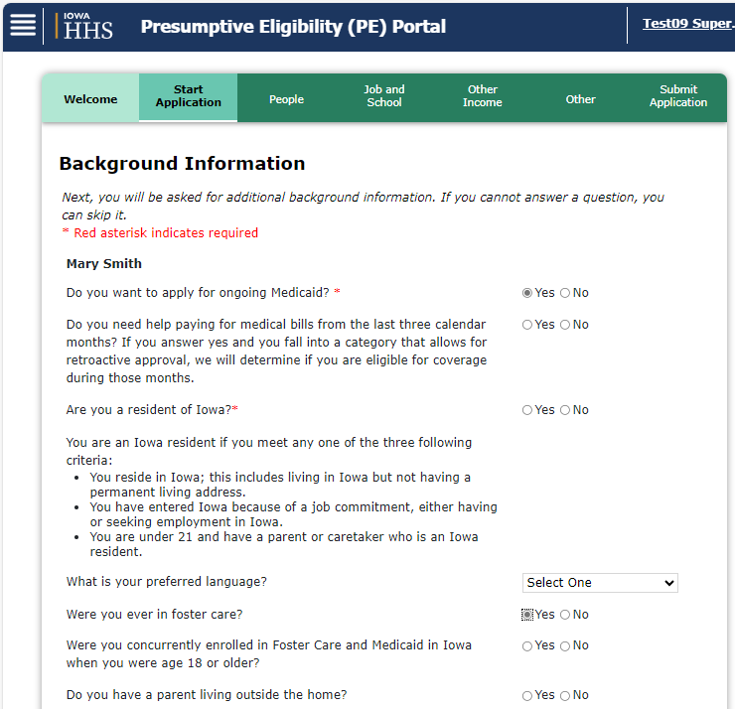
Tip: Ever in Foster Care?
Upon answering ‘Yes’ to Was this person ever in foster care?, the question ‘Were you concurrently enrolled in Foster Care and Medicaid in Iowa when you were 18 or older?’ is displayed. PE applicant may receive E-MIYA benefits only if ‘Yes’ is selected for both questions.
Note: Answer ‘Yes’ to the question ‘Were you concurrently enrolled in Foster Care and Medicaid in Iowa when you were 18 or older?’ when the individual:
Turned 18 on or after 1/1/2023, and
They were enrolled in Medicaid in any state when they turned 18.
Note: If the question ‘Was this person ever in foster care’, is left blank or answered ‘No’, the concurrently enrolled question will not be displayed, and the applicant will not be considered for E-MIYA benefits.
Notes:
Slide 71

Slide 85
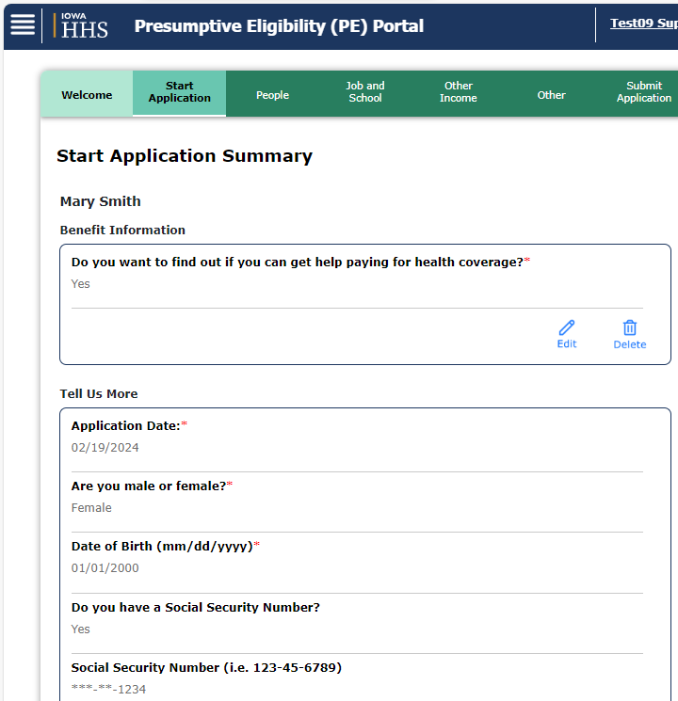
Summary
This page summarizes background information entered to this point. Information can be reviewed and edited on any and all of the summary pages.
Note: Each section of the application has a Summary page for reviewing and editing.

Slide 86
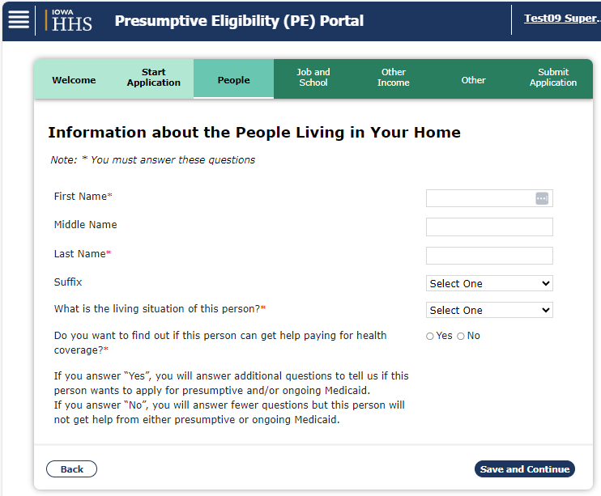
Information about People Living in Your Home
There are necessary fields for people in your household: *First and Last Names, *What is the living situation of this person?. *‘Do you want to find out if this person can get help paying for health coverage?’
If ‘No’ is selected to ‘Do you want to find out if this person can get help paying for health coverage?’ question, the system will only ask relevant questions. If ‘Yes’ is selected, more information will be requested in subsequent pages
Note: Unless specified, enter in the home for living situation.

Slide 87
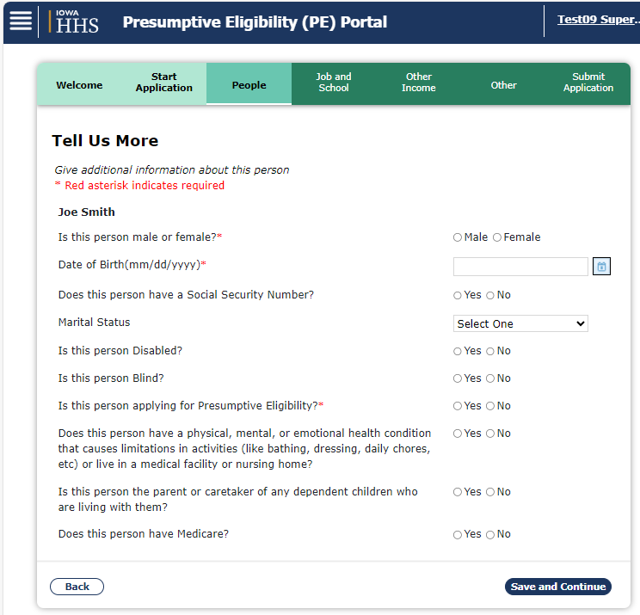
Tell Us More (About People in the Household)
The next application sections are about the People in the Household. The same questions that were asked of the primary applicant are now asked of the additional household members. As is true in all areas, a summary page displays at the end of the section.

Slide 88
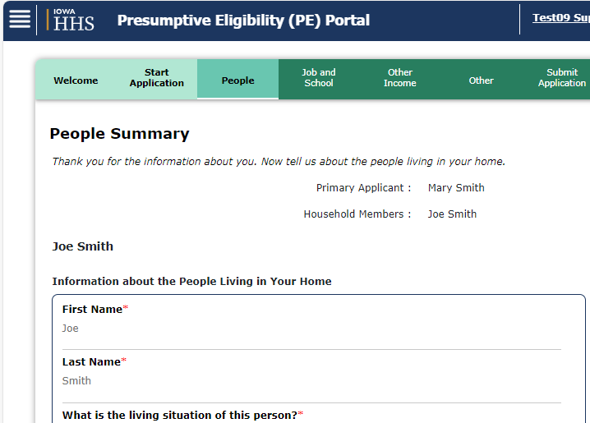
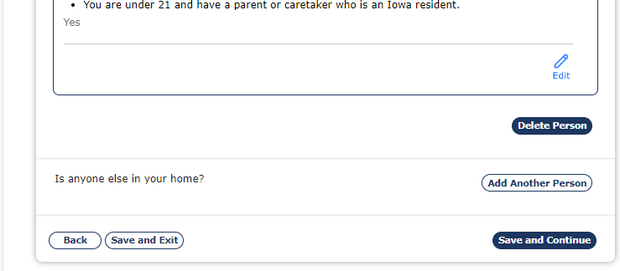
Tip: Summary Pages – Delete/Add, Show/Hide
On any of the Summary pages, the QE can edit information about the people living in the home or scroll to the bottom of the page to delete or add Household Members, other than the Primary Applicant.
Notes:
***Deleted the wording about collapsing and expanding the sections since all sections are expanded and can’t be collapsed
Added an effect to hopefully indicate scrolling down

Slide 89
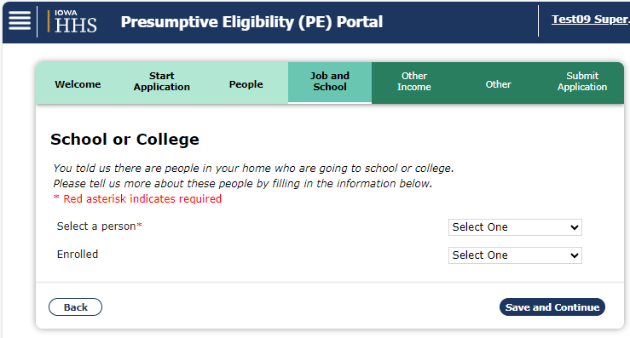
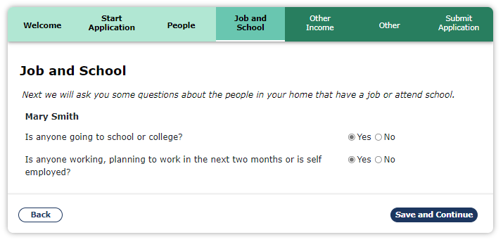
School
The Job and School page is used to collect school information for the household members. The question ‘Is anyone going to school?’ only needs to be answered if there is an 18 year old or younger in the household who is still in school. Additional fields display with a ‘Yes’ answer.

Slide 90
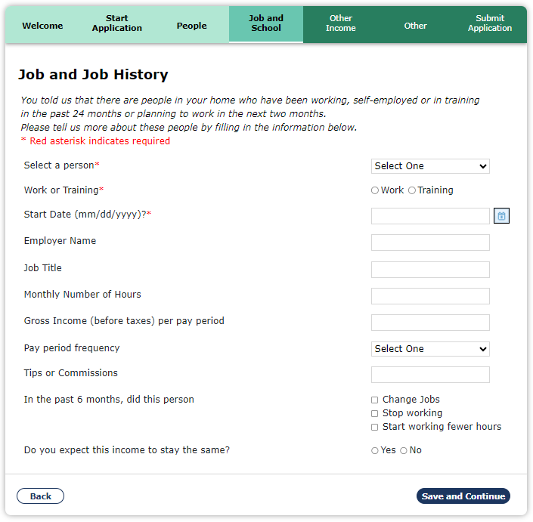
Job
This page also collects work information. If anyone in the household ‘is working or plans to work in the next two months’, the work question must be answered ‘Yes’. If this question is answered ‘Yes’ for any of the household members, additional job pages will be displayed.

Slide 91
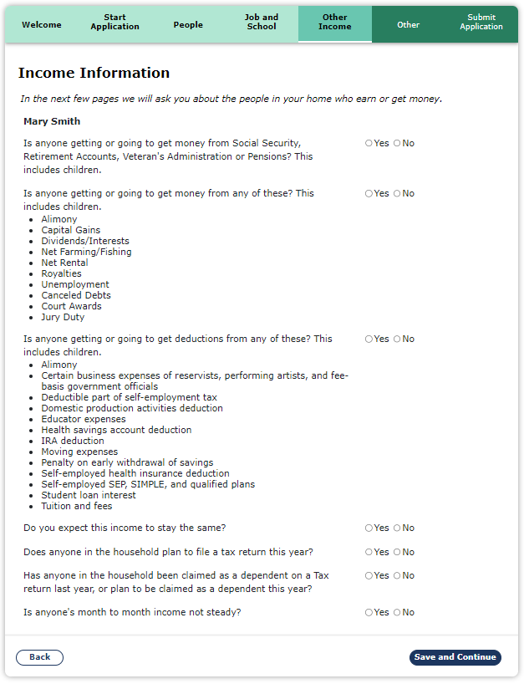
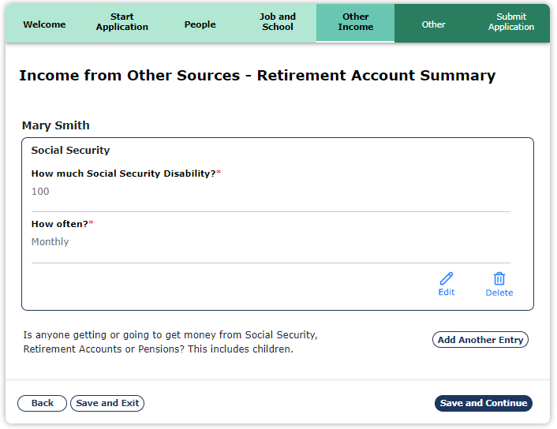
Income Section: Other than Earned Income
This section is about household members who earn/receive money from sources other than earned income including Retirement accounts, IRAs, and Pensions. Note: The ACA has changed countable income. PE Medicaid now follows the Federal tax rules, with a few exceptions.

Slide 92
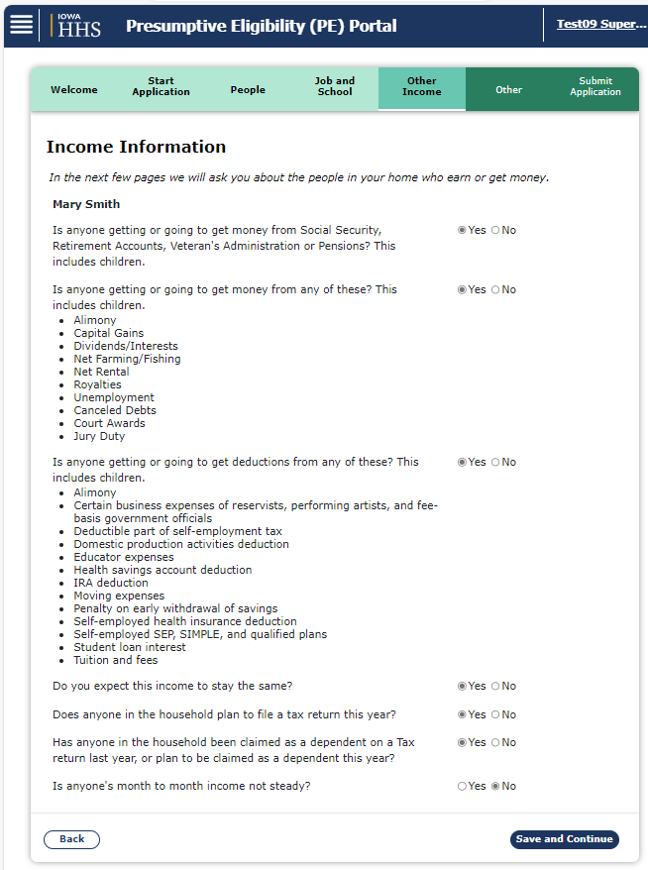
Monthly Income
The applicant’s current monthly income is to be used as the income that is entered by the applicant and recorded in the system.
The income information page captures the types of income that the applicant may be receiving.

Slide 93
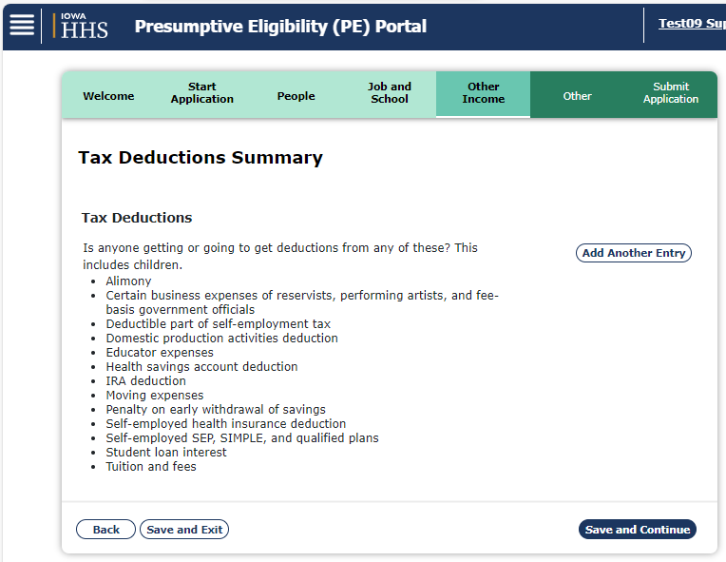
Tax Deductions
The Deductions section includes federal income tax deduction types, amounts, and frequency. Note: Under ACA, PE Medicaid follows tax rules when considering allowable deductions. The PE application forms only ask about deductions that are allowed under U.S. tax rules.

Slide 94
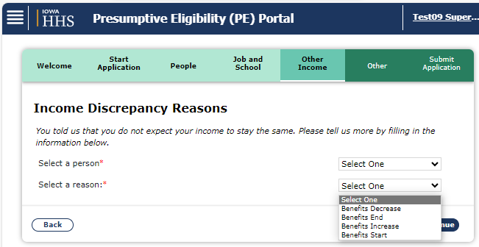
Income Discrepancy Reasons
Income Discrepancy Reasons is only asked if the question, ‘Do you expect this income to stay the same?’, is answered with ‘No’ on the Income Information page. This information is only used in the ongoing Medicaid eligibility determination.

Slide 95
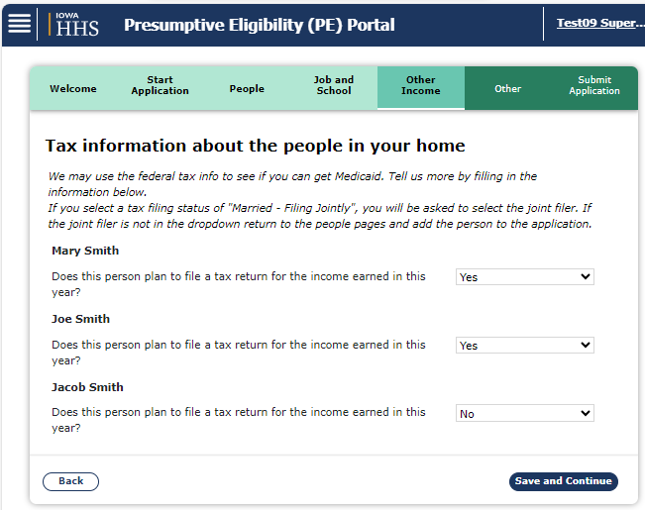
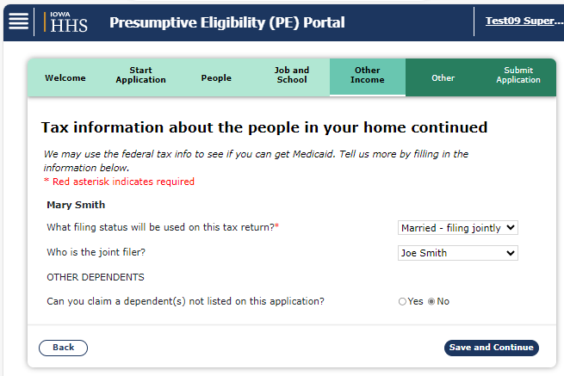
Tax Information
Income tax information, including tax filing status and tax dependent status, are used to determine household size and income. Under ACA rules, household size and income may be different for individuals within the same home, based on household composition and tax filing status.

Slide 96
Tip: Tax Information Year
The paper application asks about filing a federal income tax return next year. The MPEP refers to filing a tax return this year.
Select ‘Yes’ to the tax filer question if the individual plans to file taxes for the current year.

Slide 97
Yearly Income
Details about Yearly Income is asked if the question, ‘Is anyone’s monthly income not steady?’, is answered with ‘Yes’ when filling out the applicant’s income. This information is only used in the ongoing Medicaid eligibility determination and is only applicable if income is not steady or is unpredictable.

Slide 98
Household Relationships
Relationships* need to be established between all members of the household. Unless specified, enter Start Date as 3 months prior to application. For accurate PE Determination, Parental Control best practice is to mark for all household adults who have Parental-type responsibilities i.e. Parents/Stepparent. MPEP has safeguards in place and will assign parental control should the user fail to mark.

Slide 99
Other Information: Status
Incarceration Status / Work Release Program page is displayed upon answering ‘Yes’ to ‘Is anyone incarcerated (detained or jailed) or in a work release program?’
Note: See next slide for further instructions on completing this page.

Slide 100
Other Information: Incarceration Status: Continued
Upon selecting ‘Yes’ to ‘Is anyone incarcerated (detained or jailed) or in a work release program?’, ‘Is this person pending a court decision?’, ‘Start Date’, ‘Is this person in a work release program?’, and ‘Work Release Start Date’ fields become mandatory. If the information is known, please provide the correct responses. If the applicant does not know this information or if the information is being entered from a Paper Application, follow the instructions below:
Note: This question is asked for each person listed on the application. Review the application and complete Incarceration Status for all ‘Yes’ responses.
‘Is this person pending a court decision?’ and ‘Is this person in a work release program?’- Select ‘No’
‘Start Date’ field - Enter this first day of the month in which the applicant is seeking eligibility

Slide 101
Other Information: Authorized Representative
On this page, applicants may choose to add an Authorized Representative.
An authorized representative is an individual or organization, identified by the applicant, with whom Medicaid application and benefits information may be shared.

Slide 102
Other Information: Authorized Representative: Continued
What can an Authorized Representative do?
File Applications
Check on the progress of an application or ongoing eligibility
Request reschedule of interviews
Request extensions for providing documentation or verification
What is sent to the Authorized Representative?
All correspondence that will affect eligibility will be sent to both the applicant AND the authorized representative
Medicaid cards are sent to the authorized representative and not to the client
How can an Authorized Representative be added or removed?
These requests must be in writing on an application/review, an Authorized Representative form or any paper request
Requests can be sent to:
IMCSC@dhs.state.ia.us
Fax: 515-564-4041
Mail: Imaging Center 1, 417 E Kanesville Blvd, Council Bluffs, IA 51503

Slide 103
Other Information: Health Insurance
Health Insurance questions within the Submit Application tab are used to gather household member Health Insurance information. The questions on this page populate depending on how other questions are answered on the application.

Slide 104
Voter Registration
If the answer to the Voter Registration question is “Yes”, another paragraph appears advising the applicant that they can request help filling out a voter registration application form in the local office or that they can complete one online.

Slide 105
Iowa Medicaid Estate Recovery Program
QEs are required to make ALL applicants aware of the Estate Recovery program.
A QE is responsible to declare they have made the applicant aware of the Estate Recovery Program.
The next slide includes an Estate Recovery screenshot.

Slide 106
Estate Recovery explanation:
QE declaration and signature:

Slide 107
Rights and Responsibilities
QE is required to provide applicant with a copy of Rights and Responsibilities Comm. 233.
QE is responsible to declare they have provided the applicant with a copy of Rights and Responsibilities Comm. 233.
Note: Rights and Responsibilities can be printed via the Submit Application Chevron or at anytime time using the Useful Links.

Slide 108
Determine Eligibility
After the application is complete, Eligibility is run by clicking the Determine Eligibility button. The PE portal uses ACA rules and applicant data to determine eligibility. Note: The results show on the next page and are not final until accepted. Edits can be made before accepting results.

Slide 109
Determination Results
Eligibility results for applicants are displayed on this page, based on appropriate PE type. If results are not what the QE expected, previous screens can be reviewed and corrected. Clicking Accept PE Results accepts and finalizes results. Note: The PE begin date is the eligibility approval date.

Slide 110
Determination Results
The PE denial reason of ‘Currently has benefits on another case’ indicates the applicant is currently receiving medical benefits with the Department.

Slide 111
Before selecting the ‘Accept PE Results’ button review the results to ensure an error was not made completing the data collection pages and the correct outcome was received. A data entry error can potentially cause an incorrect approval/denial.

Slide 112
Common Things to Review Should Results NOT be as Expected:
Relationships
Income
U.S Citizenship
Do Children have Medical Coverage question
Refer to Presumptive Eligibility FAQ at the following address for a detailed process to assist if results are not as expected or results were accepted in error.
Presumptive Eligibility Frequently Asked Questions (FAQ)

Slide 113
Confirmation
The Confirmation page contains important information; eligibility results, confirmation number, and print commands. Note: The QE is required to provide the client with a copy of the NOA and application. A printed copy of the NOA and application must be part of the QE file
Select appropriate button to print.
Upon clicking ‘Upload Documents’ button, ‘Verification Documents’ page is displayed. Note: This button will only appear when at least one applicant has indicated ‘Yes’ to the question ‘Do you want to apply for ongoing Medicaid?’ or ‘Does this person want to apply for ongoing Medicaid?’

Slide 114
Uploading Documents
Although PE determination itself is based on self-attested information only, the ongoing Medicaid determination made by HHS may require documentation so uploading documentation that is readily available at the point of contact with the QE may speed up processing of ongoing Medicaid application, reduce the need for HHS to request information from the applicant, and/or reduce the number of ongoing Medicaid applications that HHS must deny when requested information is not provided.
It is not necessary to upload any documentation related to the PE application itself, as HHS will continue to receive the PE application and PE NOA via the MPEP system. Only upload documents that HHS could need when making the ongoing Medicaid eligibility determination. Some of the most commonly needed documents include pay stubs, immigration documents, and a signed copy of the authorization for release of information (found on page 21 of the application). A complete list of document type options available for uploading can be found on the next slides.
Uploading documentation with the PE application is encouraged but not required
Submission of the completed PE application in MPEP should not be delayed in order to obtain/upload documents since PE benefits may only begin once the application is submitted in MPEP

Slide 115
Verification Documents page
Upload and Delete buttons appear once a document type and file has been chosen.
Exit button is displayed bottom right-hand corner of the page. When clicked it will take you back to the MPEP Home Page
QEs can upload the documents on this page by selecting a value from ‘Document Type’ drop-down, choosing the file and clicking ‘Upload’ button

Slide 116
Verification Documents (Continued)
The following values will display in ‘Documents Type’ drop-down:

Slide 117
Verification Documents
QEs can upload the documents on this page by selecting a value from ‘Document Type’ drop-down, choosing the file and clicking ‘Upload’ button. Once the document is uploaded successfully, a message is displayed on the screen as highlighted in the screenshot above.
Notes:
Screen no longer shows the Name of the doc successfully uploaded

Slide 118
Tip: Application and PE NOA
An important component of this page is printing the NOA and Application PDF.
After this page, the QE will not have the ability to open or recreate a completed application.
NOTE: If the QE needs to print documents after uploading documents, they can return to the My PE Portal to print the forms.

Slide 119
Sample: Notice of Action (NOA)
NOAs include PE Results, PE Type, Client and Program Information, Coverage Dates, Provider Information, PE Information and Benefits, and, possibly, Denial Reason.
Note: Clients must present NOAs to providers for services.

Slide 120
Sample PE Information on NOA
NOAs also include the specific PE Medicaid Type and the associated Covered Services and Exceptions to Ongoing Medicaid Applications.
Refer to the Aid Code displayed on the PE Eligibility Results of the application PDF to determine the applicable details for each PE-approved person.

Slide 121
PE Aid Codes
This chart shows the PE Aid Codes. If an applicant is eligible for Presumptive Medicaid services, the appropriate Aid Code is printed on the NOA.

Slide 122
QE Support: PE Policy and MPEP Technical
The HHS Contact Center should be contacted when:
Information needs to be edited after saving application
There is application information that cannot be recorded in the MPEP portal
There are technical difficulties
Health and Human Services (HHS) Contact Center
855-889-7985
M-F 8 am–5 pm
IMEMPEPSupport@dhs.state.ia.us

Slide 123
Contact Center Examples
Unusual type of income – not listed in MPEP
Mistake in MPEP and application submitted – incorrect birthdate, CIN created with wrong SSN, incorrect income
Incorrect Income
Incorrect Birthdate
CIN created with wrong SSN
Unusual type of income – not listed in MPEP
Mistake in MPEP and application submitted

Slide 124
Summary – PE
Flow, ACA, Applications, Polices, MPEP

Slide 125
PE Provider Application Process Flow
The Process Flow for the PE Application is as follows:
PE data collected
Data entered into MPEP
Eligibility determined in MPEP
Copy of application, NOA and Rights and Responsibilities given to applicant

Slide 126
Summary: ACA Rules
ACA Eligibility Determinations use MAGI Rules
MAGI = Modified Adjusted Gross Income
MPEP uses ACA rules to complete all calculations
Federal Tax rules used to determine eligible income
Household (HH) size is based on the tax-filing unit
Household members may each have own HH size
All claimed dependents are included in family size
MAGI defines HH size to use when no one files taxes
Child support is excluded from taxable income

Slide 127
Summary: Application Information
Application date must be accurate
All client-provided data must be entered into MPEP
Applicant information is self-attested
Completed applications cannot be recreated or edited
Incomplete (in progress) applications can be continued
Applications expire 5 days after start, if not completed
Summary pages, found at the end of each section end, can be edited
Tax Year is the current year

Slide 128
Summary: Application Information
If the applicant does not provide SSN, leave this field blank. However, it is best practice to get and enter the SSN to avoid creating duplicate CINS.
Due date is required for PW
Applicants can identify an Authorized Representative
PE for PW: Expected number of babies is required
For accurate PE Determination results, the question Were you born in the U.S. must be answered. Additional fields display depending on the answer.
The CIN is created after saving Tell Us More page
Foster Care: May qualify for E-MIYA only if both foster care questions are answered as ‘Yes’.

Slide 129
Summary: PE Programs
PE Programs: BCCT, Children, Hospital Group (Adults/ Children), Pregnant Woman
Important to select best PE program for the individual
Households may have different PE programs
An individual may only be on one PE program
12 month prior PE period starts with application month
PW: Prior PE only counts if during current pregnancy
BCCT: A person who is diagnosed and receives treatment, but has a new cancer diagnosis may receive PE, again, during the same 12 month time period

Slide 130
Summary: Ongoing Medicaid Benefits
All applicants will see the mandatory question, ‘Do you want to apply for ongoing Medicaid?’
PE ends immediately for anyone with approved PE whose ongoing Medicaid application is then denied
Applicant may choose to opt out of applications being processed for ongoing Medicaid benefits

Slide 131
Summary: Documents
NOA, application and Rights and Responsibilities are required to be printed for the client
It is required to print NOA and Application for QE files
Required to save documentation for 5 years
Print prior to exiting Confirmation page
NOAs and PDFs can be saved to local computers

Slide 132
PE Resources
Policy, Technical, Withdrawals

Slide 133
QE Support: PE Policy and MPEP Technical
Support is available for QE through the HHS Contact Center.
Phone support: 855-889-7985 M-F 8 am – 5 pm
Email support: IMEMPEPSupport@dhs.state.ia.us

Slide 134
QE Support: Access to Online PE Materials
Online PE materials are available on the HHS website. These materials include Presumptive Eligibility FAQs, Qualified Entity (QE) MPEP Access Request Form, and the Application for Certification to become a QE.
FAQ, Manual & Summary of helpdesk messages online
Presumptive Eligibility | Iowa Department of Health and Human Services

Slide 135
Applicant: Withdrawing an Application
HHS Contact Center 855-889-7985
Ongoing Medicaid applications may be withdrawn by contacting HHS using the phone number shown above. If an application is withdrawn prior to HHS processing, it will not be processed. If receiving PE benefits, withdrawing the application will not impact the client’s current PE benefits.

Slide 136
Medicaid PE Self - Quiz
The following pages include a 13 question self-test on PE and QE.
Answers to these questions are located on the page after the self-test.

Slide 137
Questions
If eligible, Presumptive eligibility….
(Mark each statement that is true)
Begins when a determination is made in MPEP
Is not retroactive
May only be used for services at an Iowa Medicaid provider
Which of the following are true?
Each household member is required to complete his/her own PE application
The current date (date application entries are being completed in MPEP) must be accurately entered in the *Application Date field in MPEP
Applications can be future dated

Slide 138
Questions
3. To qualify for PE E-MIYA (former foster care), which of the following conditions must be met?
14-26 years of age
At the age of 18, were/are concurrently enrolled in Medicaid and Foster Care in any state.
At 175% Federal Poverty Level
4. When entering income information, use the applicant’s….
Tax information from last year
Current monthly income information
A formula of the tax information and number of dependents

Slide 139
Questions
5. Which of the following statements are true?
(Mark each true statement)
The determination of Presumptive Eligibility is based on applicant self-attested statements
Ongoing Medicaid is based on some verified information gathered by the Department of Human Services
6. QE should advise applicants (clients) on the probability of receiving ongoing Medicaid benefits?
True
False

Slide 140
Questions
7. By State of Iowa requirements, QE is to complete PE training prior to state approval for becoming a QE?
True
False
It depends on what type of PE they will be determining
8. It is important to enter as much applicant information into MPEP as possible because….
It slows the determination of ongoing Medicaid
It reduces the need for applicants to provide HHS with information at a later date
It helps ensure that the correct person is in the system with the accurate CIN (State ID#)
It increases the accuracy of the PE determination and the ongoing Medicaid determination

Slide 141
Questions
9. Only parents and step-parents can be identified on the Relationship page for Parental Control?
True
False
10. With the exception of BCCT and Pregnant Woman, how often may all other PE groups receive PE benefits?
Once in a 12 month period
Three times a year
As often as needed
11. Pregnant Woman may obtain PE benefits?
For the duration of the pregnancy
Once a pregnancy
As often as ordered by the primary care or obstetrician

Slide 142
Questions
12. Which of the following are sources of support for those working with PE programs?
(Mark each applicable information channel)
HHS Website, https://hhs.iowa.gov/ime/providers/tools-trainings-and-services/medicaid-initiatives/pe
PE Policy and Technical Support, imempepsupport@dhs.state.ia.us
None of the Above

Slide 143
Questions
13. Which individuals are allowed to sign a PE application?
(Mark all statements that are true)
The applicant
An adult in the applicant’s household
An authorized representative
Someone acting responsibly for a minor
Someone acting responsibly for an incapacitated applicant

Slide 144
Answers
Answers to Self-Quiz
a, b, c
b
b
b
a, b
b
a
b, c, d
b
a
b
a, b
a, b, c, d, e

