Slide 1
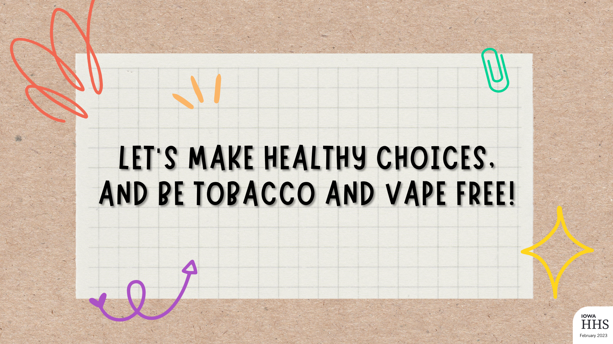
Notes:
This presentation includes the Additional Optional Activities that can be found in the Facilitator Guide (slides 6, 14 & 16). Remove or add activities as needed, based on your time limitations with the students.
Canva link to this presentation: https://www.canva.com/design/DAFbyIQ7HgI/bhBVMcYJRNQC1sTA_6YGGg/view?utm_content=DAFbyIQ7HgI&utm_campaign=designshare&utm_medium=link2&utm_source=sharebutton

Slide 2

Add your name, credentials and company logo on this slide.
Notes:
Introduce yourself
Add your name and credentials into the text box on this slide.
Insert your company logo.
Consider inserting a professional photo of yourself.

Slide 3
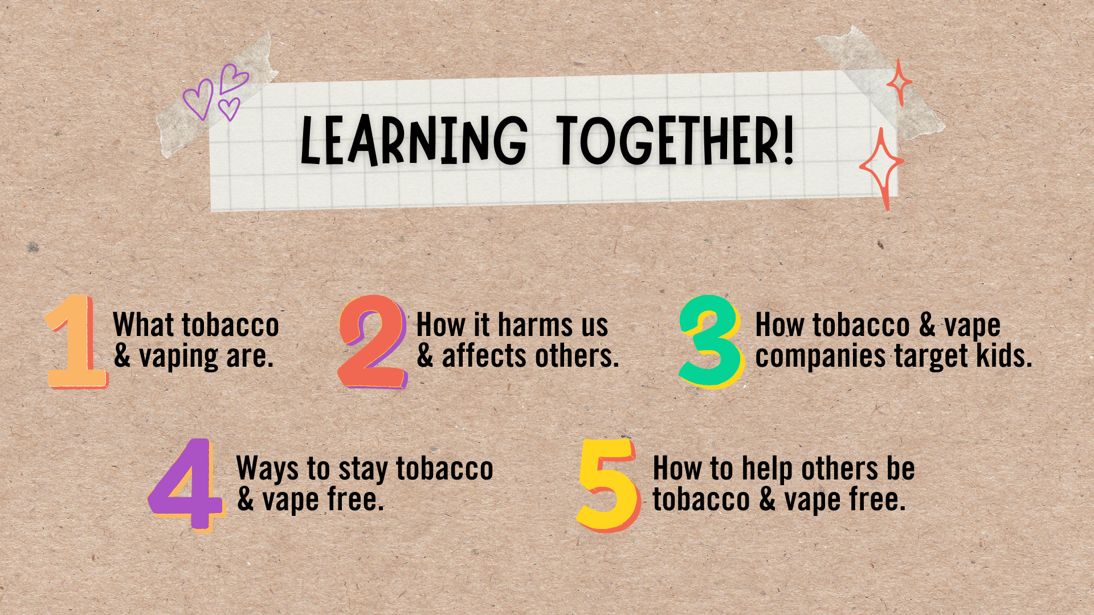
Notes:
I’m excited to learn together today! We will be discussing:
What tobacco and vaping are.
How it harms us and affects others.
How tobacco and vape companies target kids.
Ways to stay tobacco and vape free, and
How to help others be tobacco and vape free.

Slide 4
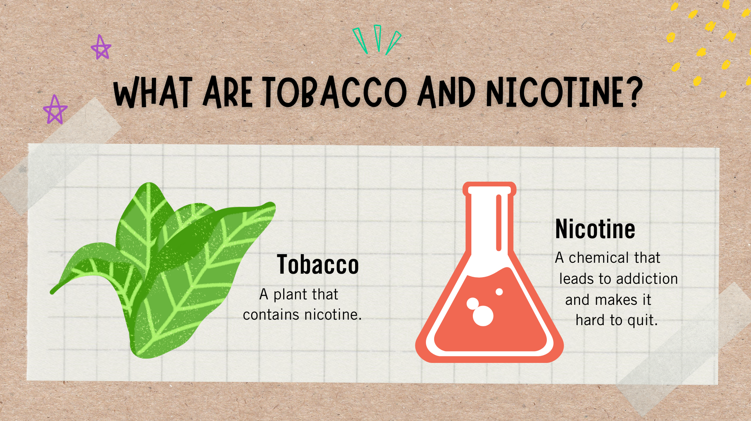
Notes:
Let’s start with talking about what tobacco and nicotine are. Raise your hand if you’ve heard of tobacco or nicotine.
{Provide time for students to raise their hand then acknowledge whether the majority of the classroom has, or has not, heard of tobacco and nicotine.}
Tobacco is a plant which contains nicotine, a chemical that leads to addiction, which makes it hard to quit. When people use tobacco and nicotine products, including vaping, the nicotine tricks their brains into thinking they need nicotine more and more.

Slide 5
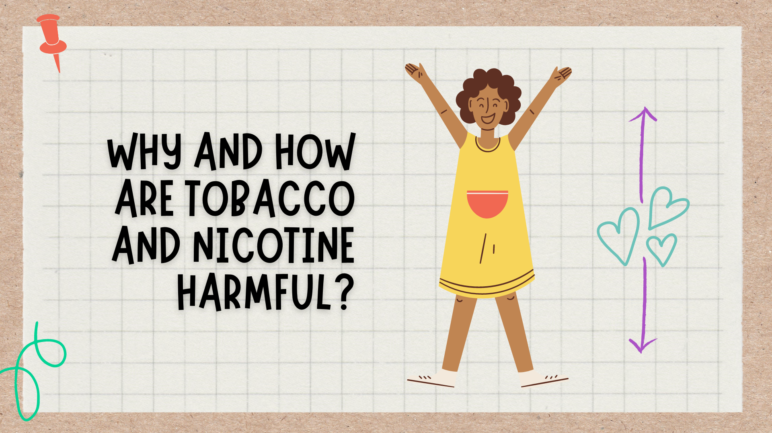
Notes:
Why and how are tobacco and nicotine harmful? Tobacco and nicotine products contains many harmful ingredients, and when smoked it harms nearly every organ of the body, which can cause many diseases. Did you know, vapes contain nicotine? This is why vaping is also harmful to our body. From our head to our toes, tobacco and nicotine use can affect our teeth, vision, mental health, breathing, heart, and so much more.
Does anyone want to take a guess as to what the leading cause of preventable death is in the United States?
{Provide time for students to guess.}
Answer: Tobacco use

Slide 6

Notes:
It’s time for an activity break! Let’s give those brains a break and move our bodies.
This is the Additional Optional Activity in the Facilitator Guide - Love your Lungs.
Materials needed: thin straws and a timer
Set a 30 second timer and ask the students to run in place. Once the timer ends, ask the students to observe how it feels to catch their breath. Then, give each student one straw. Set another timer for 30 seconds. Ask the students to run in place while breathing through the straw. Once the timer ends, ask the students again to observe how it feels to catch their breath. Allow discussion among the group. Explain that this is how a person who smokes or vapes may feel since their lungs are affected by tobacco.
Provide alternatives for youth with all abilities to participate. For students with breathing concerns or who are unable to stand and run in place, encourage them to skip running in place. If they are able, encourage them to pump their arms back and forth really fast, or simply observe other students during the activity. Ask questions, such as: Did your peers have a hard time with the activity? What happened when they tried to catch their breath after the first timer? What about after the second timer?

Slide 7
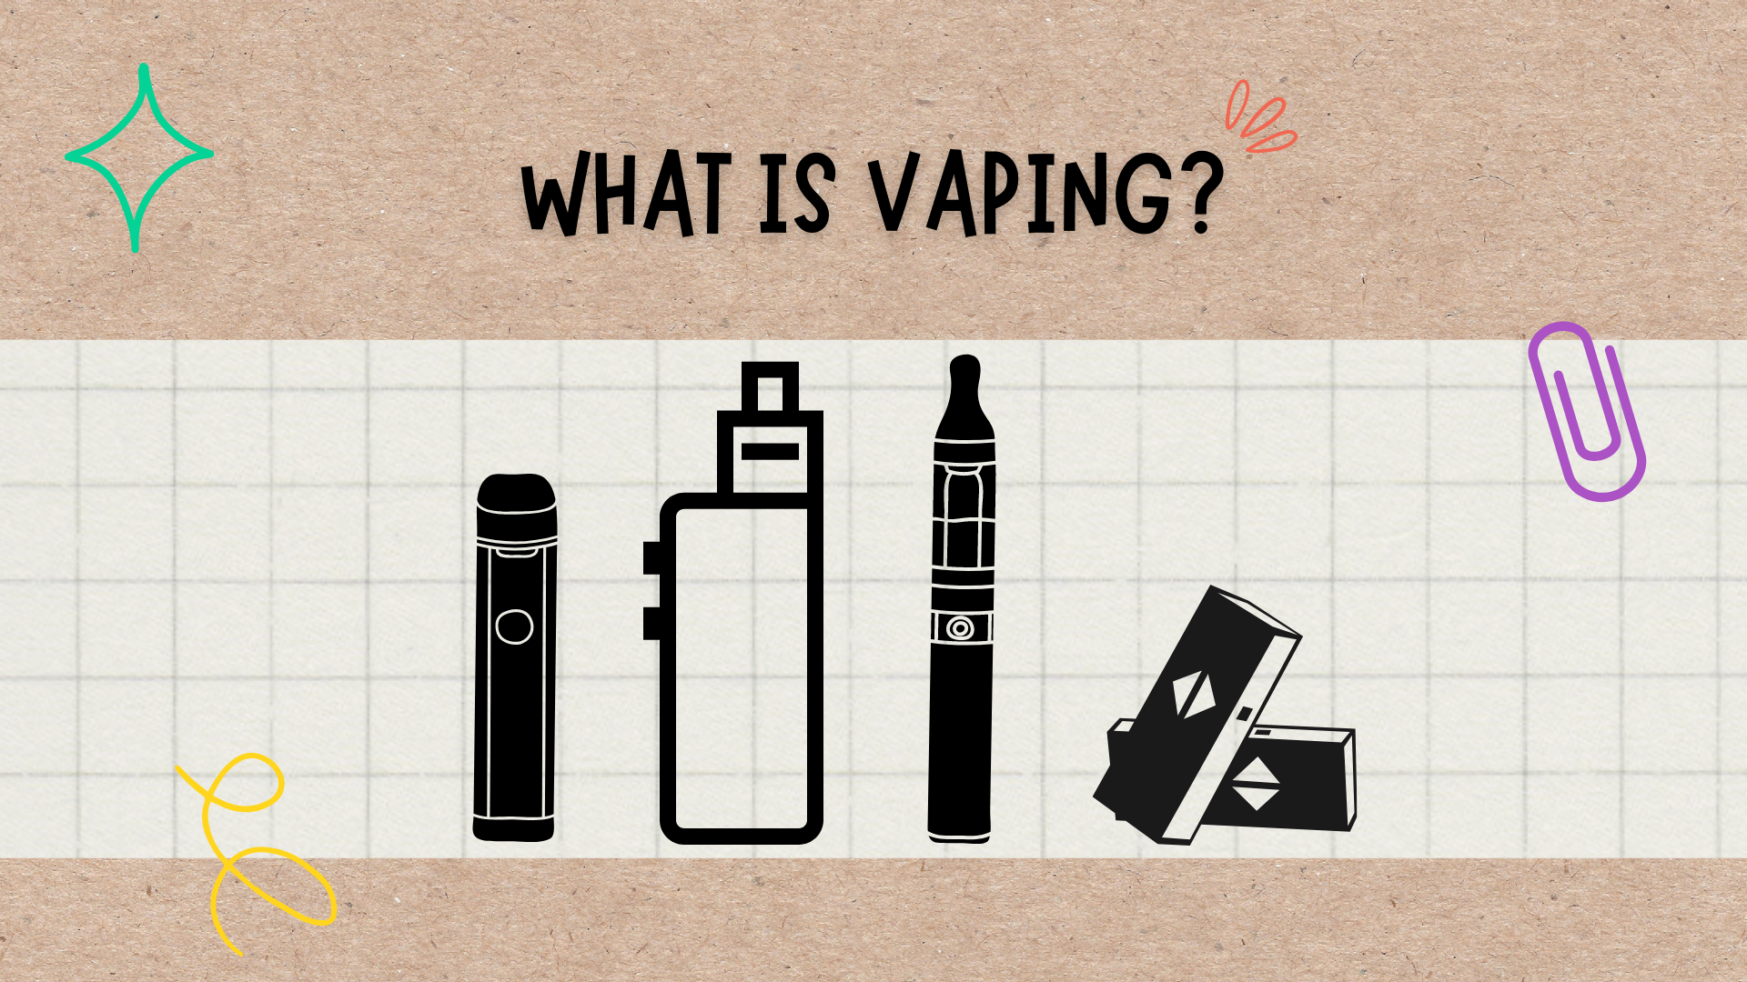
Notes:
Raise your hand if anyone recognizes any of the images on the slide?
{Provide time for students to hand their hands then acknowledge whether the majority of the classroom recognizes, or does not.}
These are vapes. Vapes come in many shapes, sizes and colors. You may have seen a vaping device without even knowing it. Vapes are known by many different names, such as e-cigarettes, electronic smoking devices (ESDs), vape pens, e-hookah or just JUUL. Regardless of what you call them, none are safe for young people to use.
But what exactly is it? Vapes are devices that heat a chemical into an aerosol that the user inhales. Aerosol is made up of chemicals and flavors from inside the vape.

Slide 8
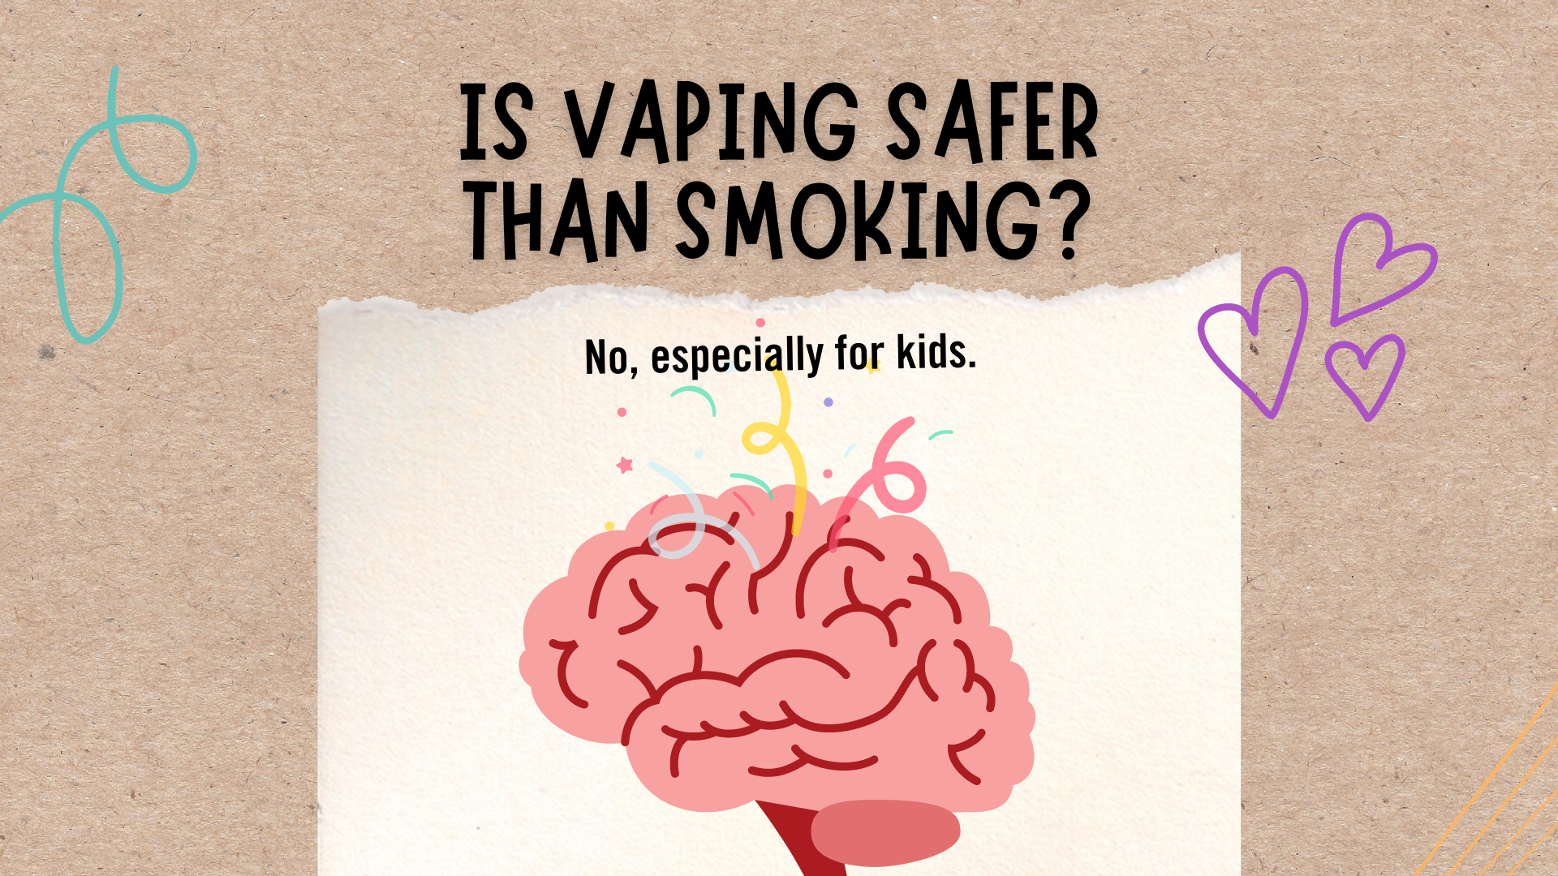
Notes:
Is vaping safer than smoking? No, especially for kids like you. Does anyone know why they aren’t safer?
{Provide time for students to answer. Most likely, they won’t know why they aren’t safer.}
Vape aerosol can contain cancer-causing chemicals, and 99% of vaping devices contain nicotine. Nicotine harms brain development. Our brains are changing and developing until around age 25. These changes help us with problem solving, controlling our emotions, staying focused and making decisions.

Slide 9
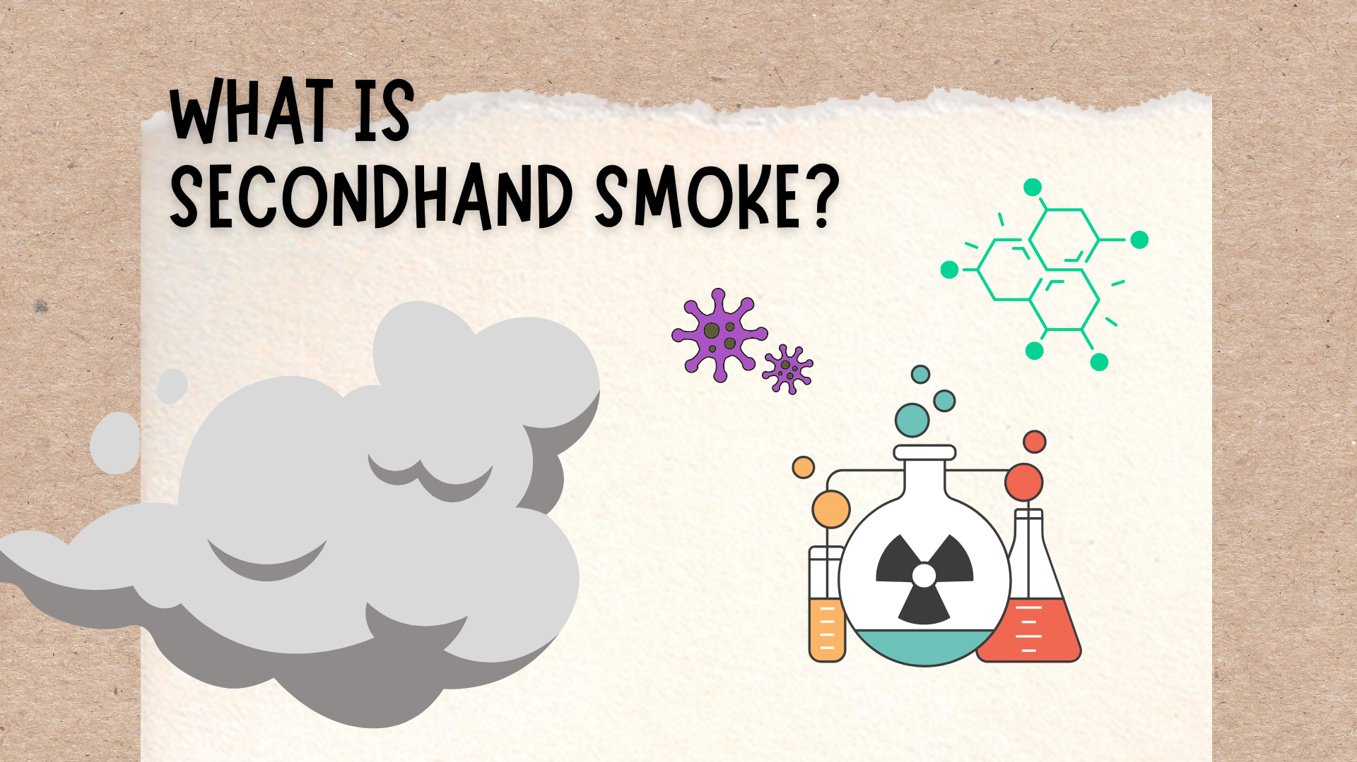
Notes:
Now let’s talk about secondhand smoke.
Secondhand smoke is the smoke that comes off a burning tobacco product, such as a cigarette, pipe or cigar. Tobacco smoke contains more than 7,000 chemicals, including toxic ingredients found in pesticides and car exhaust. Roughly 70 of the chemicals in tobacco smoke can cause cancer. Children who are regularly exposed to secondhand smoke have a greater risk of ear infections, breathing problems and illnesses such as bronchitis and pneumonia. Secondhand smoke can increase the frequency and severity of asthma attacks.
But what about vapes? Aerosol that comes from vapes is not harmless water vapor. Vape aerosol that users breathe from the device and exhale into the air can contain harmful ingredients, including: nicotine, flavorings, cancer-causing chemicals and heavy metals such as nickel, tin and lead.
Did you know, secondhand smoke also affects our pets? Animals who are around secondhand smoke have a higher risk of developing breathing problems, eye infections and cancers, such as lung cancer and nose cancer.
Now, let’s take a pause. Give me a big thumbs up or thumbs down about how you feel about secondhand smoke!
{Provide time for students to give a thumbs up or down. Call on 2-3 students who gave a thumbs down to ask why they decided this. Hopefully this will lead to them summarizing why secondhand smoke is harmful, and who it affects.}

Slide 10
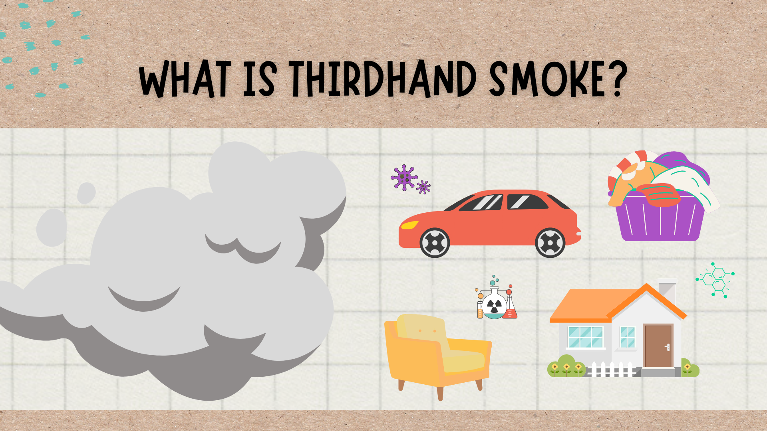
Notes:
Many of you have heard of secondhand smoke before today, but has anyone heard of thirdhand smoke?? Raise your hand if this is a new term and you haven’t heard of it.
{Provide time for students to raise their hand then acknowledge whether the majority of the classroom has, or has not, heard of thirdhand smoke.}
Thirdhand smoke is residue that is left behind on clothes, skin, furniture, walls and other surfaces after someone smokes. The residue is a mixture of chemicals in thirdhand smoke, which is toxic to humans, especially children and babies, as well as pets.

Slide 11

Notes:
Did you know that tobacco and vape companies target kids?? Yes, YOU!
Tobacco and vape companies are very creative in their marketing strategies. They purposefully target kids by using cheap prices, trendy advertising and flavors. Tobacco and vape companies want young people addicted to their products to keep them coming back for more. That’s why you’ll notice advertisements for vapes having bright fun colors! It's important to know how you are being targeted so you don't fall for their tricks.

Slide 12
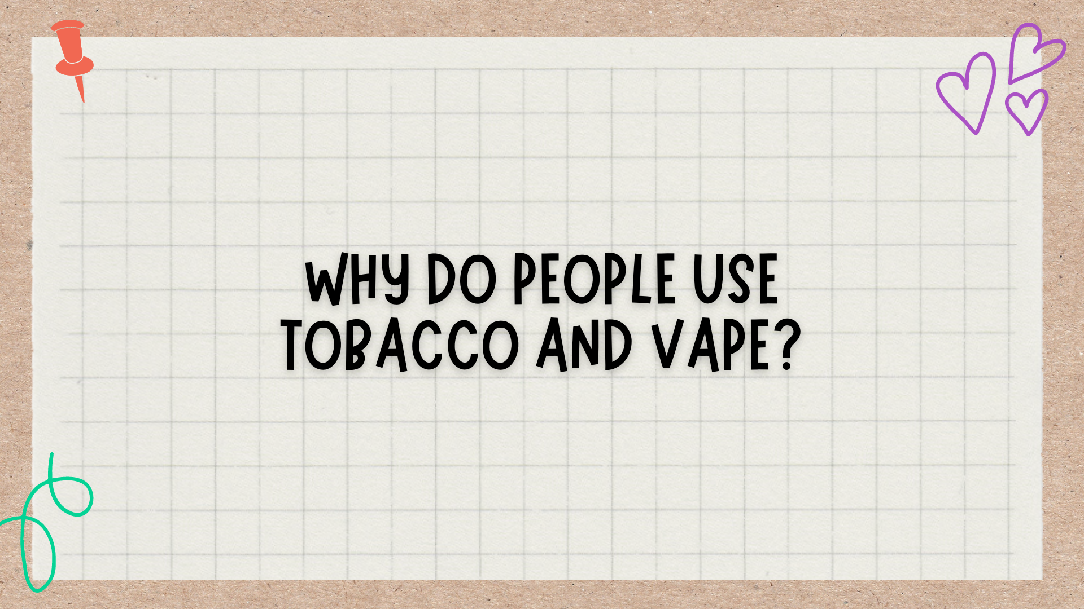
Notes:
Let’s create a list together of why people use tobacco and vape. Raise your hand if you can think of a reason you’d like to share with the class.
{Provide time for students to raise their hand and share.}

Slide 13
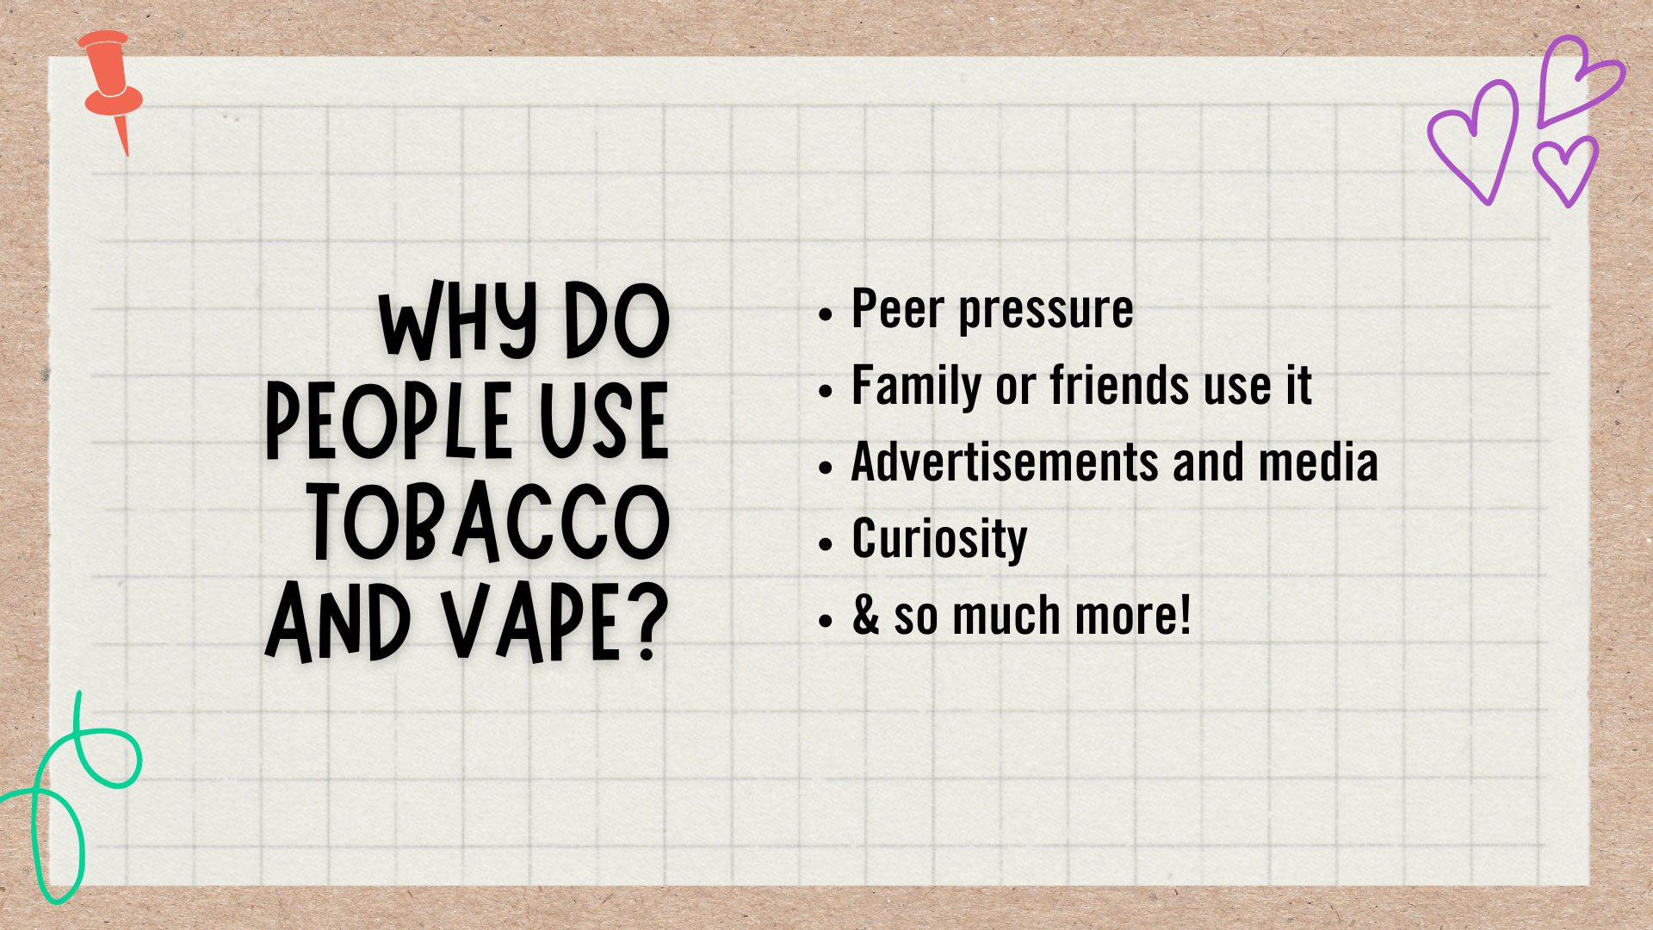
Notes:
The reasons can range from peer pressure, a friend or family member using it, nicotine or vape companies successfully targeting youth, curiosity, seeing advertisements on media, and so much more - just like the reasons we came up with together!

Slide 14
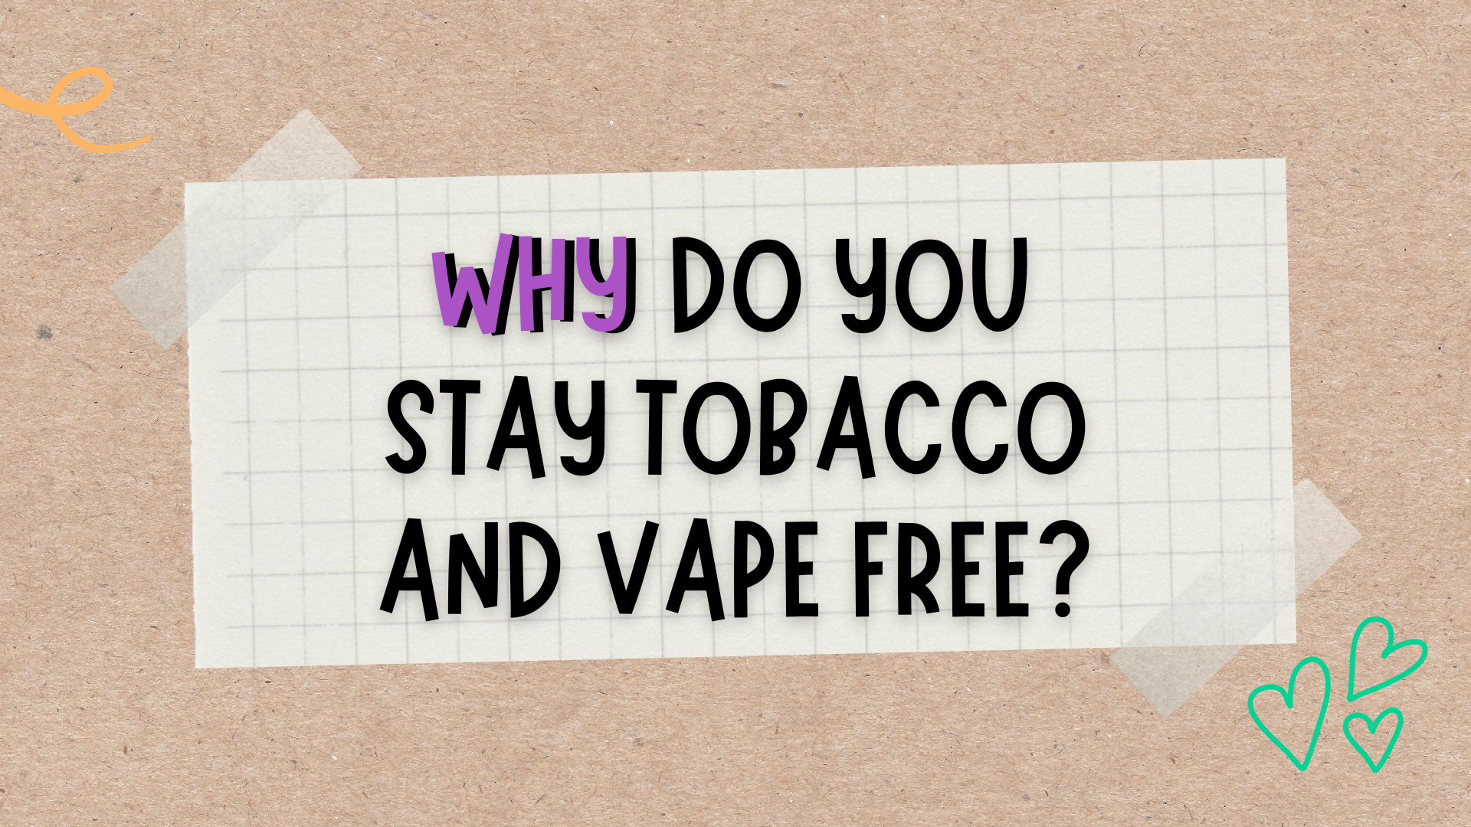
Notes:
Now that we’ve talked about reasons why people use tobacco and vape, let’s shift to talk about why you personally want to live a healthy life, which includes being tobacco and vape free. Everyone has five minutes to reflect on what we’ve talked about so far today, and to write down why you personally want to stay tobacco and vape free.
This is the Additional Optional Activity in the Facilitator Guide - What’s your Why?.
Materials needed: piece of paper
Take five minutes for the students to reflect on the lesson so far, and write down why they want to live a healthy life, which includes being tobacco and vape free. After they finish, allow students to share, and connect the discussion back to the lesson.

Slide 15
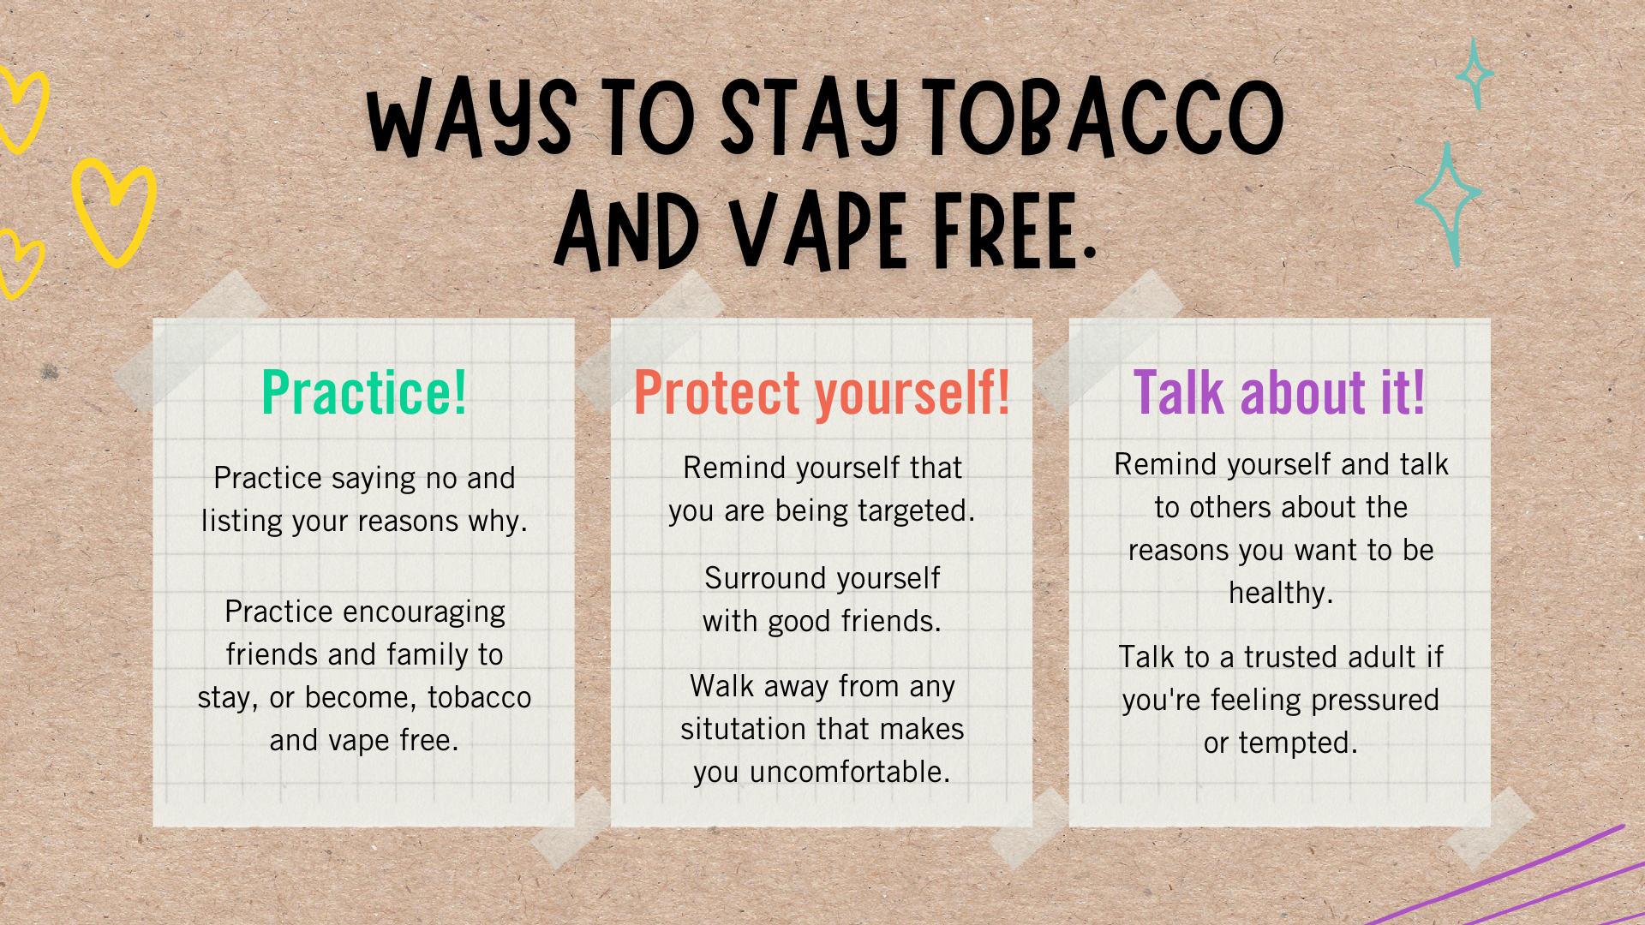
Notes:
Now that we’ve learned about what tobacco and vaping are, as well as the harmful effects, let’s talk about ways to stay tobacco and vape free.
If you are offered tobacco or a vape, prepare yourself ahead of time about how you will handle the situation. Here are some examples:
Practice:
Practice out loud saying "no" and listing your reasons why.
Practice out loud encouraging your friends or family members to stay, or become, tobacco and vape free.
Protect yourself:
Remind yourself that you are being targeted by tobacco and vape companies. They want you to become addicted so you’ll keep buying their products.
Surround yourself with good friends.
Walk away from any situation that makes you feel uncomfortable.
Talk about it:
Remind yourself and talk to others about the reasons you want to be healthy, and that includes being tobacco and vape free.
Talk to a trusted adult and ask for their advice and support, if you’re feeling pressured or tempted to use tobacco or vape.
If continue to find yourself thinking about trying tobacco or vaping, find an alternative activity, such as being active or focusing on deep breathing to keep your mind off of it.

Slide 16
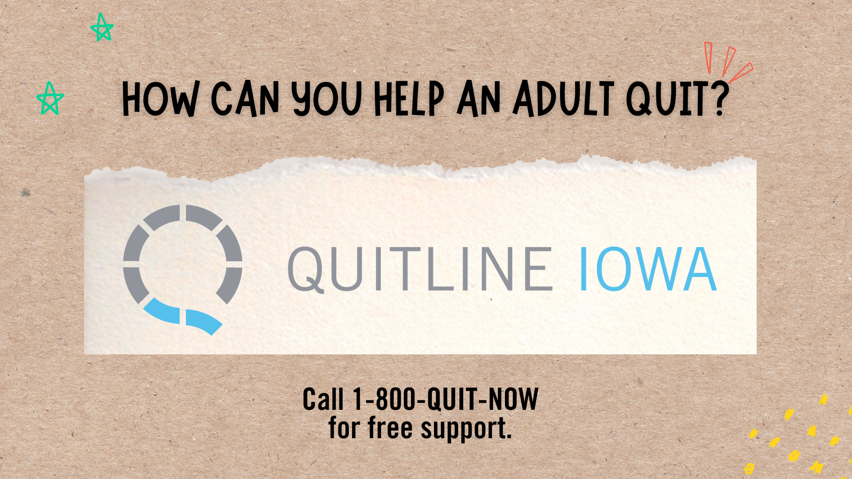
Notes:
Now that’s we’ve talked about how to say no to tobacco and vaping for ourselves, let’s talk about how you can help someone else quit.
It’s simple - be tobacco and vape free! You can make an impact on your friends by living a tobacco and vape free life.
Use the information you learned today to talk to your friends and family about tobacco and vape.
Lastly, lovingly talk to the adults in your life who use tobacco, including vaping, and encourage them to quit. They can call Quitline Iowa at 1-800-QUIT-NOW for free personalized help to support them while quitting.

Slide 17

Notes:
If you know a teen, between the ages of 13 and 17, who uses tobacco or vapes, they can text "Start My Quit" to 36072 for free help quitting.

Slide 18

Notes:
Raise your hand if you’re ever heard of ISTEP. This stands for Iowa Students for Tobacco Education and Prevention.
{Provide time for students to raise their hand then acknowledge whether the majority of the classroom has, or has not, heard of ISTEP.}
ISTEP is a youth-led movement across the state of Iowa that is made up of 7th through 12th grade youth who want to stand up and speak out against tobacco and vaping. ISTEP has chapters throughout the state who talk to their peers about the harmful effects of using tobacco and vaping, as well as how to stay tobacco and vape free.
However, ISTEP is much more than a youth tobacco program. ISTEP is where you make friends, make a difference and become a leader. There is a place for everyone in ISTEP!
You may be too young to join right now, but we hope you consider joining in the future!
{Optional video to share:
Let’s take a quick break to watch this short video clip about how the ISTEP message spreads, just by one person wanting to make a difference. While it plays, take a movement break. Whether it’s standing up, doing light stretching in your chair or simply taking a few deep .
Video Link: https://www.youtube.com/watch?v=C76Lcra3DxQ}
Other ISTEP video options: https://docs.google.com/document/d/1HkyH1kCg1McG5rGHJyvnxTkes7KUBl5eWhY2Rkb5VZc/edit?usp=sharing

Slide 19

Notes:
As we just talked about, it’s important to practice how we will handle the situation when, or if, we are asked to use tobacco or vape. In just a moment, I will split you into partners of two to practice saying out loud how to say no. Each of you will have two minutes to practice. Remember to use the information we have learned so far, and I will display our previous slide to remind you of the ways we just talked about to stay tobacco and vape free.
This is the Additional Optional Activity in the Facilitator Guide - Role Play.
Split the classroom into pairs.
Display the Ways to Stay Tobacco and Vape Free slide during the activity.
Set a 2 minute timer for partner 1 to practice saying no.
Switch roles.
Set another 2 minute time for partner 2 to practice saying no.
Once both partners have gone, have a quick discussion with the class. Connect it back to the lesson.

Slide 20
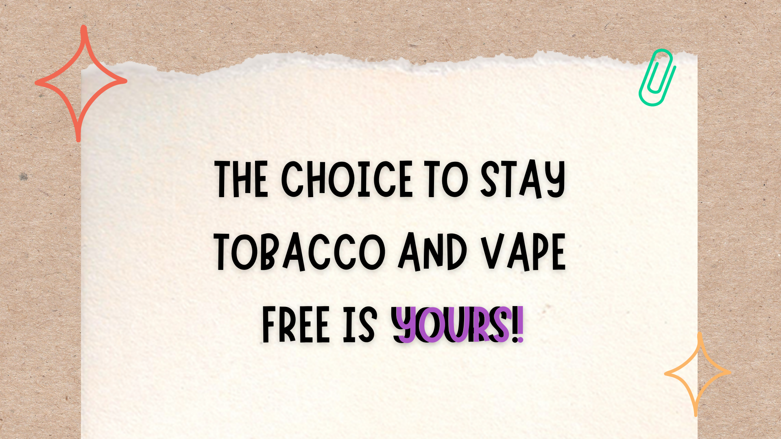
Notes:
Ultimately, remember that the choice to stay tobacco and vape free is YOURS! You can stand up against tobacco and vaping, and choose to live a healthy life that is tobacco and vape free. You can be a leader and make a difference among your friends and family by being tobacco and vape free.

Slide 21

Notes:
As we’re coming to an end to the lesson today, we’d really like to stay in touch with you. We’re going to take a few minutes to assign everyone a Pen Pal Buddy. This means each of you will have an upperclassmen to write a letter to. In your letter you will tell them what you learned today and why you plan to stay vape free!
This is the Additional Optional Activity in the Facilitator Guide - Pen Pal Buddy Letter.
This applies to those partnering with their local youth ISTEP chapter members to present this lesson.
Assign each 3rd - 6th grader to an upperclassmen "pen pal buddy".
Once the upperclassmen leave, ask the 3rd - 6th graders to write a letter to their buddy explaining what they learned and why they plan to be tobacco and vape free.
Arrange a date/time for the upperclassmen to get their letters so the 3rd - 6th graders can see them face to face one more time.

Slide 22

Notes:
Who has questions for me today?
{Allow time for questions. If you don’t know an answer to a question, let the class know you will follow up with the teacher and send her/him the answer.}

Slide 23

Add your name and contact information in this text box.
Notes:
Add your name and contact information to the text box on this slide.

