Slide 1

Iowa's Behavioral Health Prevention
Service System
<Name of Presenter>
<Title & Organization>
Notes:
*CBOs – customize slide to add the name and contact information of the person(s) facilitating the presentation.

Slide 2
Welcome & Introductions
Notes:
Begin by introducing yourself and organization.

Slide 3

Purpose
Provide an overview of Iowa’s Behavioral Health System Alignment
Identify changes to substance misuse & problem gambling prevention services
Discuss the future state of Iowa’s prevention services system
Notes:
Briefly review the purpose of the presentation.

Slide 4
Overview of Behavioral Health System Alignment

Slide 5
What is Behavioral Health?
Behavioral health means mental health, addictive disorders and life stressors and crises.
Behavioral health disorders are common and treatable.
Behavioral health care refers to a full spectrum of prevention, early intervention, treatment, recovery support and crisis care.
Notes:
As we think about this work, it’s important to make sure we all understand - what is Behavioral Health? ​
​
According to the American Medical Association, behavioral health generally refers to mental health and substance use or addictive disorders, life stressors and crises, and stress-related physical symptoms. It is commonly accepted and understood terminology reflecting an integrated approach to care that acknowledges that co-occurring conditions are the expectation, not the exception. ​
​
​

Slide 6

Behavioral Health Service System Overview of Changes
On May 15, 2024, a new law (House File 2673) was signed.
This new system started on July 1, 2025.
This law combines mental health, substance use, and problem gambling services into one system, now called the Behavioral Health Service System (BHSS).
Notes:
HF 2673 was signed into law on May 15, 2024:
Consolidated Iowa's 13 Mental Health and Disability Services regions into seven new, unified behavioral health districts.
The aim of this bill was to improve outcomes for Iowans by aligning mental health and substance use services into one system.
No matter where you are in the state, you can get the help you need.

Slide 7
Behavioral Health Service System Overview of Changes (Cont.)
Established System Navigation that ensures that all Iowans have access to Behavioral Health services.
The Iowa Primary Care Association (Iowa PCA) serves in a statewide capacity as the Administrative Service Organization (ASO) for the state’s redesigned Behavioral Health System.
Notes:
There is no wrong door to accessing mental health, substance use, or problem gambling services.
To learn more about Iowa Primary Care Association and System Navigation services, visit https://www.iowapca.org/administrative-service-organization

Slide 8
System Navigation
Helps Iowans by:
Educating them on available services and options
Helping schedule appointments
Connecting to support groups and other resources
Helping to address barriers to care and troubleshoot when access is challenging
Find support now with Your Life Iowa.
Call: (855) 581-8111
Text: (855) 895-8398
Chat: yourlifeiowa.org
Notes:
System navigation is a brief intervention that helps individuals and families understand the behavioral health service system and provides information, education, referral and support.
System navigation assists Iowans in coordinating key transitions in the behavioral health service system, including crisis services and jail-based behavioral health services.
Anyone can use the System Navigation—there are no rules about who qualifies.
To learn more about System Navigation, visit Navigating the BHSS — Iowa Primary Care Association (https://www.iowapca.org/navigating-the-bhss)

Slide 9
District Advisory Councils
What is a District Advisory Council?
Who serves on the District Advisory Councils?
What are their responsibilities?
When do District Advisory Councils meet?
How can I learn more about my District Advisory Council?
https://www.iowapca.org/district-advisory-councils
Notes:
What is a District Advisory Council?
A District Advisory Council is established to identify opportunities, address challenges, and advise the Administrative Service Organization (ASO).
Who serves on the District Advisory Councils?
Consists of 10 members who represent their behavioral health district in one of the following roles:
- Three members shall be local elected public officials currently holding office within the district, or the public official’s designated representative.
- Three members with lived/living behavioral health experience will be chosen to ensure representation of the populations served within the district. Lived/living experience is defined as personal knowledge gained through direct and/or first-hand experience with behavioral health conditions. At least one member chosen shall represent child or adolescent persons.
- Three members shall be chosen who have experience or education related to core behavioral health functions, essential behavioral health services, behavioral health prevention, behavioral health treatment, population-based behavioral health services, or community-based behavioral health initiatives.
- One member shall be a law enforcement representative from within the district.
What are their responsibilities?
Per Iowa Code 225.A.5. the responsibilities of the District Advisory Councils include the following:
- Identify opportunities and address challenges based on updates received from the ASO regarding the implementation of the district behavioral health plan.
- Advise the ASO while the ASO is developing BH policies.
- Advise the ASO on how to best provide access to BH prevention, education, early intervention, treatment, recovery support, and crisis services related to mental health and addictive disorders, including but not limited to alcohol use, substance use, tobacco use, and problem gambling, throughout the district.
When do District Advisory Councils meet? How can I learn more about my District Advisory Council?
Meeting schedules and more information about District Advisory Councils can be found at https://www.iowapca.org/district-advisory-councils

Slide 10
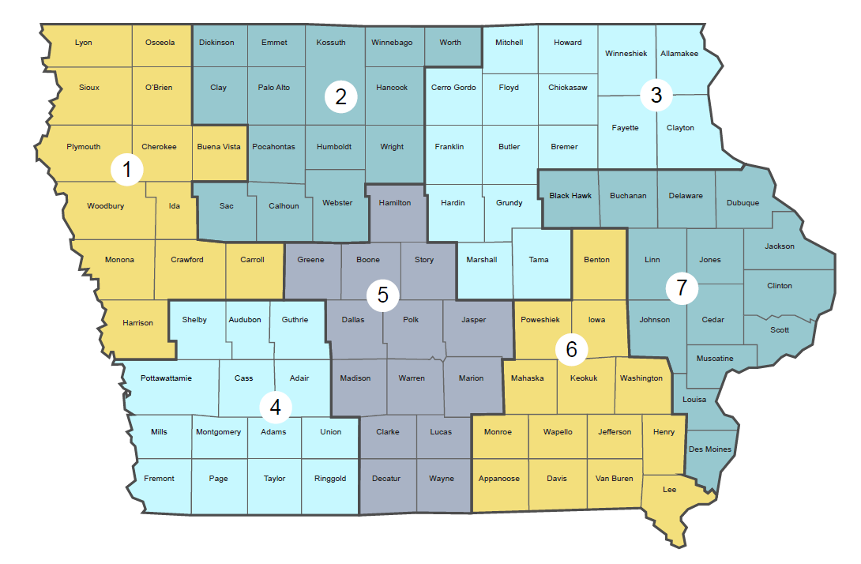
Behavioral Health Districts
Notes:
This new system is comprised of seven districts. Each district has a District Advisory Council to ensure strong local connections are maintained.
So how was this map created?
The new districts were established using a data-driven approach and extensive community engagement, with over 1,000 providers, advocates and people with lived experience participating in the process.
The districts were designed to ensure equitable resource distribution, minimize service disruption, enhance access to quality care, and address the specific needs of different populations.

Slide 11
County Snapshots
Iowa HHS created snapshots of each county
You can find all 99 counties at https://hhs.iowa.gov/initiatives/system-alignment/hhs-system-county-snapshots

Slide 12
Impacts to Substance Use & Problem Gambling Prevention Services
Prevention work will continue and will now encompass mental health and addictive disorders, including but not limited to alcohol use, substance use, tobacco use, and problem gambling.
Notes:
OPTIONAL SLIDE (INTENDED FOR AUDIENCES FAMILIAR WITH PREVENTION SERVICES)
Some prevention services through Iowa HHS are now contracted by the Iowa Primary Care Association (Iowa PCA) who serves as Iowa’s Behavioral Health Administrative Service Organization (BH-ASO).

Slide 13
Future State of Prevention Services in Iowa

Slide 14
What behavioral health issues are you seeing in your community that would benefit from prevention services?
Notes:
Engagement Opportunity
Have participants engage in open discussion to better understand concerns about issues happening in their communities.
This could be done through one of the following ways:
Open discussion where participants openly share;
The use of Qualtrics or another digital tool to poll the collective group
After the discussion, briefly explain that behavioral health prevention services are guided using a data-driven process called the Strategic Prevention Framework that will be discussed in more details in the coming slides. In addition, provide information as to the substance misuse and problem gambling prevention priorities and strategies that are being provided in the county.

Slide 15
Future State of Prevention Services in Iowa
Broader array of prevention services
Focus on the Strategic Prevention Framework (SPF)
July 2026-June 2027
Assessment step of the SPF process to begin
Notes:
Funded prevention services will focus on a variety of behavioral health topics including substance use, problem gambling, mental health and suicide.
The Strategic Prevention Framework or SPF will be used to guide prevention services and will begin this work with the first steps of the SPF which is the assessment step. This SPF step reviews local data to determine the behavioral health issues happening in the county. An overview of the SPF process is provided on the next slide.

Slide 16

What is Prevention?
Going "upriver" to find out what is causing behavioral health needs.
Working to reduce those risks and build protection against preventable health conditions.
Story of the river
Notes:
This is prevention. Collectively we work to discover what is causing people to misuse substances or engage in high-risk gambling activities in our community, and then we work to reduce those risks and to build protections against substance misuse and/or problem gambling.
Story of The River – show the video which is hyperlinked in the slide
Should there be technical difficulties with accessing the link in the video, the "Story of the River" is below:
This story is often used to illustrate the role of prevention specialists: Two friends, Susan and Fernando, are fishing on a river when Fernando looks upriver and sees a man in the water. He is struggling to stay afloat, so Fernando drops his fishing pole and pulls the man out of the water. The man is sputtering and cold, and Susan calls an ambulance on her cell phone to take him to a hospital. Susan and Fernando go back to fishing. Pretty soon they look upriver again and see a woman in the water. She is struggling, too, so Fernando drops his fishing pole again and pulls the woman out of the water. She is not in very good shape, so Susan calls another ambulance to take her to a hospital. The friends return to fishing when they look upriver and see a whole group of people in the water. They are struggling to stay afloat and look like they are dragging each other down. Fernando drops his fishing pole and starts hauling people out of the water. He looks up and sees Susan walking away, upriver. He calls to her to come help pull people out of the river, and Susan responds that she is going upriver to find out why all the people are ending up in the water. What prevention is: We go upriver to find out what contributes to people misusing substances or experiencing issues related to problem gambling. We want to know exactly what is causing people to fall into the river, which may be different from river to river. Perhaps we go upstream—like Susan—and find that a fence to keep people away from the river has fallen and needs to be rebuilt. Maybe we find a slippery slope running into the river and can plant vegetation to prevent people from falling down the banks. Perhaps we find a big sign announcing, “The water’s great; jump in!” and we can take the sign down and replace it with a warning. We in prevention work to discover what is causing people to misuse substances or engage in high risk gambling activities in our community, and then we work to reduce those risks and to build protections against substance misuse and/or problem gambling.
Source: Introduction to the field of prevention, The Athena Forum by the Washington State Health Care Authority/Division of Behavioral Health and Recovery, 2025 (https://theathenaforum.org/introduction-prevention)

Slide 17
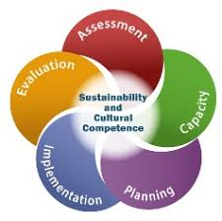
Strategic Prevention Framework (SPF)
Developed by the Substance Abuse and Mental Health Services Administration (SAMHSA)
Includes five steps:
  Assessment
  Capacity
  Planning
  Implementation
  Evaluation
Focus in SFY 2027 will be on Assessment
Notes:
SPF was developed by the Substance Abuse and Mental Health Services Administration
SPF is a comprehensive approach designed to help planners gather and use data to guide prevention decisions. It uses a five-step process to guide communities in the selection, implementation, and evaluation of effective, culturally appropriate, and sustainable prevention activities.
Assessment: Identify local prevention needs based on data (e.g., What is the problem?)
Capacity: Build local resources and readiness to address prevention needs (e.g., What do you have to work with? How can you facilitate the communication of prevention science?)
Planning: Find out what works to address prevention needs and how to do it (e.g., What should you do and how should you do it?)
Implementation: Deliver evidence-based programs and practices as intended (e.g., How can you and your coalition put your plan into action?)
Evaluation: Examine the process and outcomes of programs and practices (e.g. Is your plan succeeding?)
Guiding Principles:
Cultural Competence: communities must engage in an inclusive and culturally appropriate approach to identifying and addressing their substance misuse problems
Sustainability: Engage partners who represent and work with sub-populations experiencing BH disparities in your planning effort. Sustain processes that have successfully engaged members of these populations. Sustain programs that produce positive outcomes for these populations

Slide 18
How can you contribute?
Participate in Behavioral Health Town Hall meetings
Join a local prevention coalition
Share data
Engage new partners
Attend events
Volunteer
Be part of the Assessment process in SFY27
Notes:
Prevention is most effective when the entire community is involved. There are a variety of ways for you to contribute to healthier communities. Here are a few suggestions:
Attend a Behavioral Health Town Hall meeting to learn what is taking place in your district to address mental health, substance use, problem gambling, and suicide.
Join a local coalition. Here you can be a part of exiting change in your own community.
Share data. Consider what types of data are available. This helps to determine why certain behaviors are happening in your community.
Engage new partners. Invite your family, friends, and neighbors to a coalition meeting or prevention activity to learn more.

Slide 19
Resources
Iowa HHS System Alignment
https://hhs.iowa.gov/initiatives/system-alignment
Iowa Primary Care Association
https://www.iowapca.org/
Notes:
If you would like more information about Iowa's new Behavioral Health Service system, you can visit any of the websites seen here.
There are two different pages on the Iowa HHS website, or you can visit the website for the Iowa Primary Care Association.

Slide 20
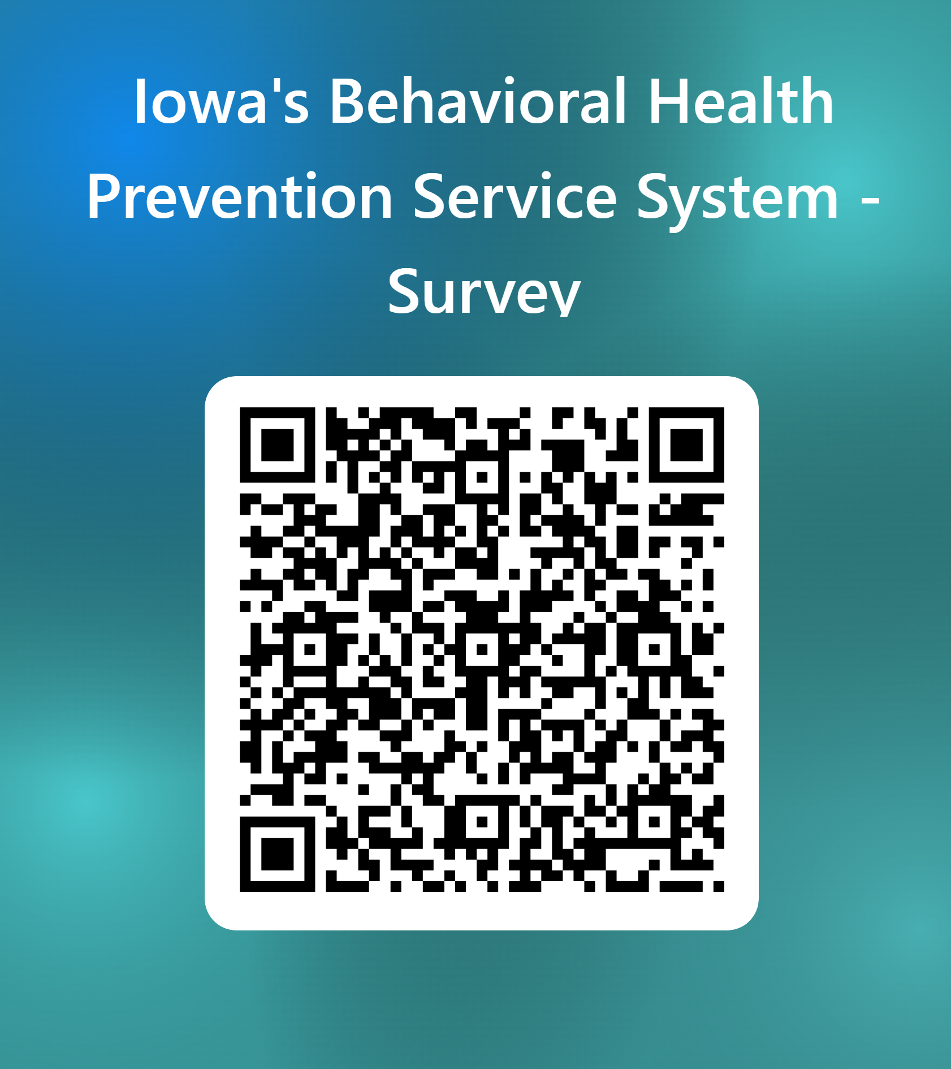
Let's test your knowledge!
https://tinyurl.com/mrw6jz7b
Notes:
Survey Instructions
- Please complete our survey by opening the camera app on your phone and focusing it on the QR code on the screen. You should then see a website appear at the bottom of your screen.
- If you are unable to access the survey using your camera, you may also type the website shown on the screen into your internet browser as well: https://tinyurl.com/mrw6jz7b
Questions:
For Agency Name, select the name from the drop-down menu of the Agency that I represent: ______________________________.
Please enter today's date
From the drop-down menu, select our county name: ___________________________.
Please select Yes, No, or Don't Know to indicate if our presentation today increased your knowledge about Iowa's Behavioral Health System.
Be sure to click "submit" when you have answered all of the questions.

Slide 21


Questions
<Name>
<Title>
<Contact Information>
Notes:
*CBOs – customize slide to add the name and contact information of the person(s) facilitating the presentation.

