Slide 1

Network Development
Prepared by Morgan Tackett

Slide 2

Topics of Conversation
Roles and Responsibilities
Overview of what recruitment looks like
Retention roles and why retention is important in a MCO network

Slide 3
Roles and Responsibilities
Purpose of Position:
Contract, build and maintain adequate dental provider networks. Provide education, training and guidance for providers in the MCNA Dental Medicaid and CHIP Programs
Responsibilities:
Develop new contractual relationships with providers in states/territory
Recruit providers identified in new and existing states to build a strong network of providers to service members in the program(s) and to maintain network adequacy standards as a means of retention. These providers include:
Solo practice providers of all specialties
Large Group Practices
Federally Qualified Health Centers
Tribal Providers
Rural Health Clinics
County Health Department
In some states: Mid Level Providers, i.e., hygienists, denturists, anesthesiologists, etc.

Slide 4
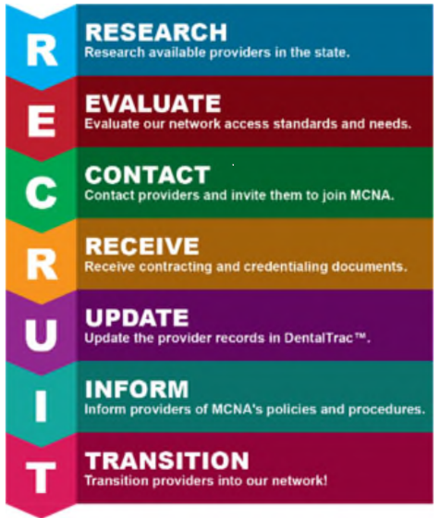
Recruitment Approach
MCNA’s multi-pronged and ongoing approach to growing and maintaining a provider network that is fully compliant with the time, distance, and appointment access standards applicable to all provider types includes recruitment activities, training and education opportunities, and initiatives to maintain provider satisfaction.
MCNA’s process for network development and recruitment begins with assessing the available dental providers in a state. We followed this process in Iowa to build our DWP network and to expand our network. Our Network Development team researches all available providers within a state by evaluating all available provider listings and then follows this outreach process

Slide 5
Provider Network and Network Adequacy
MCNA has a proven track record in developing and growing provider networks, capable of delivering specialized care and meeting stringent access standards in urban and rural areas.
MCNA’s on-the-ground engagement and stakeholder feedback has allowed MCNA to gain insight into the challenges and issues facing Iowa’s dental community.
The relationships of our Network Development team and plan leadership are central to our contracting strategy
  Enables us to understand and address the needs and concerns of providers and stakeholders
  Strengthens our recruitment efforts.
MCNA has extensive experience overcoming challenges to developing complete, statewide networks that we apply in Iowa.
  MCNA’s philosophy is to pay providers on a fee-for-service basis and give our members throughout Iowa variety of provider choices.
  Offering Value Base Purchasing alternative payment models
  We do not close or limit provider panels; our network is always open to new providers willing to meet MCNA’s terms and conditions.
  MCNA is committed to providing dentists with a capably staffed Provider Hotline and dedicated Medicaid Provider Relations Representatives.
  We fully support our network through the provision of leading-edge technology designed to eliminate administrative barriers to Medicaid participation, including MCNA’s free, easy-to-use, online Provider Portal.

Slide 6

Questions, comments or discussion

