Slide 1
Iowa Tobacco Prevention and Control Program (TPCP)
Adam Shanks, Tobacco Cessation Coordinator
January 13, 2026
Notes:
Iowa Department of Health and Human Services (Iowa HH) - > Division of Behavioral Health > Tobacco Prevention and Control Program
Tobacco Cessation Coordinator (managing Quitline Iowa, MLMQ, SFH, etc).

Slide 2

Tobacco & Nicotine
  Nicotine is the drug found in tobacco plants (and what causes addiction)
  Tobacco harms almost every organ in the body
  Nicotine damages the developing brain
  Nicotine activates areas of the brain that make you feel satisfied and happy
  Nicotine primes the brain for addiction to other substances
Notes:
Quick background on Tobacco & Nicotine -
What is tobacco?
A plant with leaves that have high levels of the addictive chemical nicotine. After harvesting, tobacco leaves are cured, aged, and processed in various ways.
Tobacco products encompass multiple varieties of products, including cigarettes, cigarette tobacco, roll-your-own tobacco, smokeless tobacco, electronic cigarettes, cigars, hookahs, pipe tobacco, nicotine gels, and dissolvables.
Nicotine affects the brain in several ways, including:
Reward pathway
Nicotine activates the brain's reward pathway, releasing dopamine, a chemical that produces feelings of pleasure and satisfaction. This can lead to addiction, as the body craves the dopamine release and people may lose control over their use.
Brain development
Nicotine exposure during adolescence can cause long-term changes in brain development, which can impact learning, memory, attention, and behavior.
Cognitive control
Nicotine affects the brain regions that control cognition, motivation, and impulses.
Individual differences
The effects of nicotine on the brain vary from person to person. Some people have stronger responses to nicotine cues, making it harder to resist and more likely to relapse.
Withdrawal
When someone stops using nicotine, they may experience withdrawal symptoms like cravings, irritability, difficulty concentrating, and poor sleep. Nicotine can take three to four days to leave the body, and cravings can be especially strong during this time.
These risks include: addiction, mood disorders, and impulse control. Nicotine also changes the way that the brain forms synapses which can harm the parts of the brain that control attention and learning. Due to changes in the brain, quitting is harder for those who start at a young age. So prevention is key!

Slide 3
What is the problem?
Smoking is the #1 cause of preventable disease and death worldwide (1 in 5 deaths annually are tobacco-related)
16 million Americans have a tobacco-related disease
Primary use causes more than 480,000 deaths each year in the United States
Claiming the lives of over 5,100 adults annually in Iowa (smokers die 10 years earlier than non-smokers)
58 million non-smoking Americans exposed to secondhand smoke
  Contains more than 7,000 chemicals
  70 of which are known to cause cancer
  41,000 deaths each year due to secondhand smoke exposure
Annual healthcare costs directly due to smoking totaling $1.49 billion
Medicaid costs caused by smoking among Iowans exceed $391 million annually
Notes:
Over 16 million people live with at least one disease caused by smoking, and 58 million nonsmoking Americans are exposed to secondhand smoke.
Cigarette smoking and secondhand smoke exposure cause more than 480,000 deaths each year in the United States. This is nearly one in five deaths
Cigarette Smoking | Smoking and Tobacco Use | CDC
Secondhand smoke exposure contributes to over 40,000 deaths among nonsmoking adults and 400 deaths in infants each year
In adults, secondhand smoke can cause coronary heart disease, stroke, and lung cancer.1

Slide 4
Iowa Adult Tobacco & Nicotine Use Rates (2023)
Any current tobacco use (including e-cigarettes) - 25.5%
  Smoke prevalence rate among adults (13.7%)
Smoking prevalence among Iowa Medicaid members – 26%
Smoking prevalence rate among pregnant women – 5.1% (9.3% among pregnant female Medicaid members – 2022)
Smoking prevalence rate among LGBTQ+ - 15.2%
Smoking prevalence rate among reported heavy drinking – 27.2%
Smoking prevalence rate among adults who report frequent poor mental health days (14+ in past 30 days) - 23.7%
Notes:
Credit to BRFSS for data/stats
Iowa Birth Cert. - pregnant women
in Iowa is 9vi.3%.

Slide 5
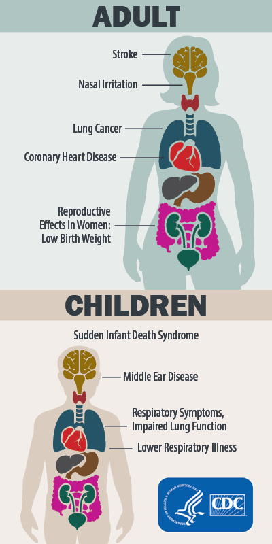
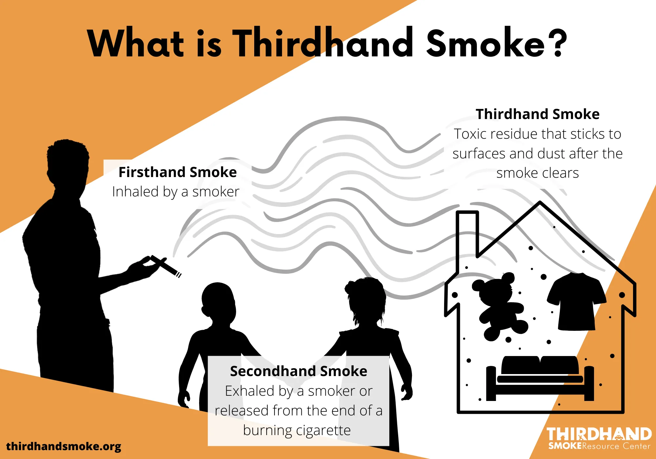
What is Thirdhand Smoke?
Notes:
Nicotine can have many negative health effects, including:
Cardiovascular issues: Nicotine can increase your heart rate and blood pressure, and narrow your arteries. This can lead to hardened arteries and an increased risk of heart attack.
Mental health: Nicotine dependence can worsen anxiety and depression, and lead to poor mental health.
Lung damage: Nicotine can cause respiratory problems and permanent lung damage.
Oral health: Nicotine can cause canker sores and increase your risk of oral cancers.
Addiction: Nicotine is highly addictive and can cause withdrawal symptoms if you stop using it.
Other health issues: Nicotine can also contribute to delayed wound healing, reproductive disturbances, peptic ulcer disease, and esophageal reflux.
Nicotine is the primary agent in cigarettes and e-cigarettes. Vaping can also cause other health issues, such as nausea, vomiting, burns, and injury.
Health effect examples from smoking, secondhand/thirdhand smoke with Adults & Children -
Cancer
Heart disease and stroke
Lung diseases such as chronic obstructive pulmonary disease (COPD)
Type 2 Diabetes
Harmful reproductive health effects
Other diseases, including certain eye diseases and problems of the immune system, including rheumatoid arthritis.

Slide 6
Secondhand Smoke
Secondhand smoke is exhaled by a person who is smoking, and inhaled by a nearby person.
A dangerous mixture of over 7,000 chemicals, including 70 that cause cancer.
Increases risk for heart attacks, heart disease and stroke, and lung cancer.
Children who are exposed to secondhand smoke in the home or vehicle may be at increased risk for secondhand smoke-related disease and illness, and infants are at a greater risk for sudden infant death syndrome (SIDS).
There is no safe level of secondhand smoke exposure.

Slide 7
Chemicals in Thirdhand Smoke Can:
Increase Risk of Cancer
Damage DNA
Reduce Ability to Heal Injuries
Lower Ability to Fight Infection
Damage Cells
Cause Earaches
Trigger Asthma Attacks
Worsen Respiratory Illness
Increase Risk of Disease
Cause Headaches
Notes:
Thirdhand smoke resource center

Slide 8
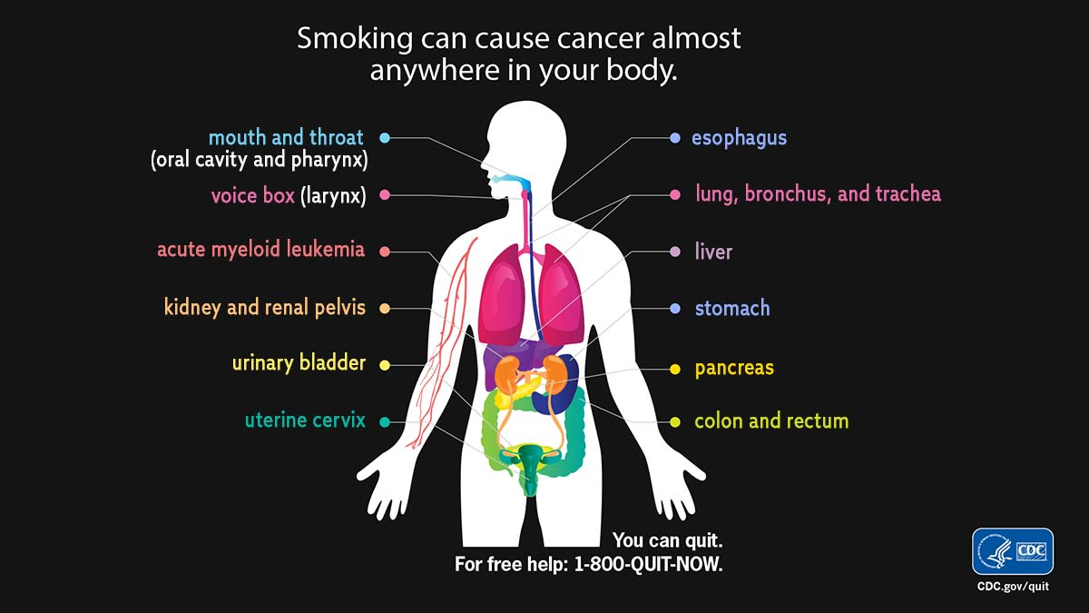
Smoking can cause cancer almost anywhere in your body.
Notes:
Health effect examples from smoking, secondhand/thirdhand smoke with Adults & Children -
Cancer
Heart disease and stroke
Lung diseases such as chronic obstructive pulmonary disease (COPD)
Type 2 Diabetes
Harmful reproductive health effects
Other diseases, including certain eye diseases and problems of the immune system, including rheumatoid arthritis.

Slide 9
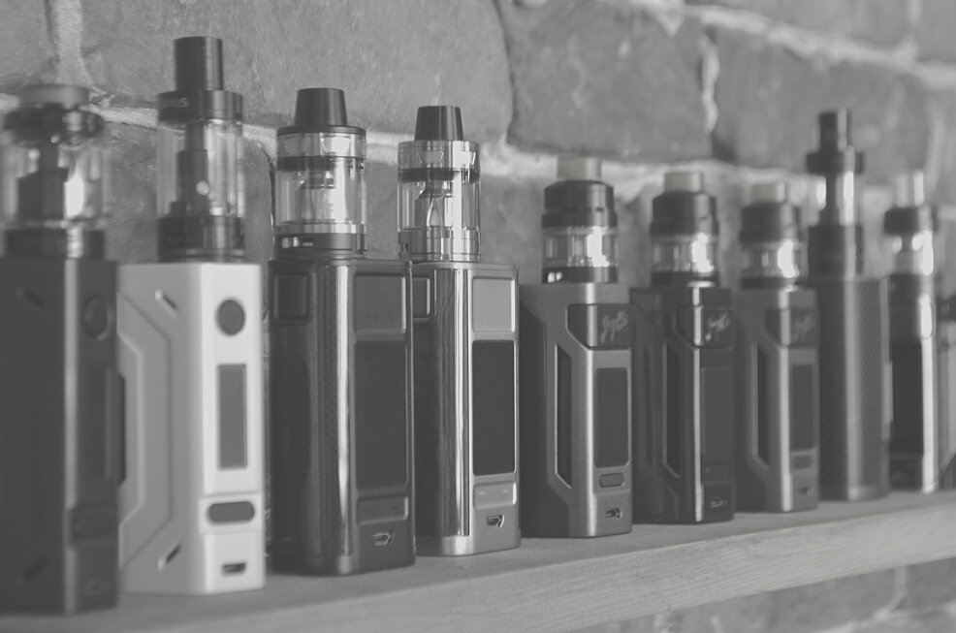
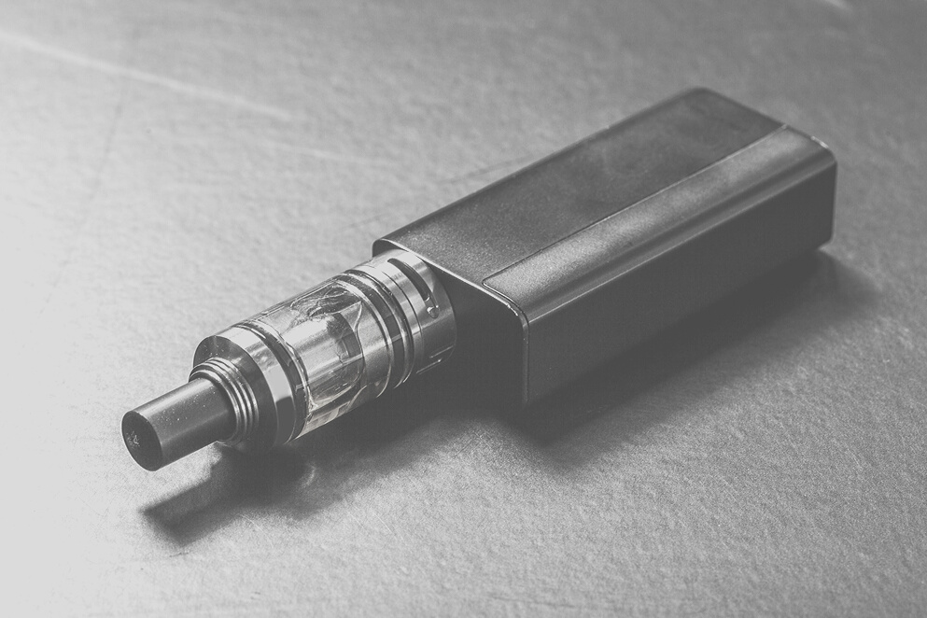
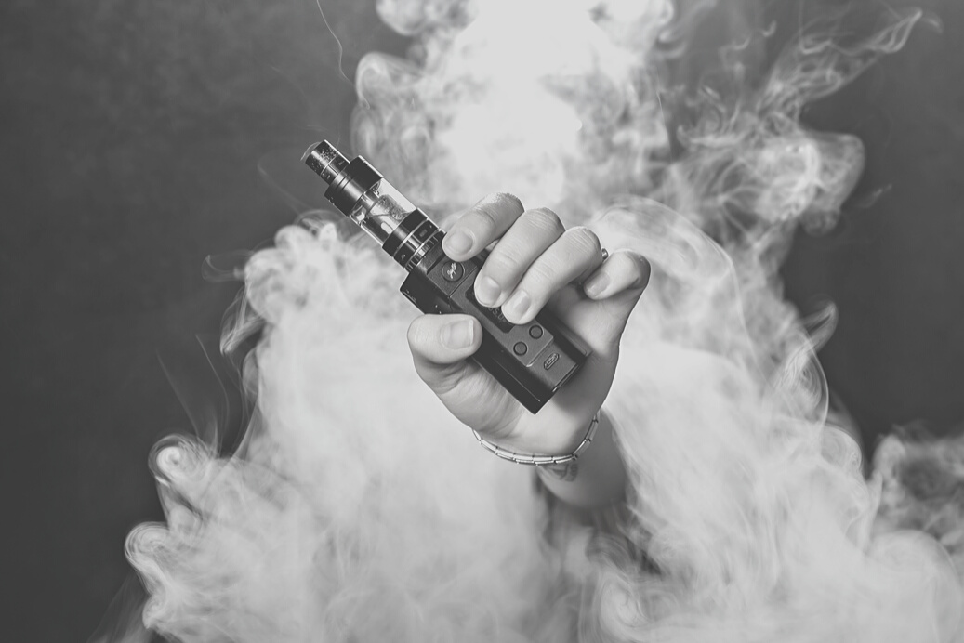
What is Vaping?
  Inhaling and exhaling the aerosol (‘vapor’) produced by an e-cigarette or similar battery powered device
  Called e-cigs, vape pens, e-hookahs, e-pipes, tanks, mods, vapes, electronic nicotine delivery systems (ENDS), and more
  Youth who use e-cigarettes are more likely to become dual users
Notes:
So what is vaping? Vaping is the act of inhaling and exhaling the aerosol that is produced by an e-cigarette or other battery powered device.
What is an e-cigarette? They are battery-powered vaporizers that simulate the act and sensation of smoking combustible cigarettes. But does not burn tobacco.
E-cigarettes are also known as e-cigs, vape pens, e-hookahs, e-pipes, tanks, mods, vapes, electronic nicotine delivery systems, or ENDS, and more. Some people refer to the brand names, like JUUL.
When you use e-cigarettes, nicotine is quickly absorbed into the body and goes directly to the brain. According to the Surgeon General, youth are more at risk for developing long-term effects to the brain from using nicotine because the brain isn't fully developed until age 25.
Users then inhale this aerosol into their lungs, and bystanders may inadvertently breathe it in when the user exhales into the surrounding air. It's worth noting that e-cigarettes can also serve as a means to deliver substances like marijuana and other drugs.
Freebase nicotine
The original form of nicotine used in e-liquids, freebase nicotine is the purest form of nicotine and is found in cigarettes and nicotine replacement products. Freebase nicotine is known for its harsh throat hit and slower absorption rate. It also offers a wider variety of flavors and nicotine strengths, and increased vapor production.
Nicotine salt
Also known as protonated nicotine, nicotine salt is made by blending nicotine with an acidic compound, such as benzoic or citric acid. Nicotine salt is absorbed more quickly than freebase nicotine and is often preferred for its smoother throat hit and higher nicotine concentrations. Nicotine salt is popular in the UK and is often found in disposable vapes. However, not all vaping devices are suitable for nicotine salt due to its high nicotine strengths
Currently, there is no state excise or specialized tax levied on e-cigarettes in Iowa. Instead, vape products are subject to taxation at the standard sales tax rate, rather than the tobacco or cigarette tax rate. Although e-cigarettes fall outside the scope of the Smokefree Act, individual businesses have the discretion to restrict the use of vape devices indoors, although this is not mandated by state legislation. In Iowa, various legal restrictions are in place to curb youth access to e-cigarettes. These measures include, but are not limited to, prohibiting the sale, distribution, possession, purchase, and usage of vapor products by individuals under the age of 21.

Slide 10
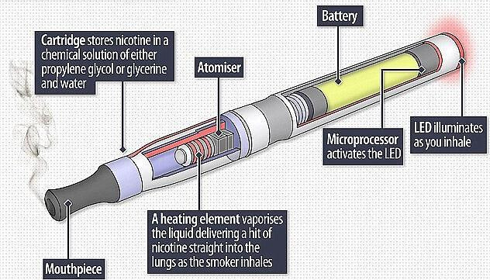
Anatomy of the E-Cigarette
Notes:
Here is a diagram of a vape pen, but most devices work pretty similar.
There is a mouthpiece where the user inhales the aerosol.
The cartridge or pod that stores the nicotine in a chemical solution (also known as an e-juice).
The atomizer is the heating element which vaporizes the chemical solution.
The battery that powers the atomizer which varies in size depending on the type of device you are using and the amount of aerosol you want to inhale.
Despite claims of “risk reduction”, there is no evidence to demonstrate that HTP (heated tobacco products) are less harmful than conventional tobacco products. Many toxicants found in tobacco smoke are at significantly lower levels in HTP aerosol but HTP aerosol contains other toxicants found sometimes at higher levels than in tobacco smoke, such as glycidol, pyridine, dimethyl trisulfide, acetoin and methylglyoxal.
Further, some toxicants found in HTP aerosols are not found in conventional cigarette smoke and may have associated health effects. Additionally, these products are highly variable and some of the toxicants found in the emissions of these products are carcinogens.

Slide 11
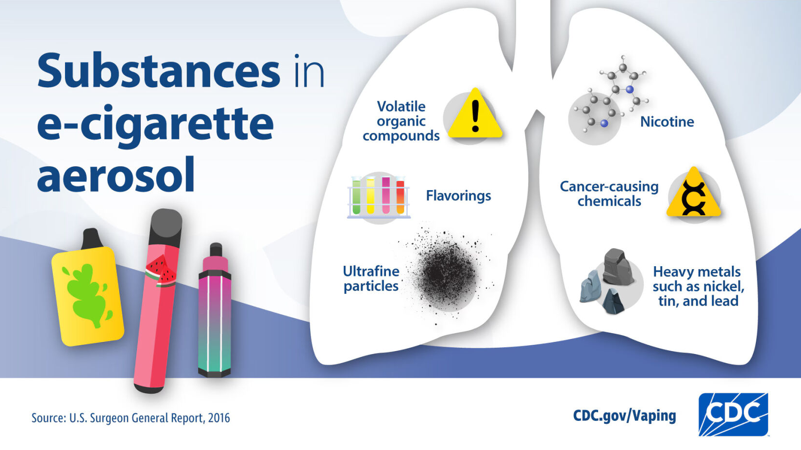
Substances in e-cigarette aerosol
Notes:
About E-Cigarettes (Vapes) | Smoking and Tobacco Use | CDC
E-cigs produce an aerosol, commonly called vapor. The tobacco companies introduced the word vapor with e-cigarettes for two reasons, one because it sounds healthy, safe and less harmful, and two because it would not identify with smoking so these products would not fall under that same laws and regulations as traditional tobacco products.
Users inhale this aerosol from the device and then exhale it. The aerosol is NOT water vapor, instead it contains many chemicals as seen here on the slide.

Slide 12
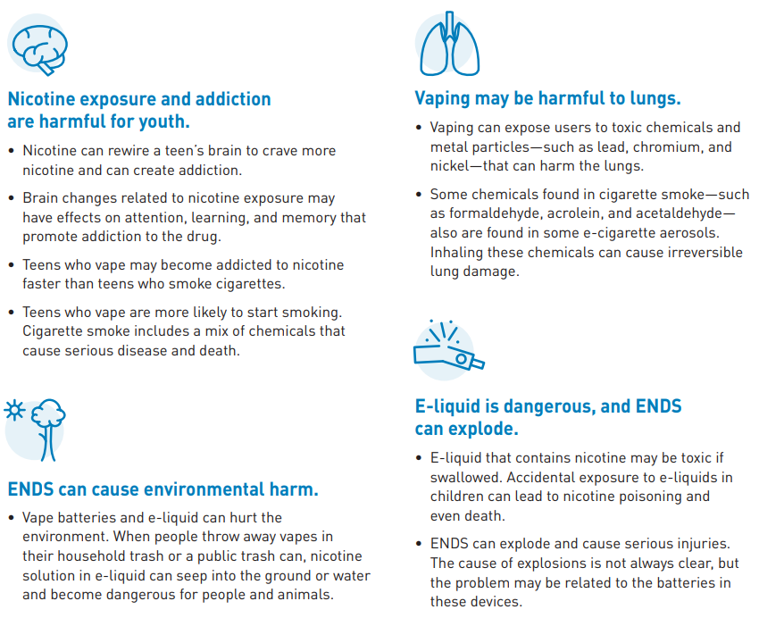
How Nicotine is Harmful
Notes:
Resources for Professionals About Vaping & E-Cigarettes: A Toolkit for Working with Youth (hhs.gov)

Slide 13
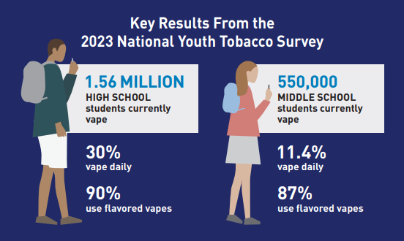
Youth & Young Adult Tobacco Use (2023)
E-cigarette rate among young adults (ages 18-24) - 20.6%
Smoking prevalence rate among young adults – 6.4%

Slide 14
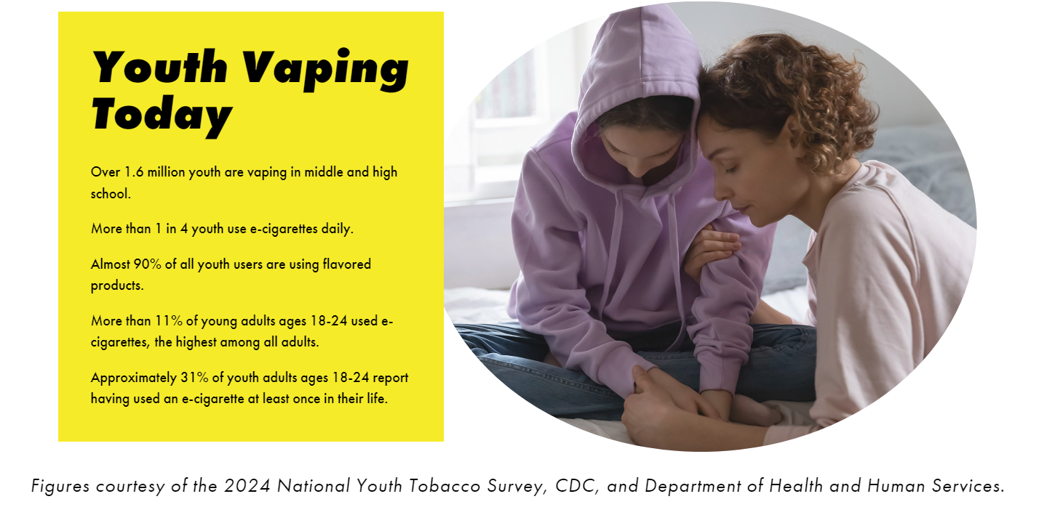
Youth Vaping Today

Slide 15
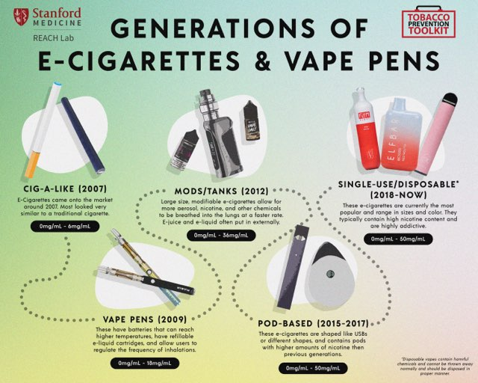
Generations of e-cigarettes and vape pens
Notes:
Halpern-Felsher REACH lab (Bonnie)

Slide 16
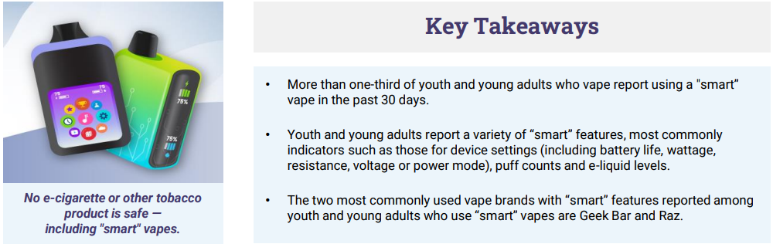
Key Takeaways
CDC Foundation – June 2025
Notes:
CDC Foundation PDF can be included in follow up

Slide 17
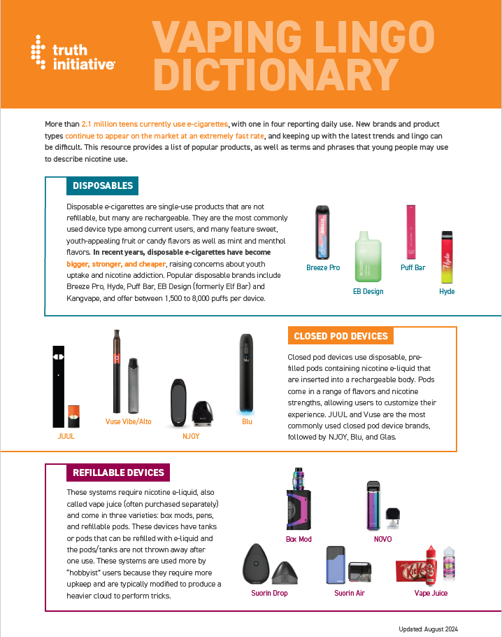
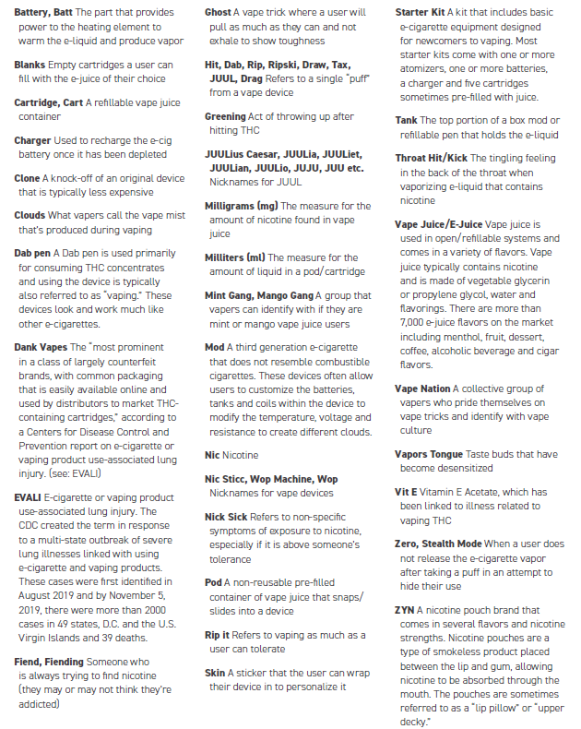
Vaping Lingo Dictionary
Notes:
Find the resource here: Truth_Vaping Lingo Dictionary_082824.pdf (truthinitiative.org)

Slide 18
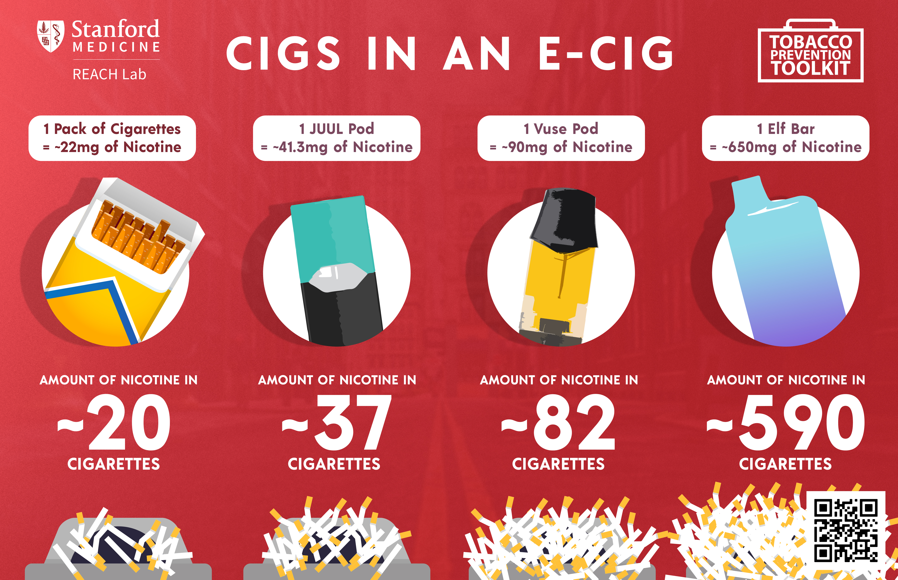
Cigs in an E-Cig

Slide 19
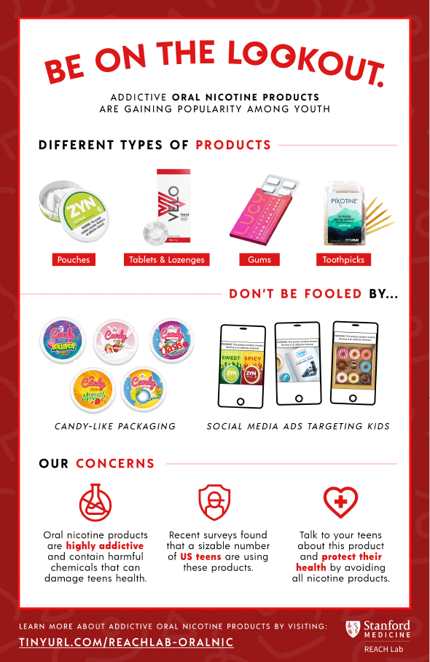
Be on the Lookout
Notes:
The five larget smokeless tobacco manufacturers spent $572.7 million on marketing in 2022
Nicotine pouches are oral tobacco products that dissolve nicotine salt-based powder in the mouth without requiring spitting.
Why are nicotine pouches a concern?
Nicotine pouches come in many flavors and colorful packaging. Flavors are a primary reason youth start using tobacco products. Nicotine use at an early age increases the chances of lifetime dependence.
Nicotine pouches can contain up to 12mg of nicotine powder. That's more than double the amount than most vapes. Nicotine is highly addictive, can harm brain development and worsen symptoms of depression and anxiety.
Many products are marketed as “tobacco free” alternatives to smoking which may seem low-risk and safe, however these claims are not authorized by the U.S. Food & Drug Administration (FDA).
January 2024
Sources:
Truth Initiative
CDC
Nicotine
Pouches
CITRUS
6
MG
WARNING: This product contains nicotine.
Nicotine is an addictive chemical.
Hiccups
Nausea
Irritation of the gums
Sore mouth
Nicotine pouches are growing in popularity. Between 2019-2022, nicotine pouch sales increased by six-fold.
Increased irritability and mood swings
Nicotine addiction

Slide 20
Tobacco Industry ('Big Tobacco')
Tobacco products are one of the most heavily marketed products in the U.S.
  It is estimated that $9.1 billion is spent annually on tobacco marketing nationally
  Estimated $106 million spent annually on tobacco marketing in Iowa
Increased tobacco product normalization in movies, video games, streaming services, and much more
Notes:
SOURCE
U.S. Federal Trade Commission (FTC), Cigarette Report for 2020, October 2021; FTC, Smokeless Tobacco Report for 2020, October 2021; FTC, E-Cigarette Report for 2019-2020, August 2022. S
tate total is a prorated estimate based on cigarette pack sales in the state. For tobacco marketing influence on youth, see HHS, Preventing Tobacco Use Among Youth and Young Adults: A Report of the Surgeon General, 2012; National Cancer Institute (NCI), The Role of the Media in Promoting and Reducing Tobacco Use, Smoking and Tobacco Control Monograph No. 19, 2008.

Slide 21
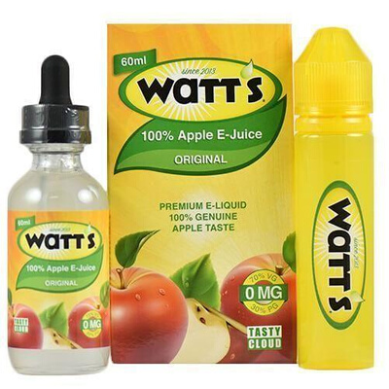
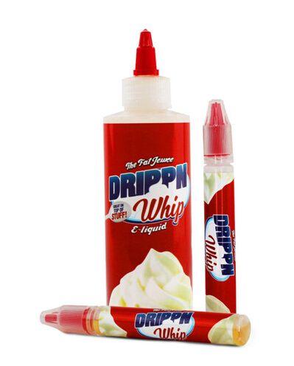
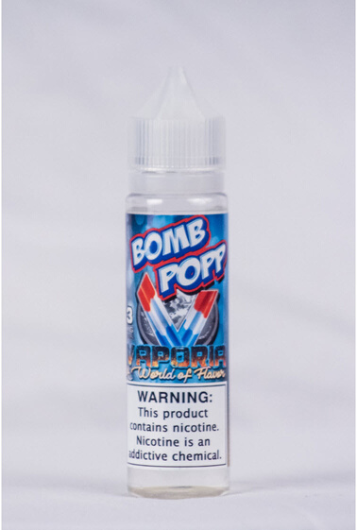
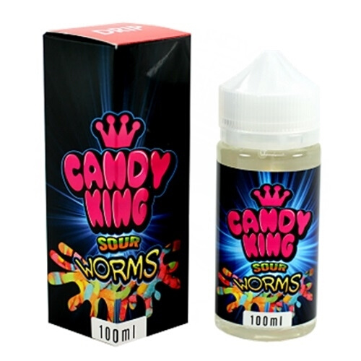
Flavors
  E-liquid and juices contain flavorings
  8,000+ flavors
  Flavors appeal to youth
  Flavors make vaping seem harmless
Notes:
Flavored tobacco products appeal to youth. And the tobacco companies design flavors with youth in mind. That's why the FDA made it illegal to sell flavored combustible cigarettes (with the exception of menthol) in 2009. But that action excluded other tobacco products such as cigars, chew, and other emerging products like e-cigs.
E-cigarettes contain pre filled pods or cartridges or e-juices that the user adds to the devices. E-liquids consist of many additives including propylene glycol, heavy metals, the addictive drug nicotine, and other cancer causing chemicals. When the e-juice is heated it creates a vapor that is made up of formaldehyde, acrolein, and glycerin and many other harmful chemicals.
The other problem with flavors is that the actual flavors used are chemicals that you would typically ingest, similar to what they put in a Starbucks drink. The effects of inhaling these chemicals into your lungs are still unknown.

Slide 22
Iowa HHS
Tobacco Prevention & Control Programs (TPCP)
Overview on programs and resources you can utilize
Notes:
OVERVIEW OF OUR IOWA HHS TPCP PROGRAMS

Slide 23

Centers for Disease Control Target Areas
Prevent the initiation of tobacco use among young people.
01
Eliminate non-smokers’ exposure to secondhand smoke.
02
Promote quitting among young people and adults.
03
Identify and eliminate tobacco-related disparities among population groups.
04
Notes:
The Centers for Disease Control and Prevention (CDC) is at the forefront of the nation’s efforts to reduce deaths and prevent chronic diseases that result from tobacco use. The agency and its partners promote tobacco control interventions, including actions to:
Prevent youth from starting to use tobacco.
Promote smoke-free environments.
Enhance programs to help tobacco users quit.
Support steps to eliminate tobacco-related health disparities in different population groups.

Slide 24

TPCP Programs
Smoke Free Air Act
Tobacco Free / Nicotine Free Policy Initiatives
Smoke Free Homes
ISTEP
Cessation Programs
Quitline Iowa
My Life My Quit (MLMQ)

Slide 25
Cessation Programs
Quitline Iowa & My Life My Quit

Slide 26

Quitline Iowa Website
Notes:
Quitline podcast resources

Slide 27

What Services Are Provided Through Quitline Iowa?
24/7 access to free support to all Iowans.
One-on-one counseling with a Quit Coach through phone, text or chat.
Specific programs offered:
  Behavioral Health
  Pregnancy Postpartum Program
  Young Adult Program
  American Indian Program
  My Life My Quit
Nicotine Replacement Therapy (NRT)
Ask, Advise, Connect (AAC)
Notes:
Approved to show this video to highlight Ask Advise Connect - Provider Video.mp4 (sharepoint.com)

Slide 28
In SFY25, there were
2,717 unique individuals who completed Quitline Iowa registrations.
Source: Iowa HHS, Division of Behavioral Health, Quitline Iowa. Data accessed in December 2025.

Slide 29
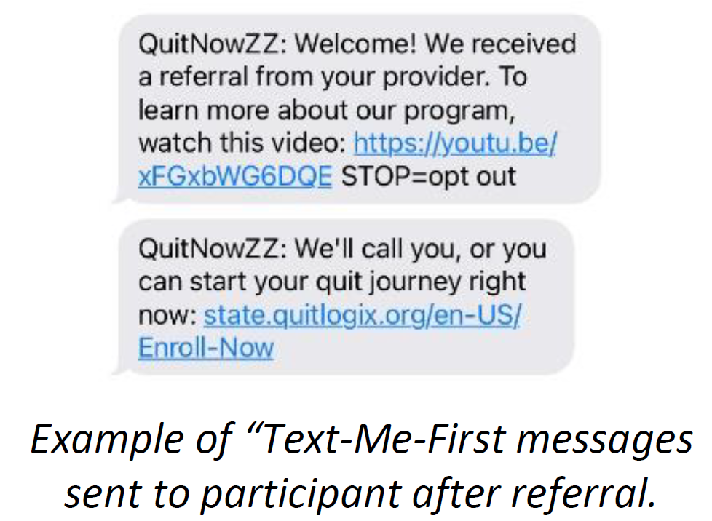
Text-Me-First
Fax and web referrals who have consent to text from individuals.
Will receive back-to-back messages.
  First message will show brief video about Quitline.
  Second message will help them to enroll and start quit journey.
This increases reach rate!
Notes:
Technology enhancements to make the process easier for Iowans -

Slide 30
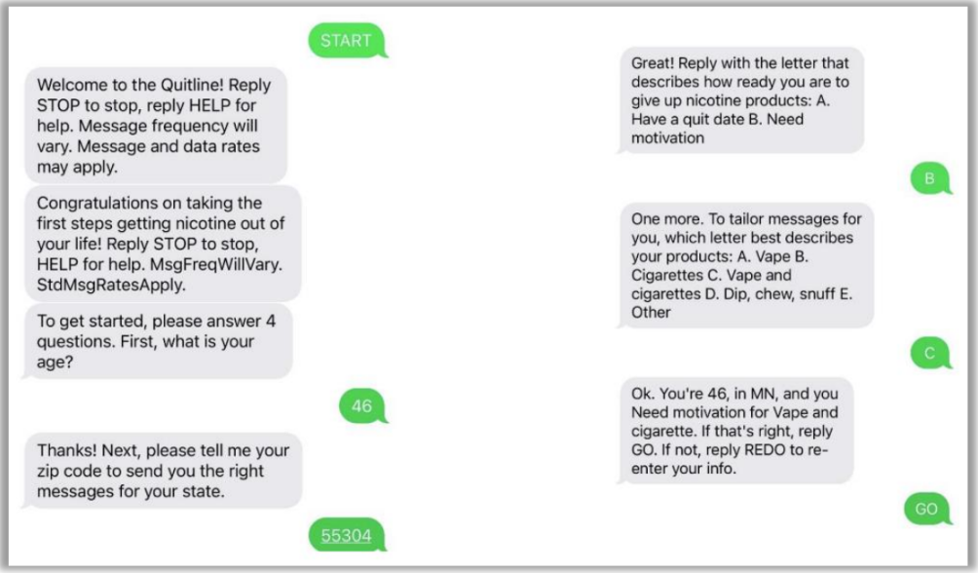
Short Code Enrollment
Individuals text START to 300500 and they will answer four questions:
  Age
  Type of tobacco/nicotine used
  Zip code
  Readiness to quit
Notes:
Upon completion of registration, the individual is enrolled in the Quitline Iowa text message program with automated text messages based on the type of tobacco they use and their readiness to quit. The messages will support participants throughout their quit journey and encourage them to engage in services offered by the Quitline Iowa. See examples below.
Programs/Services for participants to choose from:
• Enroll in the web only resources
• Web and phone
• Phone only
• Utilize Nicotine Replacement Therapy (NRT)

Slide 31
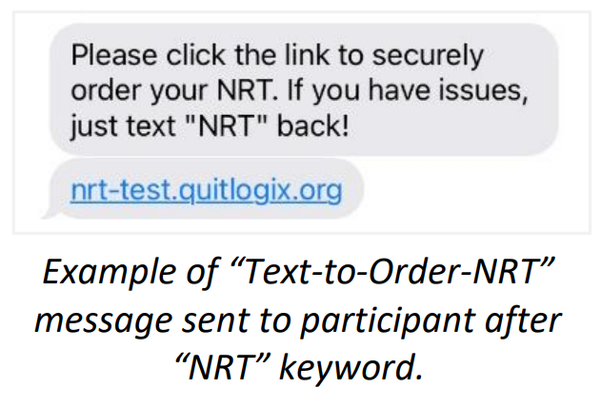
Text-to-Order-NRT
To support increased engagement and low-barrier access to nicotine replacement therapy (NRT).
Adults in texting program can text keyword ‘NRT.’
  To order additional one-time two-week supply to NRT patches, gum, or lozenges.
  Quitline coach will facilitate ordering process and use secure forms to verify PHI.

Slide 32



Quitting Vaping is Hard
Notes:
New FY25 Quitline Iowa media campaign -

Slide 33
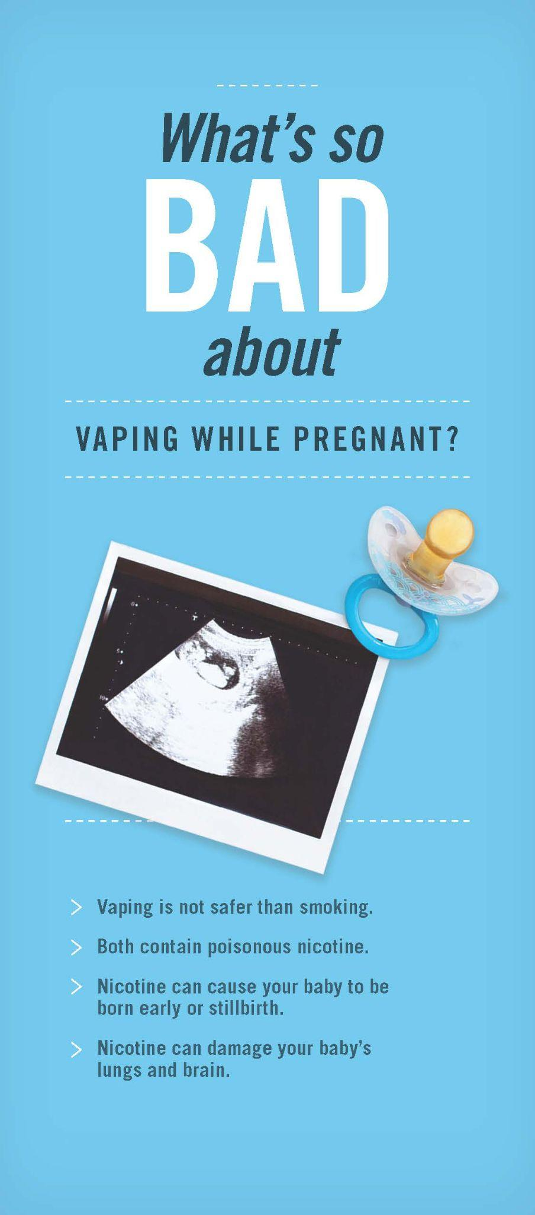

Vaping and Pregnancy
Notes:
Printed materials available for you and partners!

Slide 34

Quitlogix Education
Notes:
New tab (quitlogixeducation.org)
Quitlogixeducation.org/iowa
CEU's available – providers, nurses, SWs, BH, etc.

Slide 35
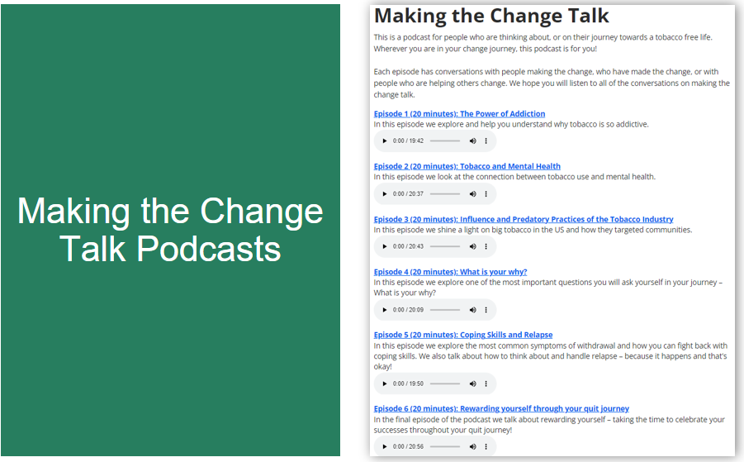
Making the Change Talk Podcasts
Notes:
Quitline podcast resources

Slide 36

My Life My Quit Website
Notes:
Quitline podcast resources

Slide 37

What Services Does My Life My Quit Offer?
Youth tobacco cessation program
Five coaching sessions
Texting, online or call
Dedicated youth coaches
Free and confidential
Great opportunity for alternative to suspension in schools
Notes:
Mylifemyquit.com
12-17 year olds can participate
Certificate of completion for those completing the program

Slide 38
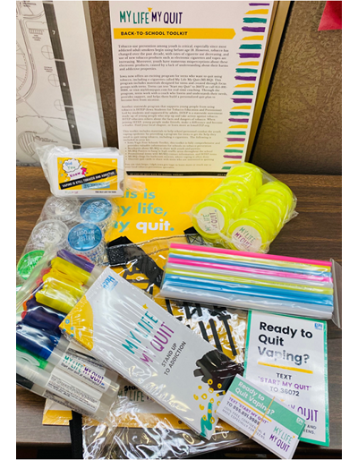


Alternative to Suspension
Iowa Vape-Free Schools Toolkit
Public Health Law Center resources
MLMQ promotional materials
Notes:
Public Health Law Center - Alternative Measures - chrome-extension://efaidnbmnnnibpcajpcglclefindmkaj/https://www.publichealthlawcenter.org/sites/default/files/resources/Student-Commercial-Tobacco-Use-in-Schools-Alternative-Measures-2019.pdf

Slide 39
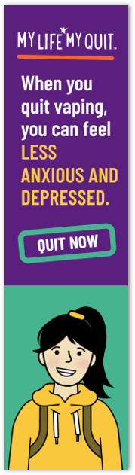

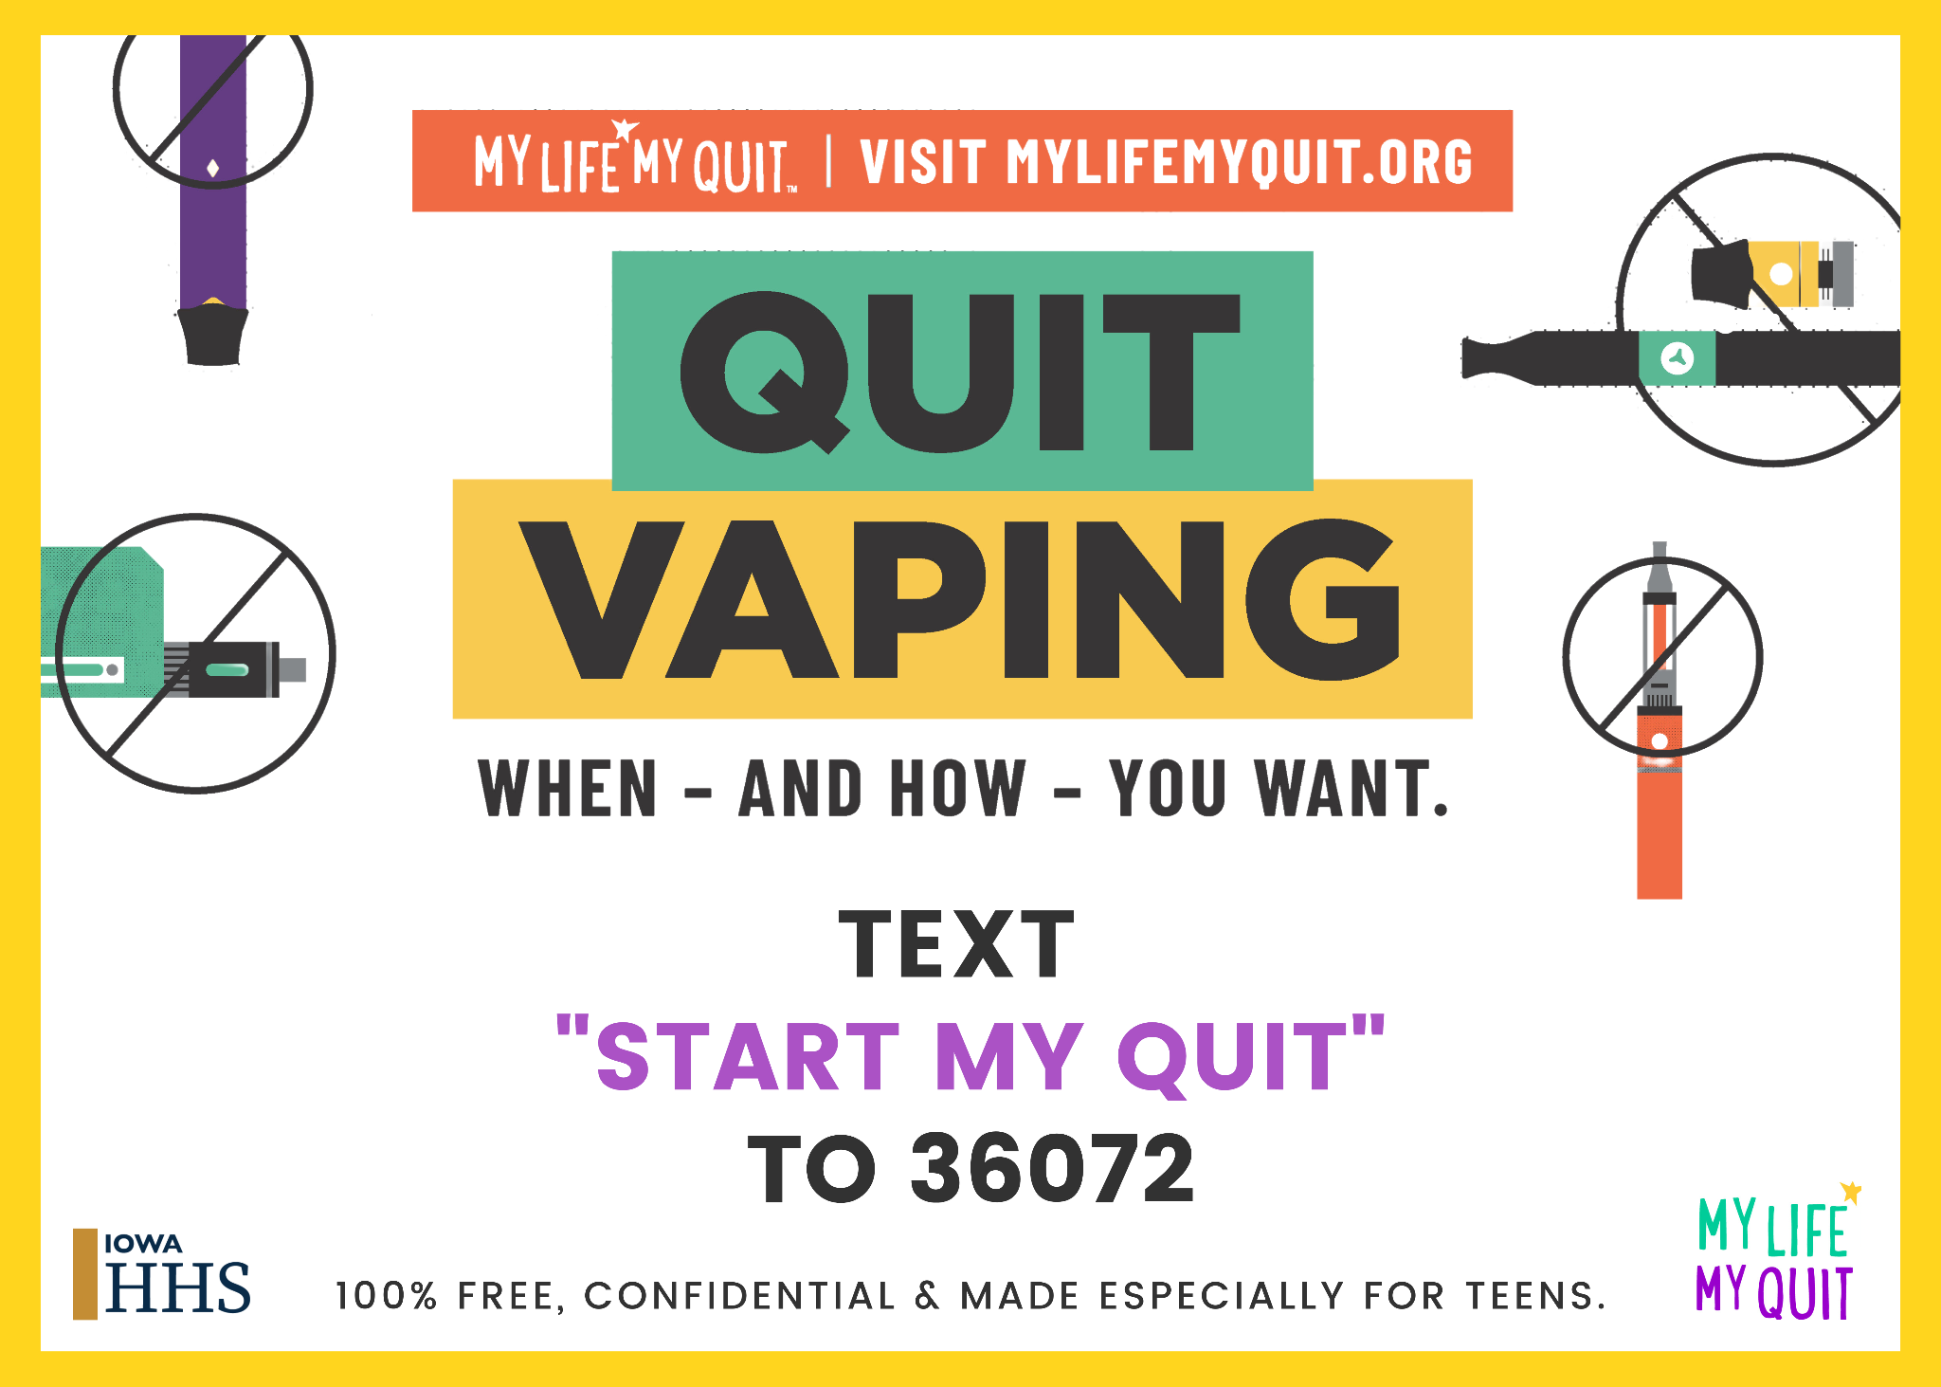

My Life My Quit Ads
Notes:
Quitting Vaping is a Real No Brainer (youtube.com)
FY24 campaign that we'll be re-launching FY25 – over 1 million views on YouTube!!
Addresses vaping and the effects on anxiety and depression

Slide 40
Iowa Students for Tobacco Education and Prevention (ISTEP)
Youth Prevention & Collaboration

Slide 41

Iowa Students for Tobacco Education and Prevention
Notes:
We Are ISTEP (youtube.com) - use this one – Jill's fav!
What is ISTEP Final (youtube.com)
Iowa Students for Tobacco Education and Prevention also known as ISTEP, is our youth program here at HHS. Completely led by students and supported by adults, ISTEP is a statewide movement made up of young people, in grades 7 through 12, who want to step up and take action against tobacco and nicotine, including vaping.
However, ISTEP isn't only about ending tobacco use in Iowa; it's also a way for young people to find a group with a common passion; all while making friends, making a difference and developing important skills that they will use for a lifetime. ISTEP has many leadership opportunities for young people - at the local level through chapters, and the state level by joining the Executive Council.
The youth Council currently consists of 9 high schooler students across Iowa. In order to join, they go through an online application process, a virtual leadership training then have to be offered an invitation to serve on the Council. These young people are quite impressive! They even lead an entire event once a year called the ISTEP Summit! This happens in October each year at the state fairgrounds.
Currently, ISTEP has 47 chapters registered on hhs.iowa.gov/istep; by the end of the school year, there should be approximately 80 chapters. If you want to follow along with our events, check ISTEP out on Facebook or Instagram - @IowaSTEP.

Slide 42
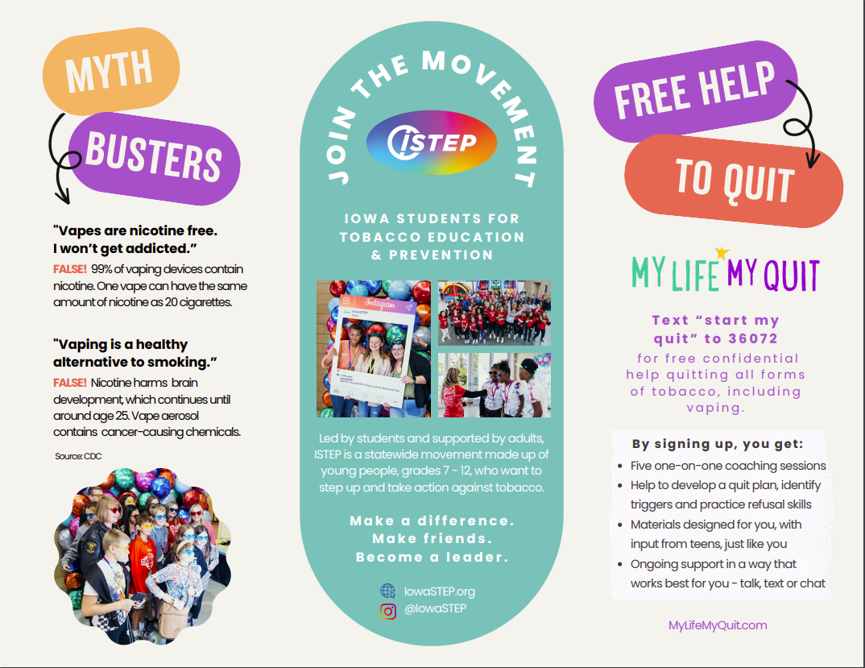
ISTEP Myth Busters
Notes:
ISTEP/MLMQ brochure – Vaping Vs. Reality
Currently, ISTEP has 47 chapters registered on hhs.iowa.gov/istep; by the end of the school year, there should be approximately 80 chapters. If you want to follow along with our events, check ISTEP out on Facebook or Instagram - @IowaSTEP.
We had close to 350 youth at ISTEP Summit in mid-October!!! - Iowa State Fairgrounds -

Slide 43
Smoke Free Air Act &
Smoke Free Homes
Secondhand & Thirdhand Smoke Efforts

Slide 44
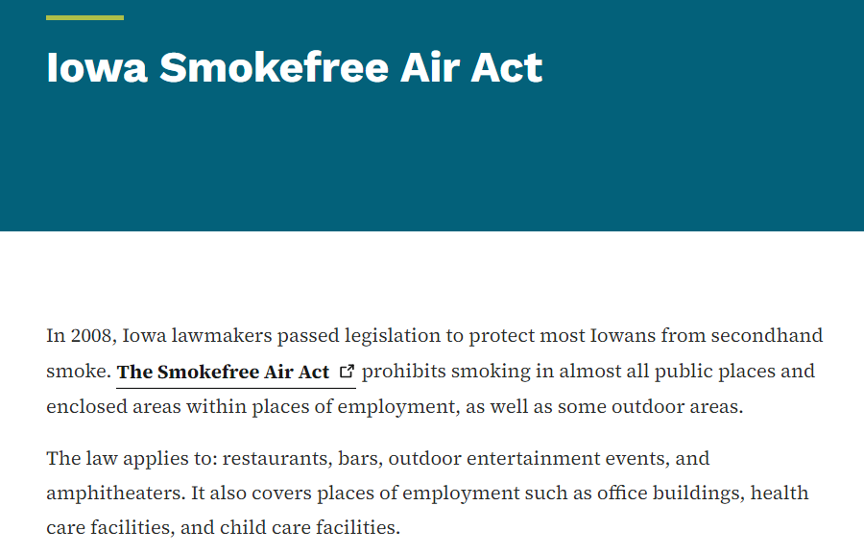
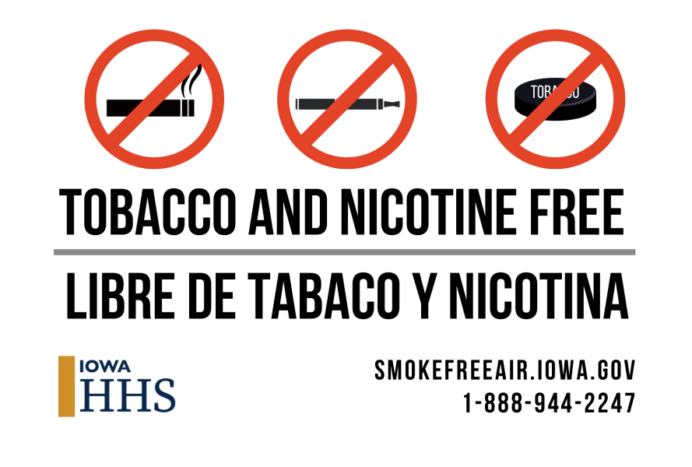
Iowa Smokefree Air Act
Notes:
Right now (November 1st) I have 2,622 comprehensive policies and 3,220 total policies.
Smokefreeair.iowa.gov

Slide 45
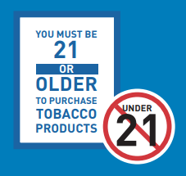

Laws & Policies
Federal & State Laws
Minimum age to purchase tobacco products is 21
Smoke Free Air Act – does not include e-cigarettes
Policies
Businesses and schools can adopt voluntary policies to prohibit the use of e-cigarettes on their grounds
Procedures
Schools/organizations have different procedures for vaping related issues
Notes:
Currently Iowa has the SFAA which prohibits smoking in almost all public places and enclosed areas within places of employment, as well as some outdoor areas.
The Iowa Smokefree Air Act does not apply to Electronic Smoking Devices. The use of these products MAY be prohibited by a business or property owner only if they adopt such a policy.

Slide 46
Smoke Free Homes
Started in 2012 (the Smoke Free Air Act started in 2008).
Assist property managers, owners and landlords who want to make their buildings smoke free (i.e. provide technical assistance, model policies, free signage, etc.)
Manage and promote the online mapping registry of smoke free housing across the state (+1,700 properties across the state)
Our goal is to increase the number of smoke free housing opportunities in Iowa and help eliminate exposure to secondhand and thirdhand smoke

Slide 47
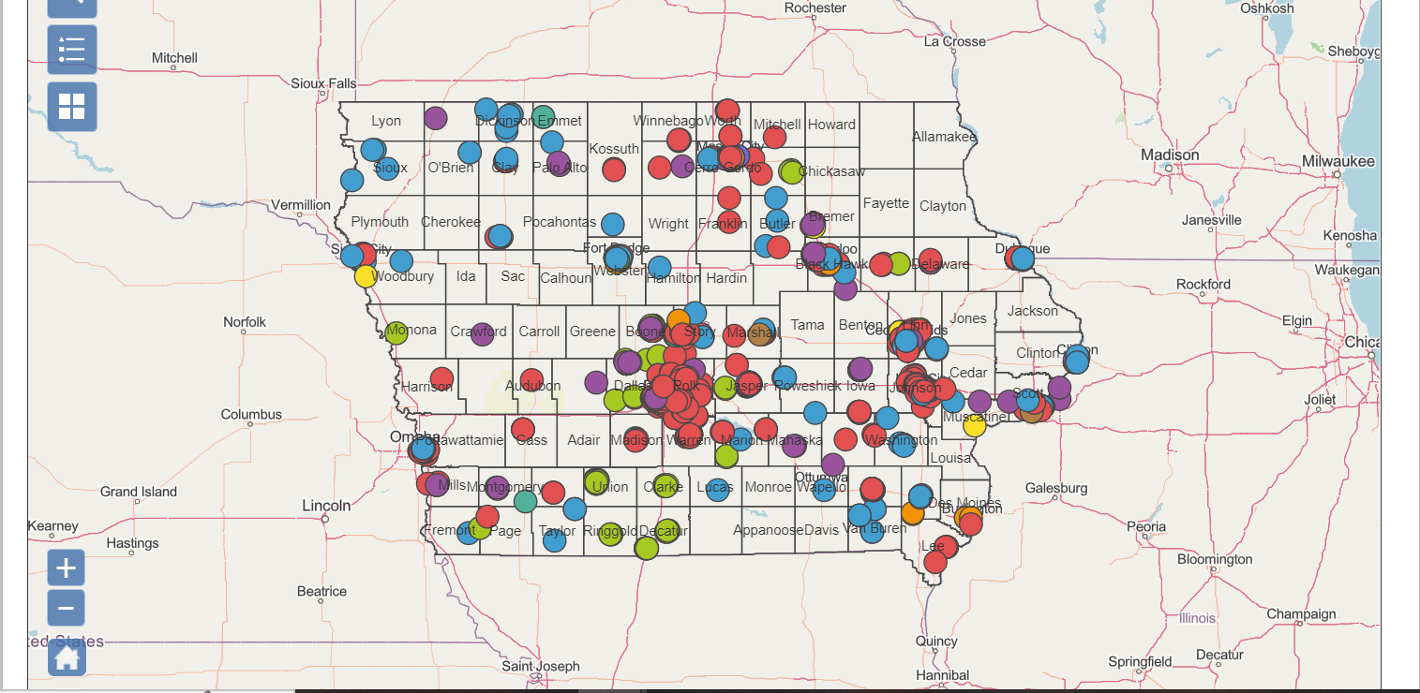
Map of Iowa

Slide 48

Smoke Free Homes Collaboration
Notes:
Join the Smoke Free Homes program (featuring Iowa's State Fire Marshal) (youtube.com)

Slide 49
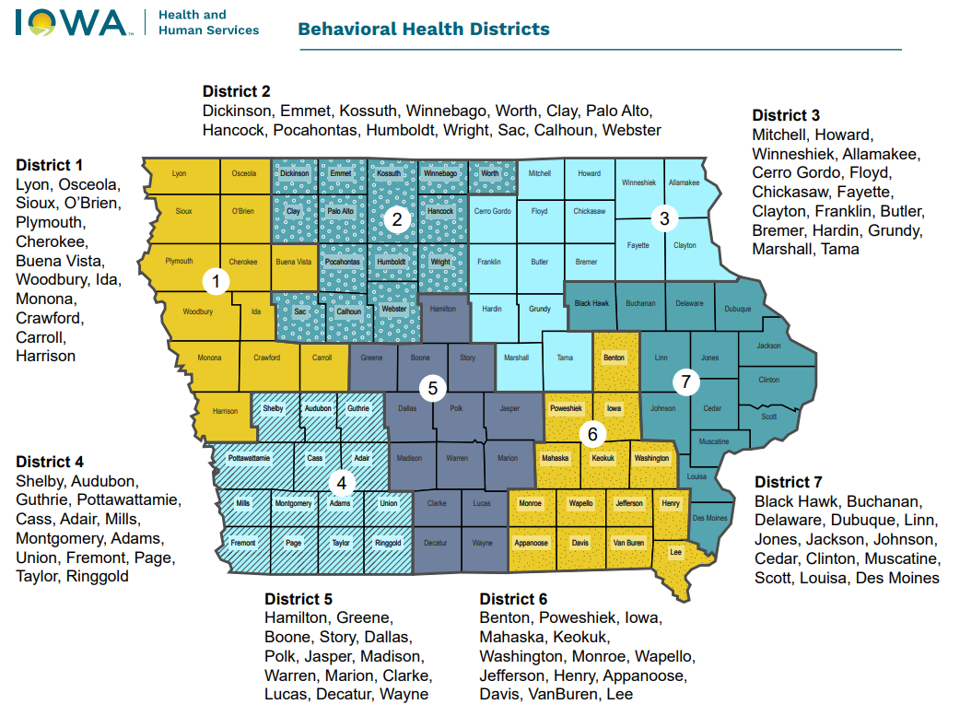
Behavioral Health Districts
Notes:
Join the Smoke Free Homes program (featuring Iowa's State Fire Marshal) (youtube.com)

Slide 50


Questions
Adam Shanks
Tobacco Cessation Coordinator
adam.shanks@hhs.iowa.gov

