Slide 1

Smoke Free Homes
Adam Shanks
Smoke Free Homes Program Manager
Tobacco Cessation Coordinator
Iowa HHS
January 21, 2026

Slide 2

Centers for Disease Control Target Areas
Prevent the initiation of tobacco use among young people.
01
Eliminate non-smokers’ exposure to secondhand smoke.
02
Promote quitting among young people and adults.
03
Identify and eliminate tobacco-related disparities among population groups.
04

Slide 3

Tobacco Prevention & Control Programs
Smoke Free Air Act
Tobacco Free / Nicotine Free Policy Initiatives
Smoke Free Homes
ISTEP
Cessation Programs
Quitline Iowa
My Life My Quit (MLMQ)

Slide 4
Secondhand Smoke
Secondhand smoke is exhaled by a person who is smoking, and inhaled by a nearby person.
A dangerous mixture of over 7,000 chemicals, including 70 that cause cancer.
Increases risk for heart attacks, heart disease and stroke, and lung cancer.
Children who are exposed to secondhand smoke in the home or vehicle may be at increased risk for secondhand smoke-related disease and illness, and infants are at a greater risk for sudden infant death syndrome (SIDS).
There is no safe level of secondhand smoke exposure.

Slide 5
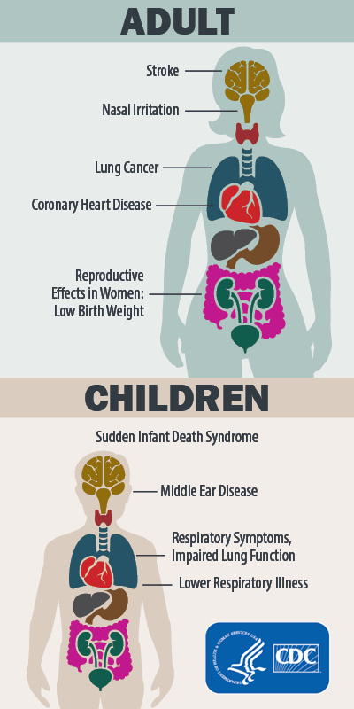
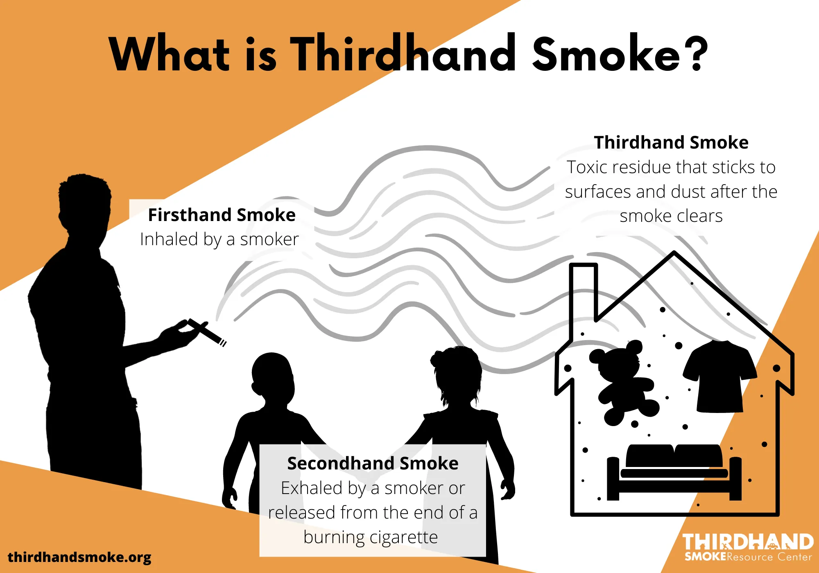
What is Thirdhand Smoke?
Notes:
Nicotine can have many negative health effects, including:
Cardiovascular issues: Nicotine can increase your heart rate and blood pressure, and narrow your arteries. This can lead to hardened arteries and an increased risk of heart attack.
Mental health: Nicotine dependence can worsen anxiety and depression, and lead to poor mental health.
Lung damage: Nicotine can cause respiratory problems and permanent lung damage.
Oral health: Nicotine can cause canker sores and increase your risk of oral cancers.
Addiction: Nicotine is highly addictive and can cause withdrawal symptoms if you stop using it.
Other health issues: Nicotine can also contribute to delayed wound healing, reproductive disturbances, peptic ulcer disease, and esophageal reflux.
Nicotine is the primary agent in cigarettes and e-cigarettes. Vaping can also cause other health issues, such as nausea, vomiting, burns, and injury.
Health effect examples from smoking, secondhand/thirdhand smoke with Adults & Children -
Cancer
Heart disease and stroke
Lung diseases such as chronic obstructive pulmonary disease (COPD)
Type 2 Diabetes
Harmful reproductive health effects
Other diseases, including certain eye diseases and problems of the immune system, including rheumatoid arthritis.

Slide 6

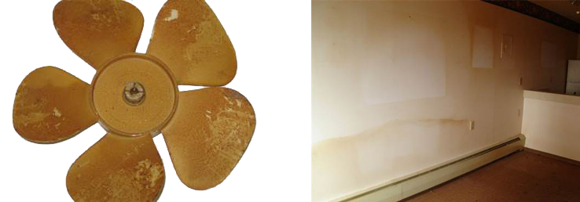
Thirdhand Smoke
Thirdhand Smoke Resource Center

Slide 7
Thirdhand Smoke
Thirdhand smoke is the chemical residue that persists after secondhand tobacco smoke has disappeared from the air.
The chemicals in thirdhand smoke are toxic to humans, especially children.
It can linger for years in dust and on household surfaces.
It can also become embedded in carpets, furniture, clothes, and building materials. It is difficult and expensive to remove.
People can be exposed to thirdhand smoke by touching contaminated surfaces (absorption through the skin), by eating contaminated objects or dust, and by breathing contaminated air and re-suspended thirdhand smoke components.

Slide 8
Chemicals in Thirdhand Smoke Can:
Increase Risk of Cancer
Damage DNA
Reduce Ability to Heal Injuries
Lower Ability to Fight Infection
Damage Cells
Cause Earaches
Trigger Asthma Attacks
Worsen Respiratory Illness
Increase Risk of Disease
Cause Headaches
Notes:
Thirdhand smoke resource center

Slide 9
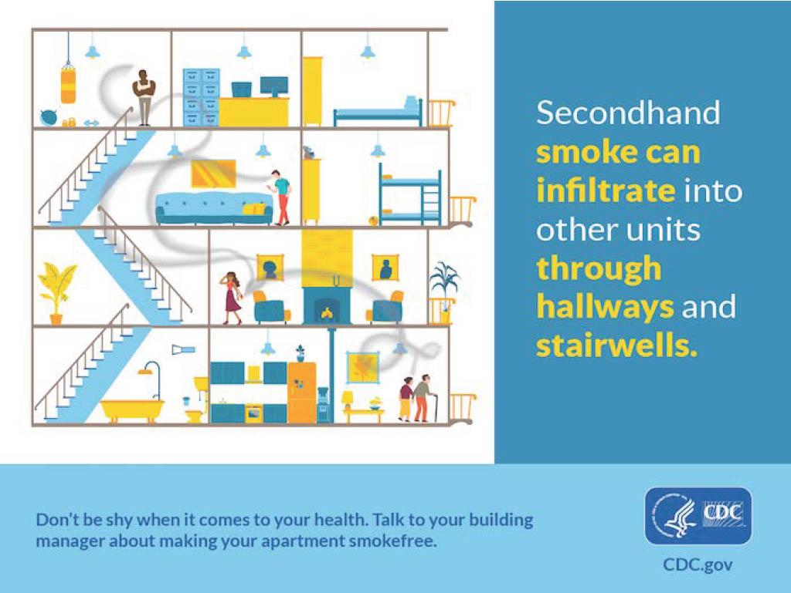
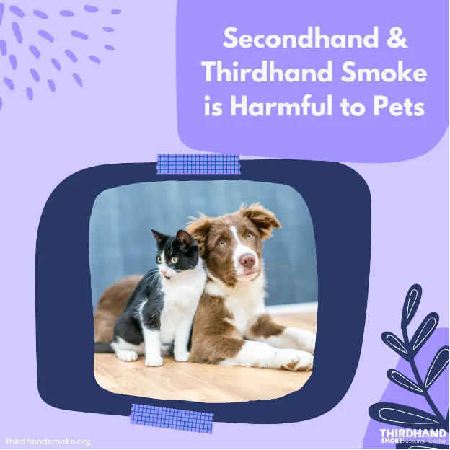
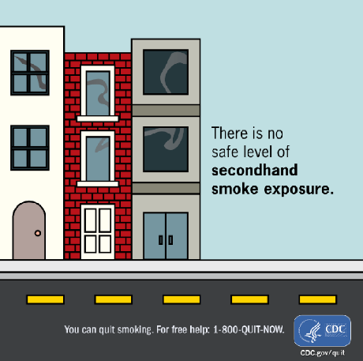
Secondhand Smoke

Slide 10
How can Smoke Free Homes help?

Slide 11
Smoke Free Homes
Started in 2012 (the Smoke Free Air Act started in 2008).
Assist property managers, owners and landlords who want to make their buildings smoke free (i.e. provide technical assistance, model policies, free signage, etc.)
Manage and promote the online mapping registry of smoke free housing across the state (+1,700 properties across the state)
Our goal is to increase the number of smoke free housing opportunities in Iowa and help eliminate exposure to secondhand and thirdhand smoke

Slide 12
How-To-Overview for Property Contacts
RESEARCH
Survey residents and solicit input.
CREATE
Policy details and timeline.
NOTIFY
Notify residents, staff, and guests (i.e. post signage, fliers, update website)
Organize resident meetings
Offer cessation resources:
Explain why you’re considering going smoke free and outline possible policy features.
Seek feedback from legal resources, announce the effective date, and allow AT LEAST 30 days before implementing!
Quitline Iowa
My Life My Quit

Slide 13
What Makes a Good Policy?
Smoke Free Air Act covers common areas (i.e. hallways, laundry rooms, community rooms, other public areas)
A Smoke Free Homes property is required to have 100% of indoors covered (gold standard - outdoor areas/grounds are a plus!)
Written in a lease, addendum, or house rules
Defines "smoke free" for tenants, guests, and staff
Consequences and violations are clearly defined; violations may result in eviction
No grandfathering (they cannot be a SFH property until any grandfathered tenants have signed the new policy)

Slide 14
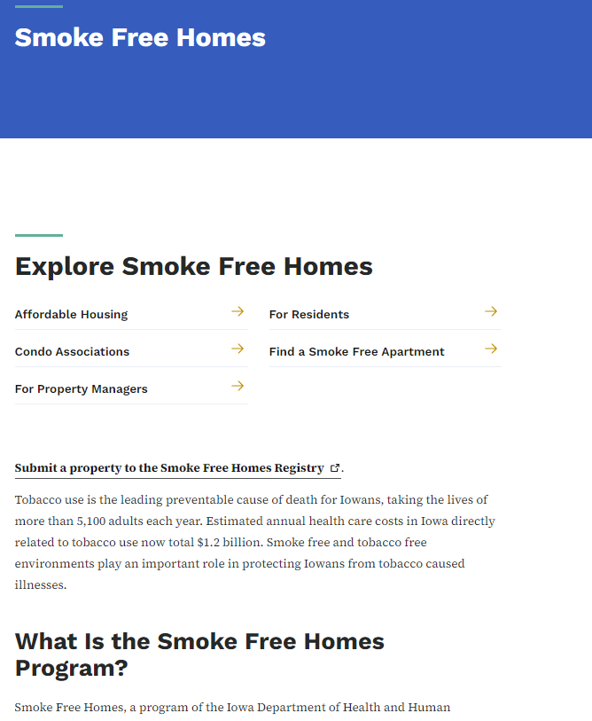
Smoke Free Homes: Benefits
Support and technical assistance
Model policies, addendums, surveys, fliers
Welcome kits and free signage
Free promotion of property on Registry
Healthier and safer living environment
Saving money and decreasing legal/fire risk
Attracting residents who are seeking smoke free housing!

Slide 15
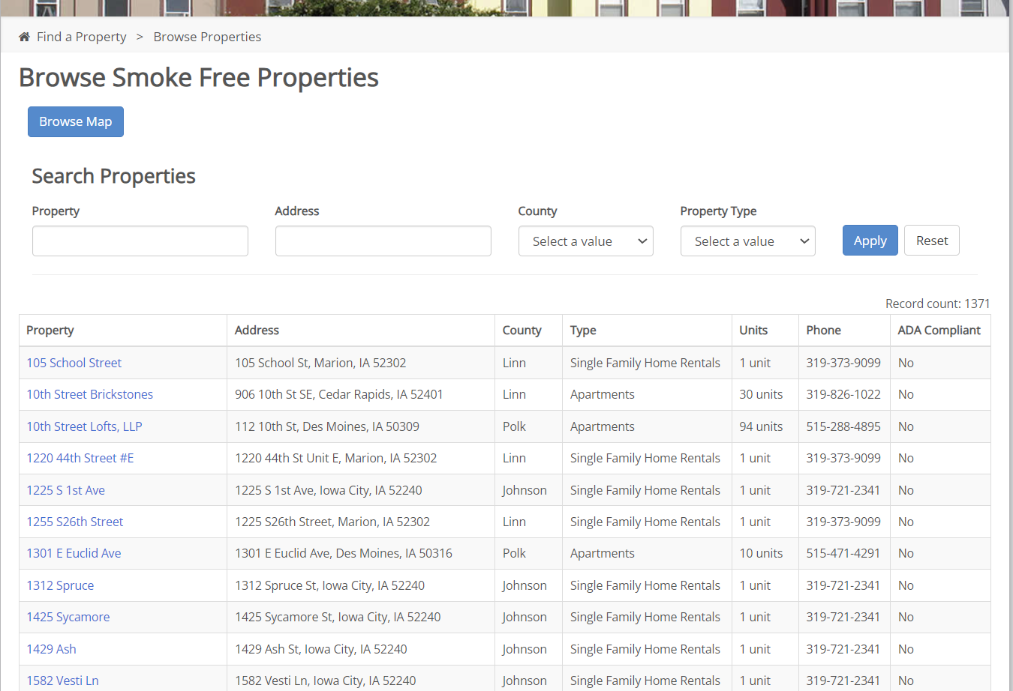
Smoke Free Homes Registry: Database

Slide 16
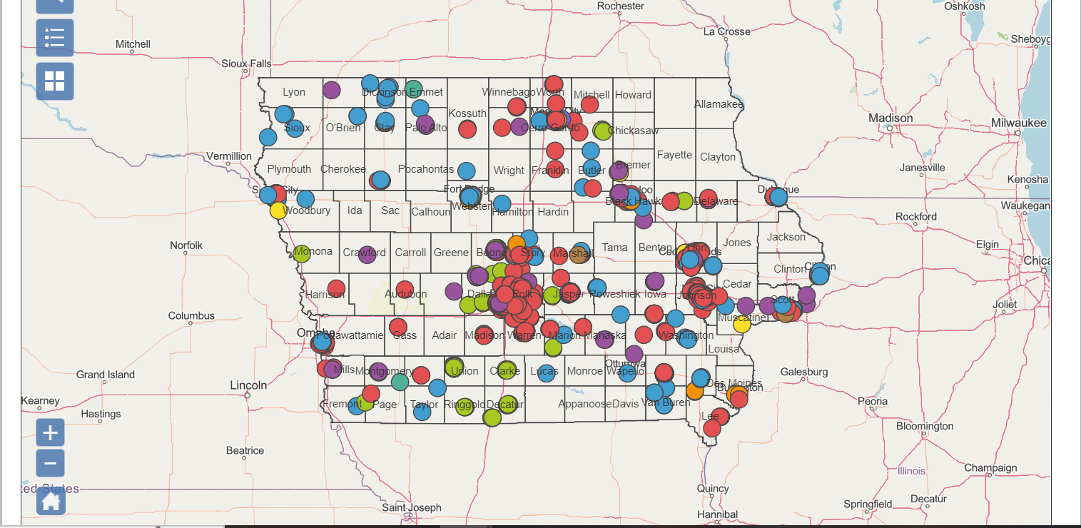
Map of Iowa

Slide 17
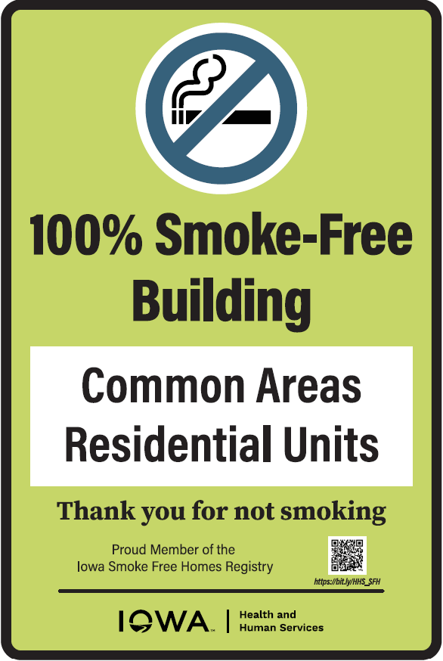
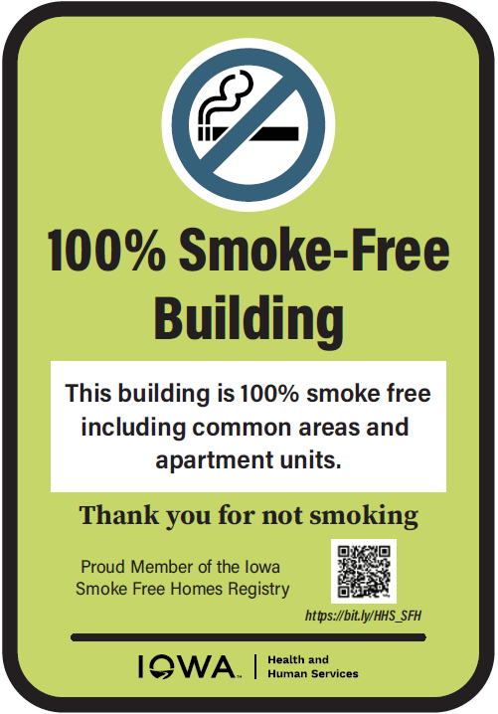
Smoke Free Homes

Slide 18
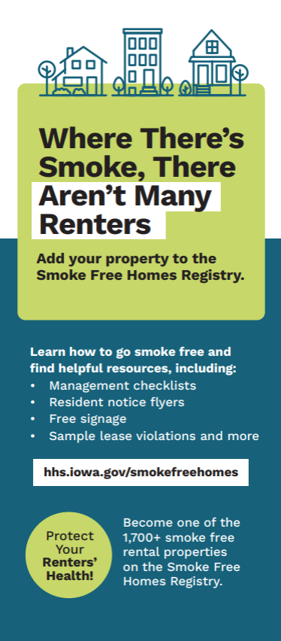
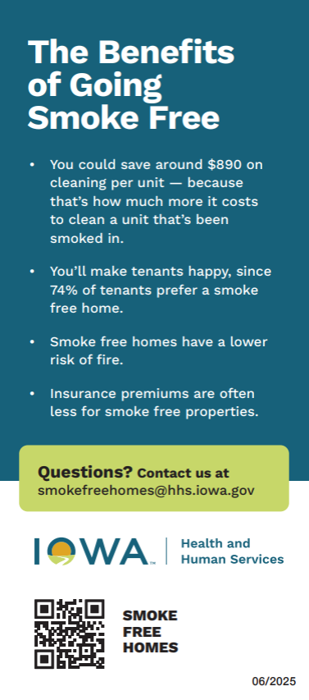
Smoke Free Homes

Slide 19
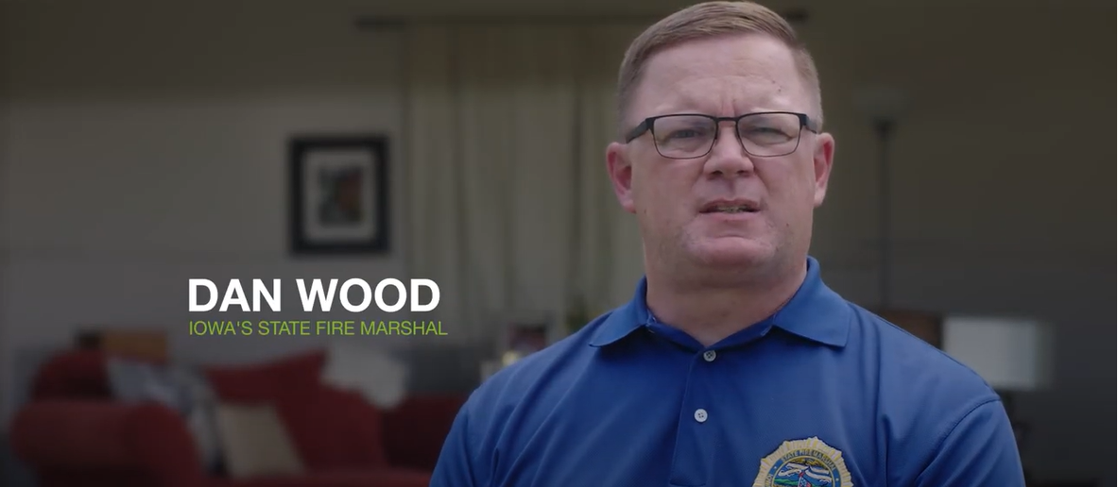
Smoke Free Homes Collaboration
Notes:
Join the Smoke Free Homes program (featuring Iowa's State Fire Marshal) (youtube.com)

Slide 20
Advocates and Partners
  Iowa’s State Fire Marshal Division
  U.S. Dept of Housing and Urban Development (HUD)
  Iowa Finance Authority (IFA)
  Greater Iowa Apartment Association (GIAA)
  Public Housing Agencies (PHA)
  Thirdhand Smoke Resource Center
  Live Smoke Free
  Public Health Law Center

Slide 21
Annual Opportunities for Promotion
  Day of Breathing (Americans For Nonsmokers’ Rights)
  Fire Prevention Week (National Fire Protection Association)
  Great American Smokeout (American Cancer Society)
  National Healthy Homes Month (Month of June)

Slide 22
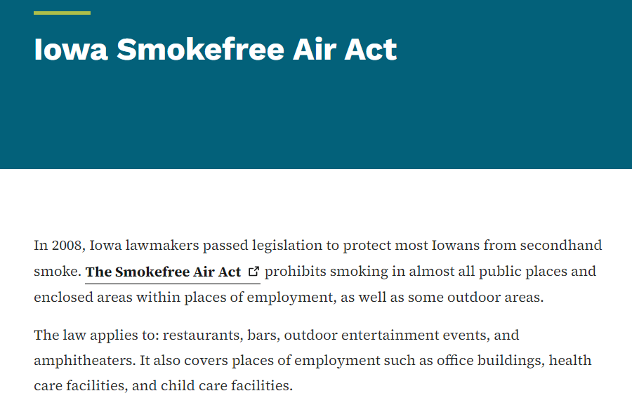
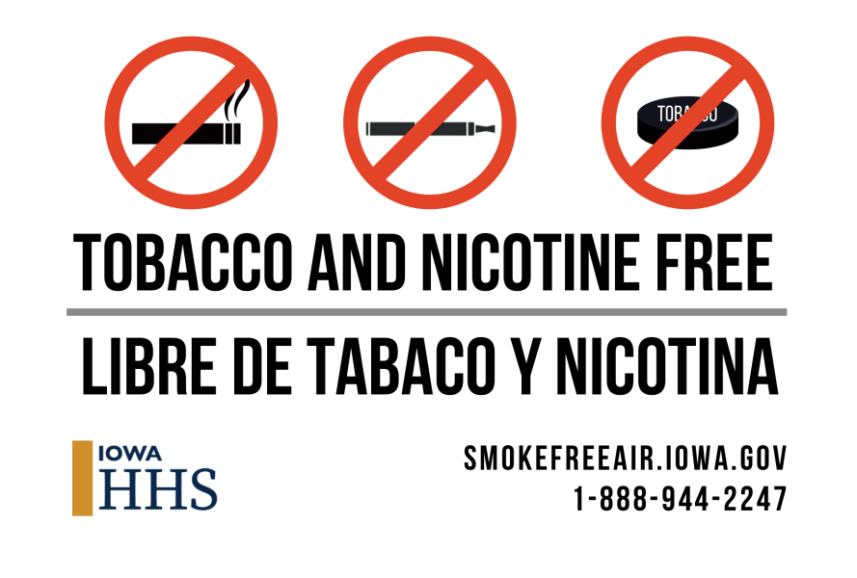
Iowa Smokefree Air Act
Notes:
Right now (November 1st) I have 2,622 comprehensive policies and 3,220 total policies.
Smokefreeair.iowa.gov

Slide 23
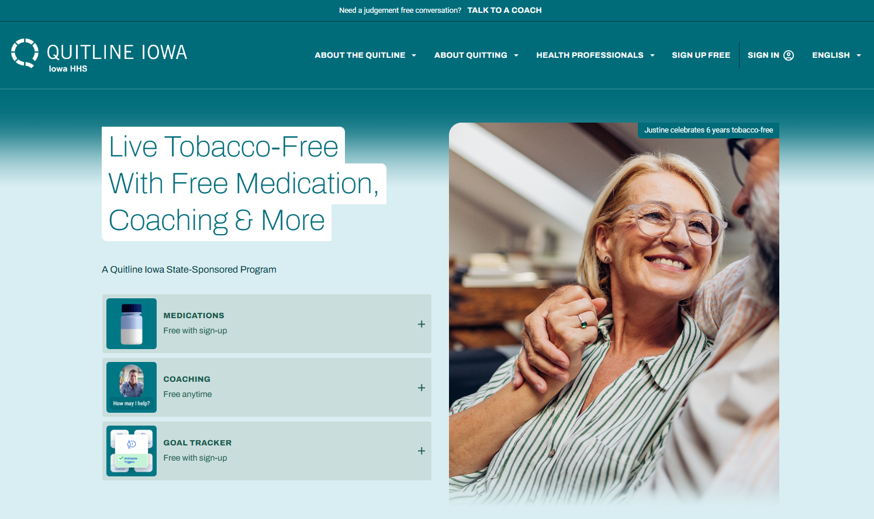
Quitline Iowa Website
Notes:
Quitline podcast resources

Slide 24

What Services Are Provided Through Quitline Iowa?
24/7 access to free support to all Iowans.
One-on-one counseling with a Quit Coach through phone, text or chat.
Specific programs offered:
  Behavioral Health
  Pregnancy Postpartum Program
  Young Adult Program
  American Indian Program
  My Life My Quit
Nicotine Replacement Therapy (NRT)
Ask, Advise, Connect (AAC)
Notes:
Approved to show this video to highlight Ask Advise Connect - Provider Video.mp4 (sharepoint.com)

Slide 25

What Services Does My Life My Quit Offer?
Youth tobacco cessation program
Five coaching sessions
Texting, online or call
Dedicated youth coaches
Free and confidential
Great opportunity for alternative to suspension in schools
Notes:
Mylifemyquit.com
12-17 year olds can participate
Certificate of completion for those completing the program

Slide 26
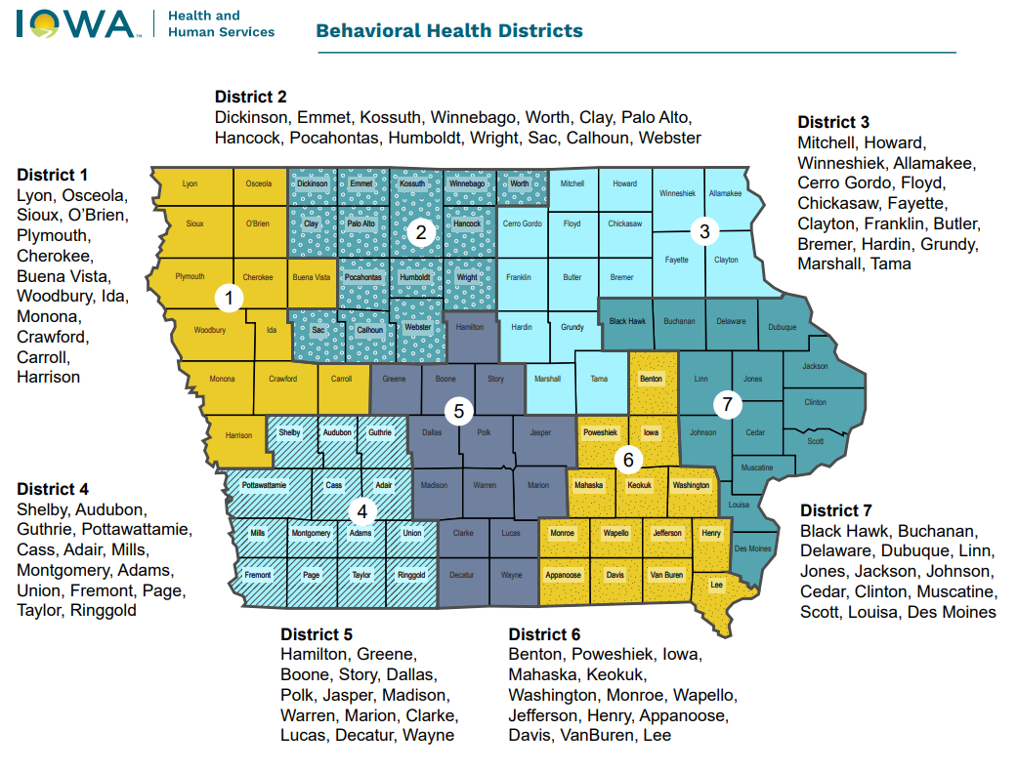
Behavioral Health Districts
Notes:
Join the Smoke Free Homes program (featuring Iowa's State Fire Marshal) (youtube.com)

Slide 27


Questions
Adam Shanks
Smoke Free Homes Program Manager
adam.shanks@hhs.iowa.gov

