Slide 1

Healthy Hometowns
Iowa’s Rural Heath Transformation Program
Best and Brightest Medical Equipment REQUEST FOR PROPOSAL # PHTHORC26011
Notice of Intent to Release Informational Webinar
February 23, 2026

Slide 2
Disclaimer
Iowa’s Rural Health Transformation Program, Healthy Hometowns, Best and Brightest Program is supported by the Centers for Medicare and Medicaid Services (CMS) of the U.S. Department of Health and Human Services (HHS) as part of a financial assistance award totaling approximately $50,000,000 with 100 percent funded by CMS/HHS. The contents are those of the author(s) and do not necessarily represent the official views of, nor an endorsement, by CMS/HHS, or the U.S. Government.

Slide 3
Disclaimer Continued
This webinar is not intended to be legal advice. If you have any legal questions, please consult your attorney.
As the presenter today, I will not be on the evaluation committee for the future procurement being described.
Attendance or lack of attendance at this webinar will not impact future scoring of Iowa HHS procurements in any way.
The information presented in this webinar today is intended to be general in nature and available to any organizations that may wish to apply for Iowa HHS procurements. The guidance provided today is not directed to any specific organization or specific situation. This will be recorded and available on HHS website.
In the event that any information provided on this webinar differs from information provided in a current or future procurement document, the language within the RFP shall govern.

Slide 4
Eligibility
Any organization that has already been awarded funding through Best and Brightest Medical Equipment RFP # PHTHORC26009 will not be eligible to receive funds through the procurement described on this webinar.
Organizations that applied for the RFP noted above and were not awarded funds are eligible to apply again, assuming all other eligibility requirements are met. You can apply for the same piece of equipment again.

Slide 5
HHS.Iowa.gov/HealthyHometowns
Agenda
Overview of Healthy Hometowns
Overview of Best and Brightest Program
Reading an Iowa HHS RFP Document
Navigating Iowagrants.gov
How to get help
General Recommendations

Slide 6
Overview of Healthy Hometowns

Slide 7
Healthy Hometowns

Slide 8



Goals
Iowans will be able to get health care within their rural communities at the most appropriate locations for type and level of care thanks to support from newly developed partnerships, more rural primary care physicians and specialists, and upgraded equipment.
Iowans living in rural areas will have improved health outcomes with similar rates of morbidity and premature mortality to those living in Iowa’s more populous areas.
Iowa will invest in the development and utilization of innovative technology and data infrastructures to support sustainable care options close to home, seamless care partnerships, and data sharing throughout the state.

Slide 9

Strategic Goals Alignment
Make Rural America Healthy Again – develop new and support existing access points for care
Sustainable Access – Allow rural health providers to be long-term access points
Workforce Development – Recruitment and retention, support practicing at top of license
Innovative Care – Innovative models of care
Tech Innovation – foster innovative technologies

Slide 10
Overview of Best and Brightest
Medical Equipment

Slide 11
Objectives
As part of Healthy Hometowns, the objective is to procure equipment, install equipment, and report use of medical equipment in rural Iowa.
These funds are intended to be used for the acquisition and installation of advanced medical technologies, such as (but not limited to) robotic surgical systems, low-dose CT scans, radiotherapy units, CT/PET scanners, and cardiac catheterization equipment that increase the ability of Rural providers to offer new lines of service, provide enhanced screening capabilities, and/or reduce the occurrence of rural bypass by keeping rural residents in rural communities to receive preventive and diagnostic services, surgeries, and healthcare treatments.

Slide 12
Objectives Continued
Expected Outcomes include:
  Improved access to specialized medical equipment in rural Iowa.
  Reduction in patient readmissions, transfers, and rural bypass for healthcare service delivery.
Healthy Hometowns Rural Healthcare Workforce Recruitment program has one primary objective: to enable qualifying organizations to recruit the best and brightest Healthcare Providers for Rural Iowa by offering competitive incentives that make rural practice attractive and sustainable.

Slide 13
Scope of Work
Procure, install, and use a needed piece of large-scale medical equipment. The medical equipment must be necessary for the intended service area and population, feasible to procure and install between before 9/30/2027, supported by staff and medical professionals knowledgeable in the use of the equipment, and sustainable for the site of installation to maintain.

Slide 14
Reading a Request for Proposal

Slide 15
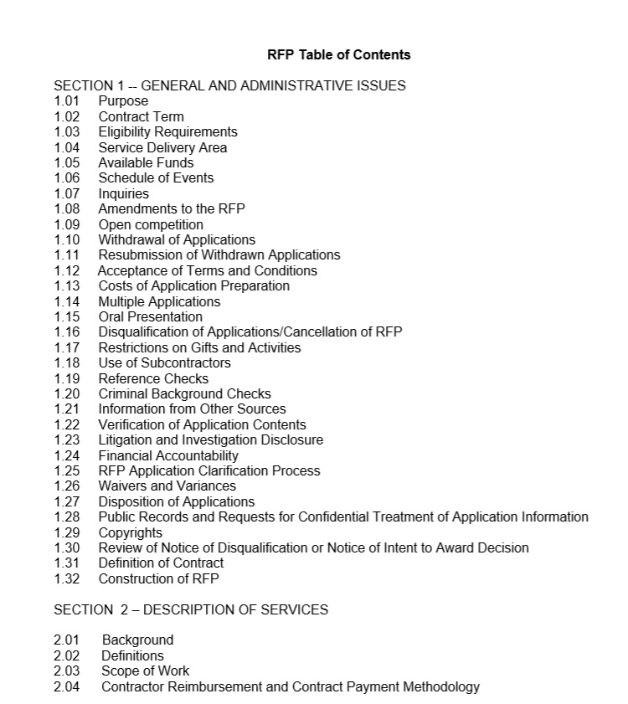
15

Slide 16
Eligibility Requirements
Service Delivery Area
Schedule of Events
  Question and Answer Opportunities
  Create an account to read these
  Letters of Intent
  Due dates
EVENT | DATE
RFP Issued | DATE
Written Questions and Responses
Round 1 Questions Due: Responses Posted By: | DATE, Time DATE, Time
Final Questions Due: Responses Posted By: | DATE, Time DATE, Time
Applications Due | DATE by 4:00 PM Local Iowa Time
Post Notice of Intent to Award | On or around DATE

Slide 17
Register in Iowagrants.gov early
Written Questions and Responses
Applicant must be registered with IowaGrants in order to submit a question.
Written questions submitted after the date specified for final questions in the table above will not be considered and a response will not be provided by the Agency.
  Registered Users login to www.IowaGrants.gov
  Click on ‘Users click here to login’
  ID.iowa.gov, sign-in (email address), click next (enter password), hit enter or click verify
  Search Funding Opportunities
  Select this Funding Opportunity
  Click on ‘Ask A Question’ link located at the top right-hand side of the Opportunity Details page, and enter a single question in the ‘Post Question’ box
  Click the ’Save’ button

Slide 18
Additional questions may be submitted by repeating the process above for each individual question. If the question or comment pertains to a specific section of the RFP, the section and page must be referenced. Verbal questions will not be accepted. Questions will not be displayed in IowaGrants until written responses are posted by the Agency.
The Agency will prepare written responses to all pertinent, timely and properly submitted questions according to the schedule of events table above. The Agency’s written responses will be considered part of the RFP.

Slide 19
Amendments to the RFP
The Agency reserves the right to amend the RFP at any time. In the event the Agency decides to amend, add to, or delete any part of this RFP, a written amendment will be posted at www.IowaGrants.gov under the Attachments section of this Funding Opportunity. The applicant is advised to check this website periodically for amendments to this RFP. In the event an amendment occurs after the Funding Opportunity is closed, the Agency will email the written amendment to the individuals identified in the submitted application as the Project Officer (Registered Applicant) and the Authorized Official listed in the Cover Sheet- General Information Form.

Slide 20
Pay attention and monitor:
Questions and Answers
Amendments
These become part of the formal RFP

Slide 21
Multiple Applications:
If only allowed to submit one application – only submit one application!
If only allowed to submit a request for one piece of equipment, only include information for one piece of equipment!

Slide 22
Application Content
Read Carefully and Follow Exactly!
Make sure email addresses provided on application are correct for who you want to get communications
Monitor email throughout evaluation process. Check spam. Check in with your colleagues.

Slide 23
Application Content Pt. 2
Background and demonstrated experience
  Provide details relevant to the scope of work
Work Plan Details
  Read each sentence and make sure you are responding
  If asks for dollar amount, give dollar amount/budget
  If asks for an address, give an address
  If asks for justification, provide concrete details, sources, citations, etc

Slide 24
Application Part 3
Needs Assessment
  Provide data, numbers, percentages, wait times, travel distances,
  Respond to each bullet point/request
  Use the same headings as RFP and bold them
"Justification"
  Provide details, explanations, sources, data
Timelines
  Dates
  Who will do what by when
Reporting
  Who will report what and how

Slide 25
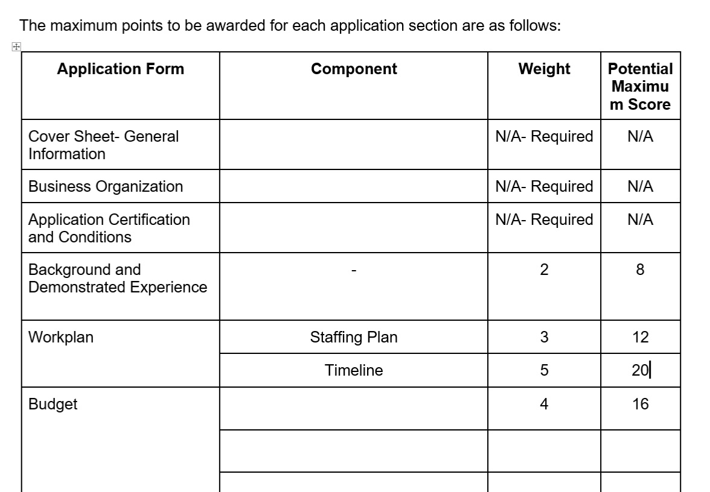
25

Slide 26
IowaGrants Resources

Slide 27
IowaGrants Help
For assistance with using IowaGrants, please use the following training materials and guides:
  IowaGrants External User Training
  IowaGrants Application Guide
Iowa Grants Help Desk:
  iowagrants.helpdesk@hhs.iowa.gov

Slide 28
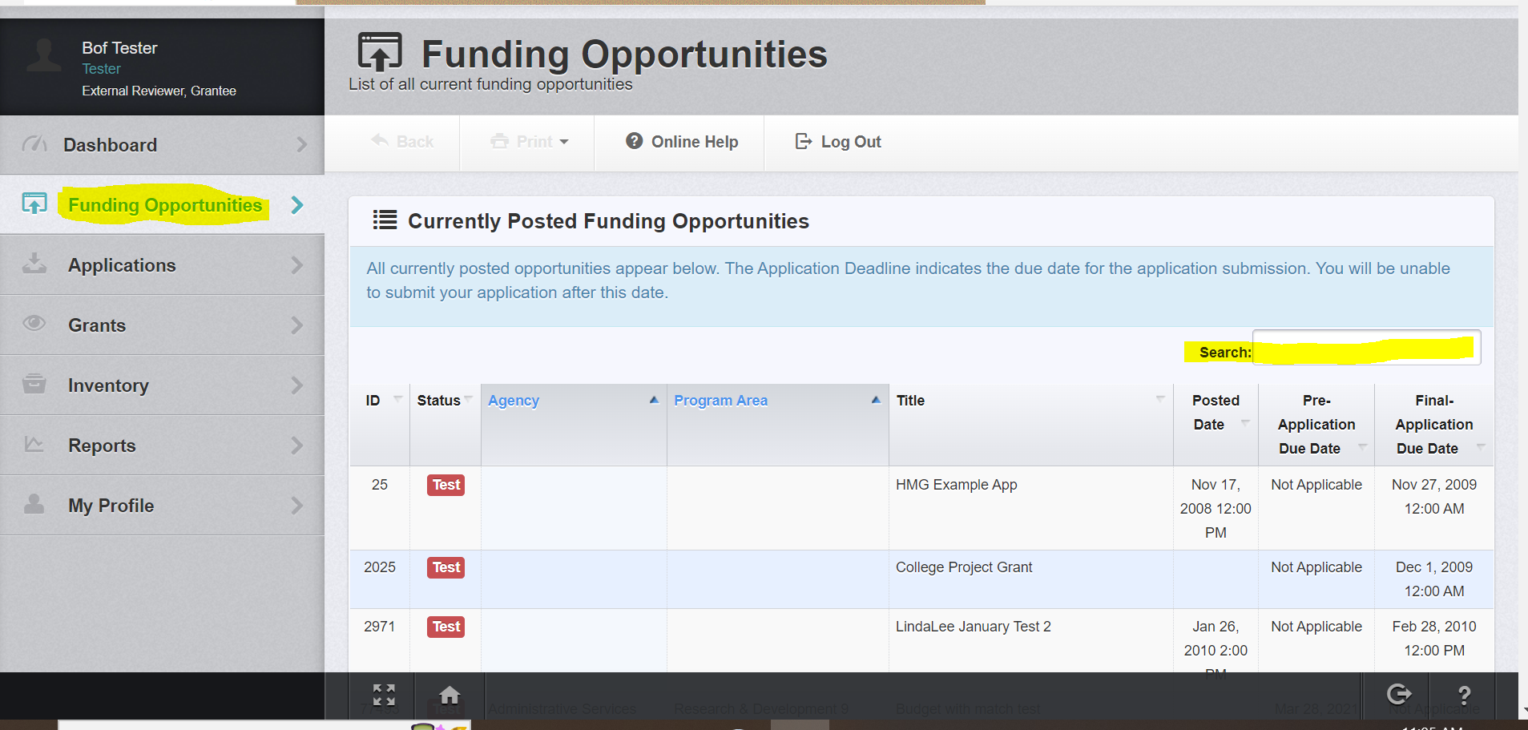
IowaGrants Help – Find Opportunity
Each individual within the applicant organization who desires or needs access to the application must be registered in IowaGrants.Gov.
Once signed in you will see the left side bar and click on Funding Opportunities.

Slide 29
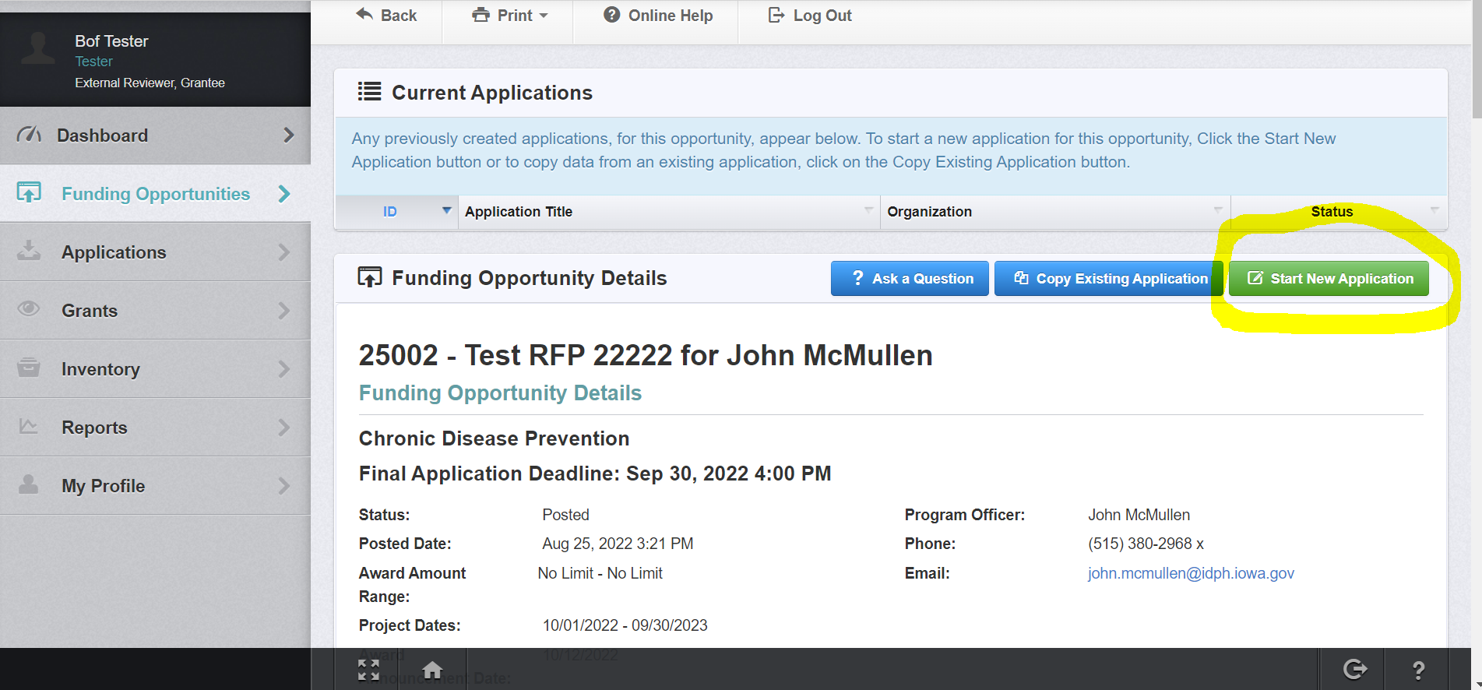
IowaGrants Help – Start Application
When ready to create your application, click on “Start a New Application”

Slide 30
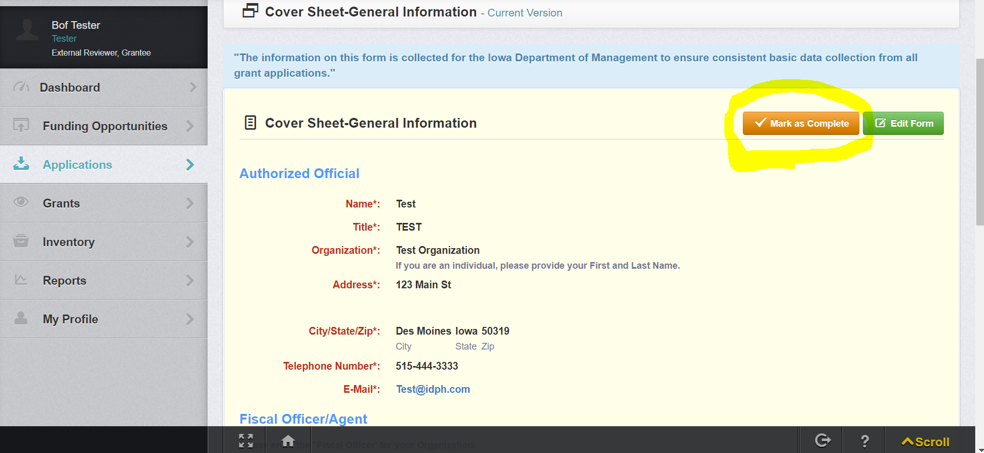
IowaGrants Help – Save Form
After you have clicked “Save Form” you will get the following screen for review before you click “Mark as Complete” to add the green check mark on the form.
Note: there are multiple “Save Form” and “Mark as Complete” buttons. All buttons will save or mark the form complete in its entirety, not just the section you are working on. Always scroll through the form to make sure you did not miss any sections before saving or marking the form as complete. If you miss something you can always go back in the form and edit.

Slide 31
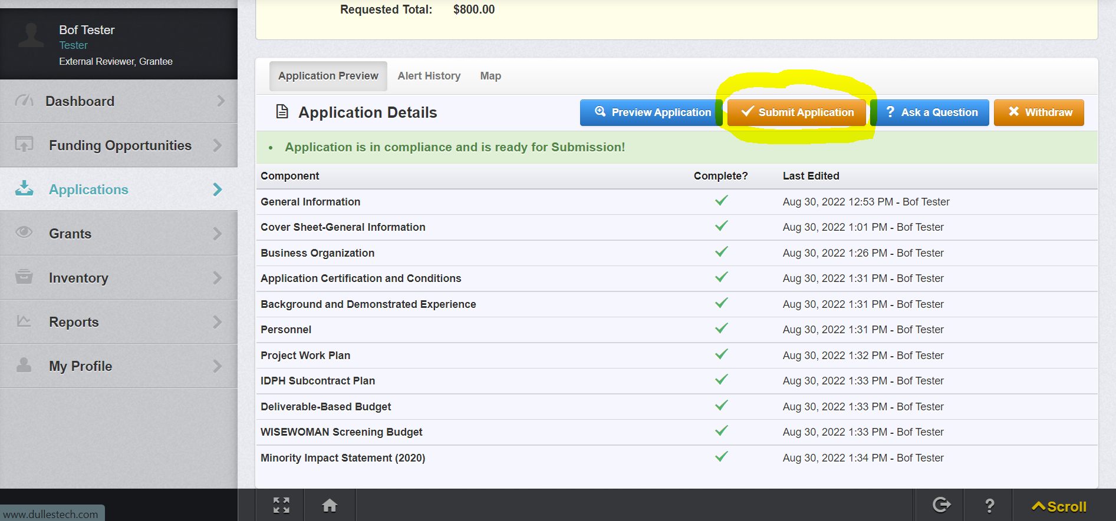
IowaGrants Help – Submit Application
A completed application ready to submit will look like the below example.
  Click “Submit Application” when you are ready to.

Slide 32
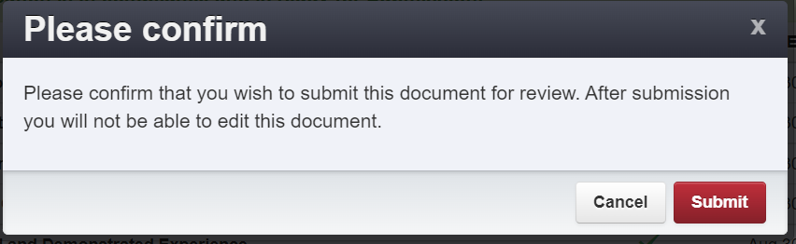
IowaGrants Help – Submit Application Continued
All applicants must sign and certify that they have read and understand the terms of the Funding Opportunity. Click “Submit”.
Reminder Notes:
The application can’t be submitted until ALL forms are completed and saved and marked as complete.
The applicant has the opportunity to go back into the application forms as many times as deemed necessary to edit/complete the application even if they have marked the forms as complete.
Once the application is submitted the applicant can no longer access the forms to edit. They will always have a view of the application for reference or for printing.

Slide 33
Summary

Slide 34
34
Review what is eligible for type of equipment - Dollar amount, examples of types
Organizations that we awarded under first Best and Brightest procurement are not eligible
If RFP says only one application, you should only submit one application
If RFP says only one piece of equipment, you should only request one piece of equipment.
Following directions is very important
Pay attention to the email addresses that you put in IowaGrants. Those people are who we will contact if issues. Consider upcoming vacations, extended leaves, retirements. Make sure to check your spam folder often.
Do not guess at your budget and don't leave it blank. Provide a justifiable number. Describe how you know that number is reasonable.
Make sure the location of the equipment is within an eligible service area.
Be clear on what you are asking for. Assume that some reviewers may be unfamiliar with technical terms and other reviewers may be very familiar with the technical terms.
Impact - tell reviewers how this will make a difference in your community in actual numbers.
This is competitive. Give it a good effort.

Slide 35
Questions?
Iowa Grants Help Desk:
iowagrants.helpdesk@hhs.iowa.gov
Healthy Hometowns Questions:
healthyhometowns@hhs.iowa.gov
Kelsey Feller
Principal Investigator, Healthy Hometowns
HHS Chief Data Officer
Division Administrator, Data Privacy and Strategy
Iowa Department of Health and Human Services
HHS.Iowa.gov/HealthyHometowns

