Slide 1
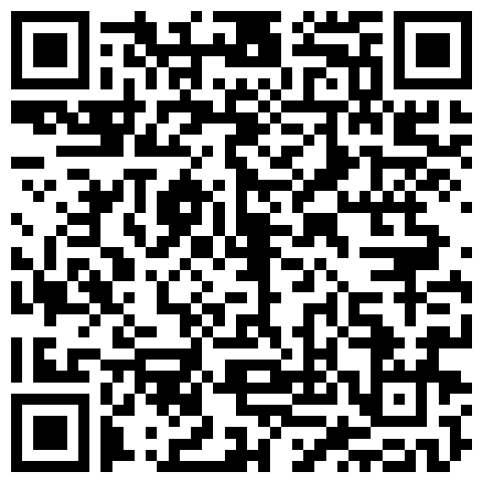
Thousands of People. Millions of Hours.
Consistent. Reliable. Person-Centered Support.
SCAN HERE

Slide 2
What Is Remote Supports?

Slide 3

Remote Supports
Empowers people with intellectual and developmental disabilities to live independently in their own homes and communities using a remote support staff and assistive technologies.
Notes:
Remote Supports, follows the HCBS guidelines of what’s important to and important for the individual, as well as directed by the individual – we empower people to live more independently on their own terms.
And we allow for, and follow, person-centered planning that adheres to the requirements of HCBS – creating plans that supports what is important to and important for the person.
We share this mutual goal

Slide 4

A person-centered support service that offers:
The Person Supported
Individualized Solutions developed by the person and their team
A Learning Environment that’s supportive and safe
The Next Step to Independence people thrive when given a chance
Remote Support Staff always available -24/7 always supportive - never directive
Notes:
We take a person-centered approach that focuses on what is important TO the person and FOR the person. Our solutions are devised based on what the individual tells us they want and what they need. They have the power to decide. We want to provide what they want.
We then create environment that’s supportive of building their desired skills and provides the means to support their need for independence, safety, and privacy.

Slide 5
Our Remote Supports is a service,
not a thing.
It is not replacing humans with technology but is a trained workforce connecting and supporting people through technology.
Notes:
What’s important to remember that Remote Supports does not replace people coming into the home. It has yet to displace a DSP from a job. It simply integrates technology into the service to provide alerts, privacy and safety. Our RSS are available 24/7 to respond to a call, perform ISP check-ins, or just to talk. We follow the care plan protocols. The human-to-human connection remains. It is a service. Not a thing.

Slide 6
Hired a Service Before?

Slide 7

What do we want…
Available Service
Reliable Service
Consistent Service

Slide 8
We Should Have the Same Expectations for Waiver Services
Available
Reliable
Consistent

Slide 9
Support Services: The Reality
Long waitlists
Limited choices
Service interruptions
High Turnover

Slide 10
Meet Josh

Slide 11
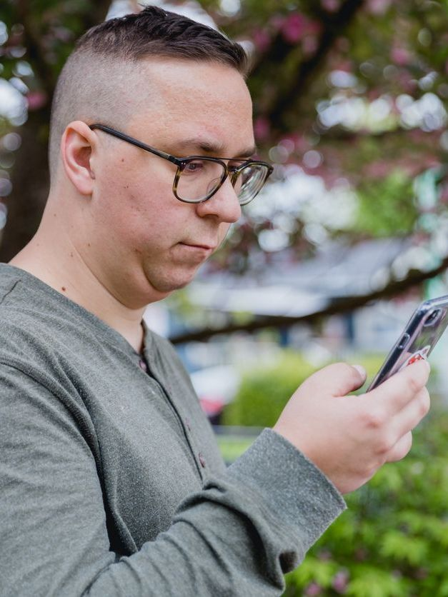
About Josh
Felt lonely and disconnected
Called family, providers, and case managers constantly
Relationships became strained
Repeated behavioral health visits

Slide 12
Josh’s Team Implements Remote Supports
Consistent access to another person
Able to rebuild relationships
Behavioral health visits dropped significantly
Felt more supported day to day

Slide 13
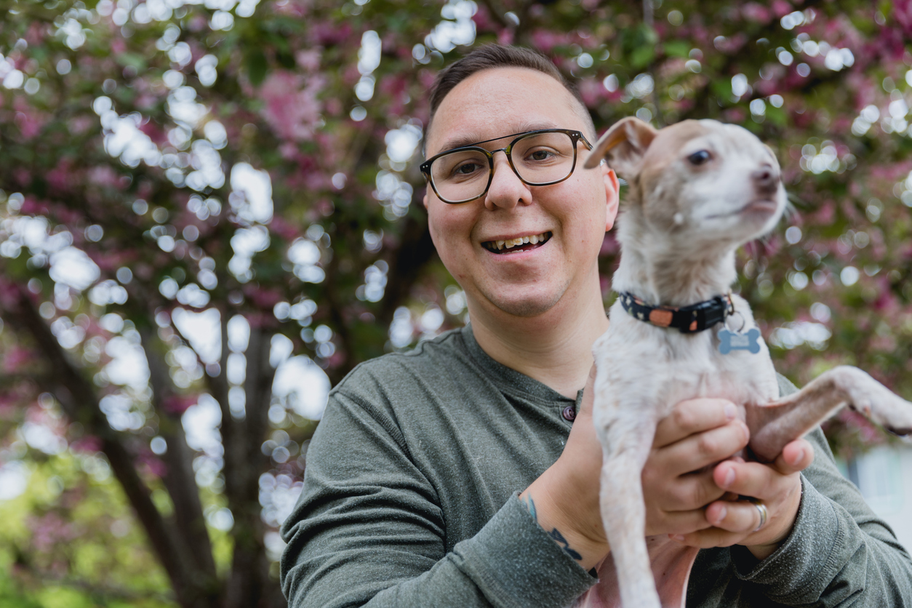
Josh Remote Supports Outcomes
What Actually Changed
Support delivered by trained professionals
Increased communication filled an unmet need
Care was available on his terms when HE needed it

Slide 14
Why Remote Supports Works

Slide 15

Available
NO WAIT LISTS FOR REMOTE SUPPORTS

Slide 16

Reliable
ALWAYS ON. ALWAYS THERE.
24/7 SUPPORT

Slide 17

Consistent
99.7% SUCCESS RATE OF COMPLETING ASSIGNED TASKS

Slide 18
Makes Space for Privacy
The individual chooses when to engage or disengage with the service.
The individual's space is respected

Slide 19
Allows Voice & Choice
The individual shapes their support plan, choosing what they need and want for the life they choose
The individual is heard

Slide 20
Least Restrictive
The individual decides their daily life—what to do, what to wear, and when to go out—knowing support is there if needed.
The individual is in control

Slide 21

Emotional Well-being
80%
CLIENT SENTIMENT SCORE

Slide 22
Meet Desmond

Slide 23

Desmond: Agency Provider
Struggled to find DSPs
Existing staff over-worked & strained
Drowning in Over Time
Forced to turn away referrals
Real Story with image for illustrative purposes only

Slide 24

Remote Supports Integration
Faded 20 hours/week of in-person support
Reduced the need for overtime
DSPs shifted to people requiring more intense support

Slide 25
Why Remote Supports Works

Slide 26

Scalability

Slide 27



Supporting More People with the Same Budget
HYPOTHETICAL BUDGET:
$10M
$33.52
AVG COST PER PERSON PER HOUR
$9.48
AVG COST PER PERSON PER HOUR
~102
PEOPLE SERVED ANNUALLY ¹
~362
PEOPLE SERVED ANNUALLY ¹
Traditional Supports
Remote Supports
Remote Supports makes it possible to reach 3.5X more individuals with the same resources—without compromising quality or outcomes. It doesn’t replace traditional services where they’re needed; instead, it adds flexibility and expands the capacity of support services.
¹ Assumes support of 8hrs per day, 7 days per week.
OH

Slide 28
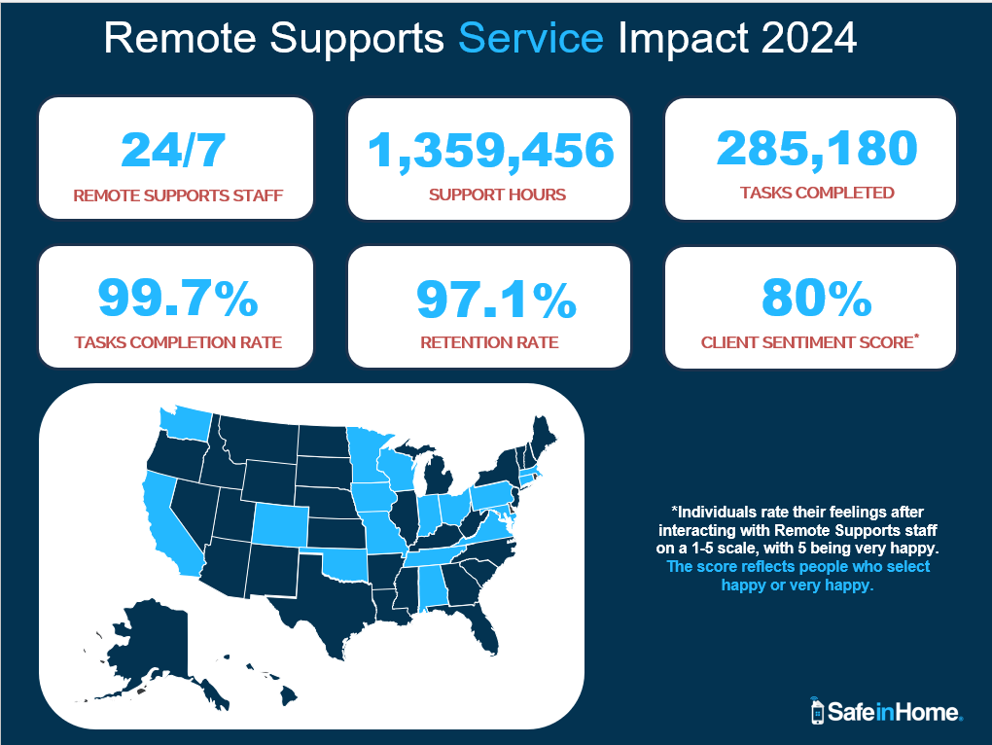
Remote Supports Service Impact 2024 - SafeinHome

Slide 29
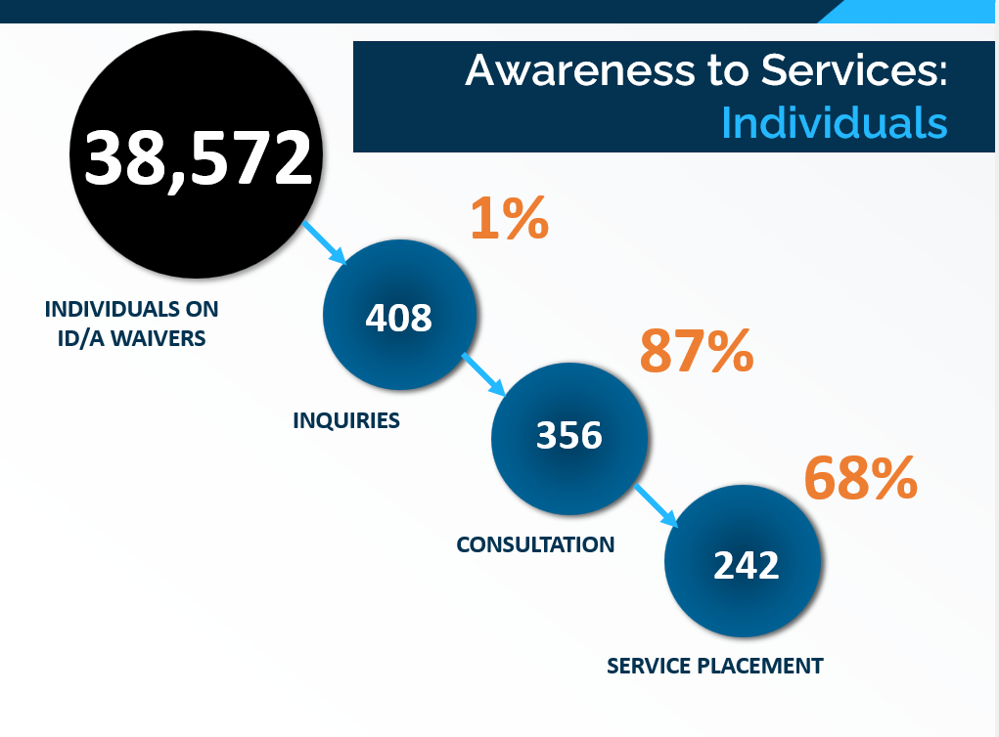
Awareness to Services: Individuals

Slide 30
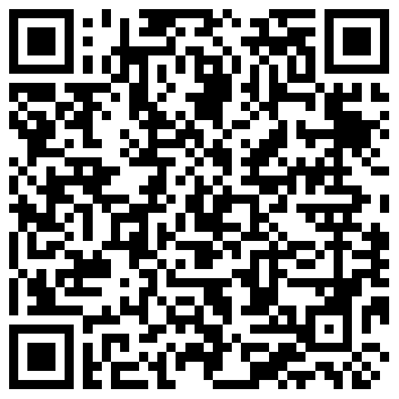
Connect with us to learn more:
URL: https://bit.ly/41s6627
Kyle Corbin
kcorbin@safeinhome.com
(937) 623-5139

