Slide 1





PROPEL
Adolescent Substance Use Prevention
Notes:
Start by engaging audience → Before we dive in, how is everyone’s day going? (wait for response)
Say your name, (grade/role), and a fun fact about yourself
Include an introduction of your local ISTEP chapter, if applicable

Slide 2


PROPEL Introduction
Goal: provide schools and communities with research-based substance use prevention lessons that help youth make healthy choices.
Notes:
PROPEL isn't just a cool name; it stands for the values we're bringing to this room (point to each word on the image as you explain)
Prevention & Resilience: It’s about building the skills to handle stress and challenges so we don’t feel like we need to turn to substances to cope.
Outreach is just like what I’m doing now, where I’m speaking and working directly with you.
Peer Education is important because I’m also just a student. I’m not here as someone who has all the answers but someone who believes students can believe and support one another.
For teachers: Peer Education is important because students can believe, support, and learn from and with one another
Leadership: Recognizing that we can actually change the stigmas and habits in our own schools.
PROPEL’s goal is to equip schools and communities with research-based substance use prevention curriculum that help youth make healthy choices

Slide 3







Key Terms
Adolescent
Substance Use
Abuse & Misuse
A person transitioning from childhood to adulthood.
Consuming, inhaling, or absorbing substances like alcohol or tobacco.
Using substances in unintended, harmful, or illegal ways.
Notes:
Let’s get some basics out of the way. If a word is confusing, feel free to raise your hand to ask! You never know when others are confused on the same thing. Otherwise, keep those deeper questions for the end!
Adolescence is a time period when you learn more about who you are, explore independence, and make your own choices. This is normally ages 10 to 19.
Substance use: The act of consuming substances such as alcohol, tobacco, or other drugs.
Substance misuse or abuse: Using these substances in a way that is harmful to your health, safety, or well-being, or using them in ways not intended

Slide 4

Why this matters
Notes:
Some of you may be wondering, why are we even talking about this? During middle and high school, you are learning more about who you are, exploring independence, facing new pressures, and figuring out what influences the decisions you make.

Slide 5
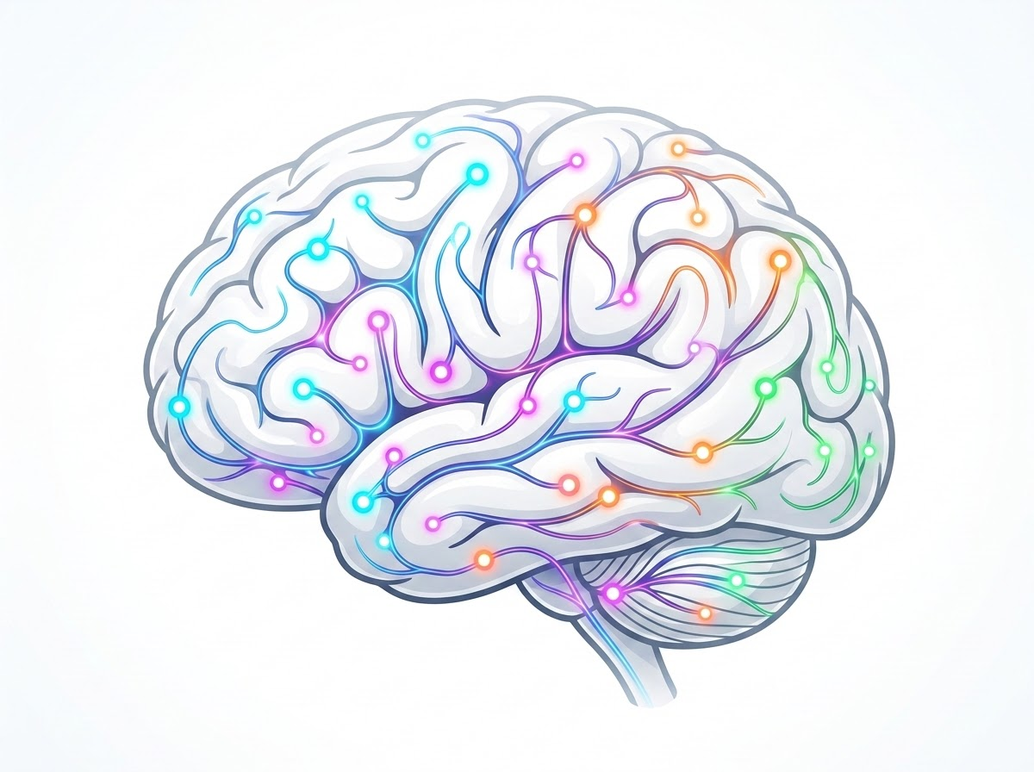
The Adolescent Brain
psychology
Still under construction
flash_on
Stronger effects
trending_up
Early use = higher risk
Notes:
Think of your brain like a smartphone that’s still getting a major software update. This update won’t be finished until you’re around 25! A huge part of this is your prefrontal cortex. Does anyone know what it does? (wait for response)
Your prefrontal cortex is the part of your brain in charge of making smart choices.
Using substances like alcohol or drugs right now is like throwing a glitch into that update. It can mess with your memory, your moods, and your ability to focus on the things you actually love doing.
Because your brain is still growing, it’s much easier for substances to cause real damage.

Slide 6



National Statistics
90%
14
Of people with substance addiction started using substances before turning 18
Average age to start using substances
Notes:
Take a guess: what percent of people with substance addiction started using substances before turning 18? (wait for response)
Click screen: it is 90% which is very high
Now for another one: What do you think is the average age to start using substances? (wait for response)
It's 14 which is a large reason we’re talking to you today.
The point of this isn’t to scare you but to educate and teach you important information and skills to reduce your vulnerability to substance use. It’s also important to know that substance use prevention is not about punishing you or getting you in trouble but helping you make healthy and safe choices for your future.

Slide 7


Influencing Factors
Risk Factors
Protective Factors
Increase likelihood of use:
Reduce likelihood of use:
Peer pressure / social norms
Strong family relationships
Stress, anxiety, or depression
Positive peer groups
Family substance use
School involvement
Easy access to substances
Coping skills & emotional regulation
Low academic engagement
Clear goals
Notes:
Life throws us curveballs. Some things make us more vulnerable, but other things, what we call "protective factors", keep us safe:
Risks factors that increase the likelihood of illegal substance use are:
Peer pressure and social stigma: this is when you feel forced or pressured to do something just to fit in or be accepted by others.
Stress, anxiety, or depression: mental health struggles can lead you to be vulnerable to coping with substances
Family history of substance use
If you have easy access to substance use
If you don’t do well in school, it has been shown that you are more vulnerable to substance use.
Factors that can reduce the likelihood of illegal substance use are:
Strong family relationships
Positive peer groups which are similar to friend groups or school environment
Being involved in school
Having positive coping strategies
Clear goals in the future

Slide 8
2. Making Informed Decisions
Notes:
Every day we make decisions based on the information we have. For example, why do we brush our teeth? (await answer)
Exactly, because it prevents cavities and maintains our teeth to be healthy. But how do we know this? Because research was done and we were told of it from a young age.

Slide 9


What does that mean?
Having all the relevant information to make a thoughtful and knowledgeable healthcare choice.
Information that may be important to know:
Potential outcomes
Risks
Solutions
Notes:
To make informed decisions regarding adolescent substance use, it’s the same thing. It’s important you have proper information to help you make decisions regarding adolescent substance use. So what kind of information may this be?
Potential outcomes of substance misuse
Risks of substance misuse
Ways to prevent substance misuse
*Image: PNGTree (used under Free License)

Slide 10
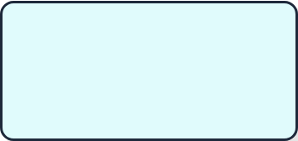









Ways to get information
School
Family
Community Based
Policy
Other Resources
Notes:
To obtain this information you need to use sources you can trust. Here are 5 places to find good information:
School: You can get information from school meetings like this one, or by reaching out to trusted adults like a counselor.
Family: If you have questions or concerns about substances, talking to your family is a great first step.
Community: Places like community centers, youth clubs, or places of worship can provide extra support and help.
Policy: Laws and school rules are designed to keep everyone safe and provide clear guidelines.
Other Resources: You can use the internet to find information, but always double-check that the source is reliable and expert-backed.

Slide 11




Consequences
Short Term
Long Term
Happen after a short period of time
Happens after a long period of time (often accumulates)
Having fun with friends
Altered brain pathways
Notes:
There are two main types of consequences when taking substances. But first, what is a consequence? (await answer)
Exactly! A consequence is a result of an action.
There are two main types of consequences: long-term and short-term consequences. Short-term consequences are those that happen after a short period of time after that action. For example, drinking soda in the morning can make you feel energized or taste good in the moment. Long term consequences, on the other hand, are those that happen after a longer period of time after doing that action. Going back to our previous example, drinking soda in the morning can make you feel tired later in the day or give you a sugar rush.
For substance use, I want you to think of a few short and long term consequences (give a minute or two to think). Does anyone want to share? (await response)
Great! Another example of a short term consequence of substance use can be having fun with friends but a long term consequence can be it changing your brain’s pathways.

Slide 12
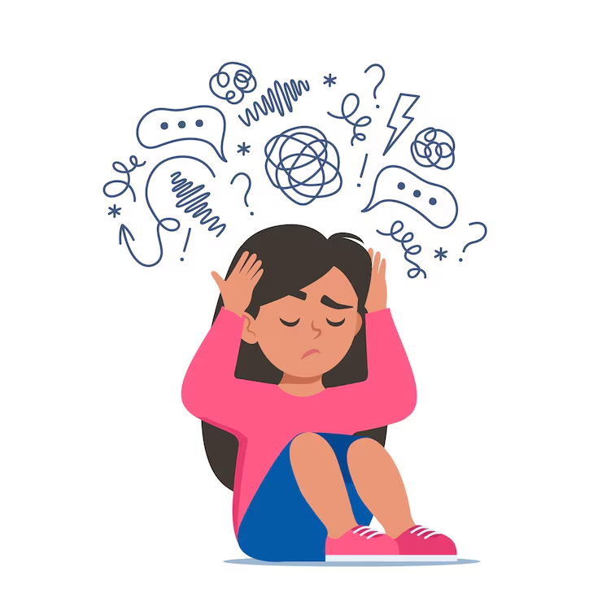
Coping with Stress
One of the largest risk factors for substance use is stress, because adolescents often rely on substances to cope.
Let's explore healthy ways to cope and build resilience.
Notes:
One of the largest reasons adolescents use substances are to cope with stress. Does you know what coping with stress means? (await response)
Exactly! It is when you do something to relieve or reduce the stress you may be feeling. So, using substances to cope with stress means that many may use substances to reduce the stress they feel. Let’s explore healthier ways to cope with stress.
*Image: Magnific/Freepik (used under Free License)

Slide 13






Healthy Coping Mechanisms
Get Support
Community
Take Breaks
Know where and how to get treatment and support services, including counseling.
Connect with community or faith-based organizations.
Take breaks from news and social media to reset your mind.
Notes:
One of the best ways to cope with stress is to figure out what may be causing you stress and how you can fix it. There are a few ways you may be able to do this. For example, you can get support and talk with a trusted adult such as a parent or counselor. These adults can help you identify your stress or figure out a plan to face that stress.
The next way you can cope with stress in a healthy way is by connecting more with community or faith based organizations such as community centers, youth clubs, sports teams, or places of worship.
The third way that can help reduce your stress is by deleting social media or taking a break from technology to reset your mind.

Slide 14



Healthy Coping Mechanisms
Mindfulness
Unwind
Body Care
Take deep breaths, stretch, or meditate. Build this into your routine.
Make time to unwind. Try to do activities you genuinely enjoy.
Get plenty of sleep, eat well-balanced meals, and exercise regularly.
Notes:
Lastly, some other ways to cope with stress in a healthy way is mindfulness such as yoga, taking time to do your favorite hobbies, and moving your body.

Slide 15

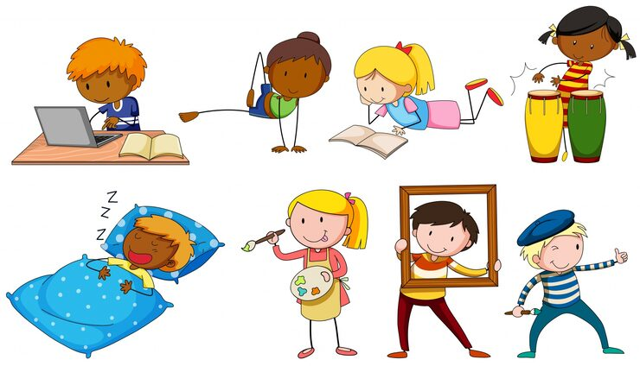
Scenario #1
You have homework, sports practice, and chores all on the same day. It feels like you can't keep up.
How do you feel?
How might you relieve this stress?
Notes:
We will be giving scenarios regarding stressful situations to practice responding to them in a healthy way. Imagine you have homework, sports practice, and chores all on the same day. It feels like you can’t keep up.
How do you feel? (await response - share as big group)
Great! This is a situation that might happen to you guys, and _____.
How might you relieve this stress? (await response - share as big group)
*Image: Magnific/Freepik (used under Free License)

Slide 16
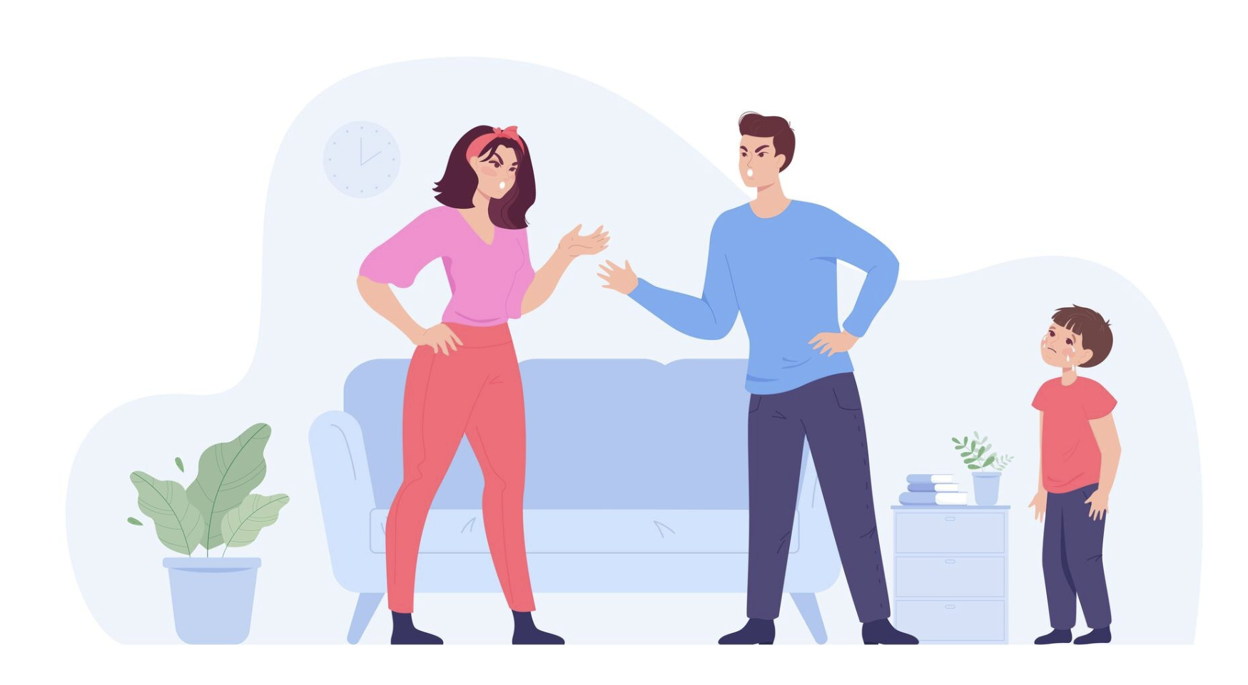
Scenario #2
There has been a lot of arguing at home lately, and it's making it hard to focus.
How do you feel?
How will you relieve this stress? Will you talk to anyone? If so, who?
Notes:
We will be giving scenarios regarding stressful situations to practice responding to them in a healthy way. Imagine you have homework, sports practice, and chores all on the same day. It feels like you can’t keep up. How do you feel? (await response - share as big group) How might you relieve this stress? (await response - share as big group)
*Image: Magnific/Freepik (used under Free License)

Slide 17
3. Recognizing Risky Situations
Notes:
Once you know why it's important to be careful of substance use, how do you recognize dangerous situations where this might happen?

Slide 18
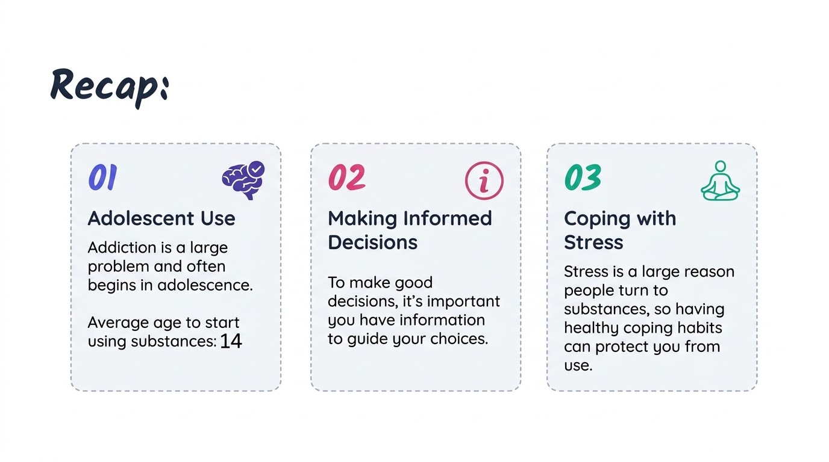
Notes:
Just to recap, we have gone over:
The reason this presentation is so important. Addiction is a large problem and often begins in adolescence. Does anybody remember the average age of someone starting to use substances? (await answer) – click screen: it is 14.
Having the information you need to make important decisions is highly important to guide smart choices. Places to get information are at school, from your family, community centers, through rules, and the internet if it is a trustworthy source.
Stress is a large reason people turn to substances. What are a few healthy ways to cope with stress? (await answers)
Great! Healthy ways to cope with stress can be doing things you enjoy, talking to someone you trust, or meditating.

Slide 19




The S.T.O.P. Acronym
S
T
O
P
See
Think
Option
Pick
Observe what’s happening.
Think about the short & long term consequences.
Look for the options you have on what to do.
Pick and plan the safest choice.
Notes:
One of the easiest ways to memorize what to do in a situation with substances is the STOP acronym. Look down at your card to fill in this information; it’s okay to simply write: see, think, option, pick.
S stands for see: it is important you are observant and know what is happening around you
T stands for think: is is important for you to think about the short and long term consequences of substance use and why it may be dangerous
O stands for options: look at the different options and choices you have.
P stands for pick. Once you know what choices you can possibly make, it’s important you pick the safest one.

Slide 20



Notice Early Red Flags
People
Place
What are they saying?
Is this a place you are familiar with?
What are they doing?
Are you with people you are familiar with?
How are they doing it?
Is there conflict?
Notes:
To see what is happening around you and recognize if it is dangerous, it can be helpful to know red flags on what to look for. Look down at your card to fill in this information so you can use it in the future.
People: when looking at the people around you, you can ask three questions
What are they saying? Are they talking about drinking alcohol or smoking?
What are they doing? Are they actively drinking, smoking, or engaging in a dangerous activity?
How are they doing it?
Place: look at the environment around you and the location you are in
Is this a place you are familiar with? Does this place look safe and if it isn’t, is there somewhere you can go for safety? Do you recognize any escape routes?
Are you with people you are familiar with? Do you feel safe with those around you?
Is there conflict? Is there imminent danger around you? Is there something you can do to make it better or stay safe?

Slide 21
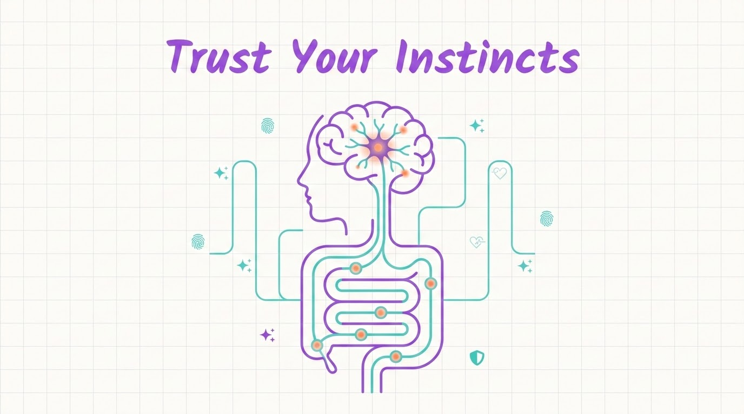
Notes:
We say this all the time, but it’s important to trust your instincts!

Slide 22




The Science of Instincts
500M
Neurons in Your Gut
Safety Mechanism
Your gut has 500 million neurons which creates a complex neural network operating inside you.
Your instincts are known to be an evolutionary safety mechanism developed to protect and guide you.
Notes:
Ever heard of a "gut feeling"? There’s actually a reason for it! Your body has a huge network of nerves in your stomach that acts like a second brain. It’s naturally built to give you a heads-up when something feels off, so if your gut is telling you a situation isn't right, you should probably listen to it.

Slide 23
Activity Time!
We will be showing different solutions.
👍
Choice A
Thumb Up
👎
Choice B
Thumb Down
Notes:
Next we will be doing an activity to practice recognizing dangerous situations. For each example there will be two choices. For choice A, do a thumbs up, and for choice B, do a thumbs down. Ready?

Slide 24

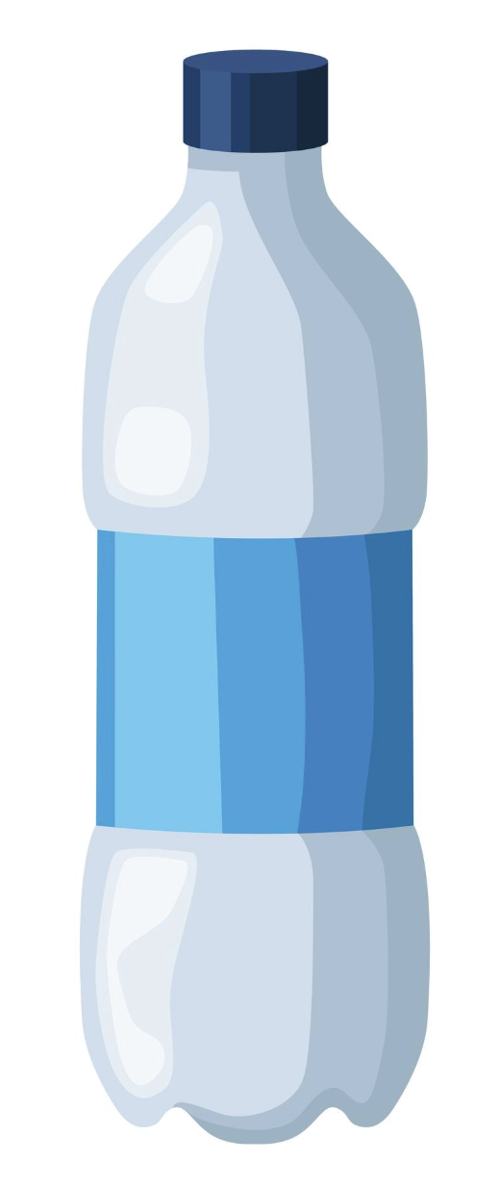
Scenario #1
"Before a big game, a teammate offers you a drink from an unlabeled bottle and says, 'Trust me it'll help you play better.'"
A) You politely decline because you don't know what's in it. (👍)
✅
B) You drink it because your teammate uses it all the time. (👎)
Notes:
Our first scenario is that before a big game, a teammate offers you a drink from an unlabeled bottle and says, “trust me it’ll help you play better.” What should you do? Give a thumbs up if you politely decline it or drink it (await response)
Do we have any volunteers who want to share why they chose what they did?
Great! Let’s see what the best action would be: click screen
The safest choice in this case would be to politely decline it because you don’t know what’s in it.
*Image: Magnific/Freepik (used under Free License)

Slide 25


Scenario #2
"A friend invites you to a party. When you arrive, you notice some older teens are vaping in the basement."
A) You decide to stay because your close friends aren't vaping (👍)
B) You text a trusted adult for a ride home to leave. (👎)
Notes:
Our next scenario is a little more tricky. A friend invites you to a party. When you arrive, you notice some older teens are vaping in the basement. Do a thumbs up if you decide to stay because your close friends aren’t vaping and do a thumbs down if you text a trusted adult for a ride home to leave (await response)
Do we have any volunteers who want to share why they chose what they did? (try to get someone to share why they chose thumbs up and someone to share why they chose thumbs down)
Great! Let’s see what the best action would be: move to next slide

Slide 26
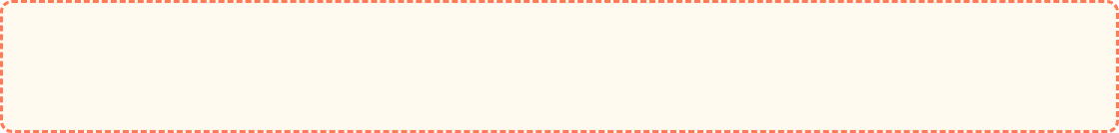
Discussion of Scenario #1
If you chose A: What are the risks of staying in that environment? Could they escalate?
If you chose B: Excellent choice for maintaining boundaries.
Takeaway: Even if you don't plan to vape, the environment could become unsafe or involve pressure later.
Notes:
This one is a little tricky. We understand you also want fun. However if you did a thumbs up, what are the risks of staying in that environment? (await response)
Exactly! Even though your close friends may not be engaging in substance misuse, the scenario could always escalate. This doesn’t mean you have to leave right away, but be cautious and think of exit strategies in case they do. We will discuss this more in the upcoming slides.
If you chose choice B, this is a great choice to maintain your boundaries.

Slide 27
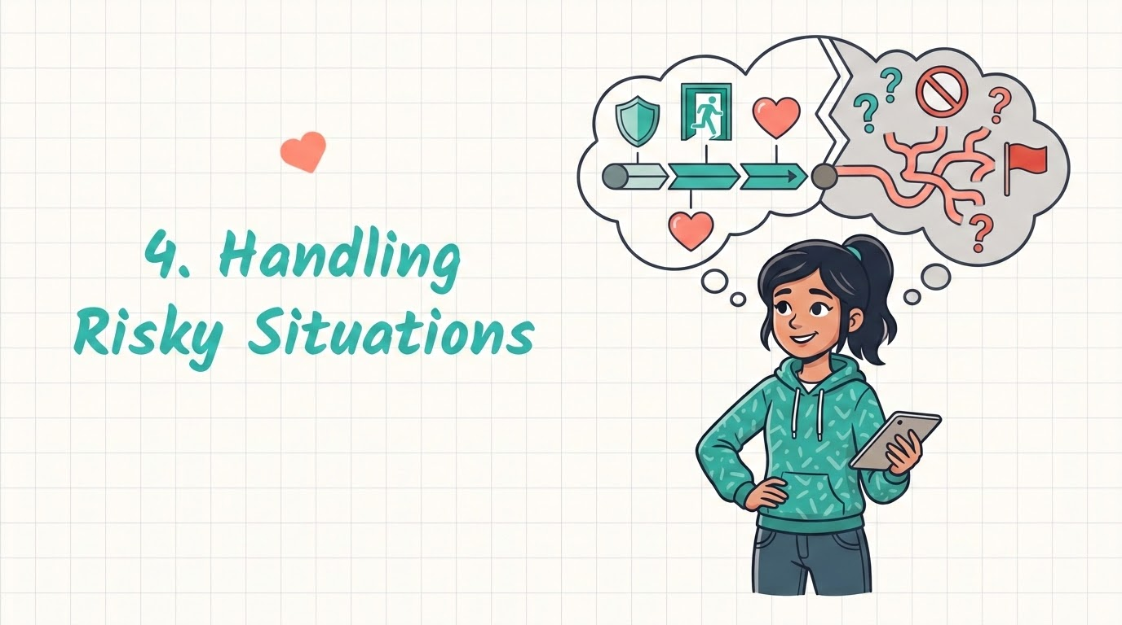
Notes:
Now that we know what a risky situation may be, what do we do to keep ourselves safe?

Slide 28




Key Strategies
Have a Plan
Discuss potential exits or escape routes in case of a dangerous emergency before you arrive.
Have a Code Word
Use a specific word to text/call your family to signal for help. (Tip: choose a word you don’t use often, such as "walrus")
Notes:
There are two keys strategies to keep yourselves safe from a risky situation. Look down at your card to fill in this information.
Have a plan: discuss potential exits or escape routes in case of a dangerous emergency before you arrive. For example, if you think there may be alcohol or other substances, you can ask a trusted adult to be ready to pick you up in case you feel uncomfortable or need to leave.
Have a code word: having a code word whether to text a trusted adult or talk to a friend can be incredibly helpful. Pick a word you don’t use often like ‘walrus’ to signal you don’t feel safe and need them to help you get out of the situation. Do you guys have any ideas on code words you would want to use? (await response)
Great! Now how would you use that in a sentence?

Slide 29
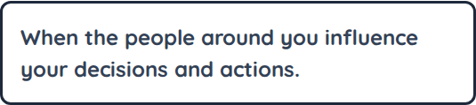
Peer Pressure
Definition
Ways to say no:
Confidence: Practice saying no firmly.
Alternatives: Suggest something else to do.
Support: Find others who share similar values.
Notes:
One of the most common reasons to engage in substance use is because of peer pressure. Who here can tell me what peer pressure is? (await response)
Nice! Peer pressure is when the people around you influence your decisions and actions. For example, if you went to hangout with your friends and they are all drinking, they may encourage you to drink as well.
Ways to say no to peer pressure are:
Saying no firmly – this can be helpful to do with practice. Lets all practice saying “no” three times. (practice as group)
You can also explain alternative things to do such as playing a board game.
Lastly, a protective buffer against stress can be to surround yourself with people who make good decisions and share similar values.

Slide 30

Activity: Real Scenarios
For each given scenario, decide:
1. What would you say?
2. What would you do?
3. Who could you contact or go to?
4. Why may this be dangerous or not dangerous?
Notes:
Now that we know more about identifying risky situations and how to handle them, we are going to practice with a few examples. For each example, I want you to spend a minute or two discussing what you would say, what you would do, who you might contact, and why it is dangerous or not dangerous. Then, I’ll call on volunteers to explain what they said.

Slide 31
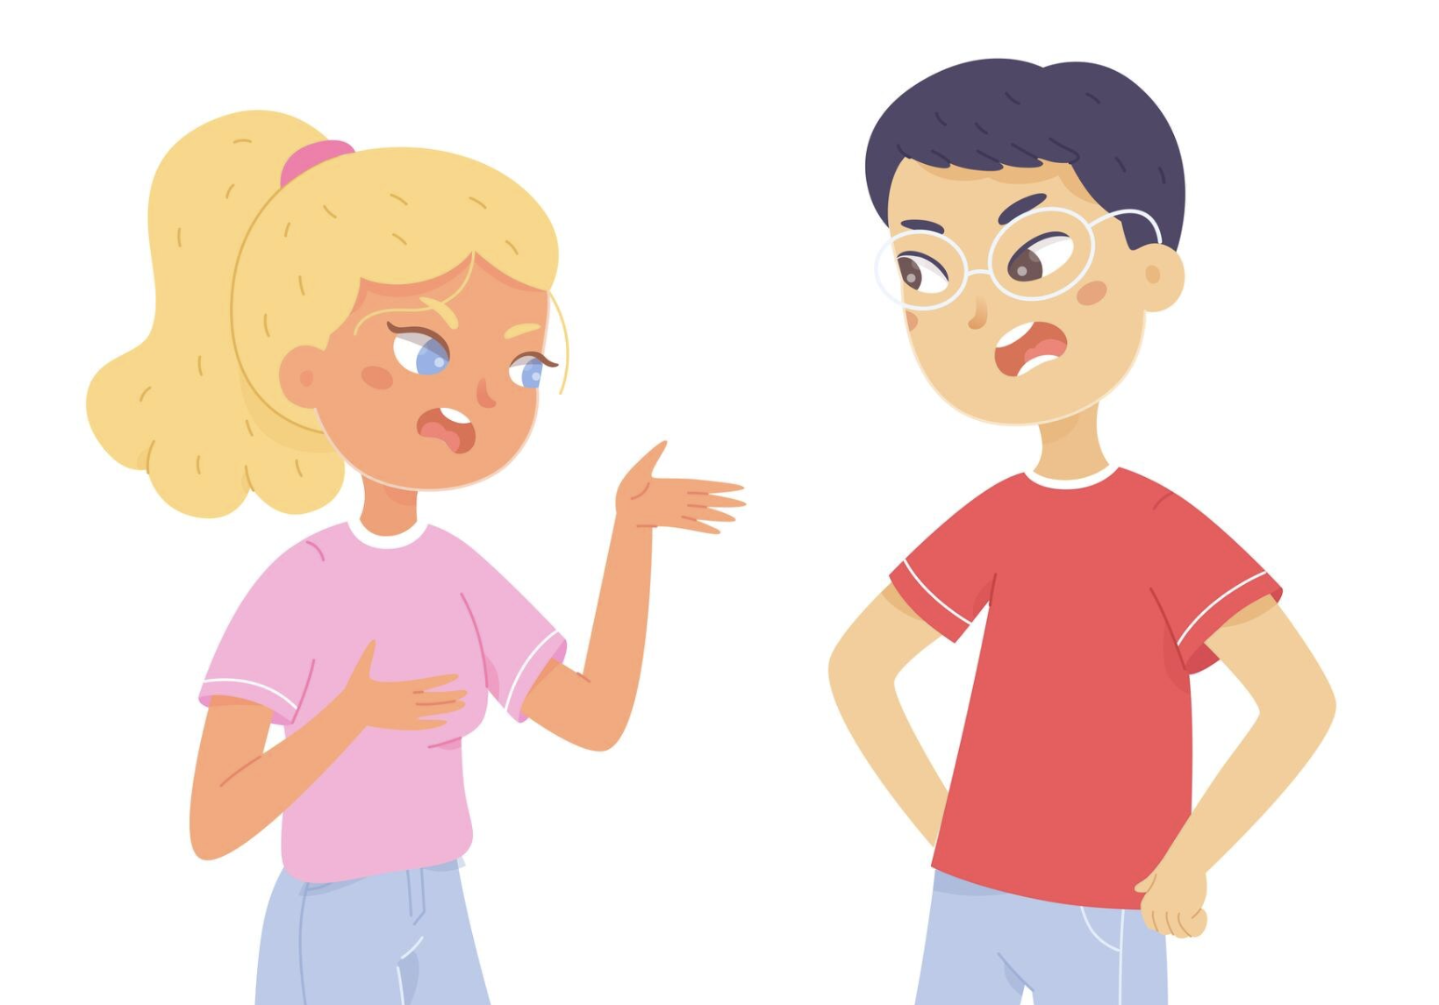
Scenario #1
You are at a friend's house when their older sibling and friends arrive. Someone says, “You should stay, we're going to try something fun later.”
What would you say?
Why or why not may this be dangerous?
Notes:
Our first scenario is that you are at a friend’s house when their older sibling and friends arrive. Someone says, “You should stay, we’re going to try something fun later.” What would you say back and how may this be or not be dangerous? (give two minutes and discuss responses)
How was that (await response)? Do we have any volunteers who want to share what they thought? (await response)
Great! Let’s move on to the next one
*Image: Magnific/Freepik (used under Free License)

Slide 32


Scenario #2
Your friends start sending messages encouraging you to try something risky. They say, “Don’t be boring, everyone is doing it.”
Just do it.
What would you text back?
What can you do next?
Who is someone you might report this to?
Notes:
Your friends start sending messages encouraging you to try something risky. They say, “Don’t be boring, everyone does it.” What would you text back, what can you do next, and who is someone you may report this to? (give two minutes and discuss responses)
How was that (await response)? Do we have any volunteers who want to share what they thought? (await response)
Great! Let’s move on to the next one
*Image: Magnific/Freepik (used under Free License)

Slide 33
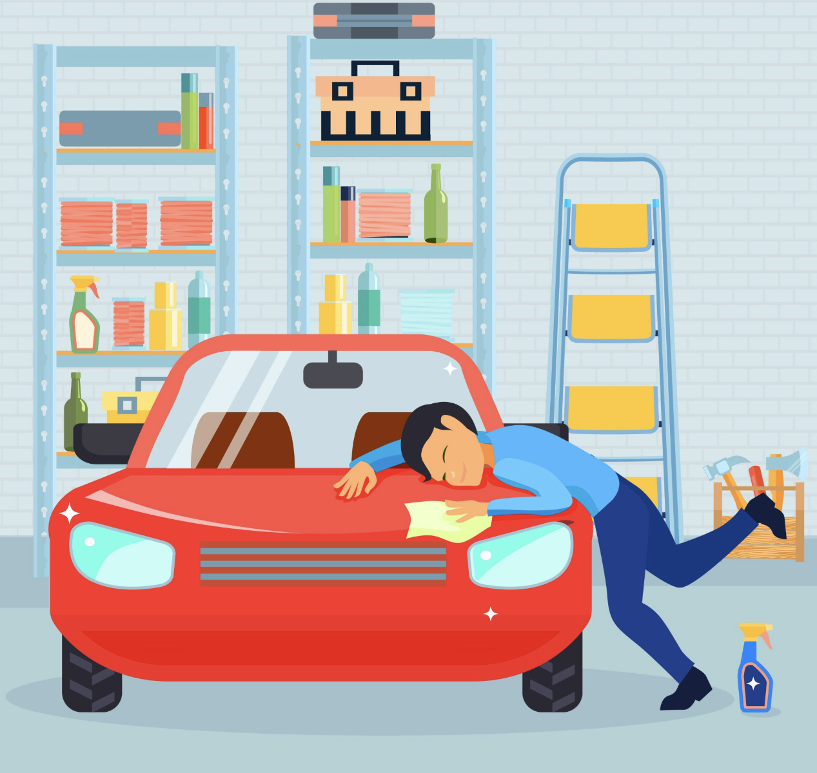
Scenario #3
You are at a friend’s house and learn that the person who is supposed to drive you home may not be able to safely due to alcohol use.
How will you get home?
How will you execute this plan?
Notes:
You are at a friend’s house and learn that the person who is supposed to take you home may not be able to drive safely due to alcohol use. How will you get home? Will you contact someone to pick you up, if so who, or will you just stick it out? (give two minutes and discuss responses)
How was that (await response)? Do we have any volunteers who want to share what they thought? (await response)
Great! Let’s move on to the next one
*Image: Magnific/Freepik (used under Free License)

Slide 34
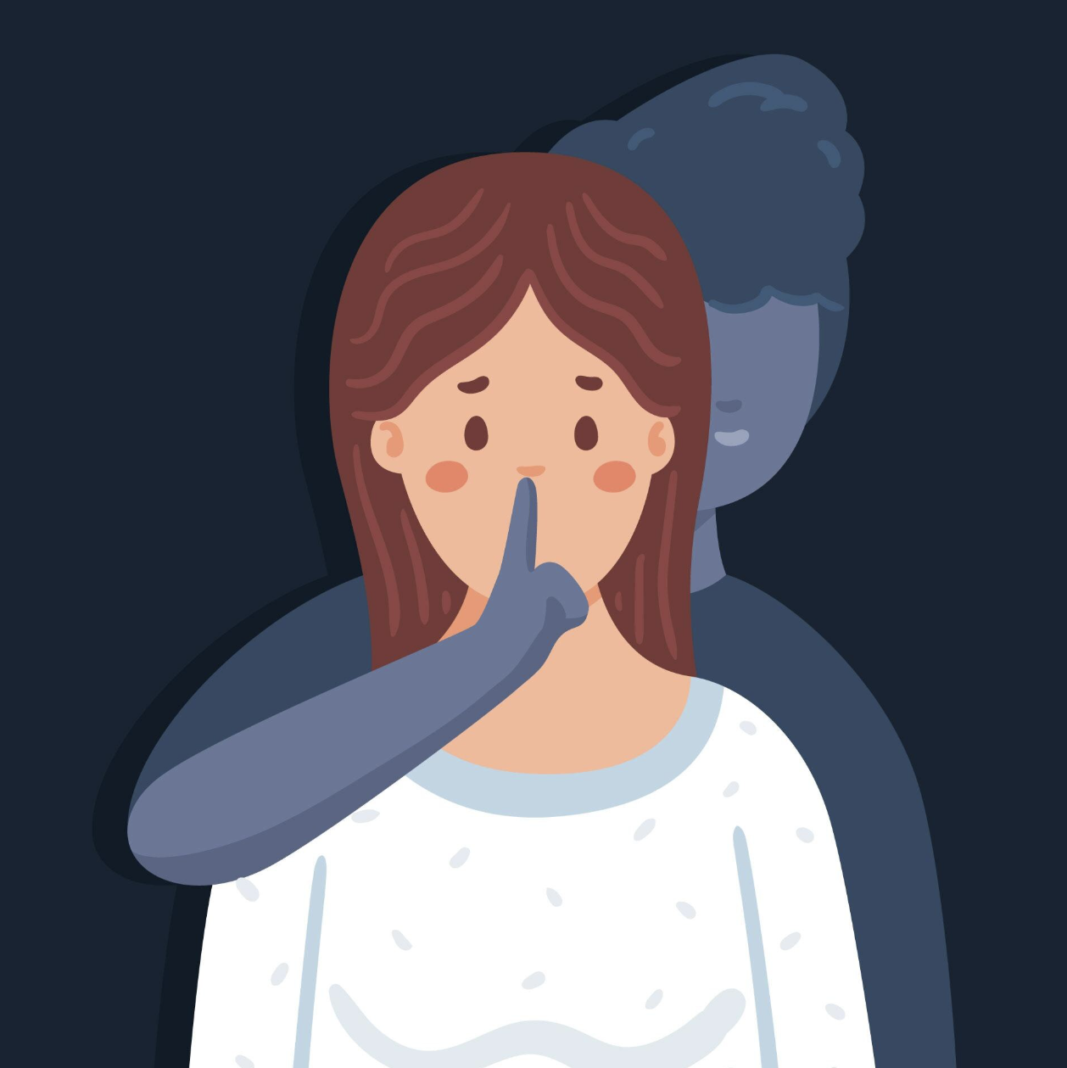
Scenario #4
A friend tells you they are secretly vaping and using drugs. They say, “You can’t tell anyone. If you’re really my friend, you’ll do it.”
What would you say back?
What do you plan on doing next and how?
Notes:
A friend tells you they are secretly vaping and using drugs. They say you can’t tell anyone and that you should also do it, if you are really friends. This is a common example of peer pressure. What would you say back and what are your next steps of action? (give two minutes and discuss responses)
How was that (await response)? Do we have any volunteers who want to share what they thought? (await response)
Great! If we have more time we can practice a few more scenarios.
*Image: Magnific/Freepik (used under Free License)

Slide 35

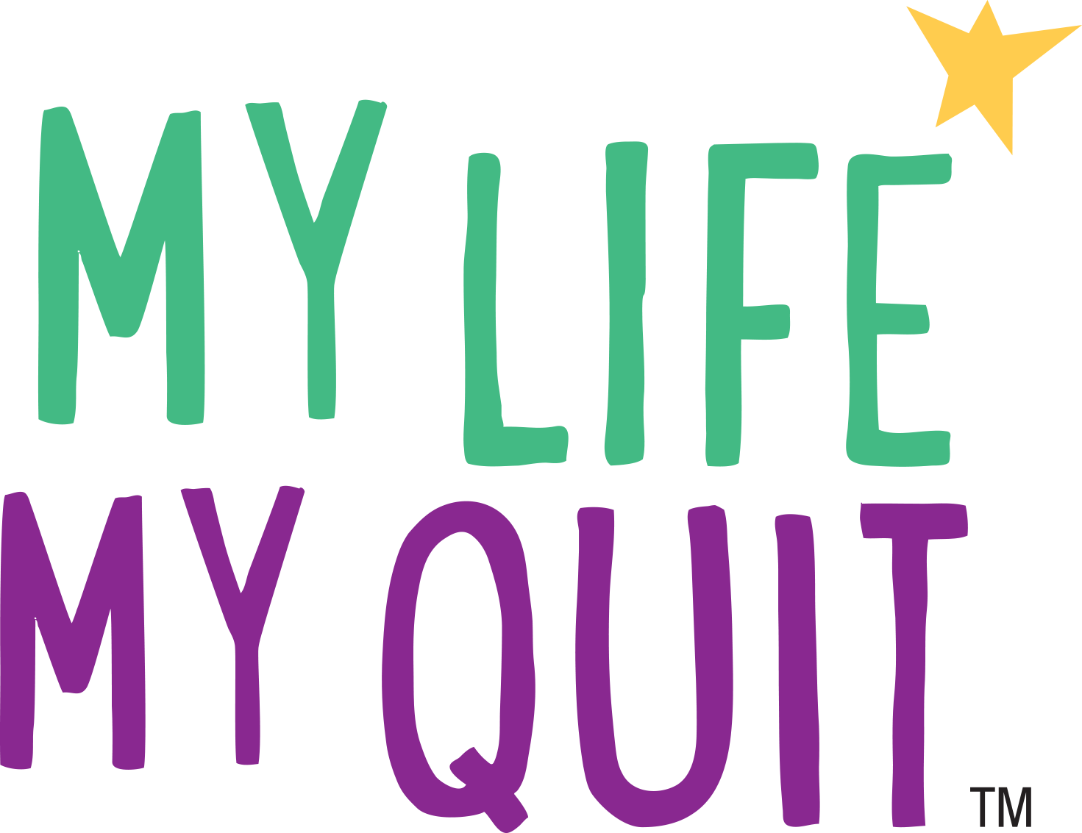
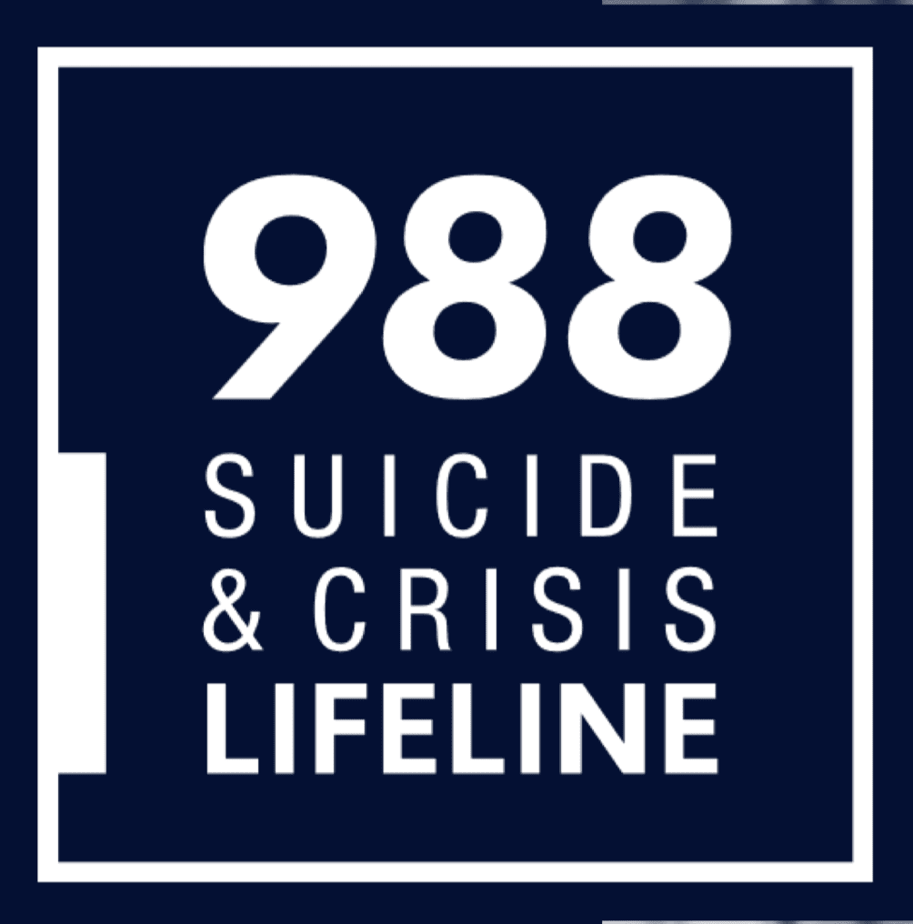
Call 1-800-QUIT-NOW for free support
Call 988 for free support
Text 36072 for free support
Notes:
Some other helpful free resources include Quitline Iowa to help an Adult with quitting tobacco and nicotine products, My Life My Quit to help teens quit tobacco and nicotine products and 988 the Suicide and Crisis Lifeline.

Slide 36
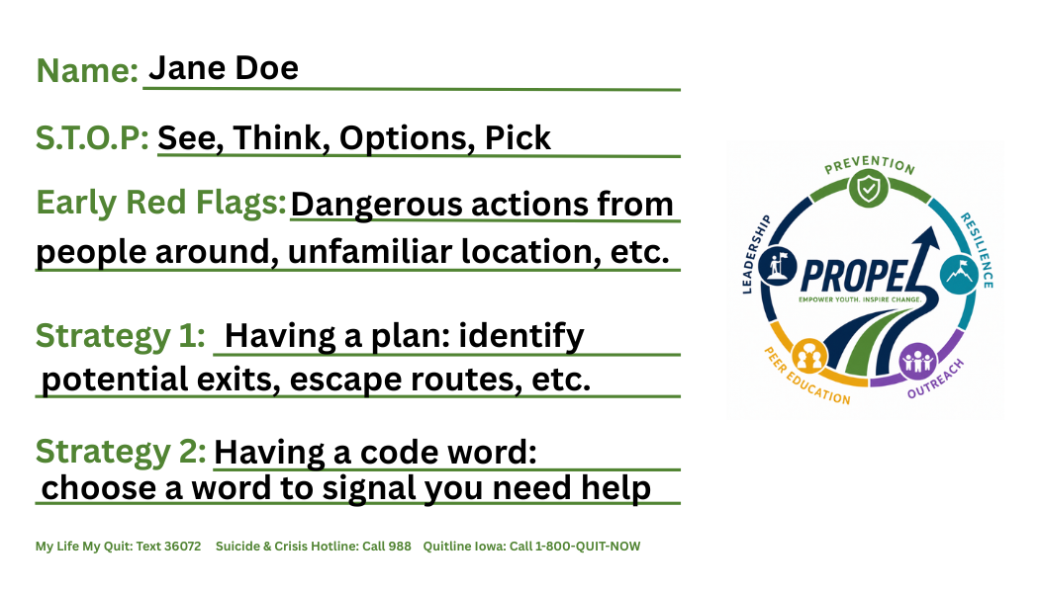
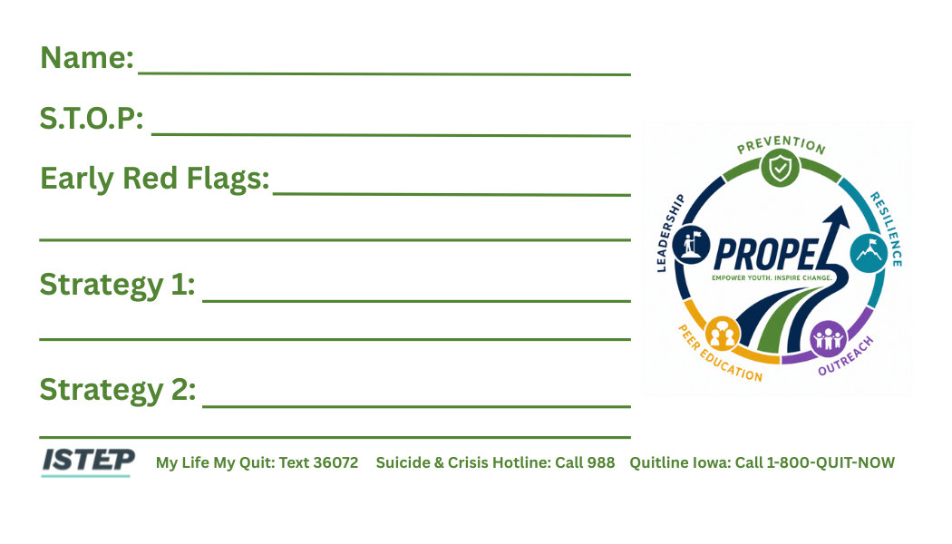
Notes:
Here is a guide to what your card might look like. It’s okay if it’s not the exact same as long as it helps you!

Slide 37
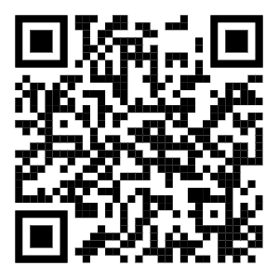
Scan and give us some feedback!
Notes:
Great job! Now, we will have you fill out a quick survey responding to how helpful this curriculum was.
*members can fill out the form while you talk about next slide
*Direct site: PROPEL Curriculum Feedback

Slide 38

Summary
01
Adolescent Use
Addiction is a large problem that often starts with adolescent substance use.
02
Informed Choices
Making informed decisions to navigate social pressures and protect personal health.
03
Recognize Risks
Recognizing risky situations before they escalate to make safer, healthier choices.
04
Take Action
Knowing how to act effectively after recognizing a risky situation.
Notes:
Overall, we went over four key concepts.
This presentation was important because of the high impact of adolescent substance use, as it is often associated with addiction further on.
Having the information you need to make important decisions is highly important as it empowers you to make healthy, informed choices for your future.
We learned to recognize risky decisions through the S.T.O.P. (see, think, options, and pick) acronym and noticing red flags.
Lastly, we learned strategies on staying safe after recognizing risky situations.

Slide 39
Sources
American Public Health Association. (n.d.). Substance misuse. Retrieved July 29, 2026, from https://www.apha.org/topics-and-issues/substance-misuse
Centers for Disease Control and Prevention. (2022, July 18). Drug overdose deaths in the United States, 2001–2021. National Center for Health Statistics. https://www.cdc.gov/nchs/data/databriefs/db440.pdf
Centers for Disease Control and Prevention. (n.d.). Substance use: Sources and definitions. National Center for Health Statistics. Retrieved July 29, 2026, from https://www.cdc.gov/nchs/hus/sources-definitions/substance-use.htm
Childline. (n.d.). Peer pressure. Retrieved July 29, 2026, from https://www.childline.org.uk/info-advice/friends-relationships-sex/friends/peer-pressure/
Drug Helpline. (n.d.). Drug Helpline. https://drughelpline.org/
Horizon Services. (n.d.). How to avoid risky situations: Tips for teens. Retrieved July 29, 2026, from https://www.horizonservices.org/how-to-avoid-risky-situations-tips-for-teens/
Hunter Ed. (n.d.). S.T.O.P. (Stop, Think, Observe, Plan). Retrieved July 29, 2026, from https://www.hunter-ed.com/national/studyGuide/S.T.O.P.-Stop-Think-Observe-Plan/201099_93097/
Iowa Department of Health and Human Services. (n.d.). Youth substance abuse. Retrieved July 29, 2026, from https://hhs.iowa.gov/about/data-reports/health-disease/substance-use/youth-substance-abuse
Magnific. (n.d.). Magnific: The AI creative platform. https://www.magnific.com/
Medium. (2023, February 26). How to trust your gut instinct: The neuroscience behind intuition. https://medium.com/@KatieWoodlandPsychologist/how-to-trust-your-gut-instinct-the-neuroscience-behind-intuition-5b52f7dc8452
National Institute on Alcohol Abuse and Alcoholism. (n.d.). Alcohol's effects on the body. Retrieved July 29, 2026, from https://www.niaaa.nih.gov/alcohols-effects-health/alcohols-effects-body
National Institute on Alcohol Abuse and Alcoholism. (n.d.). Underage drinking. Retrieved July 29, 2026, from https://www.niaaa.nih.gov/publications/brochures-and-fact-sheets/underage-drinking
National Institute of Mental Health. (2024). The teen brain: 7 things to know. https://www.nimh.nih.gov/health/publications/the-teen-brain-7-things-to-know
Overdose Lifeline. (n.d.). Youth prevention programs. Retrieved July 29, 2026, from https://www.overdoselifeline.org/youth-prevention-programs/
Patient Advocates of Southwest Florida. (n.d.). Informed decision making: Empowering patients through knowledge and clarity. Retrieved July 29, 2026, from https://www.patientadvocatesofswfl.com/informed-decision-making-empowering-patients-through-knowledge-and-clarity
Schinke, S. P., Fang, L., & Cole, K. C. A. (2010). Preventing substance use among adolescent girls: 1-year outcomes of a computerized, mother–daughter program. Addictive Behaviors, 35(11), 1060–1064. https://doi.org/10.1016/j.addbeh.2010.06.018
Stanford University. (n.d.). Warning signs. Retrieved July 29, 2026, from https://safety.stanford.edu/threat-concern/warning-signs
Substance Misuse Community Leadership Network. (2025). Iowa drug trends: Brief overview (April 2023). https://smclinn.org/wp-content/uploads/2025/02/Iowa-Drug-Trends-Brief-Overview-April-2023.pdf
The American Psychological Association. (2018, September 6). Trusting your gut makes sense if you're an expert. https://www.apa.org/news/press/releases/2018/09/gut-trust
War Resisters' International. (n.d.). Nonviolence training. Retrieved July 29, 2026, from https://nonviolence.wri-irg.org/en/node/40553
Youth.gov. (n.d.). Risk and protective factors. Retrieved July 29, 2026, from https://youth.gov/youth-topics/substance-use/risk-and-protective-factors
Notes:
Closing remarks: We hope you guys were all able to learn more about substance use and how to stay safe!
Refer to facilitator guide on more activities depending on time

