Slide 1
Behavioral Health Town Hall
October 22, 2026
Marissa Eyanson, Director of Behavioral Health, Iowa HHS

Slide 2
Overview
Welcome
Disaster Behavioral Health
  Overview
  New Initiatives
  Joining DBHRT
Reminders
October 22, 2026 | 2

Slide 3

Disaster Behavioral Health
Karen Hyatt, HHS Emergency Mental Health Specialist
October 22, 2026 | 3

Slide 4
Disaster Behavioral Health Mission
Strengthen community resilience and deliver comprehensive behavioral health support for individuals and families affected by natural disaster, human-caused events, or critical incidents through a coordinated response, trauma-informed care and long-term recovery strategies.

Slide 5
What is Behavioral Health
Behavioral health refers to the connection between behaviors and the health and well-being of the whole person. It encompasses addiction, mental health, substance use, and the way people cope with stress and their challenges.
Following a disaster or emergency event, it is common for people to experience distress and anxiety related to safety, health, well-being and recovery.
Behavioral health is an integral part of the public health and medical emergency management system and should be fully integrated into preparedness, response and recovery activities.

Slide 6
Summary of the Disaster Behavioral Health Response Plan
The Iowa Disaster Behavioral Health Response Plan provides an organizational framework for Iowa’s behavioral health response to disasters.
The plan seeks to increase understanding of disaster behavioral health, what it is and how it can help individuals, families, and communities recover following disasters.
Behavioral health preparedness activities, interventions and response are directed by the Iowa Health and Human Services, Division of Behavioral Health and are carried out by the Disaster Behavioral Health Response Team (DBHRT) and/or Project Recovery Iowa.

Slide 7
Disaster Behavioral Health Response Plan
The purpose of the plan is to provide a framework for organizing Iowa’s behavioral health response to disasters.
Behavioral health disaster response addresses the psychological, emotional, behavioral and social issues which may arise from a disaster event.
Disaster behavioral health services can help mitigate the severity of adverse psychological effects of the disaster and help restore social and psychological functioning for individuals, families and communities.
The plan is meant to be an ever-changing document that can be modified to incorporate changing technologies and emerging best practices in behavioral health response.

Slide 8
Mission
To ensure all individuals and communities are equipped to withstand, recover from, and thrive beyond natural disasters, human caused events, and other crises through strengthened resilience and equitable, accessible behavioral health supports.

Slide 9
Disaster Behavioral Health
Goals:
  Prevent maladaptive psychological and behavioral reactions of disaster survivors and all people working in the aftermath of an event.
  Minimize the counterproductive effects and maladaptive reactions within the disaster response and recovery.

Slide 10

Disaster Behavioral Health response is local responsibility first.
The first response to a disaster always occurs locally.
Local planners understand the cultural, social and psychological needs of people in their area.
The Iowa Disaster Behavioral Health Response Plan builds on the strengths of Iowa’s local communities.
Disaster behavioral health services supplement and do not replace the strength of communities and local efforts.

Slide 11

Types of Disaster
Natural Disasters
Severe Storms and Tornadoes
Floods
Winter Storms and Blizzards
Drought
Human-Caused Disasters
Agricultural Accidents
Industrial Accidents
Nuclear Accidents
Transportation Accidents
Active Threat
Health Related Disaster
Outbreaks of Diseases
Public Health Emergencies

Slide 12
Disaster Behavioral Health Planning
The plan provides a statewide framework aligned with FEMA’s Response Plan.
The plan outlines scalable and flexible strategies to address natural, human-caused, crises and technological incidents affecting Iowa.
The plan recognizes multiple incidents may occur concurrently, and behavioral health needs may evolve across response and recovery phases.
Coordinates planning to ensure appropriate resource activation, reduce duplication of service and supports behavioral health impact areas

Slide 13
DBHRT Services
Behavioral health needs assessment
Psychological First Aid
Brief counseling and intervention
Community outreach
Public information and education
Critical Incident Stress Management Services
Virtual counseling and personal support

Slide 14
Natural Disaster Response by Disaster Behavioral Health
Natural Disaster Response by Disaster Behavioral Health
Year | Event Type | Counties Affected
2007 | Ice storms, floods | Multiple
2008 | Tornado, flooding | 85
2010 | Winter storms, floods | Many
2011 | Storms, floods | Multiple
2013 | Storms, winter, floods | Multiple
2014 | Storms, tornadoes, flooding | Multiple
2015 | Storms, flooding | 19
2016 | Storms, flooding | Multiple
2017 | Storms, flooding | 9
2018 | Storms, tornadoes | 34
2019 | Flooding, storms | 80 (PA)
2020 | COVID‑19 | 99
2021 | Derecho, storms | 5
2023 | Flooding | —
2024 | Tornadoes, storms | Multiple
2025 | Winter storm | 4 counties

Slide 15
Incidents

Slide 16
Attended and Completed Training 2023 to 2026

Slide 17

Psychological First Aid (PFA)
PFA is a compassionate, evidence-informed approach designed to support people in the immediate aftermath of a crisis whether it is a natural disaster, accident, or traumatic event. It is a tool to reduce distress and promote resilience.
PFA is built around five essential goals:
Promote safety: Help people access shelter, food, and medical care.
Promote calm: Listen empathetically and help reduce emotional overwhelm.
Promote connection: Reunite individuals with loved ones and support networks.
Promote hope: Offer reassurance and information about available help.
Promote self-empowerment: Encourage survivors to take steps toward recovery.

Slide 18
Mental Health First Aid (MHFA)
MHFA is an evidence-based training program that teaches people how to identify, understand, and respond to signs of mental health and substance use challenges to equip everyday individuals with the tools to offer initial support until professional help is available.
Participants learn to recognize common signs and symptoms of mental health issues like anxiety, depression, and substance use.
Respond to mental health crises, such as panic attacks, suicidal thoughts, or psychosis.
Offer nonjudgmental support and guide individuals toward appropriate care.

Slide 19
Question. Persuade. Refer ~QPR
Question, Persuade, Refer (QPR)
QPR: The method is modeled after CPR, aiming to empower everyday people to act as gatekeepers.
Question the person about suicidal thoughts in a direct, compassionate way.
Persuade them to seek help and accept support.
Refer them to appropriate professional resources or crisis services.
QPR is based on the idea that early recognition and intervention can save lives. Much like CPR helps stabilize someone in cardiac arrest until medical help arrives, QPR helps someone in emotional crisis until professional care is available.

Slide 20
Mental Health Stigma
Mental Health Stigma is designed to help individuals and organizations recognize, understand, and reduce the negative attitudes and misconceptions surrounding mental health conditions.
The training offers a range of programs that tackle stigma through education, storytelling, and community engagement.

Slide 21
Compassion Fatigue
Compassion Fatigue: Compassion fatigue is often described as the state of physical, emotional, and spiritual depletion that can occur when helpers are unable to refuel and recover. It’s closely related to burnout and secondary traumatic stress.
Understanding the symptoms: Fatigue, irritability, detachment, and reduced empathy.
Self-assessment tools: Like the Professional Quality of Life (ProQOL) scale.
Resilience-building strategies: Mindfulness, boundary-setting, and self-care routines.
Organizational support: Creating healthy work environments and peer support systems.
Trauma-informed care principles: To reduce re-traumatization and emotional overload.

Slide 22
Resiliency
Resiliency refers to the ability to bounce back from adversity, adapt to challenges, and recover from stress, trauma, or setbacks. It’s not about avoiding hardship; it’s about how you respond to it.
Resiliency can be physical, emotional, mental, or social and it’s something that can be cultivated over time through healthy habits, mindset shifts, and support systems.

Slide 23
Critical Incident Stress Techniques
Critical Incident Stress Techniques are part of a broader approach known as Critical Incident Stress Management (CISM), which is designed to support individuals—especially first responders and disaster survivors—who experience intense psychological stress following traumatic events.
These tactics are structured interventions aimed at reducing acute stress reactions and promoting psychological recovery after a disaster or crisis. They are not psychotherapy, but rather a form of Psychological First Aid.

Slide 24
National Incident Management System (NIMS) Training
IS-100 Introduction to ICS = 4 hours
IS-700 Introduction to NIMS = 4 hours
IS-200 ICS for Single Resources and Initial Action Incidents = 12 hours
IS 800 National Response Framework = 3 hours

Slide 25

Activate and Coordinate Behavioral Health Resources to Support Local and State Disasters
Follow established lines of authority when requesting or deploying disaster response resources.
Operate within the Incident Command System (ICS) when events require multi‑agency coordination or exceed local capacity.
Support local agencies as they mobilize resources and coordinate with first responders, voluntary organizations, and public health according to local emergency operations plans.
Recognize local emergency management may activate an Emergency Operations Center (EOC) to coordinate response.
When local capacity is exceeded, local emergency management may request state assistance through the HSEMD and/or HHS duty officer or the Division of Behavioral Health. DBHRT activation typically occurs through the Disaster Behavioral Health Coordinator.
DBHRT may also be requested by local emergency personnel, state departments, the Iowa National Guard, behavioral health providers, or DBHRT members.
DBHRT may be deployed anywhere in Iowa based on need and availability.

Slide 26
Disaster Behavioral Health Belongs within the Incident Command System
The Incident Command System is used during local, state and federal disasters and emergency operations.
The Federal Government has mandated all states implement an Incident Command System.
Know where disaster behavioral health fits in the system to assist with effective and efficient operations during an event.

Slide 27

Incident Command System (ICS)
ICS is a management system used by all responders during a disaster to achieve optimal command and control when an organization as well as seamless interagency coordination during any kind of emergency.

Slide 28
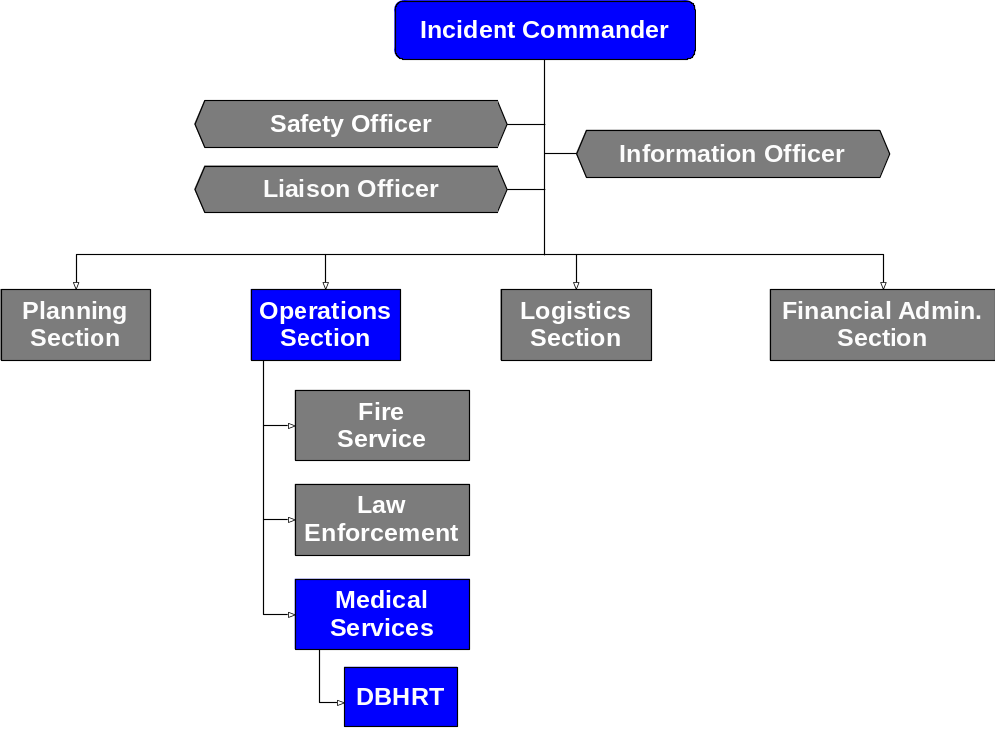
Incident Command Center

Slide 29

ICS Concepts and Principals
Common terminology
Clearly defined chain of command
Modular organization
Integrated communications
Unified command structure
Consolidated action plans
Manageable span of control
Designated incident facilities
Resource Management

Slide 30
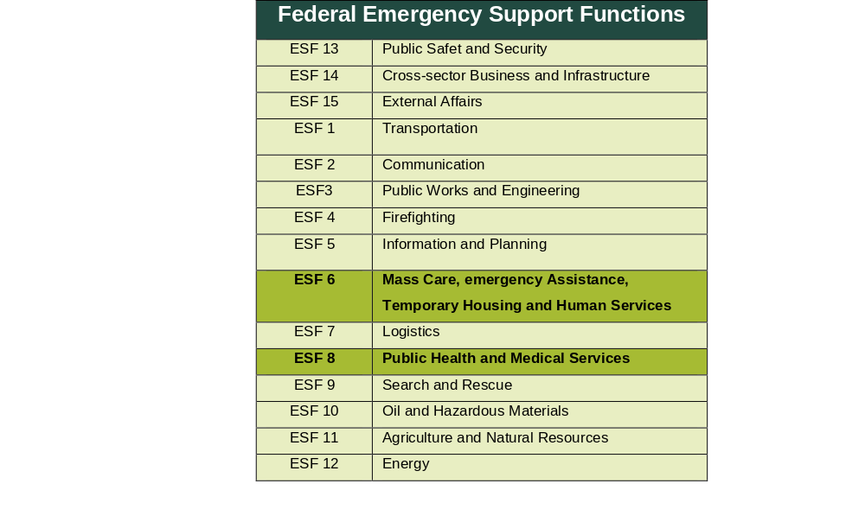
Iowa’s Emergency Management Laws

Slide 31
Emergency Support Function (ESF) 6 and ESF 8 are the Lead Support Functions for Behavioral Health
Department of Homeland Security and Emergency Management: This department is responsible for coordinating the state's emergency management efforts.
Emergency Management Coordinator: Each political subdivision of the state can appoint an emergency management coordinator to oversee local efforts.
Emergency Response Fund: A fund is created to support emergency response efforts.
Governor's Powers: The governor has the authority to declare a state of public disorder or disaster emergency.
Hazard Mitigation and Assistance: Financial assistance is available for hazard mitigation and disaster recovery.
Local Emergency Management Commissions: Local governments can establish emergency management commissions to handle local preparedness and response.
Mutual Aid: There are provisions for mutual aid among political subdivisions and with other states.
Notes:
An Emergency Support Function (ESF) is a mechanism within the United States National Response Framework (NRF) that coordinates critical services and resources during an emergency or disaster. Each ESF represents a specific area of response, such as transportation, communications, or public health, and brings together relevant federal agencies, state and local governments, non-profit organizations, and private-sector partners to provide comprehensive support in times of need.

Slide 32
ESF 6: Mass Care, Emergency Assistance, Temporary Housing and Human Services
ESF 6 focuses on providing life-sustaining resources and essential services when disaster survivors' needs exceed local, state, tribal, territorial, and insular area government capabilities.
The primary functions include:
Mass Care: Sheltering, feeding, distribution of emergency supplies, and reunification of families.
Emergency Assistance: Coordination of voluntary organizations, management of unsolicited donations, and support for individuals with disabilities.
Temporary Housing: Providing rental, repair, and loan assistance, as well as safe, secure, and accessible housing.
Human Services: Offering disaster assistance programs, crisis counseling, disaster unemployment services, and other state and federal human services programs.

Slide 33
ESF 8: Public Health and Medical Services
ESF 8 provides the mechanism for federal assistance to supplement local, state, tribal, territorial and insular area resources in response to public health, medical, behavioral or human service emergencies.
The primary functions include:
Medical Care: Providing medical care and human services to those affected by disasters.
Public Health: Minimizing and preventing health emergencies, detecting and characterizing health incidents and disseminating public health information.
Support Services: Offering patient movement, behavioral healthcare and support to individuals with disabilities.
Fatality Management: Assisting in victim identification, fried counseling and reunification of human remains.

Slide 34
Activation Criteria (1)
Confirm
Confirm the event meets pre‑established activation criteria (e.g., severity, scope, population impact).
Verify
Verify that behavioral health needs exceed local capacity or are anticipated to do so.
Ensure
Ensure an official authorization for activation has been received (emergency management, public health, incident command, Division of Behavioral Health).
Document
Document the activation decision, including time, authorizing official, and rationale.

Slide 35
Iowa Disaster Behavioral Health Response Team (DBHRT)
A trained team of volunteers who mobilize resources to provide post-event behavioral health services statewide.
Provide an organized response to individuals, family members, volunteers, responders, and the community affected by critical incidents and disasters.
Disaster Behavioral Health training is provided to all team members by HHS Division of Behavioral Health, and local community-based providers.
Provide services to supplement local providers and/or provide a service when a local option is beyond capacity or doesn’t exist.
Includes members from the Iowa National Association of Social Workers and Iowa Psychological Association and other specialty organizations.

Slide 36
Activation Criteria (2)
Team Leadership and Coordination
Personal Readiness
Deployment Planning
On-the-Ground Operations
Ongoing Monitoring and Adjustments
Documentation and Reporting
Data fields

Slide 37

Disaster Behavioral Health Response Team
Iowa DBHRT members include volunteers from a wide range of backgrounds with experience in:
Behavioral Health
Education
Faith-based or Spirituality
First Response
Peer Support Specialists
People reflecting the communities across the state
Public Health
Recovery Coaches
Retail
Refugees
Social Services

Slide 38
How DBHRT is Requested
24-hour Duty Officer for Homeland Security Emergency Management (HSEM):
  515-979-2200
24-hour Duty Office for Iowa Department of Health and Human Services (HHS):
  866-834-9671
Disaster Behavioral Health Coordinator:
  515-601-7899
  iowadbhrt@hhs.iowa.gov
DBHRT members see a need in their community and reach out to one of the above options.
Emergency Managers, Community Mental Health Centers, Crisis Services, Public Health, Community-Based Providers, State Departments.

Slide 39

New Initiatives

Slide 40
New Initiative 1
HHS is working with the Animal Rescue League, the Division of Public Health and the Iowa Department of Agriculture and Land Management.
HHS will be offering specific training to create a specialty team to work with people after the removal of animals.

Slide 41
Response After Animal Hoarding or Lack of Care
Animal hoarding is recognized as a serious mental health concern and often associated with underlying psychiatric disorders.
Accumulation of large numbers of animals
Inability to provide basic care to animals
Strong emotional attachment
Denial of problem
Living environment deterioration
Social isolation
Distress when animals are removed

Slide 42
Benefits of DBH Response for People with Animals Removed
Emotional Stabilization: Helps individuals process grief and shock.
Stress and Anxiety Reduction: Prevents escalation of mental distress.
Coping Strategies: Provides practical skills to regain control.
Connection to Resources: Links to animal recovery and support services.
Trauma-Informed Care: Validates emotional impact with empathy.
Prevention of Secondary Trauma: Reduces the risk of PTSD and substance misuse.

Slide 43
New Initiative 2
Train interested DBHRT members in mass casualty response.
1
Utilize a form requested by the state Medical Examiner’s Office at the time of a mass casualty response.
2
Work at the direction of the State Medical Examiner’s Office to support staff and families of the deceased.
3

Slide 44
Importance of DBH Response During Mass Casualty Events
Address Immediate Psychological Impact: Reduces acute stress, shock and grief.
Stabilizes Communities: Restores safety and promotes resilience.
Supports First Responders: Provides stress management and peer support.
Prevents Secondary Trauma: Early intervention reduces long-term mental health issues.
Coordinates Resources: Ensures continuity of care for vulnerable populations.
Respects Cultural and Spiritual Needs: Integrates holistic care approaches.

Slide 45
Joining DBHRT

Slide 46

ISERV Juvare
DBHRT members need to sign up through ISERV a communication notification system.
https://www.iaserv.org/

Slide 47

DBHRT Personal Information Form
https://forms.cloud.microsoft/g/J3N2dsSpXm?origin=lprLink

Slide 48


Contact Information
Karen Hyatt
Emergency Mental Health Specialist
karen.hyatt@hhs.iowa.gov
515-601-7899

Slide 49
Questions about DBHRT?
October 22, 2026 | 49

Slide 50
Reminders
October 22, 2026 | 50

Slide 51
New Behavioral Health Sign-Up Form
A new sign-up form has been created for state fiscal year 2027.
If you had previously signed-up on the SFY 2026 form, please sign-up again on the new form.
Every year, a new form will be made. Please sign-up once yearly.
The new form can be found on the Behavioral Health Town Hall section of the Behavioral Health Service System webpage.
51

Slide 52


Sign-Up for 2027 Town Halls
https://forms.cloud.microsoft/g/uwuS1ZEdnt

Slide 53
Questions?
October 22, 2026 | 53

